Slide 1



SPF UK Climate Resilience Programme
Webinar Series 2021
Website: https://www.ukclimateresilience.org/

Slide 2




Timings
12:00 | UK Climate Resilience Programme news | Dan Bernie​ Science Manger of the UK Climate Resilience Team, Met Office​
12.05 | Coastal Defender | Rachel Perks Marine Scientist, Met Office
12.35 | Q&A | Chaired by Dan Bernie
13.00 | End
Website: https://www.ukclimateresilience.org/
Notes:
Rachel Perks is currently a Marine Scientist with the Met Office, where she uses climate models to research how changing sea levels and storm surges effect coastal risk. Most recently she has assisted in the review of the Thames Estuary 2100 – 10-year review project. She has several years’ experience working across both the public and private sectors. Her previous experience focused on coastal flood risk where she built coastal modelling suites to simulate wave transformation processes, wave overtopping discharge rates and flood inundation.

Slide 3

How to engage
  Presentations first then Q&A and discussion
  Post questions in the Q&A box at any time
  Upvote your favourites
  Attendees will remain muted unless enabled to speak by the host​
  Webinar (audio and slides) will be shared after the event
  Technical problems – chat
  The webinar is being recorded​
Twitter: @UKCRP_SPF #UKclimateResil
Website: https://www.ukclimateresilience.org/

Slide 4





New UKCR Publications
Publication
Increase in the frequency of extreme daily precipitation in the United Kingdom in autumn
By Daniel Cotterill, Peter Stott, Nikolaos Christidis and Elizabeth Kendon.
Published September 2021
The impact of climate change on policy-relevant indicators of temperature extremes in the United Kingdom
By Nigel W Arnell and Anna Freeman
Published 29 July 2021
Indicators of climate risk in the UK at different levels of warming
By Nigel W Arnell, Anna Freeman, Alison L Kay, Alison C Rudd and Jason A Lowe
Published 20 September 2021

Slide 5
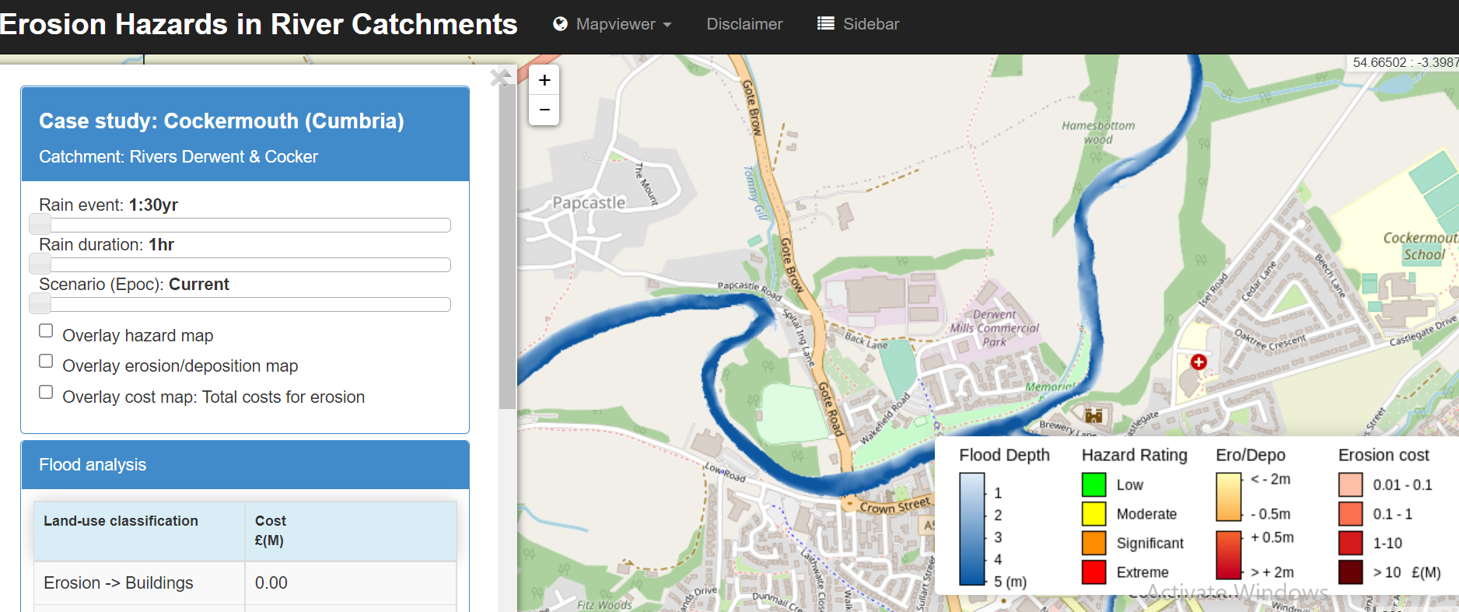
New decision support tool
Project News
New decision support tool from the Erosion Hazards in River Catchments: Making Critical Infrastructure More Resilient project, Dr James Cooper.
There’s a link to the tool on the Erosion Hazards project page on the UKCR website
Direct link - https://arcoes-dst.liverpool.ac.uk/EHRC/bootleaf-master3/index_DST_F2.php?map_no=9
Notes:
Or you can find the link on the UKCR website Erosion Hazards in River Catchments project page: https://www.ukclimateresilience.org/projects/erosion-hazards-in-river-catchments-making-critical-infrastructure-more-climate-resilient/

Slide 6

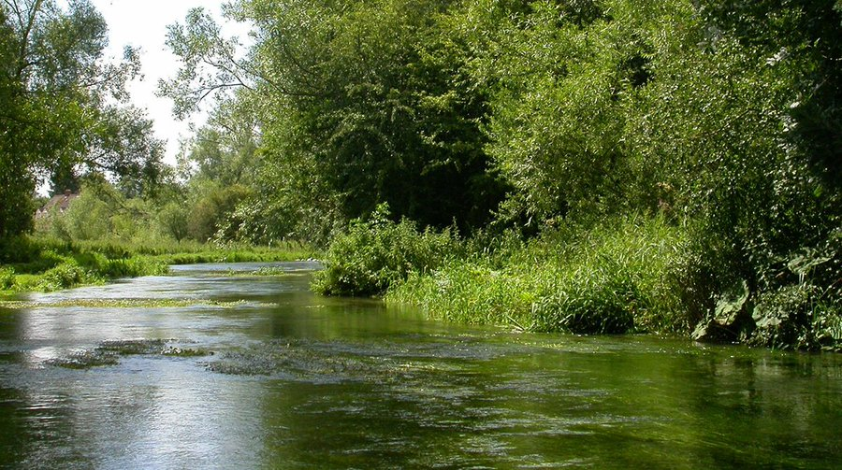
Wider news
UK Centre for Ecology and Hydrology
Survey
Please take part in a short survey assessing interest in hydrological projections for future climates and associated datasets.
Climate Risk Summit
UKCEH Survey
UKCR Researchers will be speaking
Theodore Shepherd on Risks & Extremes
Rachel Warren on Tipping Points
Charlotte Lyddon on Communicating Impacts
Register here: https://www.digitalevents.uk/climaterisksummit
https://ceh-online-surveys.onlinesurveys.ac.uk/uk-scape-water-futures-stakeholder-questionnaire

Slide 7

Coastal Defender
Rachel Perks, Met Office

Slide 8
Questions, answers, discussion

Slide 9

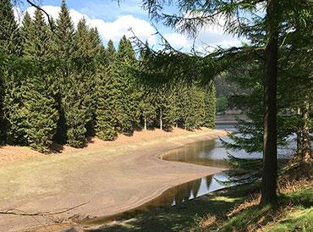


Next webinars:
Wednesday, 13th October, 2021 12.00-13.00
Speaker: Andrew Carr and Chris Bishop (DEFRA)
Title: UK Government Approaches for Domestic Adaptation and Resilience
Wednesday, 17th November, 2021 12.00-13.00
Speaker: Jamie Hannaford (UK Centre for Hydrology and Ecology)
Title: Enhanced future FLows and Groundwater (eFLaG): a climate service to enhance the resilience of the water sector to drought events
Register on our website:
https://www.ukclimateresilience.org/news-events/climate-resilience-webinar-series-2020-2021/

Slide 10
Contact details
Website: www.ukclimateresilience.org
Twitter: @UKCRP_SPF
YouTube: UK Climate Resilience programme
The UK Climate Resilience programme is supported by the UKRI Strategic Priorities Fund.
The programme is co-delivered by the Met Office and NERC on behalf of UKRI partners AHRC, EPSRC, ESRC.

