Slide 1



Impacts of climate change on the UK coast
Rachel Perks
29th September 2021

Slide 2
Presentation Overview
Sea level projections interactive tool
Impacts of sea level rise on coastal risk
Using GCMs to assess the changing frequency of weather patterns
What’s next for the project?

Slide 3
Sea level projections
Why does sea level rise matter?
How does the sea level interactive tool work?

Slide 4


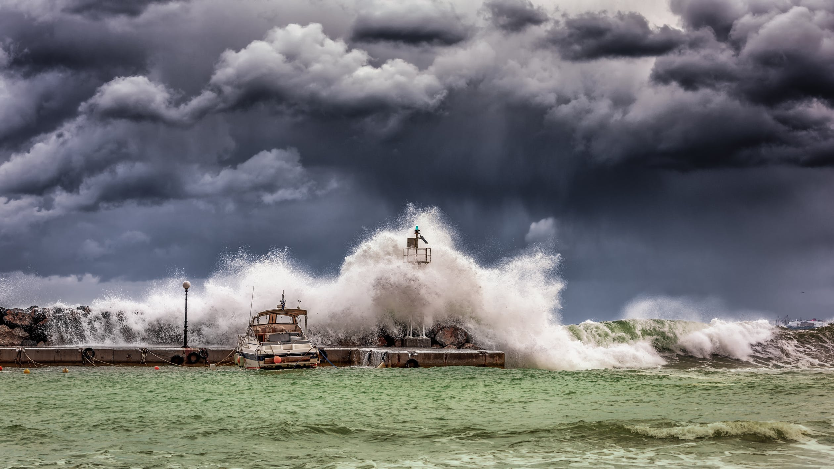
Why does sea level rise matter?
IPCC Headline Messages
“Risk related to SLR (including erosion, flooding and salinisation) is expected to significantly increase by the end of this century along all low-lying coasts in the absence of major additional adaptation efforts (very high confidence).”​
“In the absence of adaptation, more intense and frequent ESL events, together with trends in coastal development will increase expected annual flood damages by 2-3 orders of magnitude by 2100 (high confidence).”
www.ipcc.ch/srocc/
Notes:
Habitat contraction, geographical shift of associated species, loss of biodiversity and ecosystem functionality
Increased sea water intrusion in estuaries

Slide 5
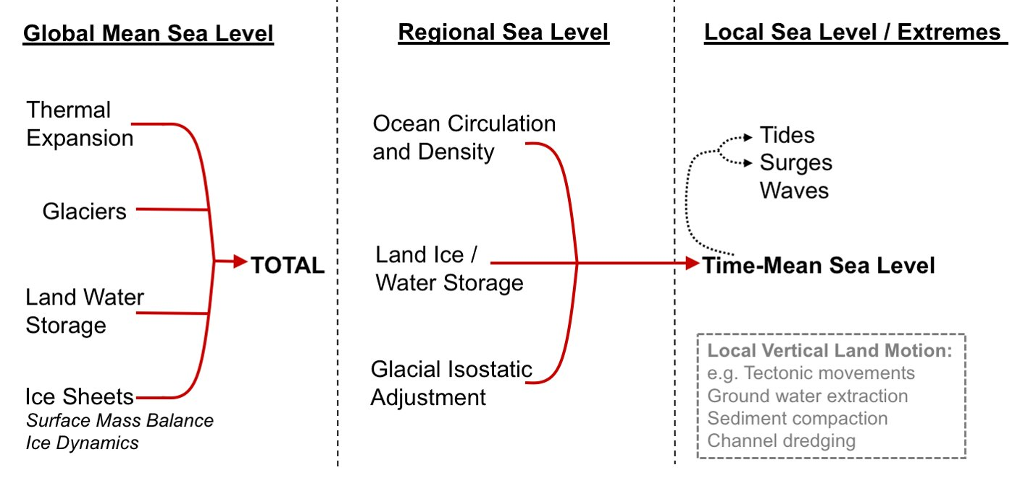
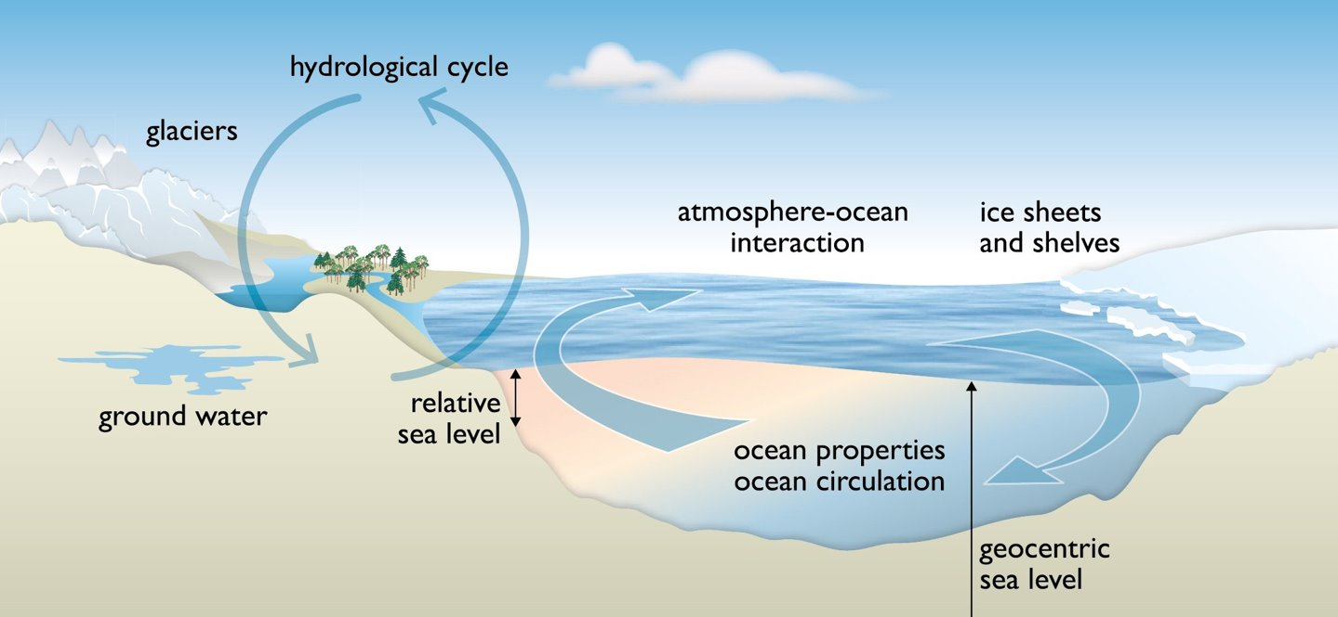
Sea-level projections tool
A relocatable sea level tool has been developed to provide regional sea-level (SL) projections, derived from climate model simulations of the Coupled Model Intercomparison Project Phase 5 (CMIP5).
These SL projections are based on the methods described in the UK Climate Projections 2018 (UKCP18) Marine Report and Palmer et al (2020)
https://www.metoffice.gov.uk/pub/data/weather/uk/ukcp18/science-reports/UKCP18-Marine-report.pdf
https://agupubs.onlinelibrary.wiley.com/doi/abs/10.1029/2019EF001413
Source: IPCC AR5 ​
Notes:
Projections are based on a baseline climate of 1981-2000
There are numerous physical processes that contribute to sea level projections.
Global = thermal expansion, melting of glaciers and ice sheets and changes to land water storage
Regional = additional effects of local oceanographic processes, specifically relating changes in water density and ocean circulation
= land-based ice and land water storage, associated with the impact on the Earth’s gravitational field
= and GIA including the effect of vertical land motion

Slide 6
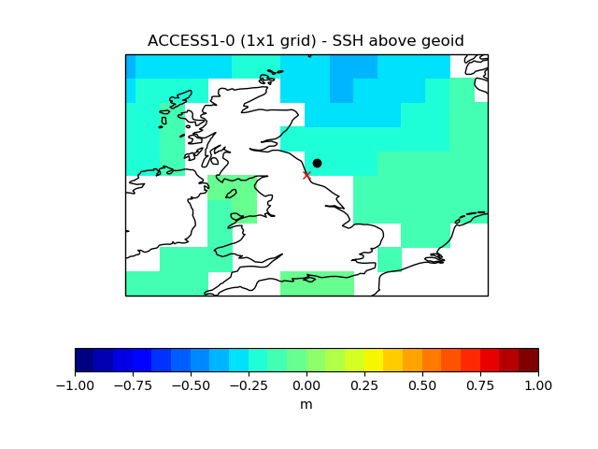
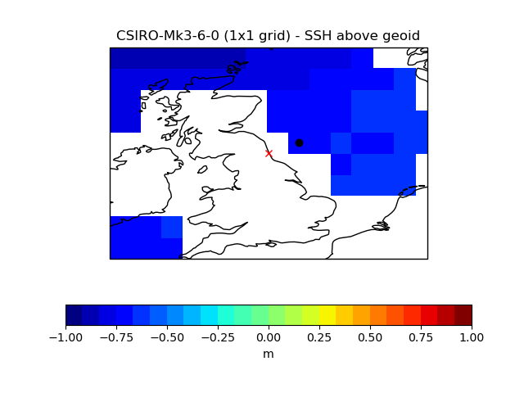
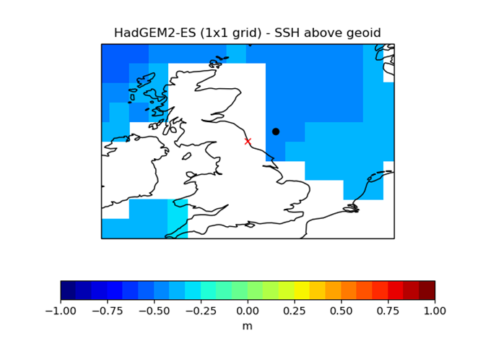
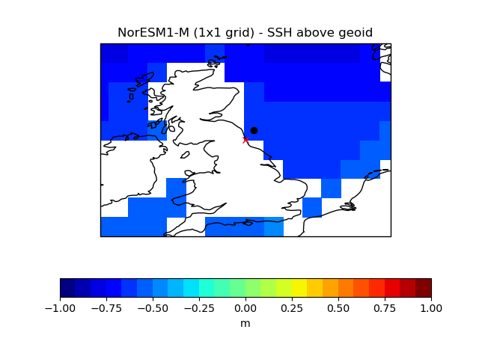
Sea-level projections tool – step 1
Loops through global climate models to find the nearest grid box in the CMIP models (black dot), to the user defined site (red cross).
Outputs a map and corresponding metadata:
  site name e.g. North Shields
  site latitude and longitude
  CMIP models’ grid box coordinates
  CMIP model latitude and longitude of the selected nearest grid box to the site
The site can be defined based on tide gauge name or latitude and longitude.
Notes:
If site is based on a tide gauge name this needs to be from the PSMSL station list.
For UK locations technically the tool starts at step 3 as it reads in pickle files.

Slide 7
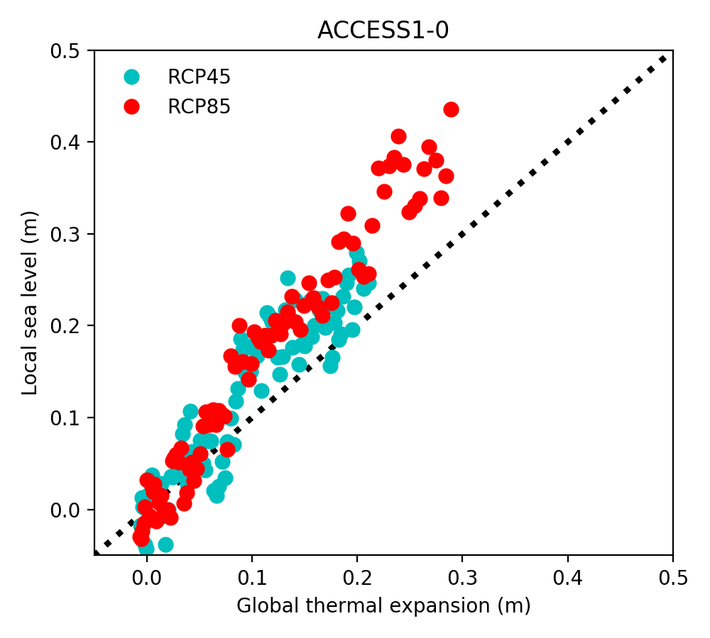
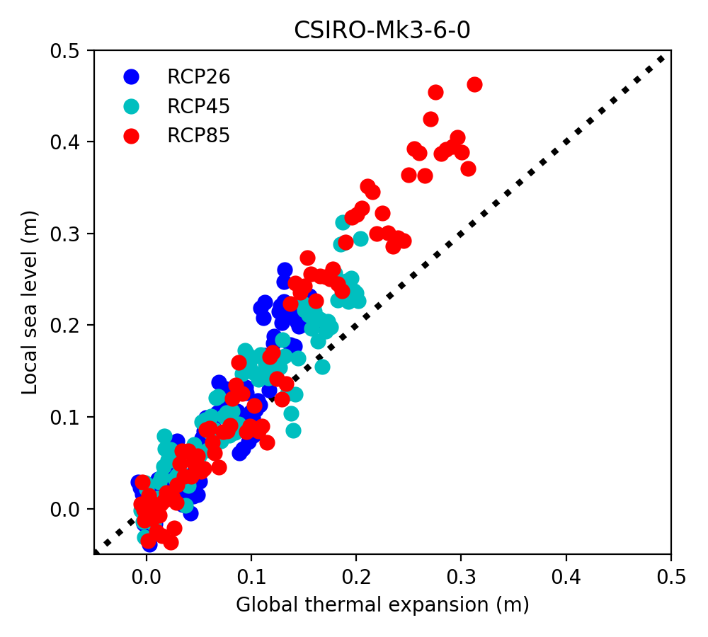
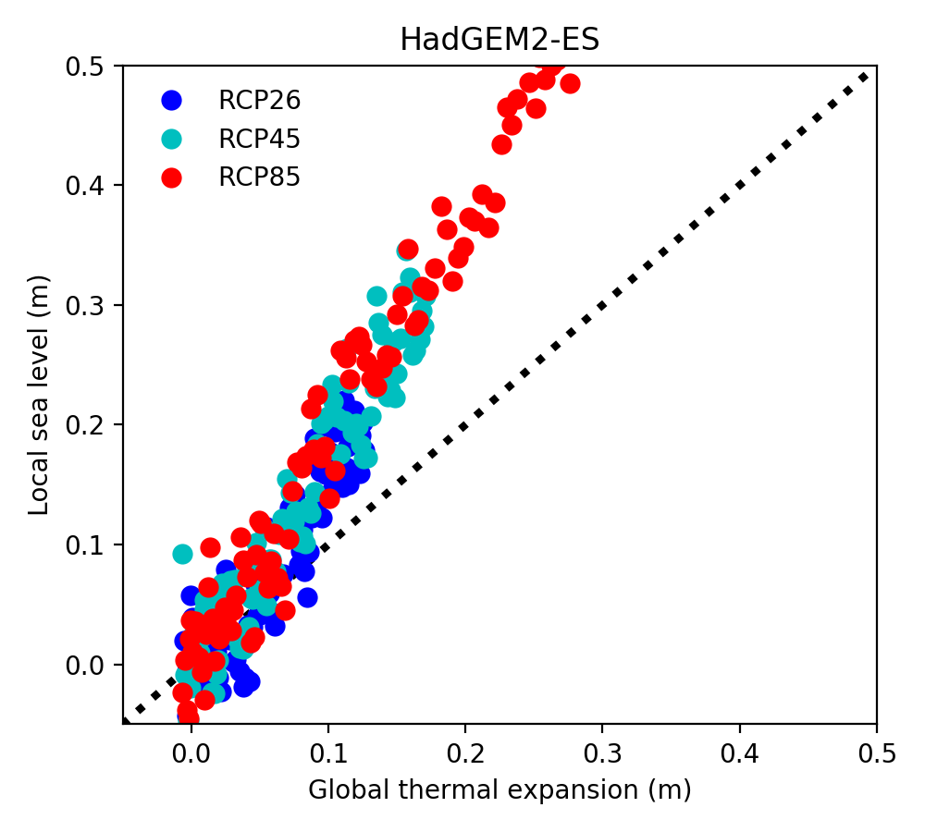
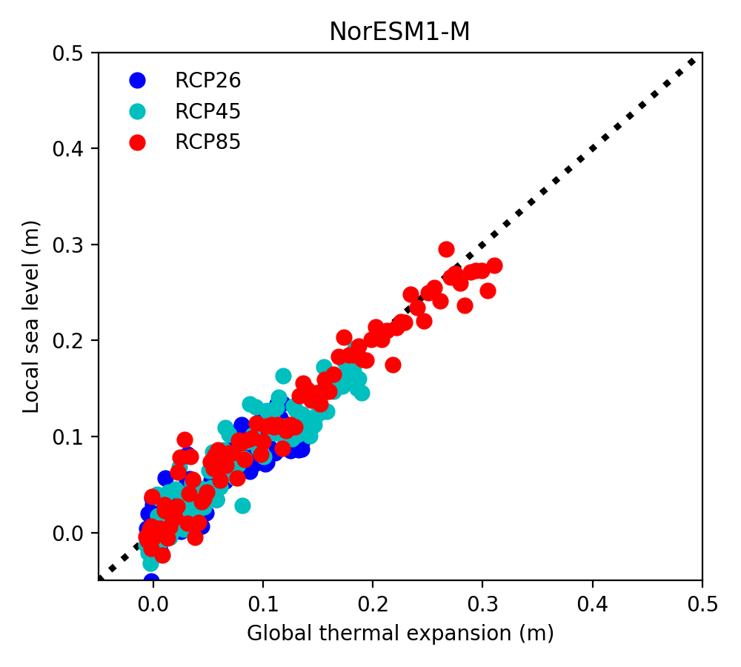
Sea-level projections tool – step 2
This step calculates the regression slopes between local oceanographic sea level and global thermal expansion for the period 2005-2100 and 2050-2100, for the available representative concentration pathway (RCP) – RCP 2.6, RCP 4.5 and RCP 8.5.
These sea level changes should be similar, if they aren't, then either the local change is increasing faster or slower than the global average.
Notes:
Each point is representative of a year (2005-2100), the global average is plotted against the local sea level (e.g. grid box) to calculate the regression slope.
ACCESS1-0 was not run for RCP 2.6 and so no data is shown on the regression slopes for this scenario.
HadGEM2-ES shows local sea level increasing faster than the global average for North Shields
NorESM1-M shows local sea level increasing at the same rate as the global average.

Slide 8
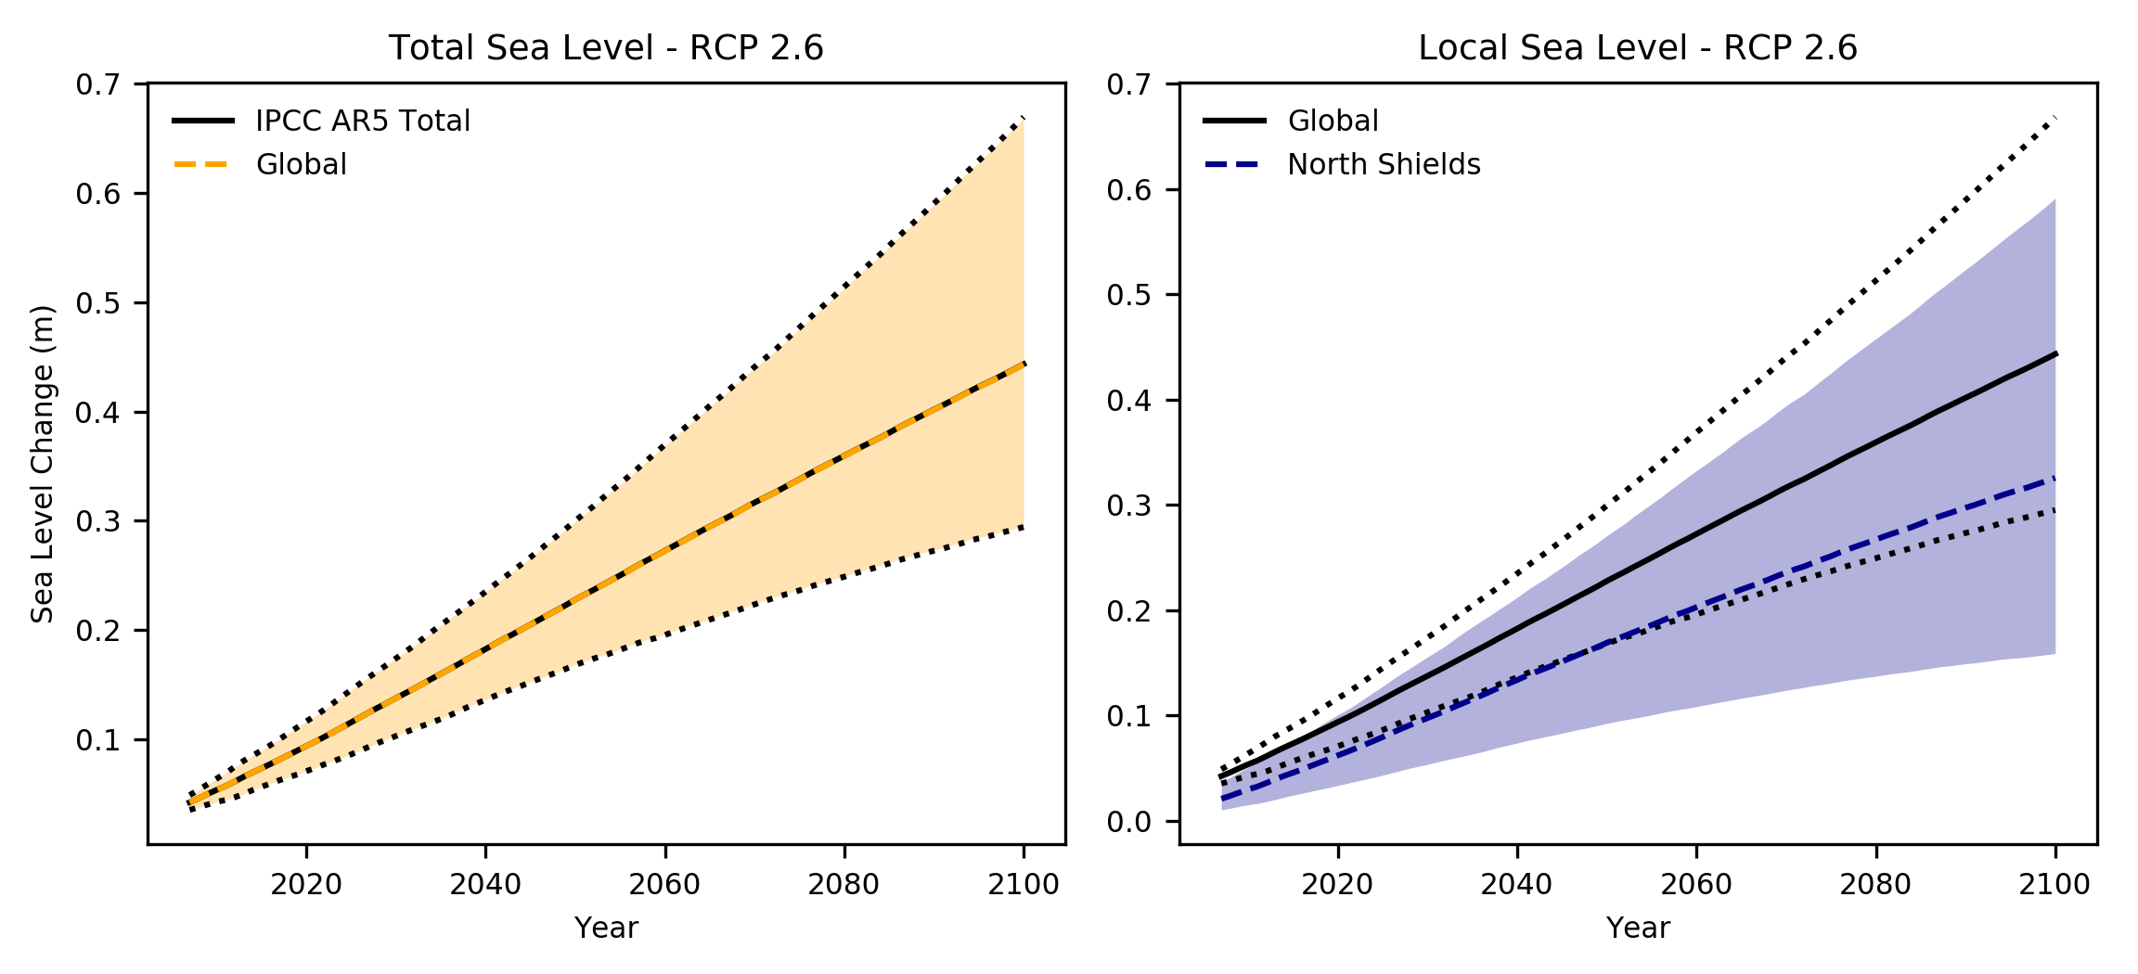
Sea-level projections tool – step 3
This step calculates the total local sea level projections and global sea level projections at a given site, based on the different contributing factors.
The local thermal expansion component of the sea level rise projections are based on the regression slopes calculated in step 2.
The GIA component of the sea level change projections are based on either GIA estimates developed for the UK as part of UKCP18 or global GIA estimates.
Also accounts for Greenland, Antarctica, glaciers and land water storage.
Notes:
This step also reads in the IPCC AR5 projections for comparison purposes – left hand plot.
The central estimate (50th percentile) is represented as the bold/dashed line and the uncertainty range (5th – 95th percentile) is represented as the corresponding shaded/dotted region.

Slide 9
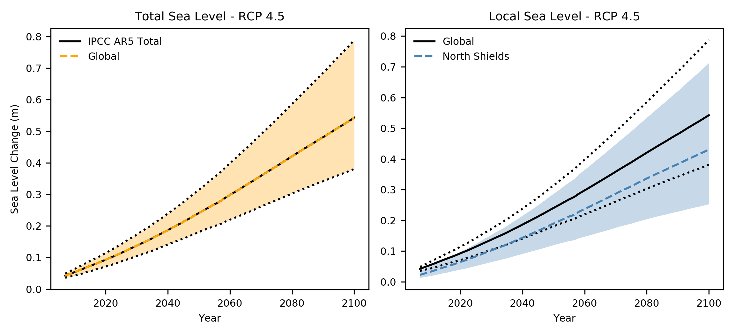
Sea-level projections tool – step 3
This step calculates the total local sea level projections and global sea level projections at a given site, based on the different contributing factors.
The local thermal expansion component of the sea level rise projections are based on the regression slopes calculated in step 2.
The GIA component of the sea level change projections are based on either GIA estimates developed for the UK as part of UKCP18 or global GIA estimates.
Also accounts for Greenland, Antarctica, glaciers and land water storage.
Notes:
Note the scale change on the y axis between RCP scenarios.

Slide 10
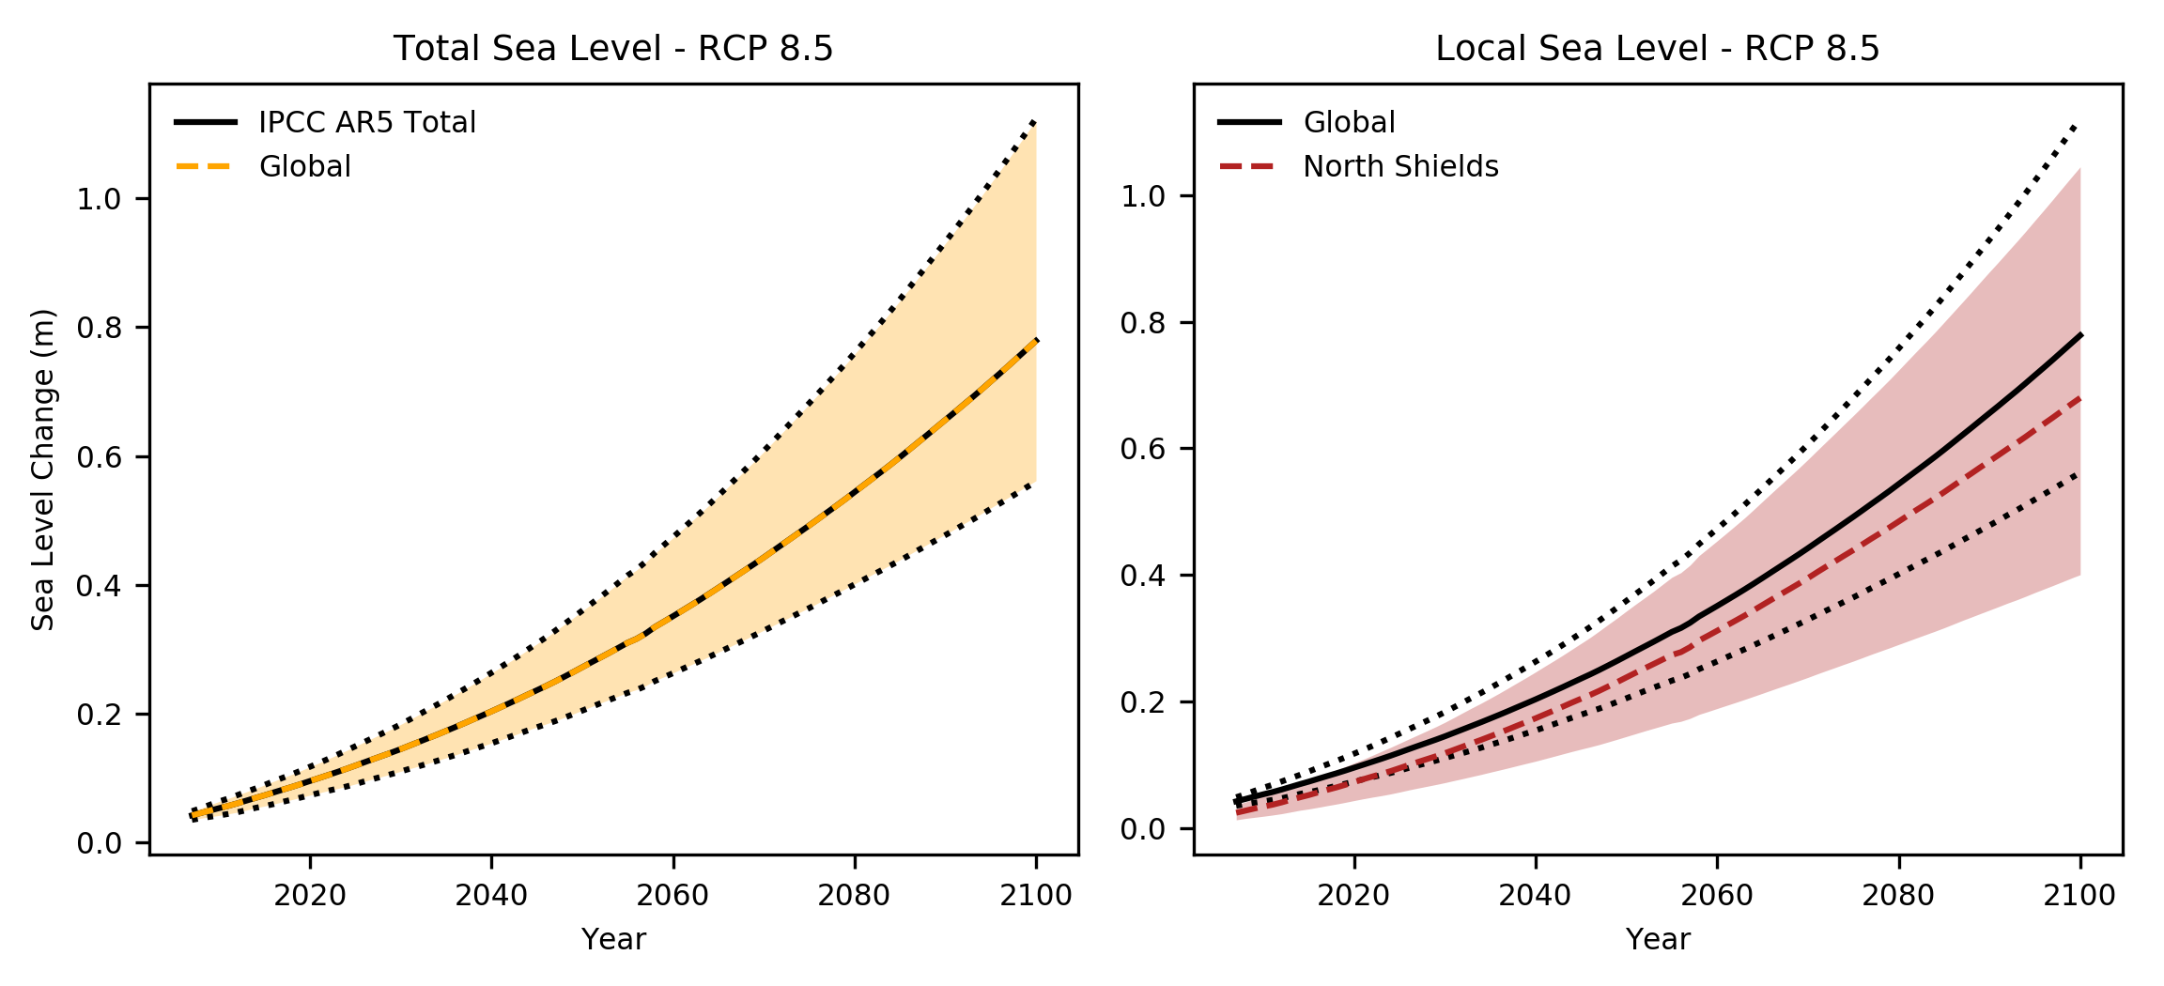
Sea-level projections tool – step 3
This step calculates the total regional sea level projections and global sea level projections at a given site, based on the different contributing factors.
The local thermal expansion component of the sea level rise projections are based on the regression slopes calculated in step 2.
The GIA component of the sea level change projections are based on either GIA estimates developed for the UK as part of UKCP18 or global GIA estimates.
Also accounts for Greenland, Antarctica, glaciers and land water storage.
Notes:
Local projections are more in line with the global projections for the site

Slide 11
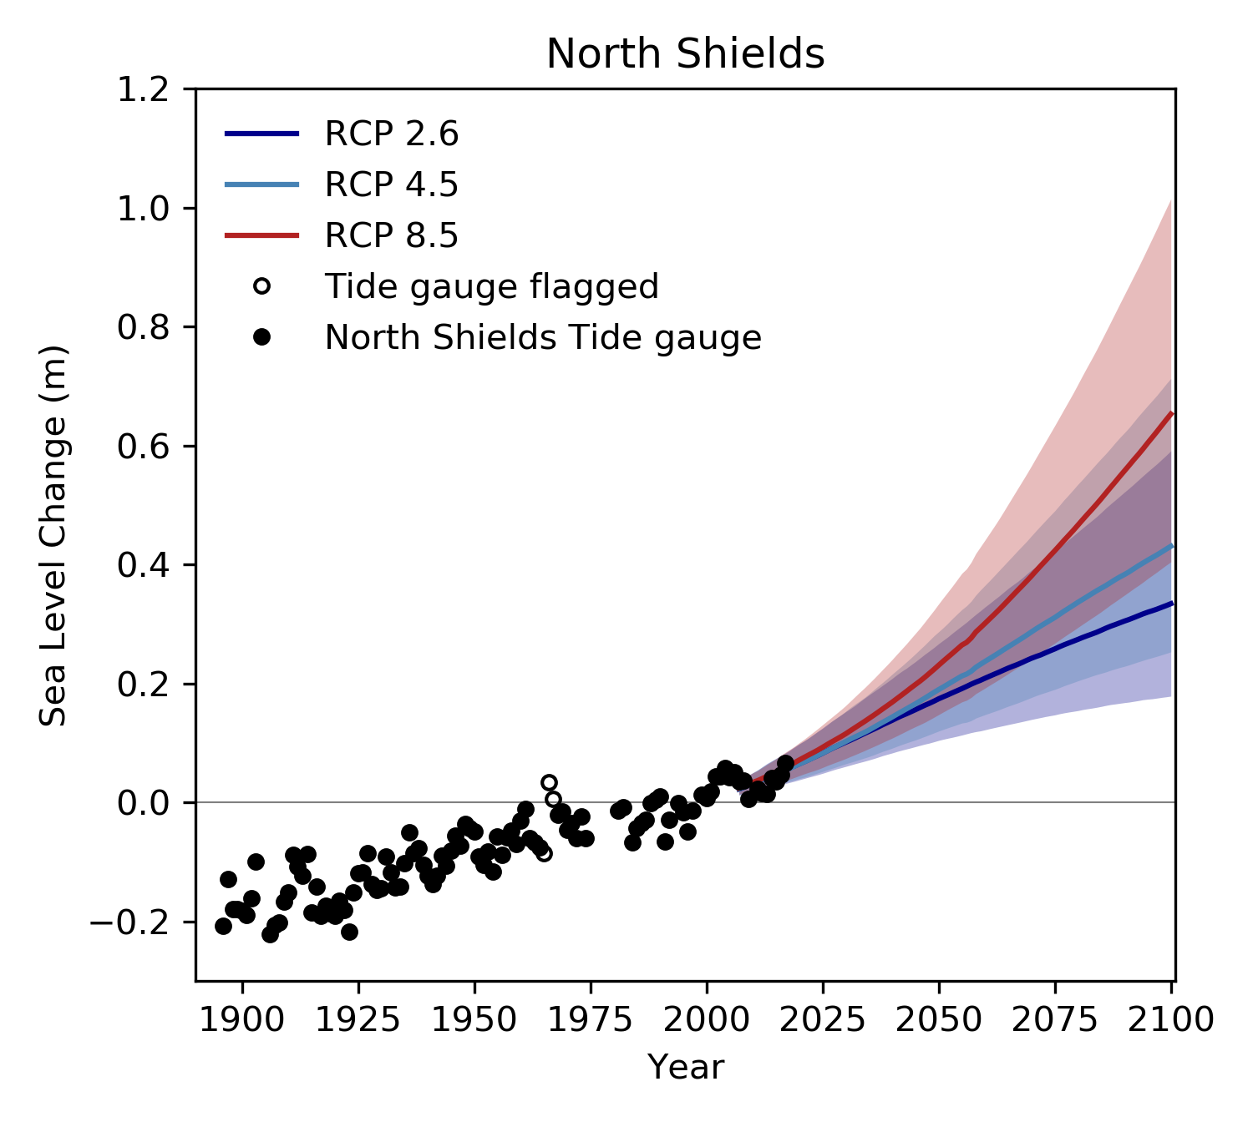
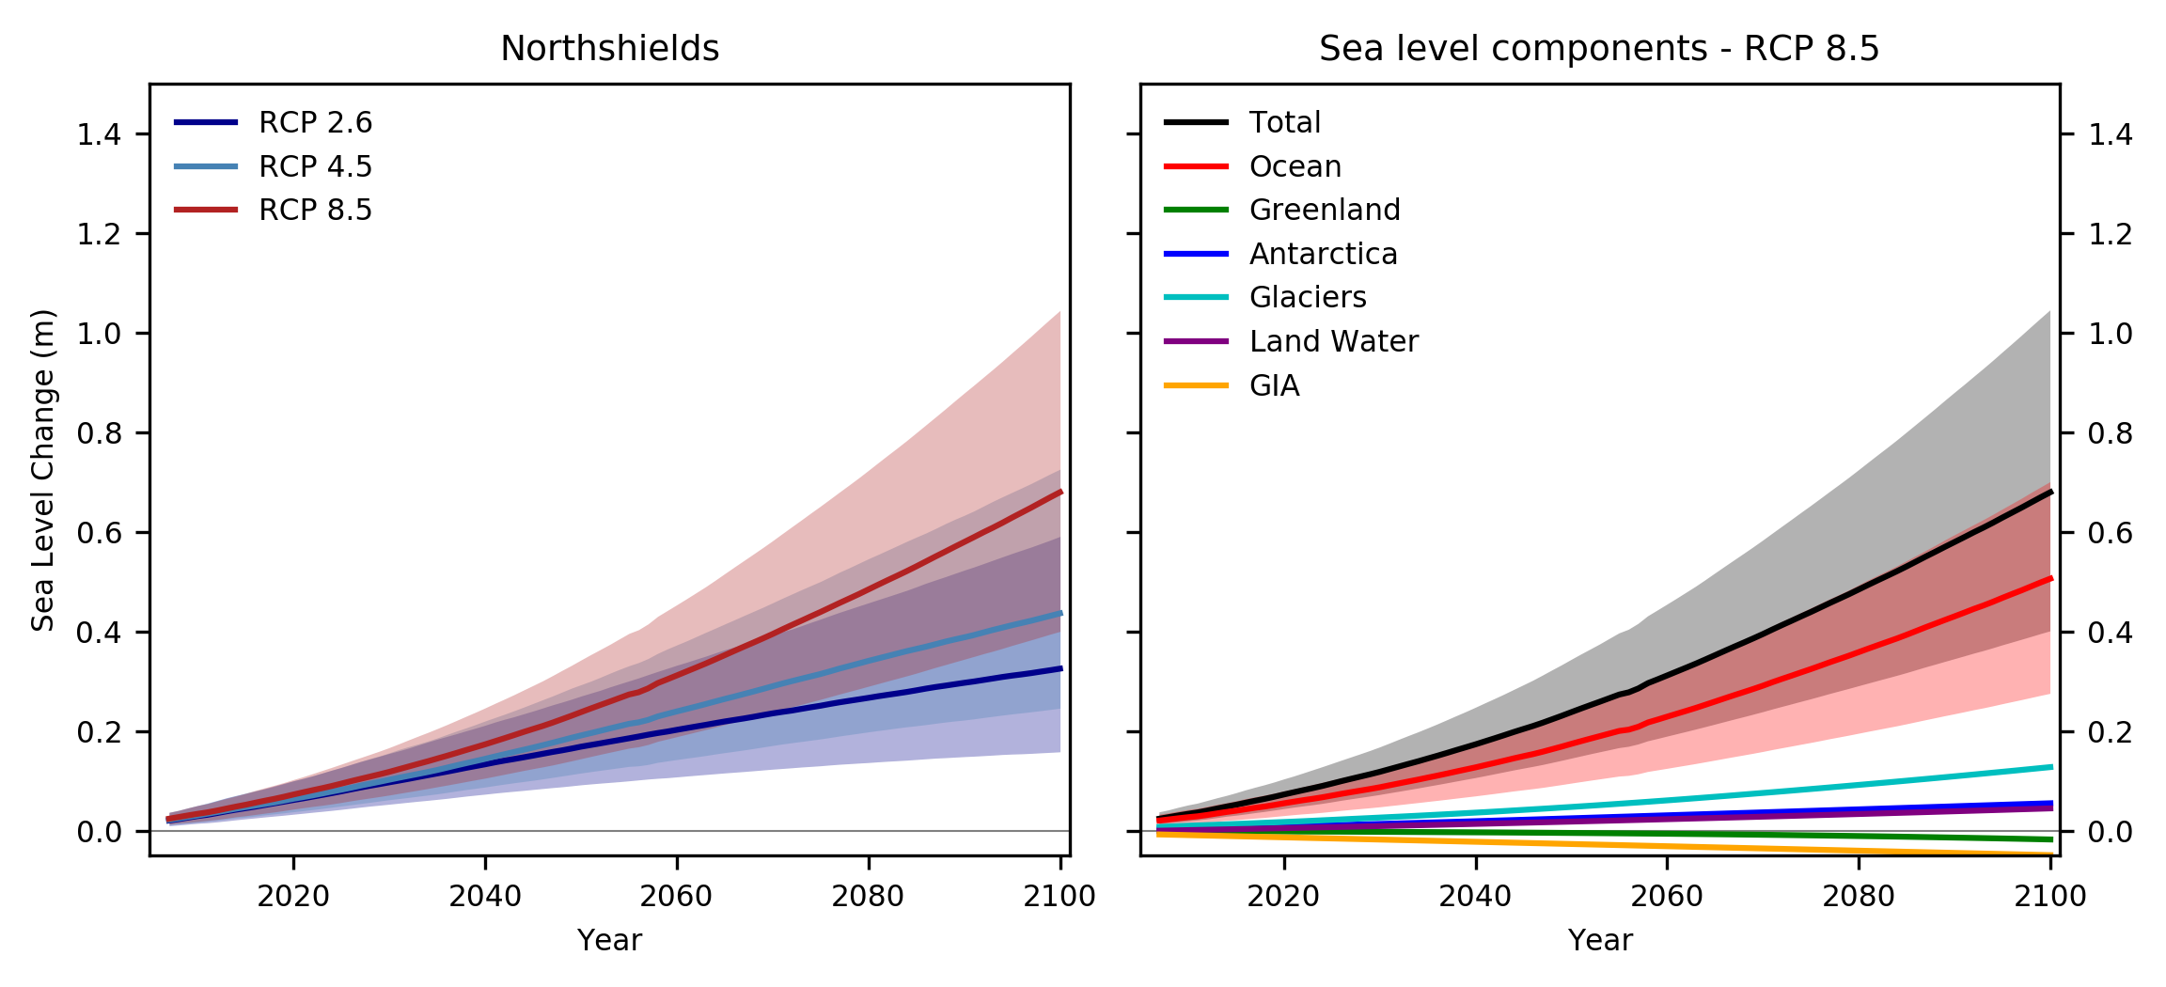
Sea-level projections tool – step 4
This step reads in the regional sea level change projections at a given site (calculated is step 3) and uses for plotting. Below:
Regional sea level projections under all scenarios
Components of regional sea level projections under the RCP 8.5 scenario.
Also read in the annual mean water level observations from the nearest tide gauge for validation purposes.
Notes:
The central estimate (50th percentile) is represented as the bold line and the uncertainty range (5th – 95th) is represented as the corresponding shaded region.
Uncertainty ranges provided for the sum total and thermal expansion (‘Ocean’).
Tide gauge data is downloaded from PSMSL – QA performed and some data could be flagged.

Slide 12
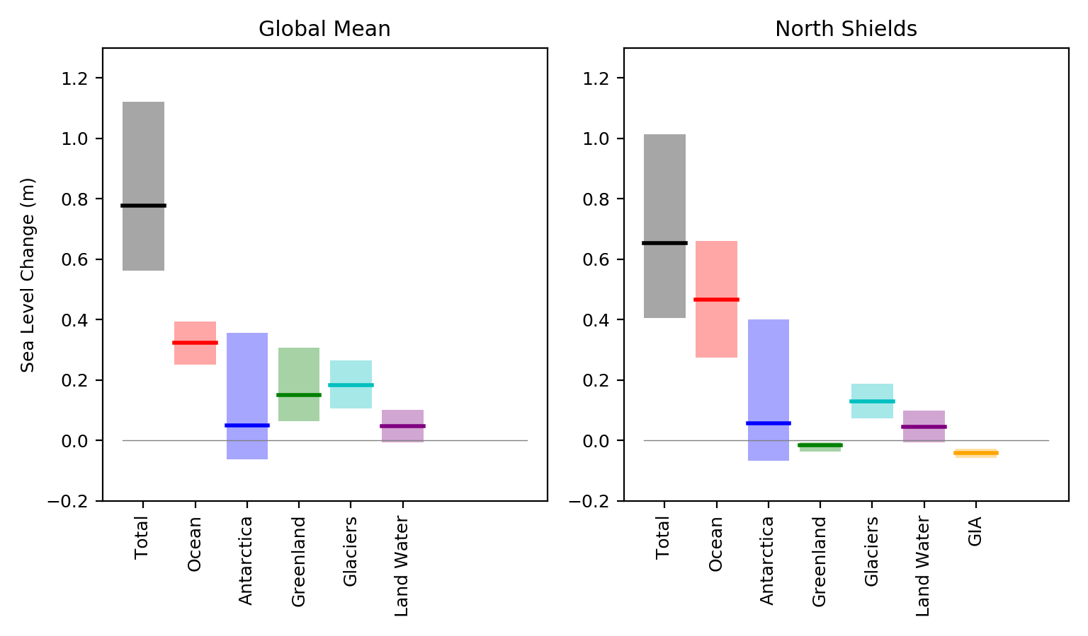
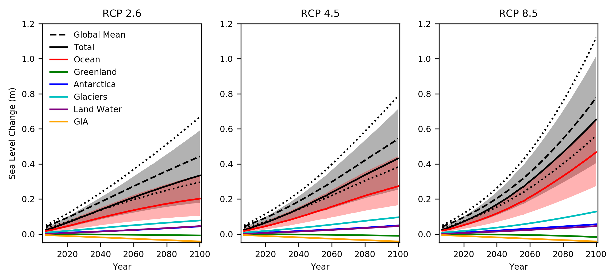
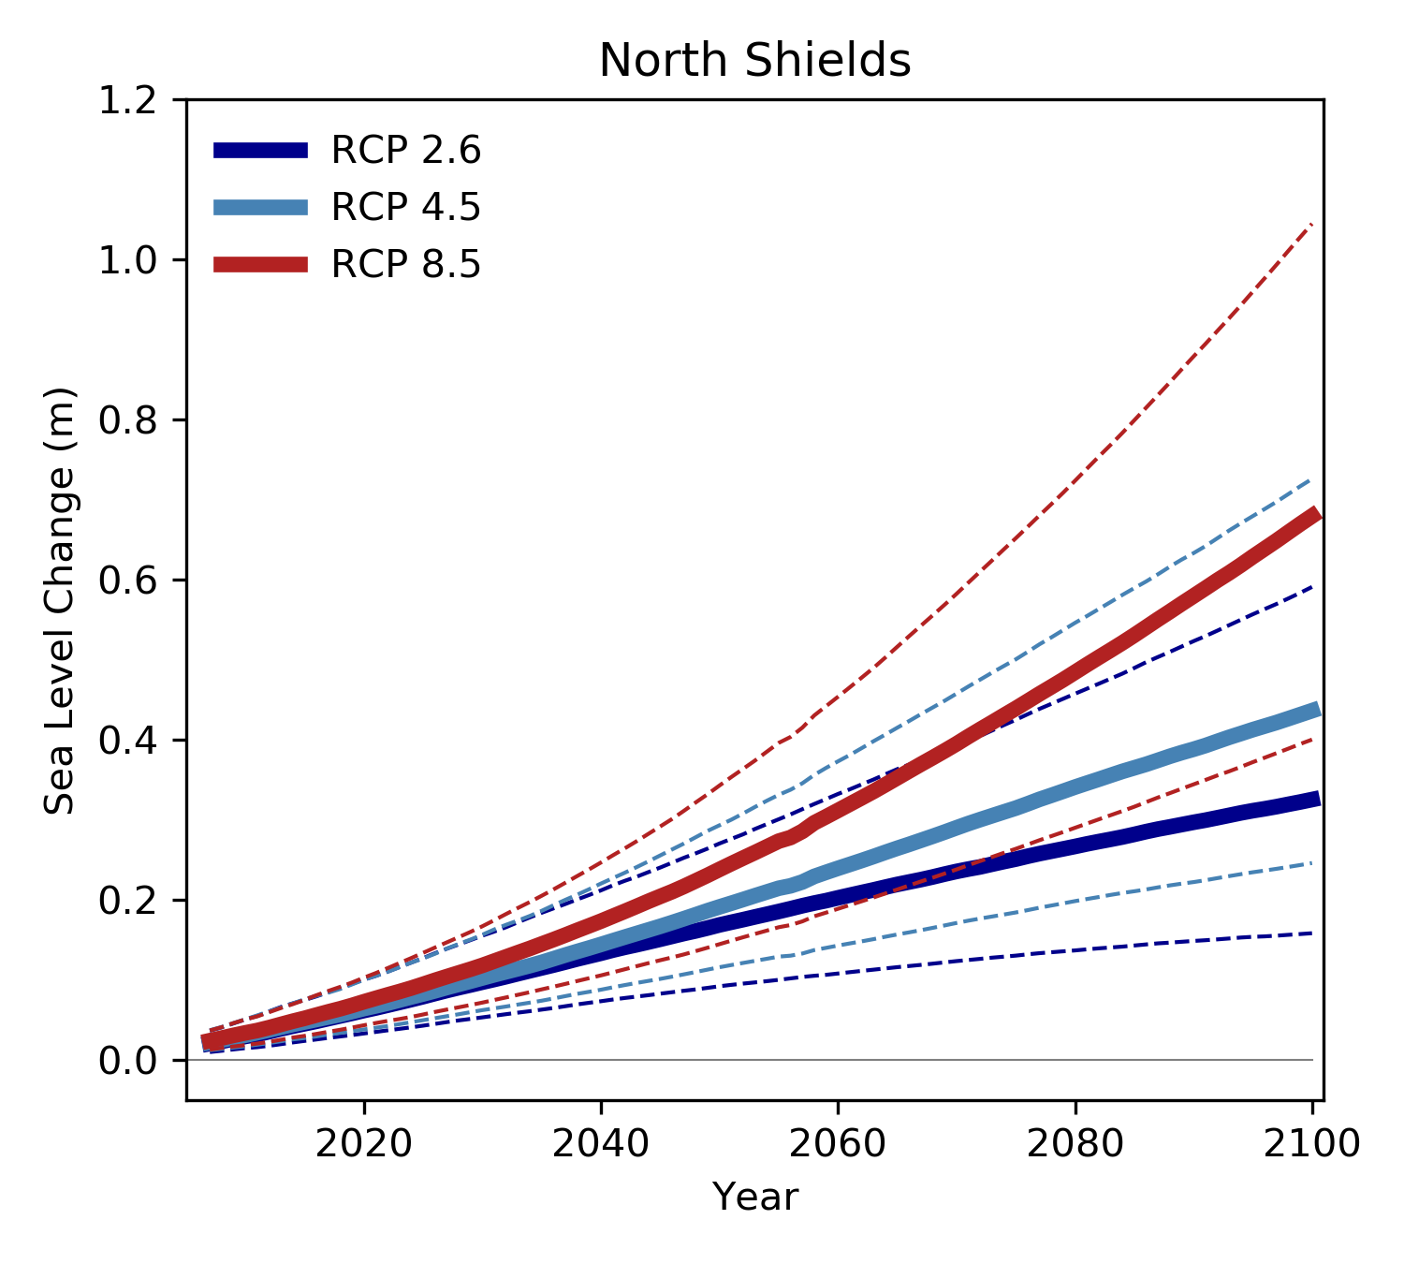
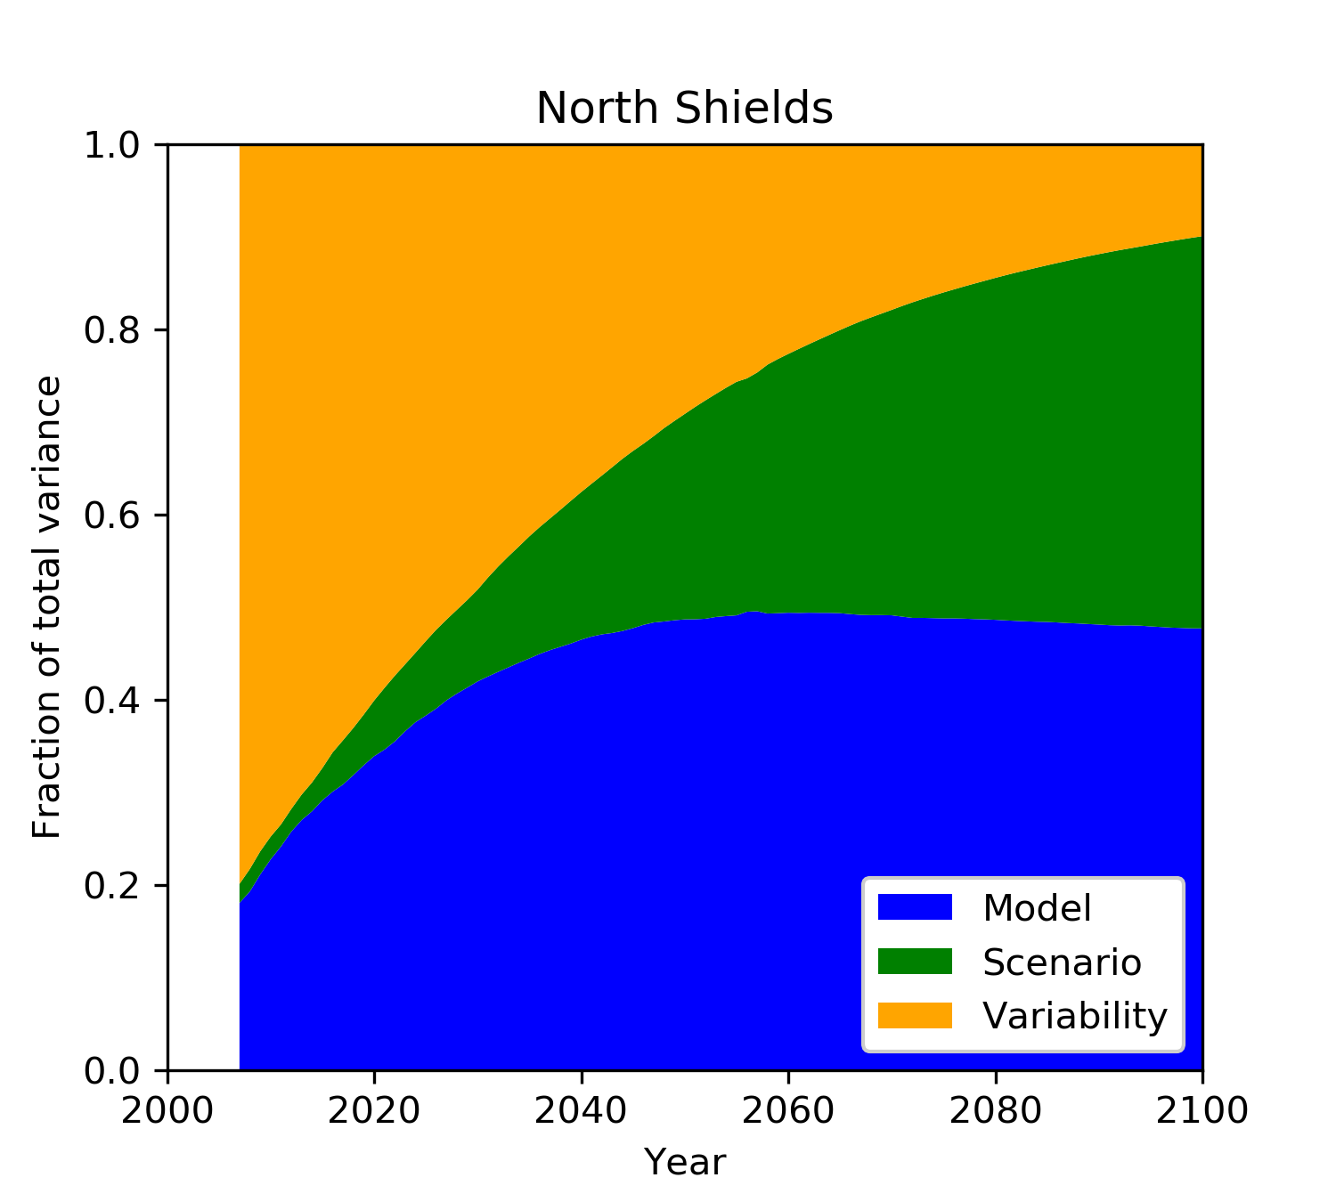
Sea-level projections tool – additional plots
Notes:
Top left - Global and local sea level change projections under RCP 8.5, total and component parts.
Top right - Global and local sea level projections under all scenarios, total and component parts.
Bottom left – Local sea level change projections under all scenarios including uncertainty range (5th-95th).
Bottom right - How uncertainty in sea level projections changes with time.

Slide 13
Using the sea level projections interactive tool

Slide 14
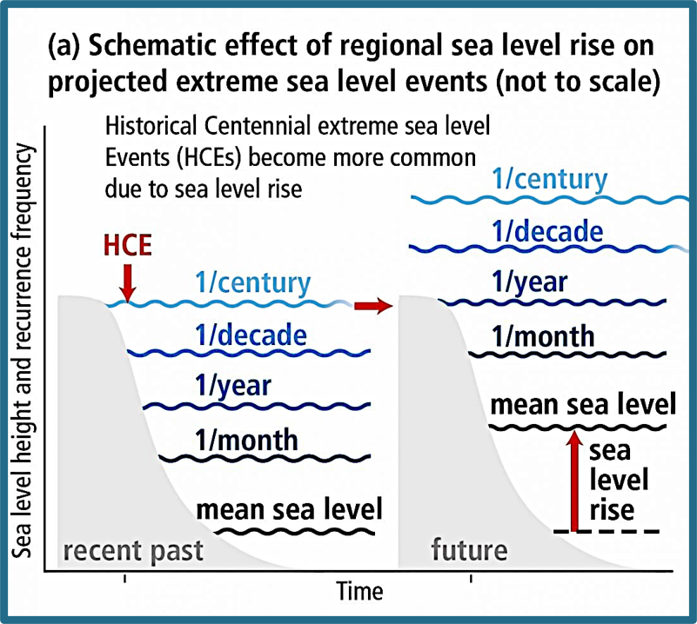
Using the sea-level projections interactive tool
This sea-level tool was recently used to respond to a request from the UK Government’s Ministry of Defence (MOD) to explore how the risk to coastal locations may change in the future, we provided:
  Sea-level projections out to 2100 for several UK sites and overseas territories (interactive tool).
  Dataset showing the implications the sea-level projections have on extreme water levels for the UK mainland sites (CFB2018, Environment Agency).
Extreme water level can be considered the combined effects of mean sea level, tides and the storm surge.
The Historical Centennial extreme sea level Events (HCEs) or the 1 in 100year event will become much more frequent with sea level rise.
Source: IPCC SROCC​
Coastal flood boundary conditions for the UK: update 2018 (publishing.service.gov.uk)
Notes:
When thinking about sea level, components for global change, components for local change, additional components for extreme water levels
With sea level rise, there is an increase in the mean sea level and all extreme water levels above this, so the impacts are likely to be more severe

Slide 15
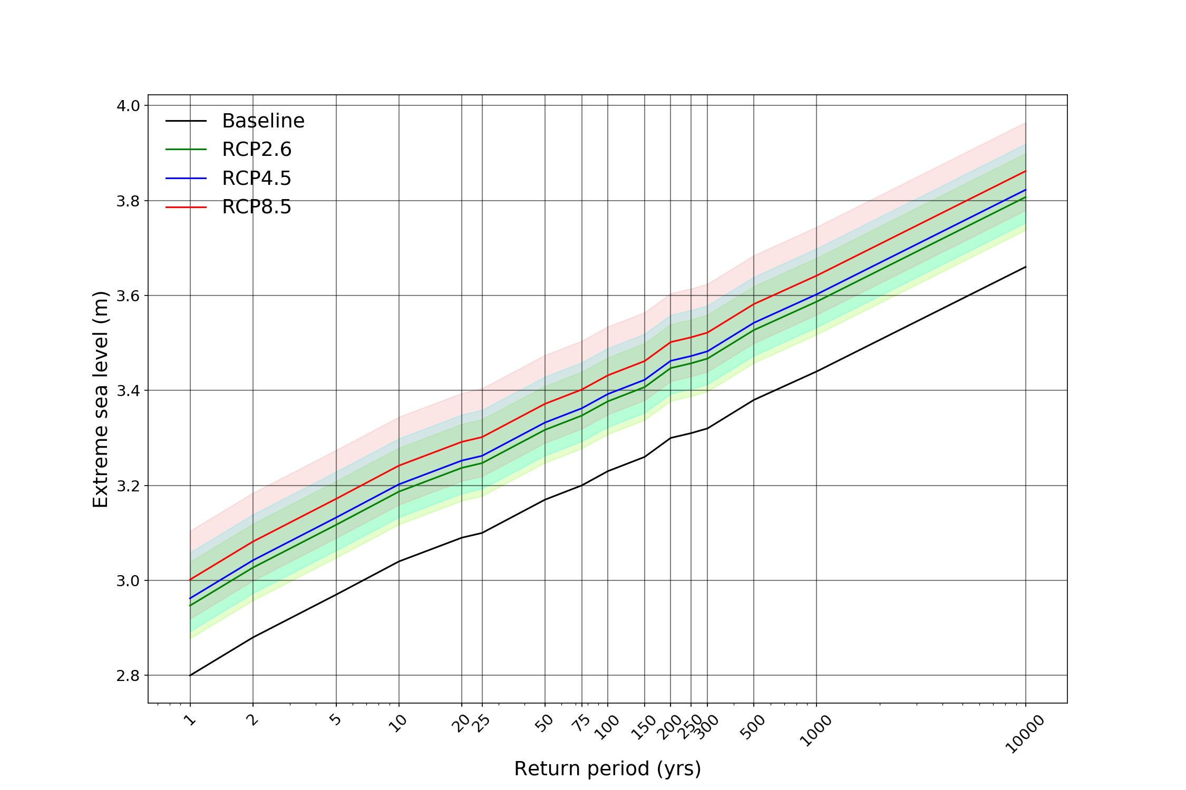

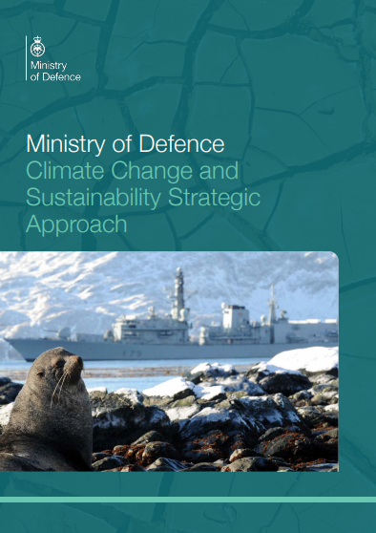
Using the sea-level projections interactive tool
Sea-level projections: “Using a 3°C scenario (RCP 4.5), the median projected regional SLR is 0.37m by the end of the century; the 5th to 95th percentile range is 0.20m – 0.65m. By 2050 the median projected regional SLR is 0.16m; the 5th to 95th percentile range is 0.09m – 0.26m.”
Extreme water levels: “A water level of 3.30m (a present-day 1 in 200 years event) will become more frequent in the future, for a 3°C scenario (RCP 4.5), this water level is projected to occur on average once every 36 years by 2050 and once every 3 years by 2100.”
These estimates have helped inform an assessment of impacts for the defence estate. Contributing to the recently published Ministry of Defence Climate Change and Sustainability Strategic Approach and are helping the UK Defence to meet the challenge of climate change.
https://www.gov.uk/government/publications/ministry-of-defence-climate-change-and-sustainability-strategic-approach
Notes:
Example statements from the report on the slide
Provided sea level projections linked to a 2/3deg temperature increase stating which RCP scenario was most appropriate. Giving the median and range.
Applied these to the CFB dataset, to show how much more frequent different return period water levels would be, for different time horizons.

Slide 16
Coastal Decider
What are the Met Office weather patterns? And what is Coastal Decider?
How are coastal-risk weather patterns identified?

Slide 17
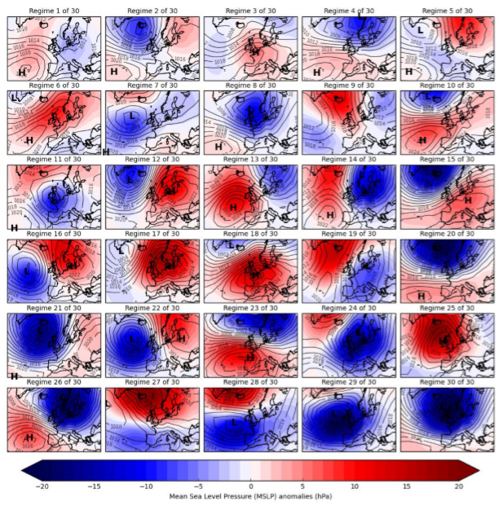
Weather Patterns
A weather pattern is one of many circulation types over a defined region, which differs in its characteristics from other patterns over the same region and varies on a daily basis. Weather patterns are defined in terms of the MSLP anomalies.​
These were objectively derived by clustering 154 years of the European and North Atlantic Daily to Multi-decadal Climate Variability (EMULATE) MSLP (EMSLP) dataset.
The 30 weather patterns are ordered based on their annual historic occurrence between 1850 and 2003 (EMSLP data availability)
Lower numbered patterns occur more in summer (weak MSLP anomalies) and the higher numbered patterns occurring more in winter (strong MSLP anomalies).
Neal, R., Fereday, D., Crocker, R. and Comer, R. (2016) A flexible approach to defining weather patterns and their application in weather forecasting over Europe. Meteorological Applications, 23, 389–400.
Notes:
Examples – 12 high pressure over Scandinavia results in a negative skew surge, 24 deep low over UK and North Sea results in positive skew surge
Understanding this variability in weather pattern helps identify more unusual patterns at certain times of year, which can be an indication of severe weather (e.g. the appearance of Pattern 30 in summer)

Slide 18
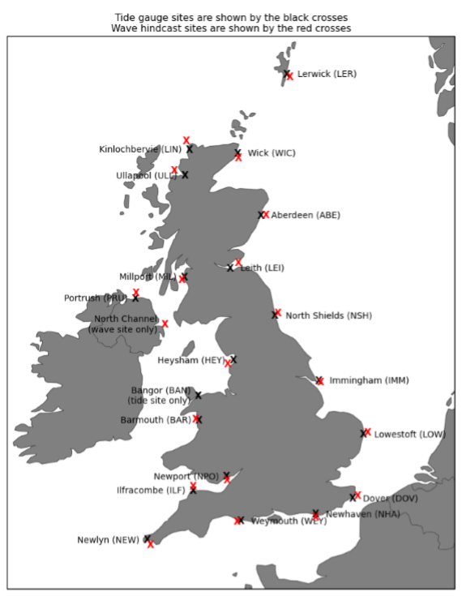
Coastal Decider
High impact coastal flooding has been associated with a subset of specific weather patterns, typically those associated with storm surges.
Coastal Decider was developed to be used as a medium to long range forecast product and is used operationally within the Flood Forecasting Centre (FFC).
It analyses the probability of a heightened risk of high impact coastal flooding around the UK
Tide-gauge data were used to calculate the daily maximum skew surge
The Met Office’s wave hindcast was used to derive the daily maximum significant wave height and daily maximum 10m wind speed
Skew surge = difference between the max observed sea level and the max predicted tide (regardless of timing)
Neal R, Dankers R, Saulter A, et al. Use of probabilistic medium- to long-range weather-pattern forecasts for identifying periods with an increased likelihood of coastal flooding around the UK. Meteorol Appl. 2018;25: 534–547. https://doi.org/10.1002/met.1719
Notes:
Tide gauge sites – black crosses, Wave hindcast sites – red crosses
TG data = BODC, Wave hindcast = produced using the WAVEWATCH III model

Slide 19
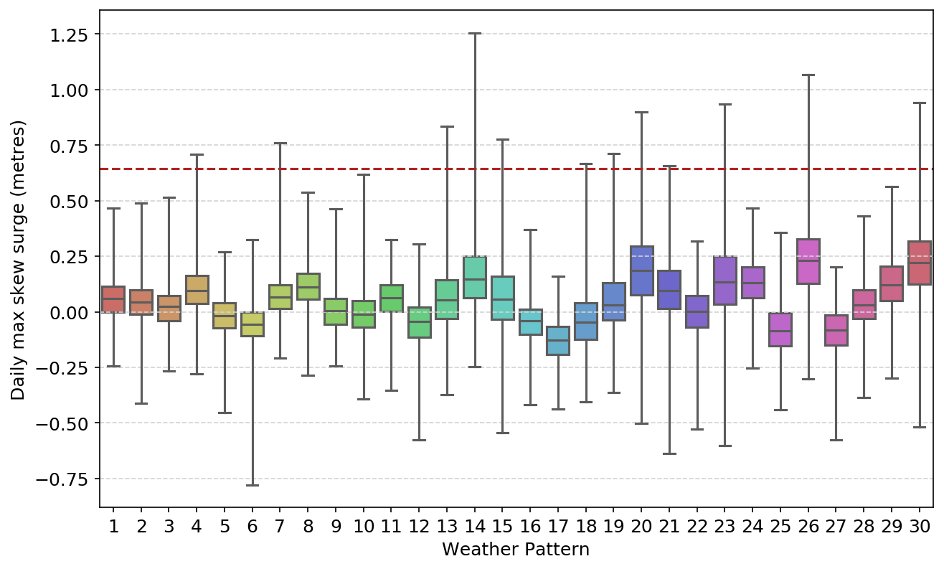
Identifying coastal-risk weather patterns
For each site, a list of weather patterns related to skew surge and wave events was objectively derived
Weather patterns 12, 17, 22 and 27 are associated with negative skew surges --> anticyclonic over the North Sea, blocking areas of high pressure over Scandinavia or Iceland
Weather patterns 13, 14, 19, 20, 23, 24 and 26 are associated with positive skew surges --> low pressure centered in the North Sea or over Scandinavia
The warning threshold is defined as a 1 in 365 days event or 99.7th percentile skew surge = 0.643m for North Shields
Notes:
Matched each skew surge in the historical record to one of the 30 weather patterns using the ERA5 dataset
EMULATE was used to derive the weather patterns originally, but for analysis we are using ERA5 because increased data resolution
Box represents IQR – 25th, 50th and 75th. Whiskers represent max and min

Slide 20
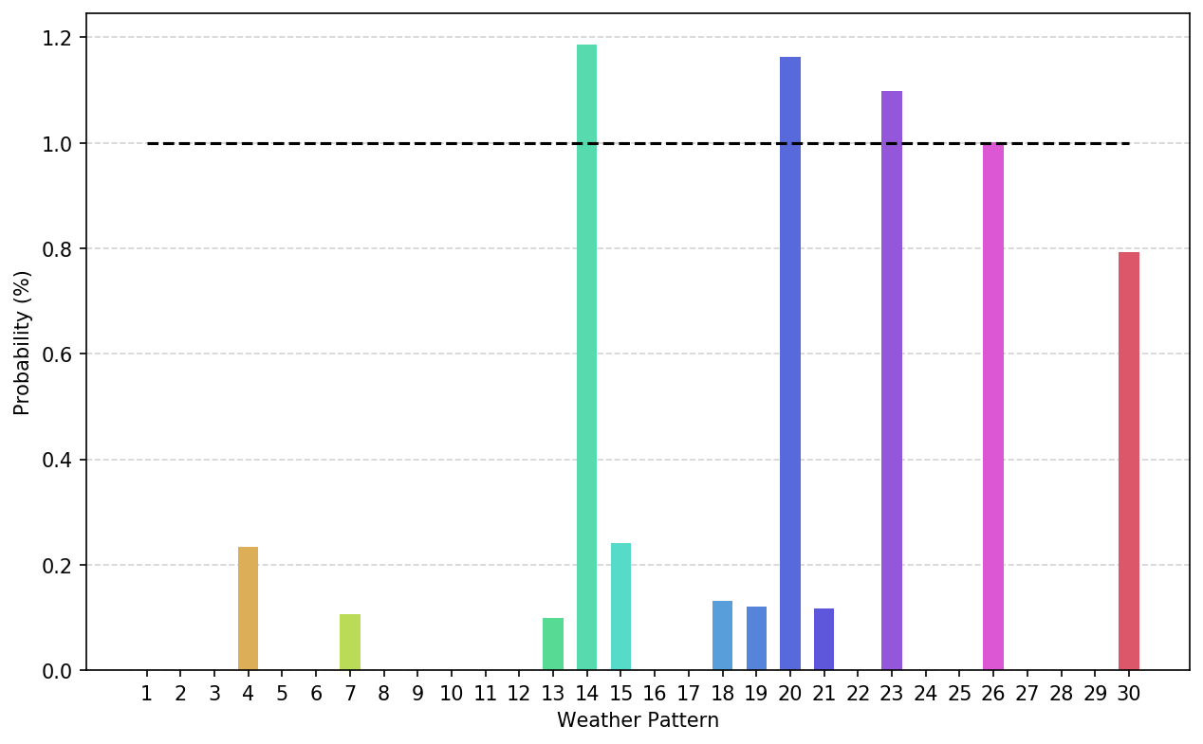
Identifying coastal-risk weather patterns
For each weather pattern and each site, the percentage probability of exceeding the warning threshold is calculated
Weather pattern 13 has 0.10% of events exceeding the warning threshold for North Shields, 0.643m
Weather pattern 23 has 1.10% of events exceeding the warning threshold for North Shields, 0.643m
A coastal risk weather pattern is defined as ≥1% of events exceeding the warning threshold = 14, 20, 23 and 26
Notes:
Weather pattern 14, 20, 23 and 26 are both associated with positive skew surges

Slide 21
Impacts of sea level change on coastal risk
What is the increased probability of exceeding the baseline warning threshold?
In order to retain the baseline level of risk, what warning threshold is required?

Slide 22
Apply sea-level projections
Year | RCP 2.6 | RCP 4.5 | RCP 8.5
2050 | 0.17 (0.10 – 0.27) | 0.19 (0.12 – 0.29) | 0.23 (0.15 – 0.33)
2060 | 0.21 (0.12 – 0.33) | 0.24 (0.15 – 0.37) | 0.30 (0.19 – 0.44)
2070 | 0.24 (0.14 – 0.39) | 0.29 (0.18 – 0.45) | 0.38 (0.24 – 0.57)
2080 | 0.27 (0.15 – 0.45) | 0.34 (0.20 – 0.53) | 0.47 (0.29 – 0.70)
2090 | 0.30 (0.17 – 0.52) | 0.38 (0.23 – 0.62) | 0.56 (0.35 – 0.85)
2100 | 0.33 (0.18 – 0.59) | 0.43 (0.25 – 0.71) | 0.65 (0.40 - 1.01)
*Projected sea level anomalies (m) at North Shields relative to a baseline period of 1981-2000, 50th percentile (5th-95th).
Sea-level change applied yearly to 2100 based on UKCP projections
Coastal Decider re-run for:
  Scenarios: RCP 2.6, RCP 4.5 and RCP 8.5
  Percentiles: 5th, 50th and 95th
  Time slices: 2050, 2060, 2070, 2080, 2090 and 2100
Notes:
RCP 6.0 is not currently available as part of the tool

Slide 23
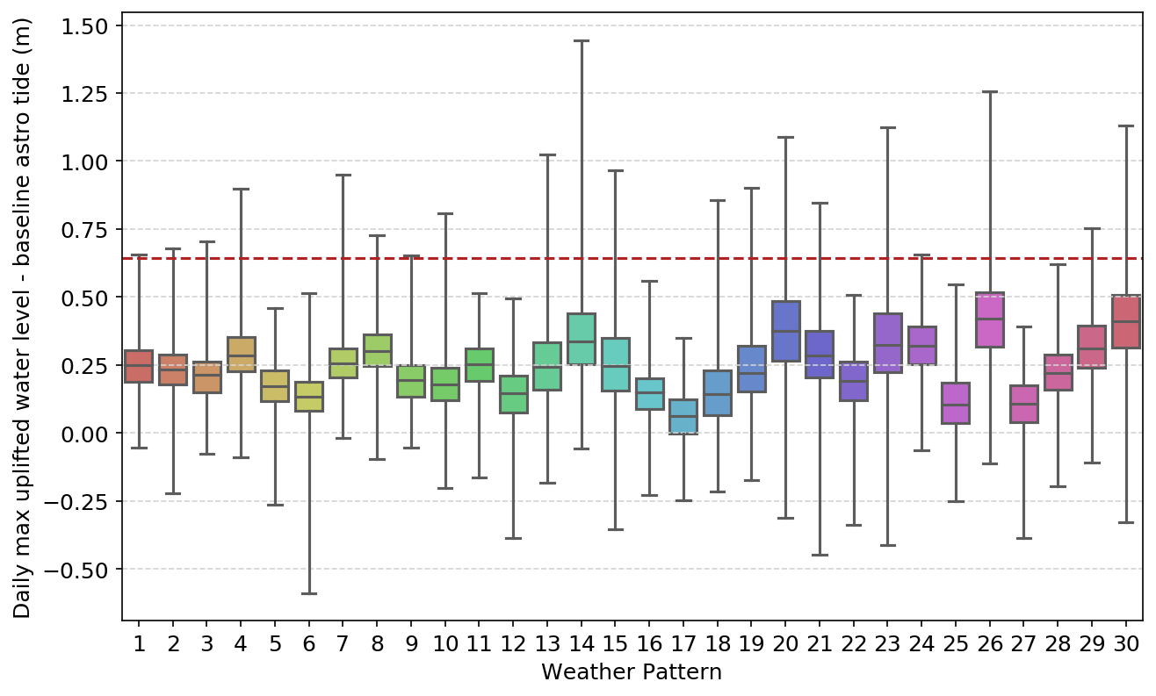
Impact of sea level change - 2050
Sea level projections where then used to uplift the daily maximum water level.
Assumptions:
Relationship between skew surge and weather pattern does not change
Skew surge height does not change
The frequency of occurrence of each weather pattern is the same
The baseline warning threshold = 0.643m for North Shields
Example: Sea level projections to 2050 under RCP 4.5, 50th percentile
Notes:
Sea level projections to 2050 under RCP 4.5, 50th percentile

Slide 24
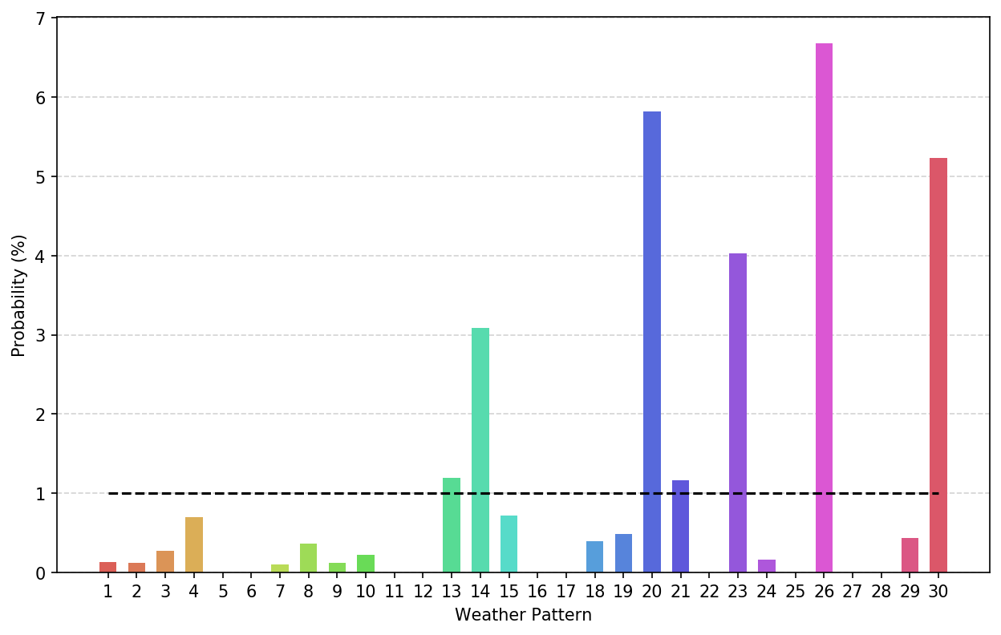
Impacts of sea level change - 2050
For each weather pattern and each site, the percentage probability of exceeding the baseline warning threshold is calculated
Under sea level projections to 2050 using RCP 4.5 (50th percentile) the percentage probability of events exceeding the baseline warning threshold for North Shields (0.643m) has increased:
From 0.10% to 1.20% for weather pattern 13
From 1.10% to 4.02% for weather pattern 23.
Coastal risk weather patterns are now = 13, 14, 20, 21, 23, 26 and 30
Example: Sea level projections to 2050 under RCP 4.5, 50th percentile
Notes:
Although weather pattern 21 and 30 are typically associated with winter conditions (cyclonic south/south-westerlies).
Weather pattern 13, relatively evenly spread across seasons, typically occurs more in spring and autumn (anticyclonic north-westerly).
Therefore sea level rise is increasing the current risk and also could affect the seasonality of risk, which would have implications for early warning systems / coastal defences etc – although not looked at seasonality in detail at present

Slide 25
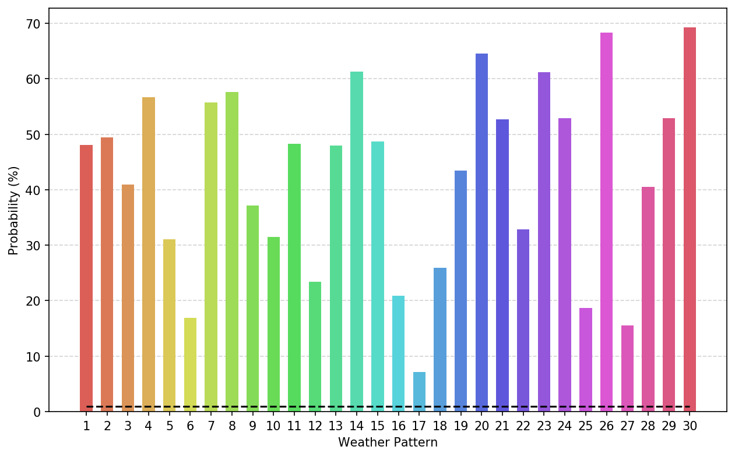
Impacts of sea level change - End of the century
Under sea level projections to 2100 using RCP 8.5 (50th percentile) the percentage probability of events exceeding the baseline warning threshold for North Shields (0.643m) has increased:
From 0.10% to 1.20% to 47.95% for weather pattern 13
From 1.10% to 4.02% to 61.22% for weather pattern 23.
Coastal risk weather patterns are now = All of them!
Example: Sea level projections to 2100 under RCP 8.5, 50th percentile
Notes:
Projections are to 2100 rather than 2050.
Mention the change in risk is not the same everywhere across the country. Some places show an even worse case than North Shields such as Newlyn some show a slightly better result such as Portrush → spatial differences in sea level rise across the country
The main thing to note here is that this is what could occur if we did nothing.

Slide 26
Impacts of sea level
What is the increased probability of exceeding the baseline warning threshold?
Summary table - Percentage probability of events exceeding baseline warning threshold
The baseline warning threshold = 0.643m for North Shields
A coastal risk weather pattern is defined as ≥1% of events exceeding the warning threshold – highlighted.
Notes:
2050 shows a slight increase in the risk, including a couple additional weather patterns possible change in seasonality
2100 even under RCP 2.6 showing even greater risk and by RCP 8.5 shows all weather patterns could cause problems.

Slide 27
Warning Threshold
In order to retain the baseline level of risk, what warning threshold is required?
Summary table – Uplifted warning threshold (m) to retain baseline level of risk
The baseline warning threshold = 0.643m for North Shields
The baseline coastal risk weather patterns are 14, 20, 23 and 26
Year | RCP 2.6 | RCP 4.5 | RCP 8.5
2050 | 0.82 | 0.83 | 0.87
2100 | 0.98 | 1.07 | 1.30
Notes:
By 2050 under RCP 4.5 the baseline warning threshold would need to increase to 0.83m to retain the same risk level we have now.
By 2100 this level would need to increase to 1.07m.
Significant implications for coastal communities needing to discuss viable defence options such as raising sea walls, developing natural flood management systems, re-design of homes e.g. raising the floor level.

Slide 28
Impacts of changing frequency of weather patterns on coastal risk
Can we use GCMs to represent past and future conditions? How well does the ‘fit’ represent the weather patterns?
Is weather pattern frequency changing over time? (James Pope)

Slide 29
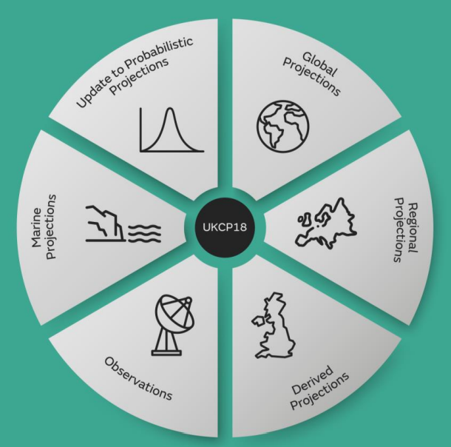
UKCP Global ensemble members
To ensure UKCP Global ensemble members are simulating MSLP conditions in the present day that are a reasonable reflection of large-scale circulation, an assessment against the European Centre for Medium Range Weather Forecasting (ECMWF) ERA5 reanalysis was completed.
The anomalous MSLP values for each day in UKCP Global ensemble members were assigned to one of the 30 Weather Patterns.
PPE ensemble = 15 members
Validation period = 1979-2010
Fit metric = pressure anomaly differences (PAD)
UKCP Global Model: https://agupubs.onlinelibrary.wiley.com/doi/full/10.1002/2017MS001115
Dataset Record: UKCP Global (60km) - European Circulation Indices (ceda.ac.uk)
Notes:
A 15-member perturbed parameter ensemble (PPE) based on the UK Met Office Global Coupled Model
Run from 1899 to 2099 used a validation period of 1979 to 2010 to compare against ERA5.
A number of fit metrics are available but most relevant to Coastal Decider is PAD

Slide 30
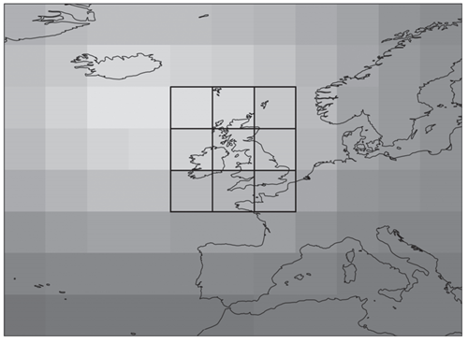
What is PAD?
Pressure Anomaly Difference (PAD) is the difference between a specific ensemble member and its assigned weather pattern.
Positive PADs mean that ensemble members have a higher pressure than their assigned weather patterns. This typically translates to a lower likelihood of large skew surges or waves.
Negative PADs mean that ensemble members have a lower pressure than their assigned weather patterns. This typically translates to a higher likelihood of large skew surges or waves.
There are two types of PAD metric
UK PAD, calculated using a UK domain and domain mean
MIN PAD, calculated using outer domain and minimum MSLP anomaly grid-point
Notes:
PAD measured in hPa
Additional details can be found in Rob’s paper linked earlier in the presentation
Measure of how well the weather pattern depiction matches the forecast/climate model ensemble

Slide 31
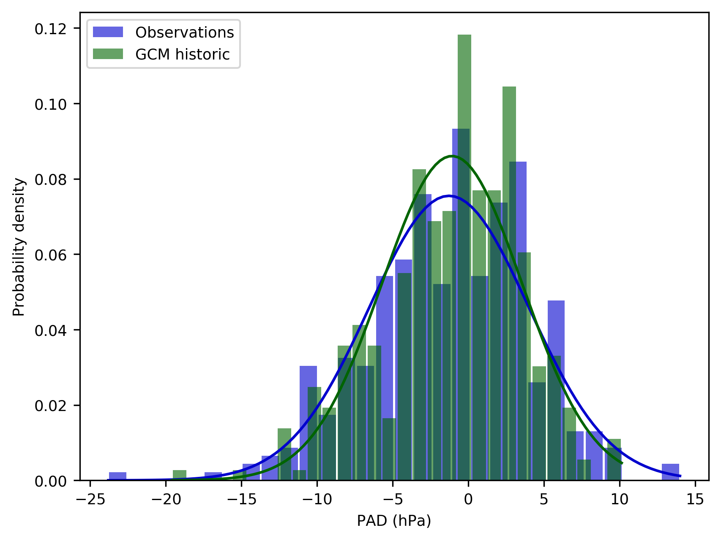
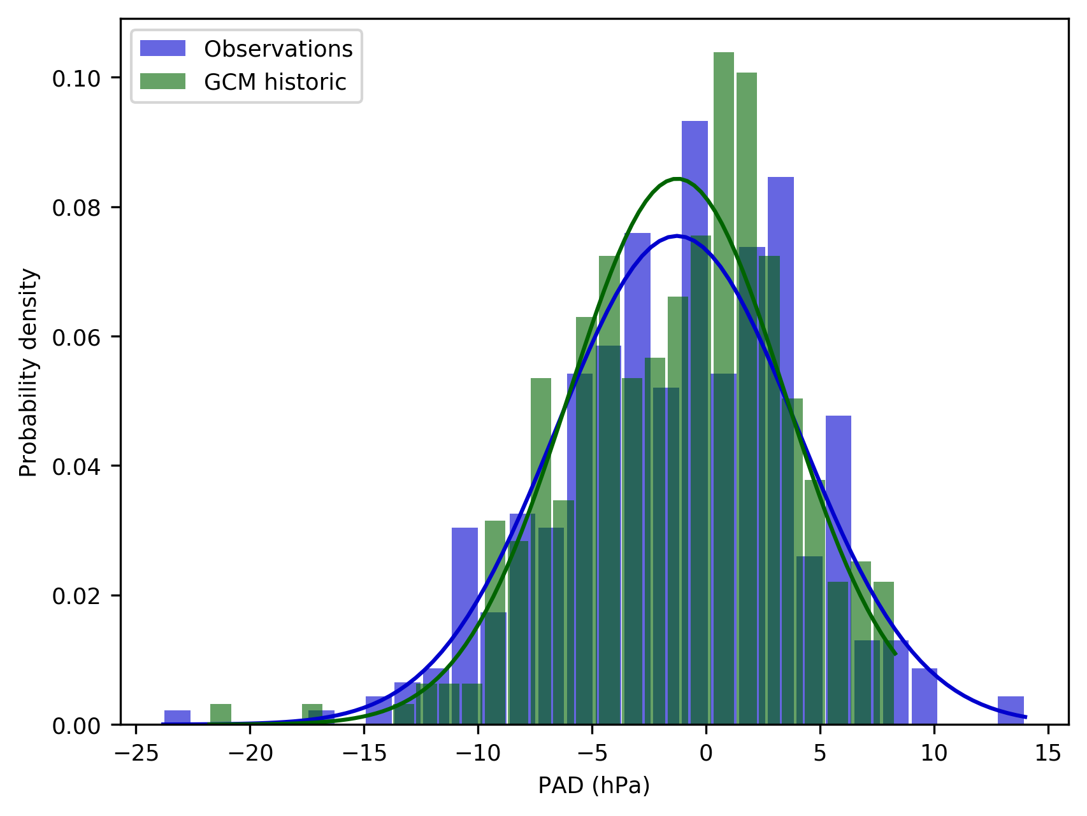
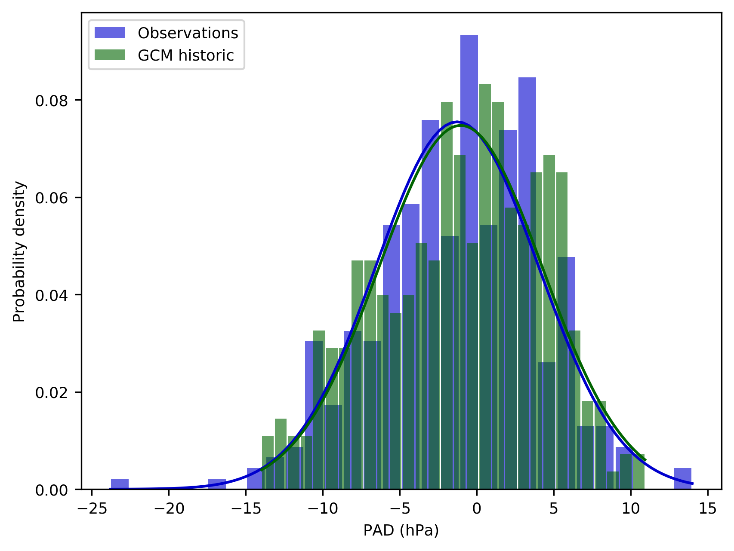
Validation of UKCP Global using PAD
Ensemble 1 Test statistics = 0.07 P value = 0.29 | Ensemble 5 Test statistics = 0.06 P value = 0.46 | Ensemble 10 Test statistics = 0.07 P value = 0.33
Weather pattern 20 – risk regime for North Shields in present day
Notes:
Wider shallower PDF indicates a worse fit between the ensemble member and the weather pattern ie. PAD should = 0 if perfect match
Time period - 1979-2010
Kolomogorov-Smirnov test – does not assume a distribution in the data
Null hypothesis = two data samples are the same and Alternate hypothesis = two data samples are different
Test statistic is the maximum difference between the two CDFs, so the larger this is the more likely that the two datasets are different
P-value is the significance level, in this case >0.05

Slide 32
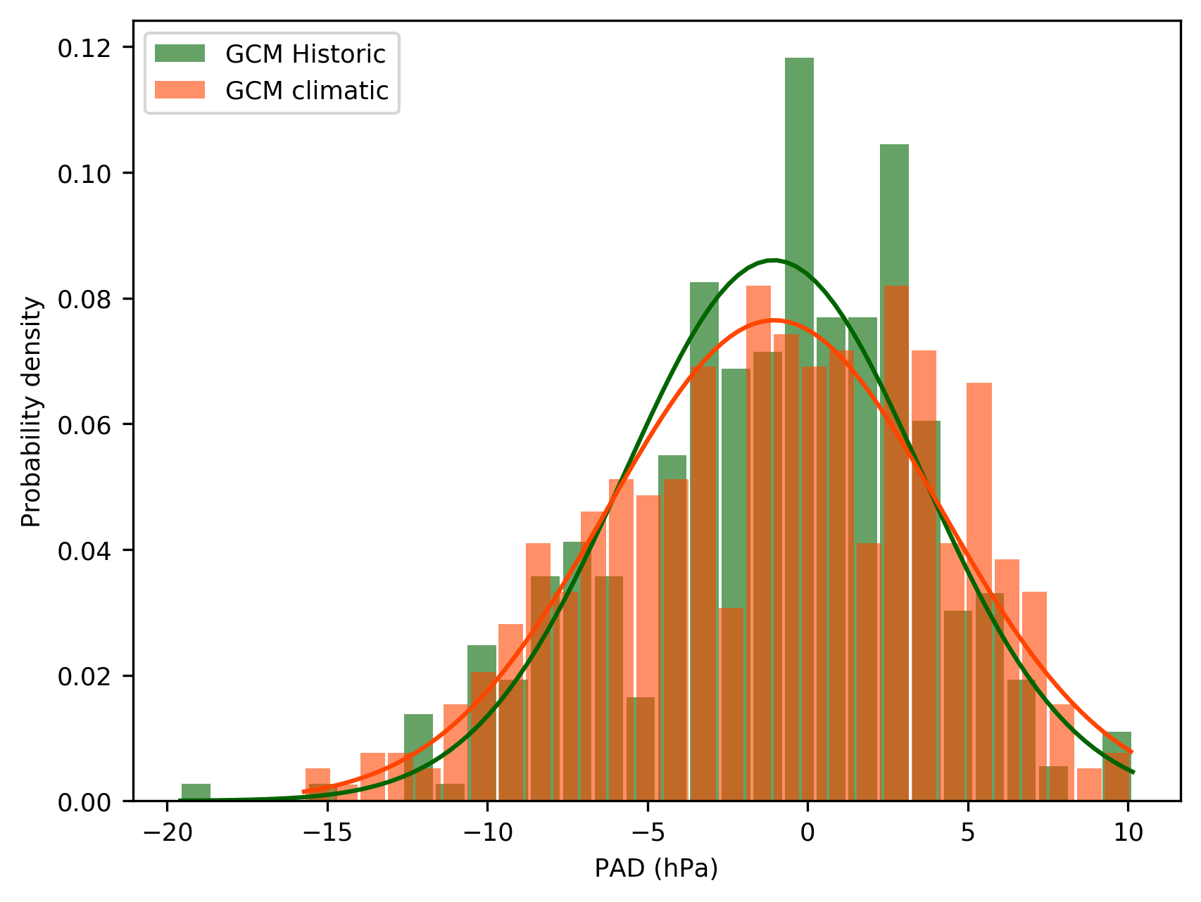
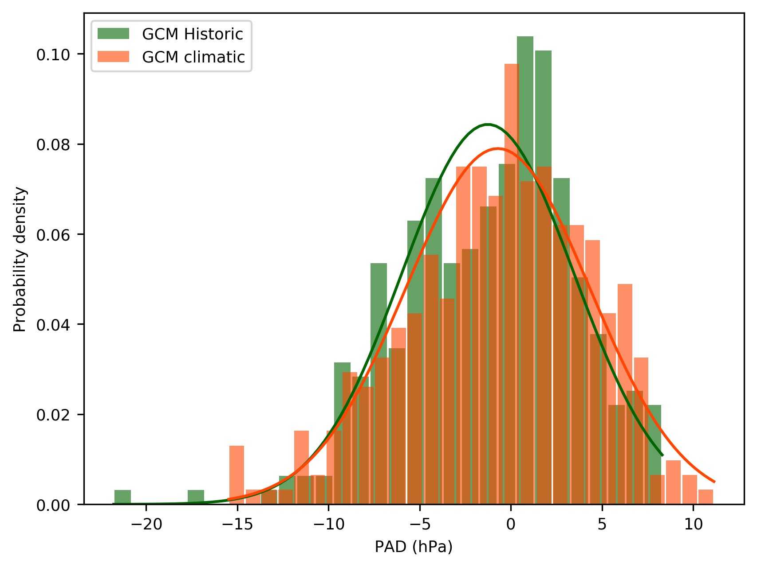
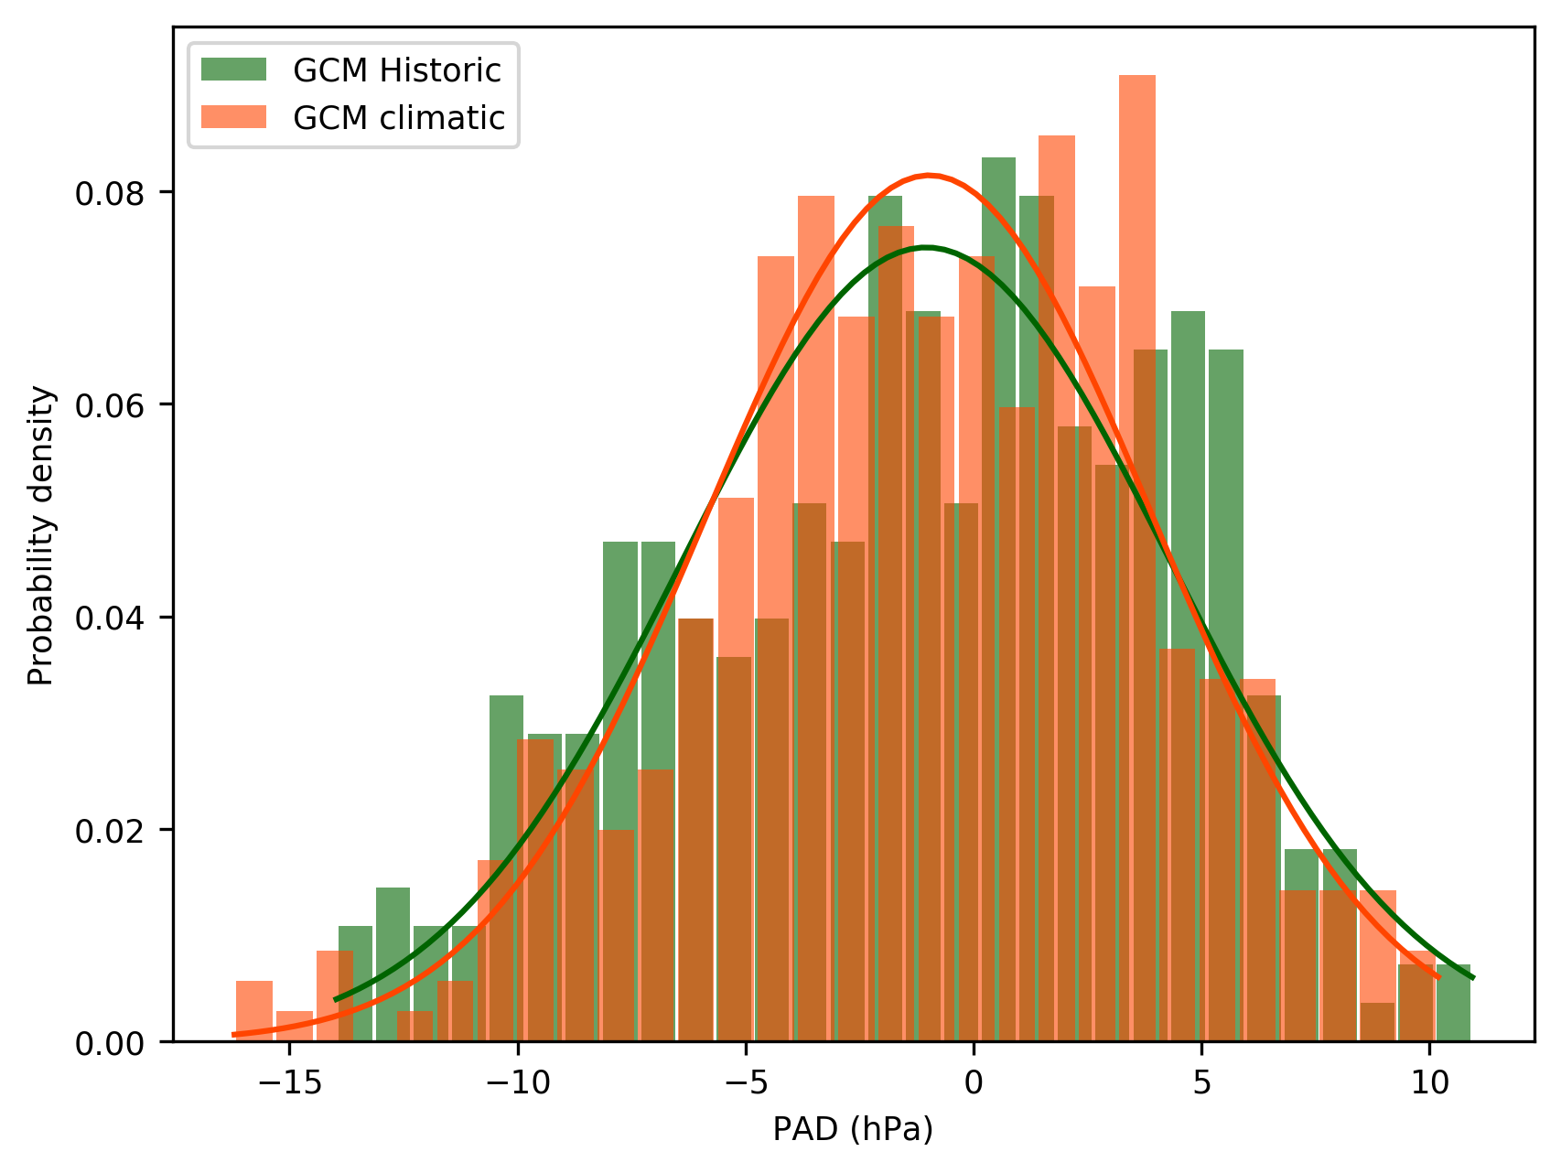
Does the ‘fit’ change over time?
Ensemble 1 Test statistics = 0.09 P value = 0.08 | Ensemble 5 Test statistics = 0.08 P value = 0.19 | Ensemble 10 Test statistics = 0.08 P value = 0.23
Weather pattern 20 – risk regime for North Shields in climatic period
Notes:
Historic period - 1979-2010 and Future period – 2059-2090
Test statistic is small therefore indicated the two datasets are similar
P-value although not as strong as the match to observations is still >0.05 significance level
This shows that UKCP Global is fit for use in assessing the changing frequency of weather patterns

Slide 33
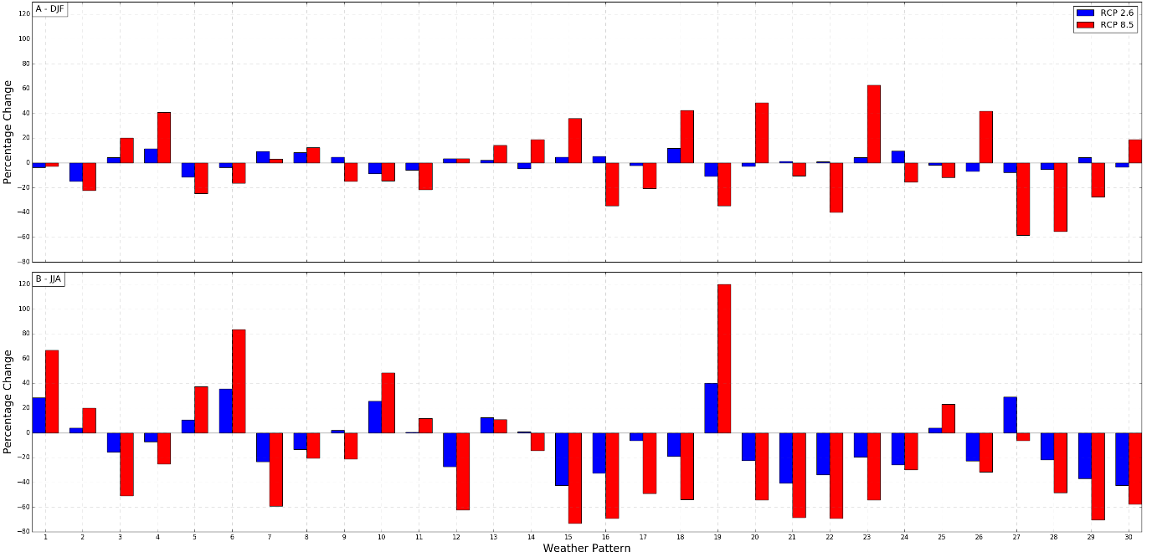
Changing frequency of weather patterns
Credit: James Pope
Notes:
PPE Ensemble mean, percentage change in frequencies of occurrence between the future (2071-2099) and the historical (1900-2010)
→ top winter (DJF) and bottom summer (JJA)
→ RCP 2.6 (blue) and RCP 8.5 (red)
Using a threshold of +/- 20% – RCP 8.5; nine patterns display an increase in winter e.g. 23, with a further ten showing a decrease e.g. 27
Implications = Of the 7 weather patterns identified with being associated with a positive skew surge -> 4 show an increase in winter and only 1 shows a decrease.
** In conclusion sea level poses a significant risk! Exacerbated by the changing frequency of weather patterns.
REF ONLY - Weather patterns 13, 14, 19, 20, 23, 24 and 26 are associated with positive skew surges
REF ONLY - A noticeable outlier is Weather Pattern 27 during summer, which has an increase of greater than 20% in the RCP 2.6 simulation, compared to negligible change in RCP 8.5 (not relevant for storm surges)

Slide 34
Next steps for the project
Sea level tool – Shortly planning an internal release of the tool prior to a public release. Aim to include additional science developments such as CMIP6 models
Coastal Decider – Combine the relative importance of sea level change and changing frequency of weather patterns to create a proxy for coastal risk.
NEMO – continue with some early work using NEMO-surge to validate the assumption that the storm surge shape does not change over time.
Marine Workshop – As part of a wider NPOP fund, we are planning a marine workshop for Spring 2022 with the hope of connecting with new stakeholders

Slide 35
Contact details
Email: rachel.perks@metoffice.gov.uk
Website: www.ukclimateresilience.org
Twitter: @UKCRP_SPF
YouTube: UK Climate Resilience programme
The UK Climate Resilience programme is supported by the UKRI Strategic Priorities Fund.
The programme is co-delivered by the Met Office and NERC on behalf of UKRI partners AHRC, EPSRC, ESRC.

Slide 36
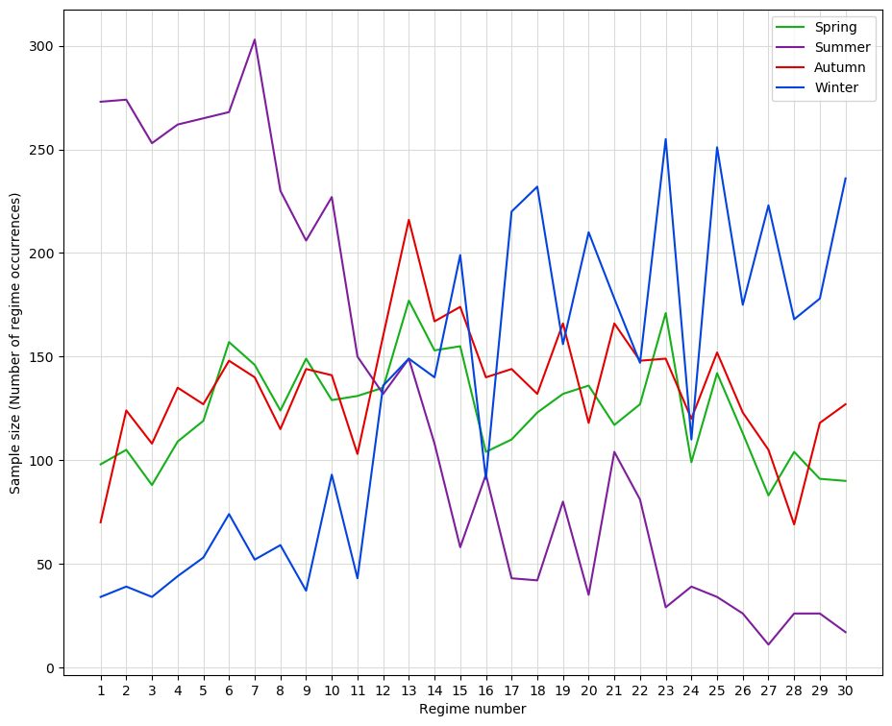
Extra Slides
Number of events by season for each weather pattern in the historical time period.
Example plot for North Shields
-- DRAFT --

