Slide 1

Resilience Study
UK Climate Resilience Programme webinar
Wednesday 8th July 2020

Slide 2
Agenda
Background to the NIC
Approach to the resilience study
Framework and recommendations
Resilience across different sectors: systems mapping for UK infrastructure systems decision-making project

Slide 3
The NIC provides independent advice to government on the UK’s long-term economic infrastructure needs
The NIC’s Charter sets out that it will:
Produce a National Infrastructure Assessment, which will be published once a Parliament and will analyse the infrastructure needs of the UK and recommend how the needs should be met.
Periodically produce other ‘specific studies’ of infrastructure needs as commissioned by the Chancellor.
Produce an annual monitoring report taking stock of government progress in key areas.
Engage with the public and other policy makers
The government is required to issue a formal response to all NIC recommendations, stating whether they accept or reject them.
Our objectives:
support sustainable economic growth across all regions of the UK
improve competitiveness
improve quality of life
We work within our fiscal and economic remits:
    Recommendations must be compatible with gross public investment in economic infrastructure of between 1.0% and 1.2% of GDP in each year
    Provide a transparent assessment of the impact on costs to businesses, consumers, public bodies and other end users

Slide 4
The first National Infrastructure Assessment
Published in July 2018, the first NIA recommendations include:
Nationwide full fibre broadband by 2033
Half of the UK’s power provided by renewables by 2030
Three quarters of plastic packaging recycled by 2030
£43 billion of stable long term transport funding for regional cities
Preparing for 100 per cent electric vehicle sales by 2030
Ensuring resilience to extreme drought
A national standard of flood resilience for all communities by 2050
Government has committed to respond with a National Infrastructure Strategy.

Slide 5
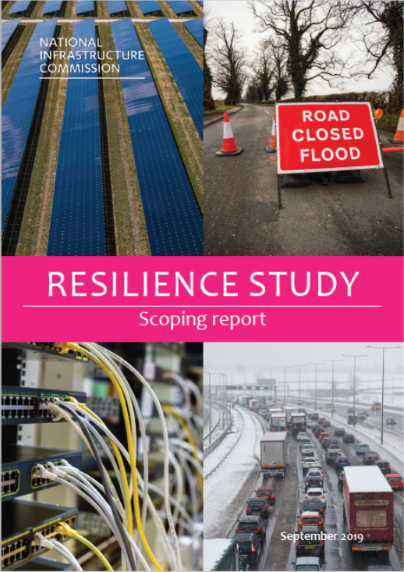
Background to the Resilience Study
Study commenced Oct 2018
  Public consultation
  Social research
Scoping report Sep 2019
  Call for evidence
Regulation study published Oct 2019
Final report published May 2020
Terms of reference. Government asked NIC to:
Review UK and international knowledge and approaches relating to the resilience of current and future economic infrastructure systems
Develop an understanding of public expectations and response to the potential loss of infrastructure services
Develop an analytical approach that can be used to better understand the resilience of economic infrastructure systems, and the costs and benefits of measures to improve this
Undertake pilot analysis of infrastructure systems to identify actions to improve resilience
Make recommendations to government
We didn’t cover the NIC’s full remit for this study, only:
Water and wastewater
Energy (electricity and gas)
Transport (road and rail)
Digital communications (fixed line and mobile)

Slide 6
Key messages in the final report
We need to:
Face uncomfortable truths, make decisions
Value resilience properly
Proactively test and plan
Take opportunities to adapt
We recommend doing this through:
A framework for thinking about resilience
Supported by three recommendations:
  government should publish a full set of resilience standards every five years
  infrastructure operators should carry out regular and proportionate stress tests
  Infrastructure operators should develop and maintain long term resilience strategies

Slide 7




Strategic context
UK relies on infrastructure services. The lack of prolonged or widespread infrastructure failures cannot lead to complacency.
Recent disruptions have revealed vulnerabilities
  Aug 2019 power cut, Storm Dennis 2020, 2018 Rail Timetabling
Covid19
Major infrastructure projects on the horizon
  High speed rail, 5G, renewables, reservoirs
Known challenges
  Climate change, demographic change, economic constraints
Opportunities to create a more resilient UK
  Net zero, 25 Year Environment Plan

Slide 8
The challenges of infrastructure resilience
Managing complexity
  Dependencies and interdependencies
  Systems are often in constant use
  Some assets have very long lifetimes
  Data
Getting incentives for resilience right
  Efficiency vs ‘gold plating’
  Costs and benefits go wider than operator and users of a particular service
  Accountability is not always straightforward
Facing up to resilience challenges
  We have limited experience of some risks, including known ones, which can mean they are downplayed
  Anticipated events aren’t always prepared for
  Groupthink and a desire for consensus mean dissenting voices are often filtered out
We commissioned a number of pieces of research to better understand these challenges, which we have published alongside the report:
Oxford University: pilot approach to modelling interdependencies
Bristol University: understanding emergence in economic infrastructure
UCL: emergence in comparable systems
Arup: infrastructure decision-making

Slide 9
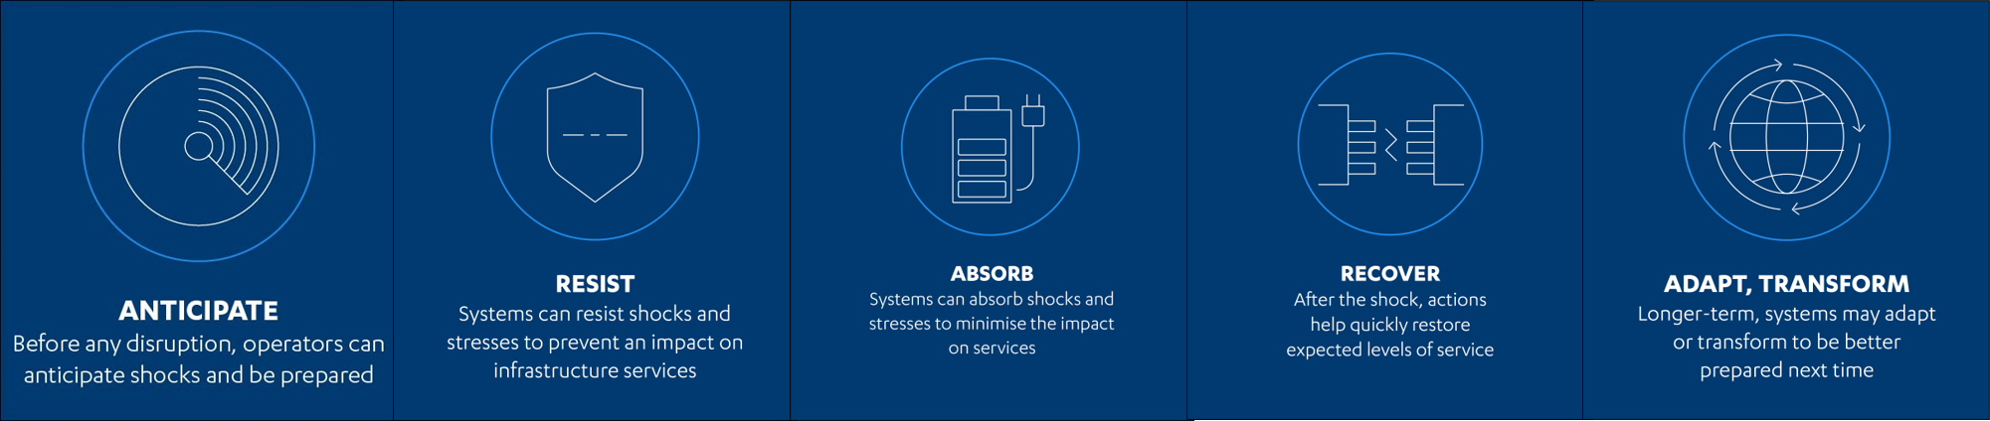
Developing a framework: the six aspects of resilience
Resilience is a dynamic concept; it’s about the ability to continue to function effectively in the face of the full range of future challenges. A dynamic and holistic approach that looks at the system as a whole over time and the service that it delivers.
Effective risk management is essential to this, but a truly resilient system is also able to respond to as yet unknown, or difficult to predict challenges.
After reviewing existing definitions and approaches, we focussed on six aspects of resilience in the final report. Together, they capture the range of possible actions to take to deliver resilient infrastructure systems.

Slide 10
The recommendations in the report are designed to deliver this framework
Recommendation | Resilience aspect
1. Government should publish a full set of resilience standards every five years, following advice from regulators, alongside an assessment of any changes needed to deliver them | Anticipate
2. Infrastructure operators should carry out regular and proportionate stress tests overseen by regulators, to ensure their systems and services can meet government’s resilience standards, and take actions to address any vulnerabilities | Resist, absorb, recover
3. Infrastructure operators should develop and maintain long term resilience strategies and regulators should ensure their determinations in future price reviews are consistent with meeting resilience standards in the short and long term. | Adapt, transform
Transform
Anticipate
Resist
Absorb
Recover
Adapt

Slide 11
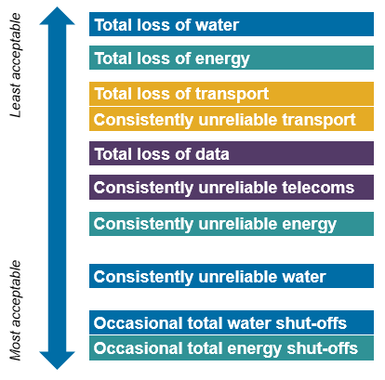
Recommendation 1: standards
Resilience standards provide clarity and transparency
Government’s responsibility to set standards
  Insurer of last resort, market failures, wide impacts of disruptions
  Difficult choices, trade-offs, prioritisation
Standards must be informed by independent evidence
Government must use standards to drive improvements in resilience
  Assess structures, powers and incentives
  Review standards regularly
Our social research, carried out by BritainThinks, found high impact, low frequency disruptions were generally seen as least acceptable, particularly total loss of water and energy services

Slide 12
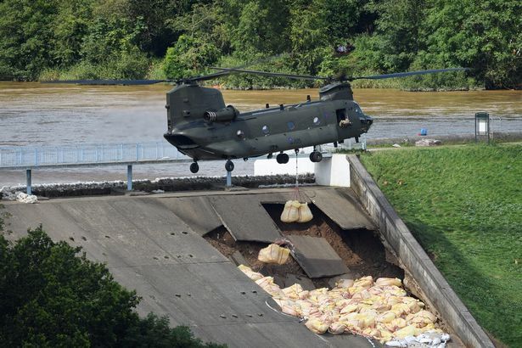
Recommendation 2: stress testing
Vulnerabilities can be invisible
  2019 power cut, Toddbrook Dam 2019
Operators must demonstrate resilience
Stress testing should:
  Be carried out regularly
  Be transparent
  Assess what would break the system
  Incentivise improvement
Operators are responsible, but regulators must guide the process
Wales Online 2019 - Whaley Bridge Dam still critical as heavy rain forecast - Peter Byrne/PA Wire

Slide 13
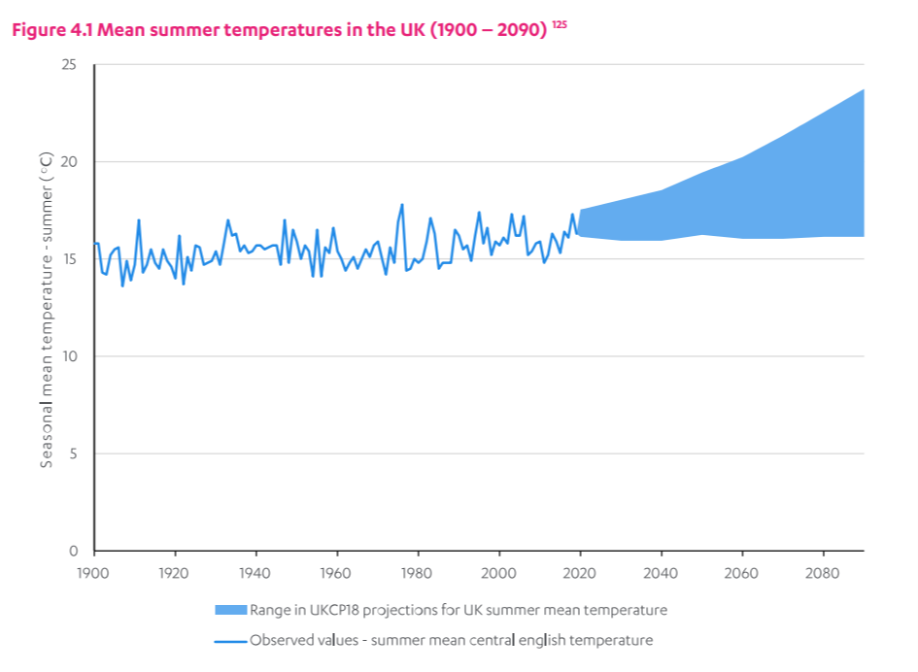
Recommendation 3: long term planning
Long term resilience strategies:
  Address issues proactively, manage interdependencies
  Take opportunities to ‘build back better’
Coping with an uncertain future
  Keeping options open, adaptive approaches
  Transformation
Operators are responsible
Regulators and government must:
  Remove barriers
  Scrutinise strategies and drive action
  Account for the costs of resilience
  Consider resilience in decisions

Slide 14
Case study: rail impacts in 2019 heatwave
What happened?
Europe experienced a short but exceptional heatwave in late July 2019 where the UK, Belgium, the Netherlands, Germany, and Paris recorded their highest temperatures on record.
The UK rail network was severely affected across south-east England with train cancellations and main lines closed out of London due to concerns with potential rail buckling.
Network Rail (NR) introduced speed restrictions to manage the risks of buckling, which required a number of train services to be cancelled and therefore some services became busier. Damage occurred to overhead electric wires as they sagged in the heat, and trackside vegetation caught fire in several locations.
Network Rail planning
NR’s Weather Resilience and Climate Change Adaptation (WRCCA) strategy is based on building resilience through improved planning and decision-making around climate change, asset renewal and increased collaboration across the rail industry. However, the strategy focuses on floods and high winds, with only limited focus on heatwaves.
NR said that for rails to withstand climate conditions from sub-zero to over 35°C, construction costs are fourfold higher, and costs also increase during operation. For example – some tracks may need to be physically adjusted from summer to winter. NR has stated it is neither practical nor cost effective to implement these measures permanently across the network.

Slide 15
Examples of good practice and areas for improvement
Resilience aspect | Examples
Anticipate | NR have committed to design for resilience for new rail infrastructure investments. Demand and customer expectations were managed by notifying customers ahead of disruptions and advising them to avoid travel if they didn’t need to^{i}.
Resist | NR takes pre-emptive measures to help infrastructure resist heatwaves, such as weatherproofing electrical systems, stressing rails, and painting hot-spots white^{ii}.
Absorb | Train companies ran reduced services at slower speeds to provide a level of service and reduce the risk of trains buckling on the tracks. Train companies provided substitute modes of transport to support some customers, including busses.
Recover | NR’s extreme weather action teams (EWATs) pre-empt areas at risk to enable faster response and resolve incidents to restore and maintain services.
Adapt & Transform | NR have committed to building back better when weather events cause assets to catastrophically fail^{iii}. NR have committed to taking opportunities to adapt through incremental asset renewal. However, more investment may be necessary to prepare for future heatwaves.
^{[i]} https://www.networkrail.co.uk/news/south-east-route-gets-ready-for-record-breaking-heatwave-on-thursday-25-july
^{[ii]} https://www.networkrail.co.uk/news/western-route-ready-to-take-on-the-hot-weather-as-the-mercury-is-predicted-to-rise
^{[iii]} https://safety.networkrail.co.uk/wp-content/uploads/2017/02/NR-WRCCA-Strategy-2017-2019.pdf

