Slide 1



SPF UK Climate Resilience Programme Webinar Series 2020

Slide 2





Programme
12:00 | Intro to the SPF UK Climate Resilience Programme | Kate Lonsdale UK Climate Resilience Champion
12.05 | The Climate Change Risk Assessment - background context | Kathryn Brown Head of Adaptation, Committee on Climate Change
12.15 | Gathering the evidence for the 3rd UK Climate Change Risk Assessment | Prof Richard Betts Met Office, University of Exeter
12.35 | Q&A and discussion | Panellists
13.00 | End
Website: https://www.ukclimateresilience.org/

Slide 3
How to engage
  Presentations first then Q&A and discussion
  Post questions in the Q&A box at any time
  Upvote your favourites
  Attendees will remain muted unless enabled to speak by the host​
  Technical problems – chat
  Webinar (audio and slides) will be shared after the event
  Please note: this webinar is being recorded​
Twitter: @UKCRP_SPF #UKclimateResil
Website: https://www.ukclimateresilience.org/

Slide 4



Programme vision
To enhance the UK’s resilience to climate variability and change through frontier, interdisciplinary research and innovation on climate risk, adaptation and services, working with stakeholders and end-users to ensure the research is useful and usable.

Slide 5
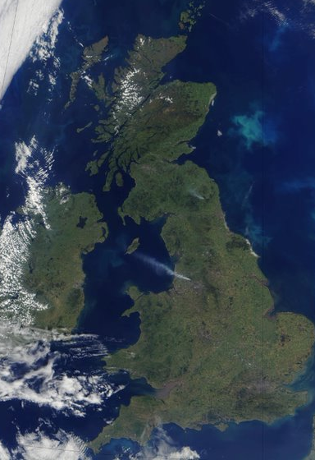

Objectives
Climate risks
Characterising and quantifying
climate-related risks to the UK
Climate adaptation
Managing climate-related risks through adaptation
Climate services
Working with partners to turn climate information and knowledge into action and usable services
Website: https://www.ukclimateresilience.org/

Slide 6
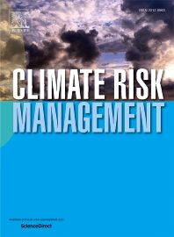
Special Issue of Climate Risk Management
Call for papers on “UK Climate Risk Assessment and Management” for a Special Issue of Climate Risk Management.
Guest edited by Suraje Dessai (Leeds), Hayley Fowler (Newcastle), Jim Hall (Oxford) and Dann Mitchell (Bristol).
Multi- and inter-disciplinary and practitioner-led research
Deadline: 30th November 2020.
Website: https://www.ukclimateresilience.org/
Notes:
In order to feed new scientific evidence from UKCR to the Third Climate Change Risk Assessment (CCRA3), we have launched a call for papers on “UK Climate Risk Assessment and Management” for a Special Issue of Climate Risk Management.
The issue is be guest edited by Suraje Dessai (Leeds), Hayley Fowler (Newcastle), Jim Hall (Oxford) and Dann Mitchell (Bristol). Submission of multi- and inter-disciplinary research is encouraged as well as practitioner-led research. Deadline: 30 November 2020

Slide 7
The Climate Change Risk Assessment Context
Kathryn Brown, Head of Adaptation,
Committee on Climate Change

Slide 8

The UK climate change risk assessment
Kathryn Brown
Head of Adaptation, Committee on Climate Change

Slide 9

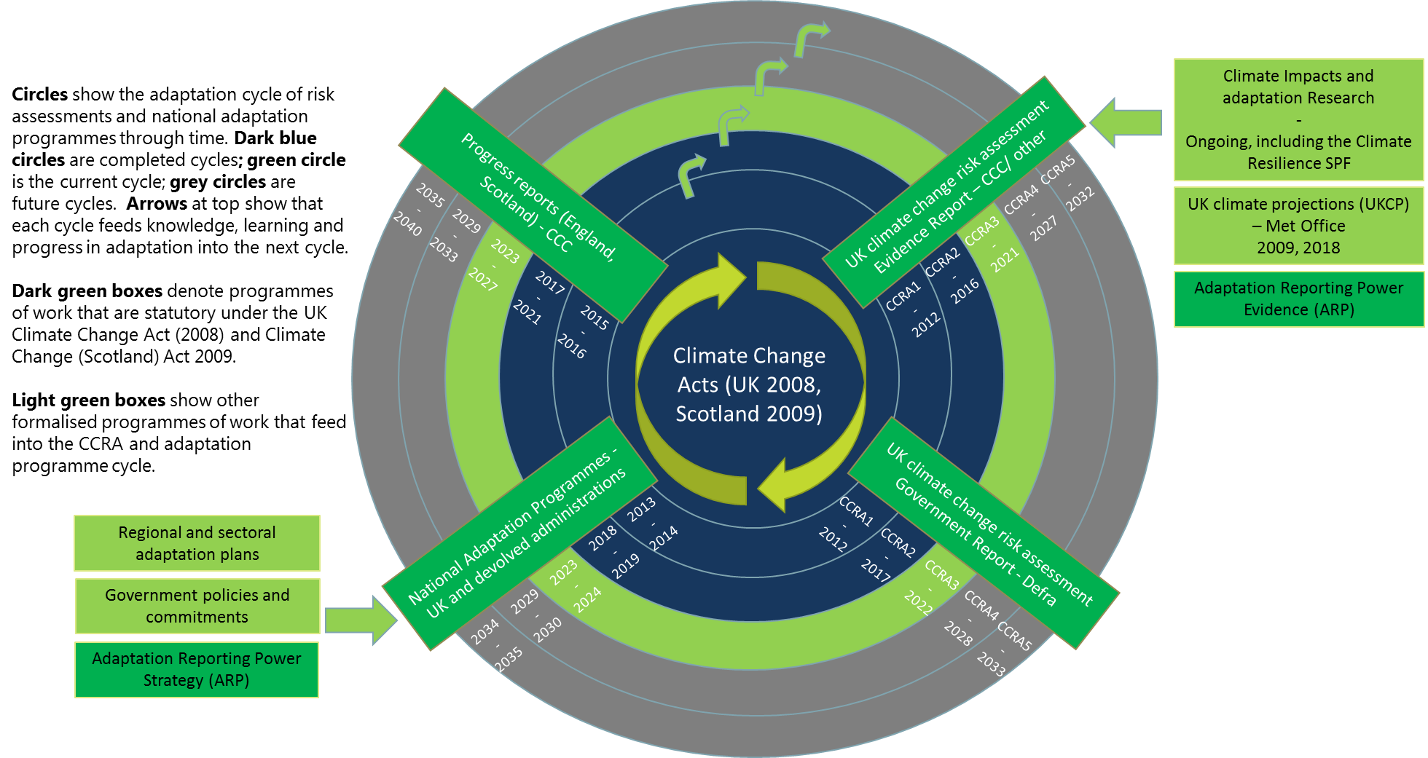
The Climate Change Act puts in place a cycle of risk assessments and adaptation programmes
Source: CCRA3 Evidence Report: Introduction Chapter (draft)

Slide 10
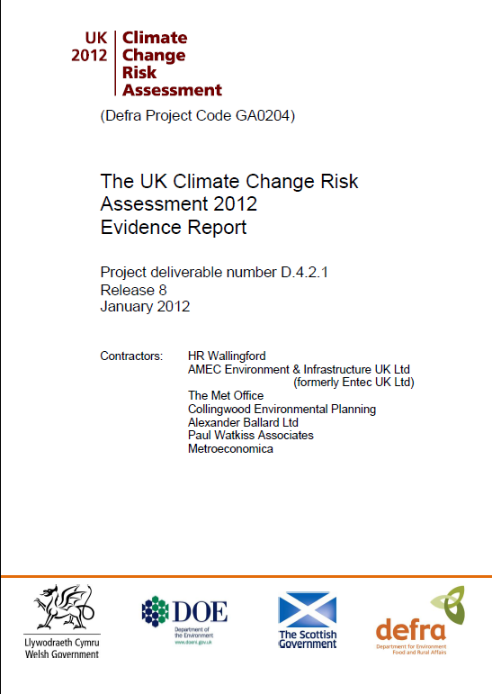
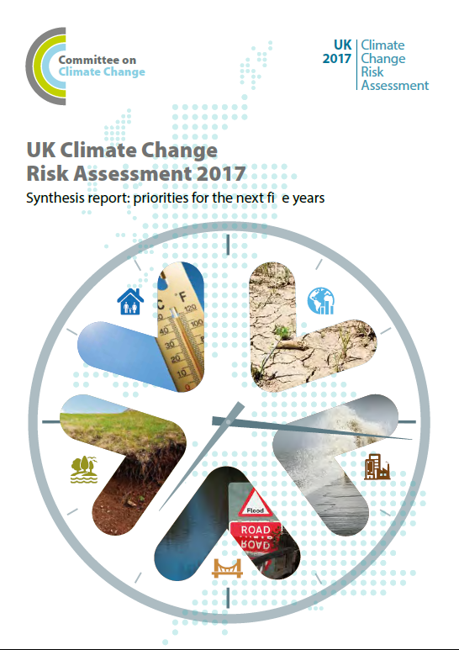
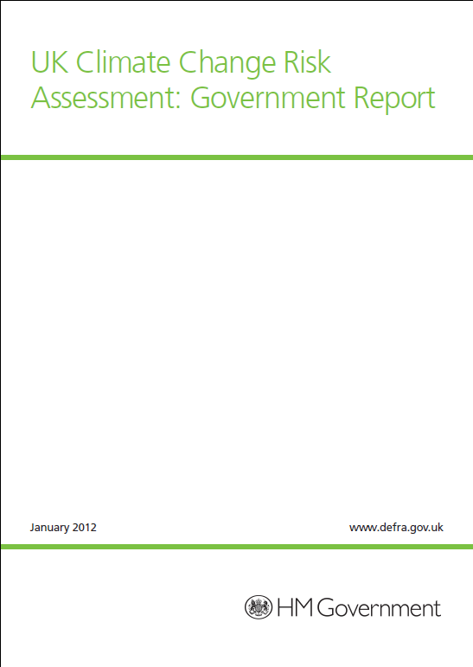
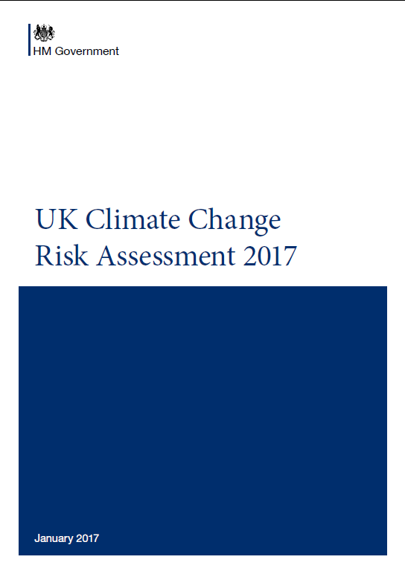
There have been two previous CCRA cycles (2012 and 2017)
https://www.gov.uk/government/publications/uk-climate-change-risk-assessment-government-report
https://www.gov.uk/government/publications/uk-climate-change-risk-assessment-2017

Slide 11
CCRA3 will be published in 2022 (Evidence Report in 2021)
 | Output | Purpose
CCRA3 Evidence Report | Synthesis Report | To provide the Adaptation Committee’s statutory advice to Government on the risks and opportunities to the UK from climate change. The Synthesis Report is based on the technical chapters and focus on the results of the urgency scoring. Authored by the CCC.
 | Technical chapters | To provide the detailed analysis that underpins the assessment of risks or opportunities, and the resulting urgency scores. Alongside this introduction, there are seven technical chapters. Evidence is drawn from the literature and new research. Authored by a consortium of experts led by the University of Exeter and Met Office, working to the CCC.
 | Summaries | To summarise the most relevant aspects of the risk assessment for different audiences; each UK country (England, Northern Ireland, Scotland and Wales), and a range of sectors that focus on different areas of policy across government (TBC). Authored by a consortium of experts led by Sustainability West Midlands working to the CCC.
 | Research projects | To provide supporting evidence to inform the technical chapters, supplementing the existing literature and filling key evidence gaps from CCRA2 or updating analysis with new information. Authored by consultants working to the CCC.

Slide 12































































Over 130 organisations are contributing to the Evidence Report

Slide 13
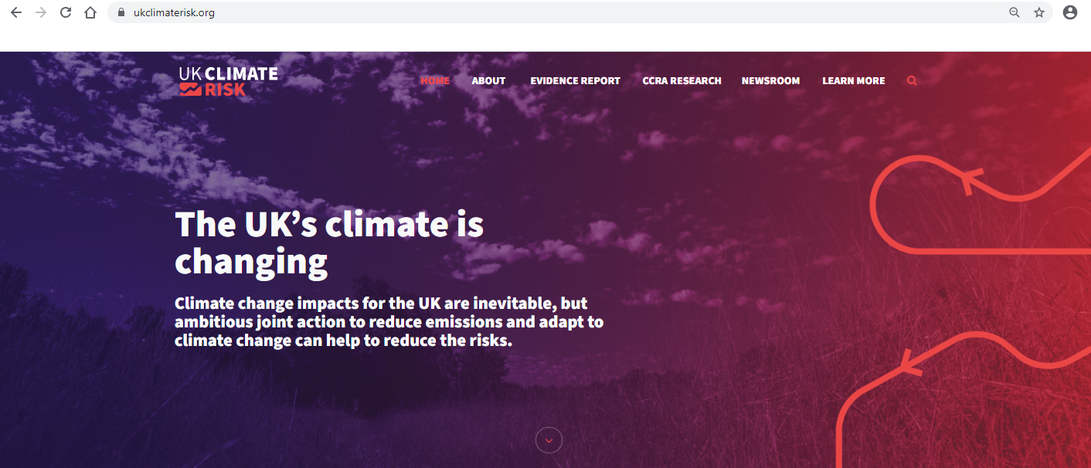
Climate risk website being launched tomorrow
Ukclimaterisk.org

Slide 14
Gathering the evidence for the 3rd UK Climate Change Risk Assessment
Professor Richard Betts, Professor of Climate Change Impacts, University of Exeter
Notes:
Hayley is Professor of Climate Change Impacts in the School of Engineering at Newcastle University. Her research focuses on improved physical understanding of changing precipitation extremes and providing better projections for climate adaptation.

Slide 15
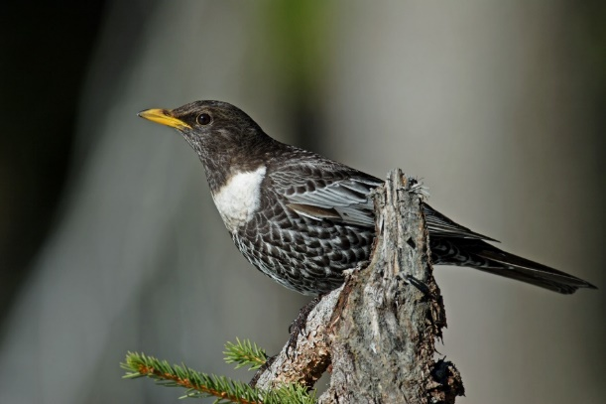
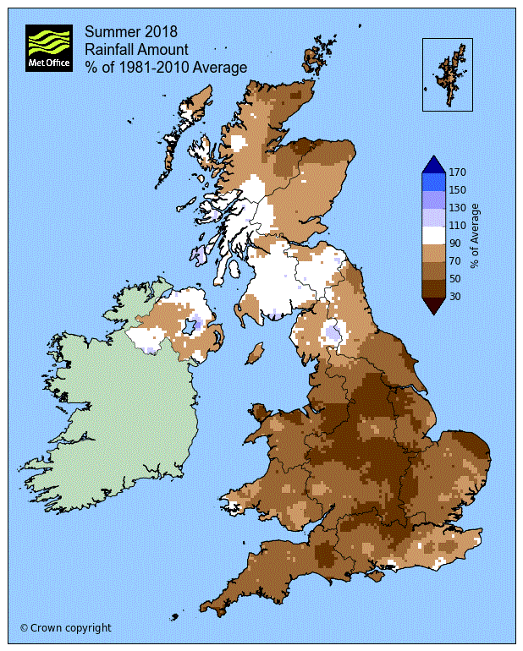
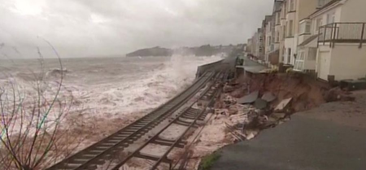

Gathering the evidence for the 3rd UK Climate Change Risk Assessment (CCRA3)
Richard Betts
29th July 2020

Slide 16
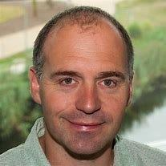

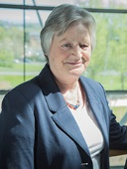
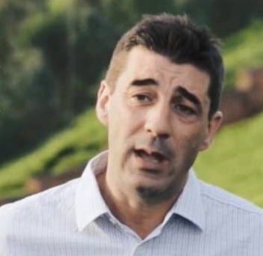
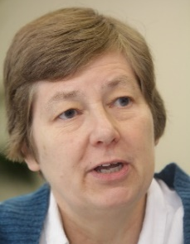
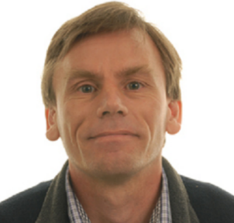
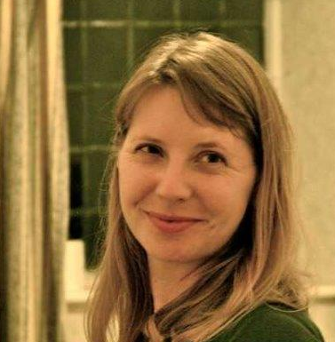
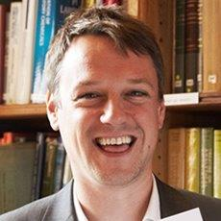
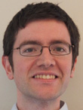
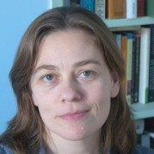
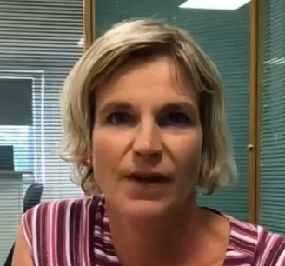
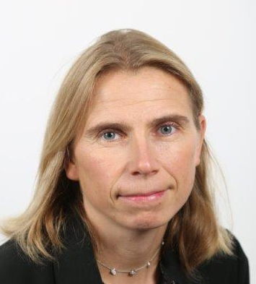
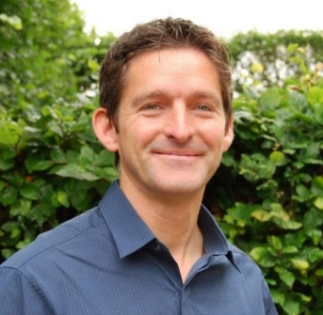
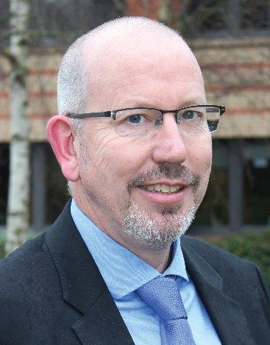
The 3rd UK Climate Change Risk Assessment (CCRA3): Technical Chapters lead authors
Also 42 Contributing Authors, 17 Additional Contributors (CCC and Expert Advisory Panel),
numerous researchers doing bespoke analysis (contracted by CCC or in other programmes)

Slide 17

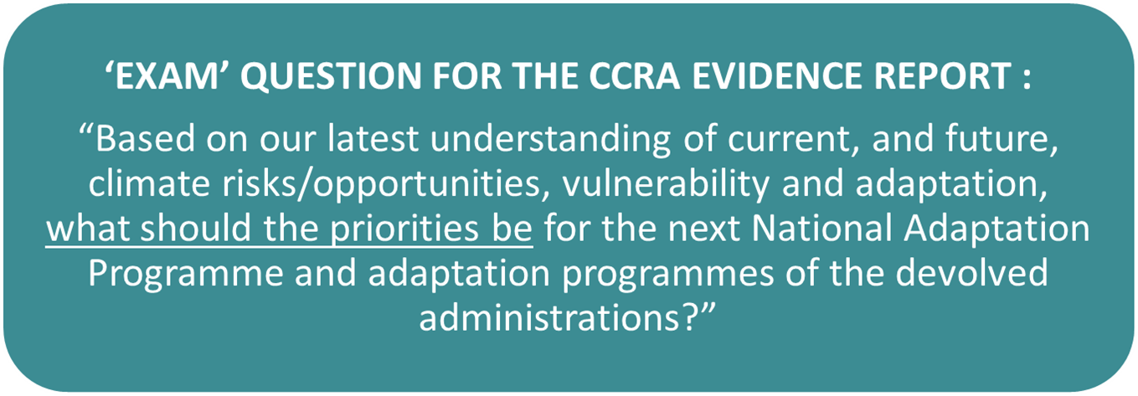
Purpose of the CCRA3

Slide 18
CCRA3 process
Parliament
Evidence report
Existing academic literature
Technical chapters including assessment of urgency of adaptation action
Synthesis report (CCC)
Government report (Defra)
Stakeholder input
New analysis

Slide 19
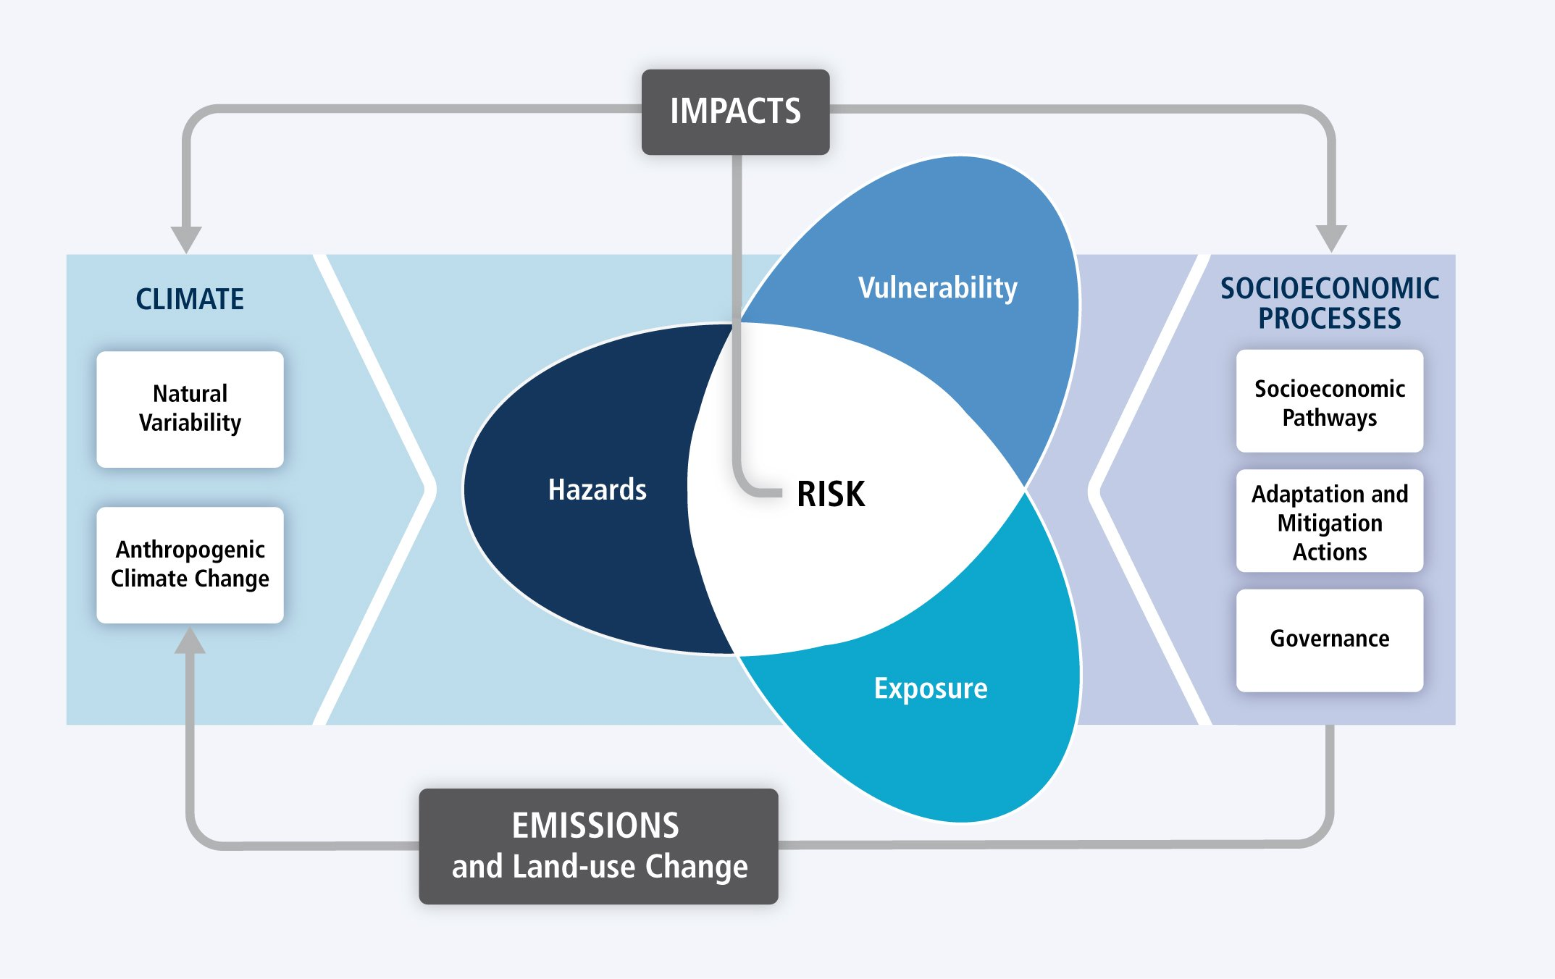
IPCC (2014)

Slide 20
Risk area | Number of Risks assessed
Natural environment and natural assets | 22
Infrastructure | 13
Heath, communities and built Environment | 13
Business and industry | 7
International dimensions | 10
 | Total: 65

Slide 21
Natural Environment risks / opportunities
– selected examples
Risks to terrestrial species and habitats from changing climatic conditions and extreme events
Opportunities for agricultural and forestry productivity from new/alternative species becoming suitable

Slide 22
Infrastructure risks / opportunities
– selected examples
Risks to infrastructure services from river, surface water and groundwater flooding
Risks to public water supplies from reduced water availability

Slide 23
Health, communities and the built environment Risks / Opportunities – selected examples
Risks to health and wellbeing from high temperatures
Risks to people, communities and buildings from flooding

Slide 24
Business and Industry Risks / Opportunities – selected examples
Risks to business sites from flooding
Risks to business from reduced employee productivity due to infrastructure disruption and higher temperatures

Slide 25
International Risks / Opportunities – selected examples
Risks to food safety, quality and supply from climate change overseas
Risks to the UK from climate-related international human displacements
Risks to the UK from international violent conflict from climate change on the UK

Slide 26
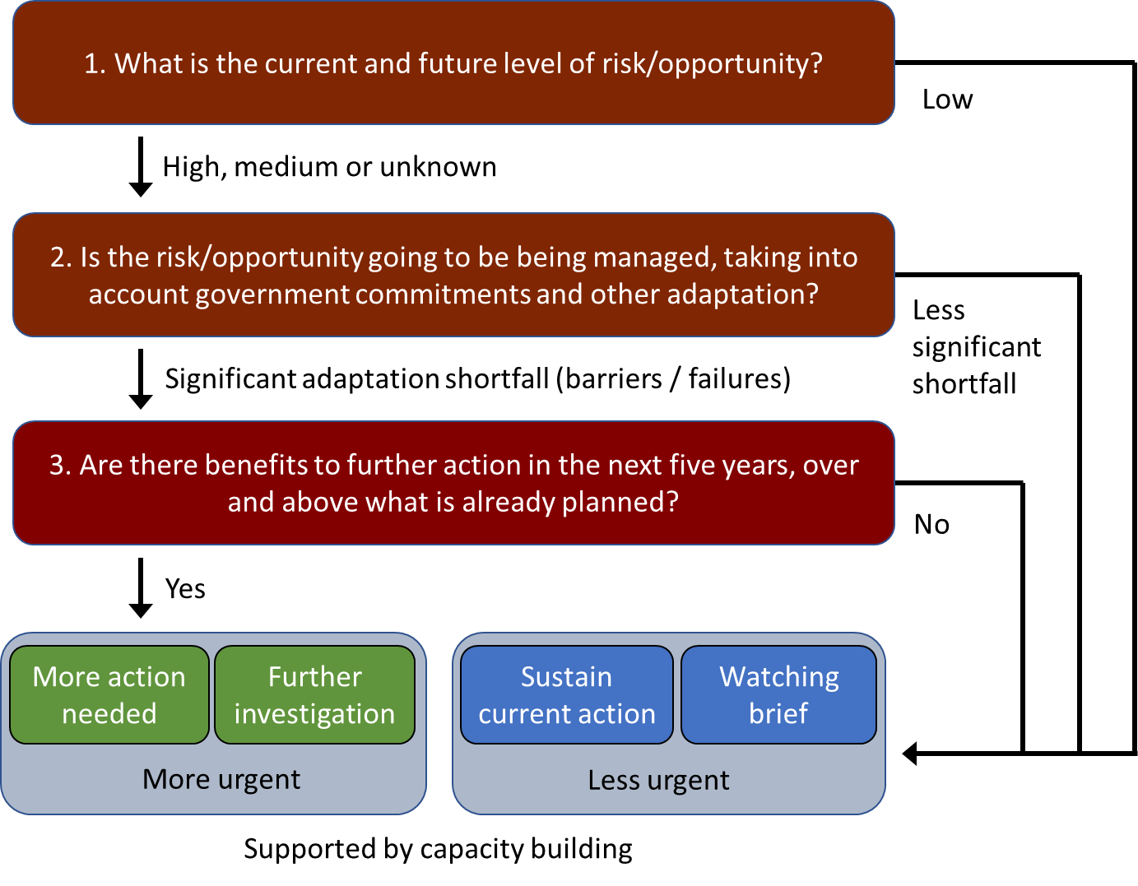
Urgency scoring for climate risks: how soon is adaptation action needed?

Slide 27
CCRA urgency framework

Slide 28
CCRA urgency framework

Slide 29
CCRA urgency framework

Slide 30
CCRA urgency framework

Slide 31
CCRA urgency framework

Slide 32
CCRA urgency framework

Slide 33
CCRA urgency framework

Slide 34
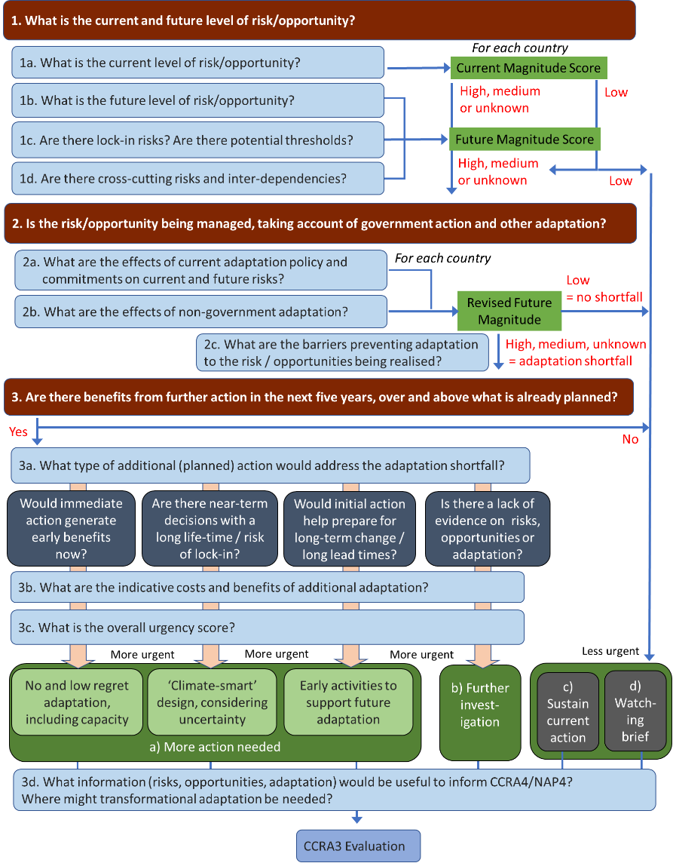

Slide 36
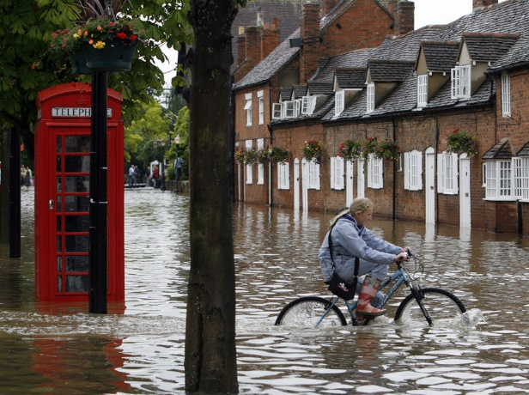
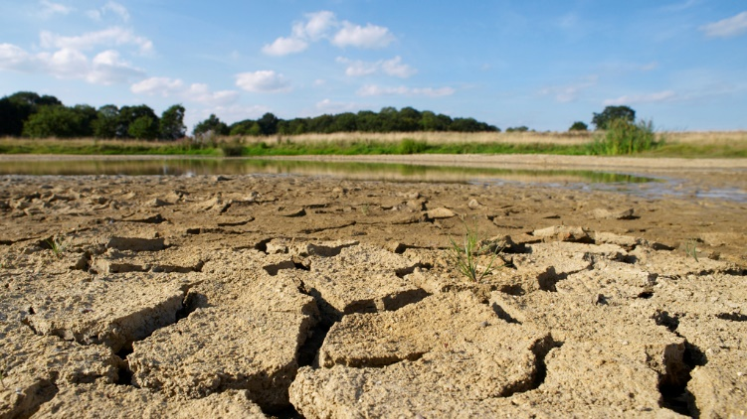

Slide 37
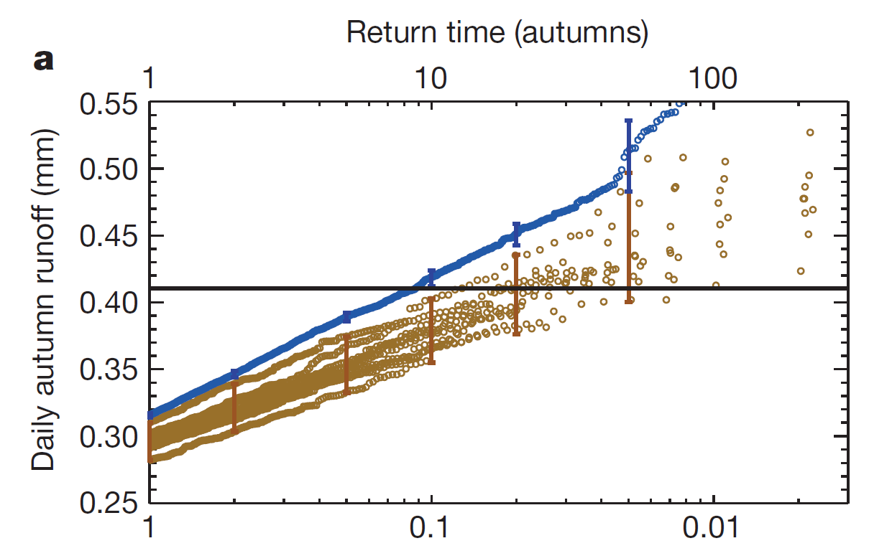
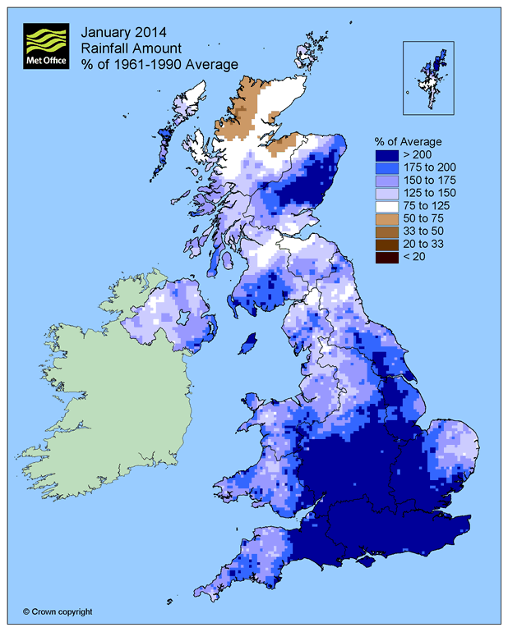
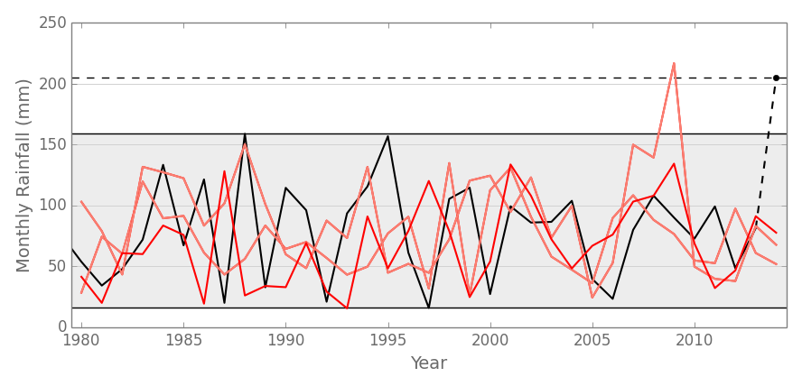
Conditions like Autumn 2000
Pall
et al (2011)
Current and near-term risks
Extreme event attribution
Unprecedented events
Conditions like Autumn 2000 but without GHG and SST change
Thompson et al (2017)
Notes:
Sea level and temperature inferred from oxygen isotopes in benthic formanifera (microorganisms deposited on the ocean bed)
During the mid-Pliocene (3.3 to 3.0 million years ago), atmospheric
CO2 concentrations between 350 ppm and 450 ppm (medium confidence) occurred when global mean surface temperatures were 1.9°C to 3.6°C (medium confidence) higher than for pre-industrial climate
There is high confidence that global mean sea level was above present during some warm intervals of the mid-Pliocene (3.3 to 3.0 million years ago), implying reduced volume of polar ice sheets. The best estimates from various methods imply with high confidence that sea level has not exceeded +20 m during the warmest periods of the Pliocene, due to deglaciation of the Greenland and West Antarctic ice sheets and areas of the East Antarctic ice sheet
New temperature reconstructions and simulations of the warmest millennia of the last interglacial period (129,000 to 116,000 years ago) show with medium confidence that global mean annual surface temperatures were never more than 2°C higher than pre-industrial.
There is very high confidence that the maximum global mean sea level during the last interglacial period (129,000 to 116,000 years ago) was, for several thousand years, at least 5 m higher than present and high confidence that it did not exceed 10 m above present. The best estimate is 6 m higher than present
}. During the Early Eocene (52 to 48 million years ago), atmospheric CO2 concentrations exceeded ~1000 ppm (medium confidence) when global mean surface temperatures were 9°C to 14°C (medium confidence) higher than for pre-industrial conditions.

Slide 41

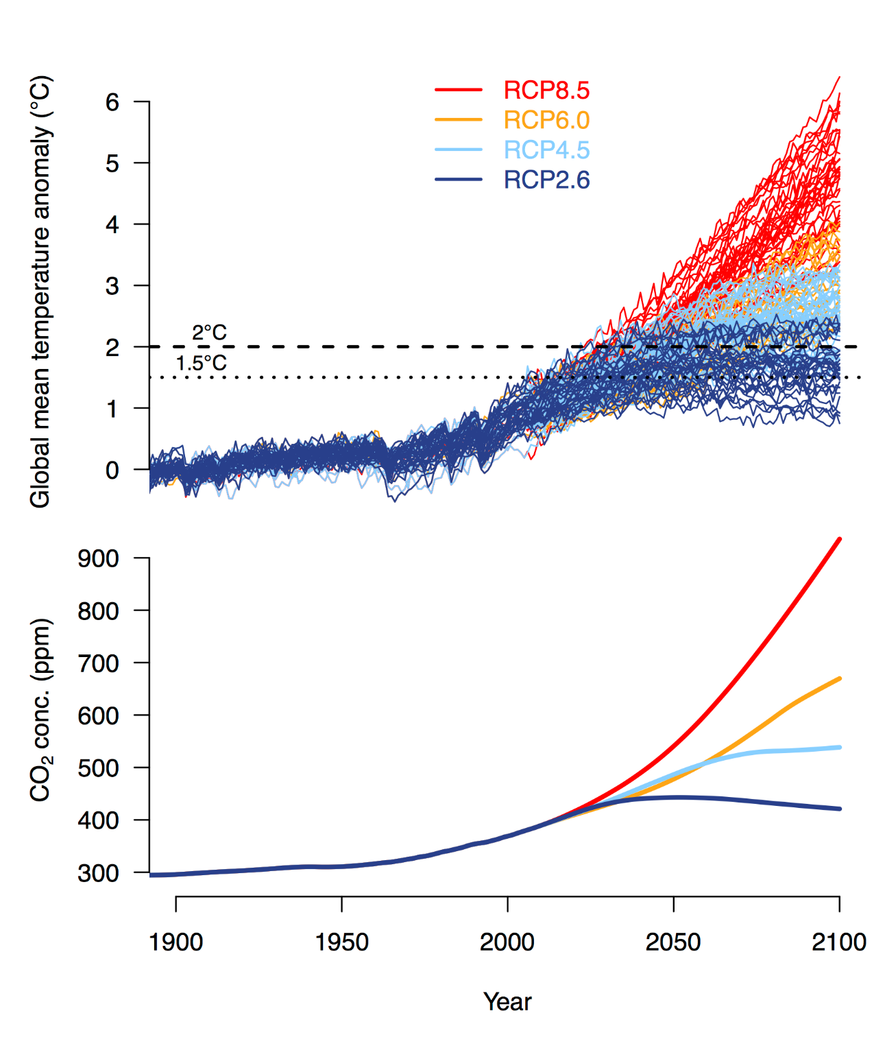
Scenarios of future CO₂ concentrations
RCPs: Representative Concentration Pathways

Slide 42
Scenarios of future CO₂ concentrations
RCPs: Representative Concentration Pathways
International Energy Agency (IEA) emissions scenarios
current policies and stated policies, extrapolated after 2040
(Hausfather & Ritchie 2019)

Slide 43
Scenarios of future CO₂ concentrations
RCPs: Representative Concentration Pathways
?
Feedbacks
International Energy Agency (IEA) emissions scenarios
current policies and stated policies, extrapolated after 2040
(Hausfather & Ritchie 2019)
?
After Booth et al (2017)

Slide 44
Projections from multiple climate models

Slide 45
Projections from multiple climate models
IEA

Slide 46
Projections from multiple climate models
4°C
IEA

Slide 47
Projections from multiple climate models
?
4°C
Feedbacks
?

Slide 48
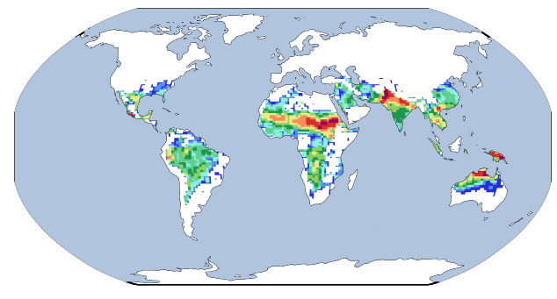
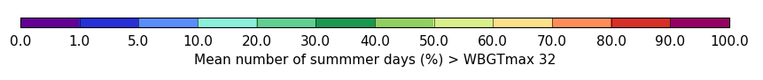
Percentage of summer days with “extreme” heat stress risk 4°C global warming
% change in summer rainfall intensity by 2080s

Slide 49
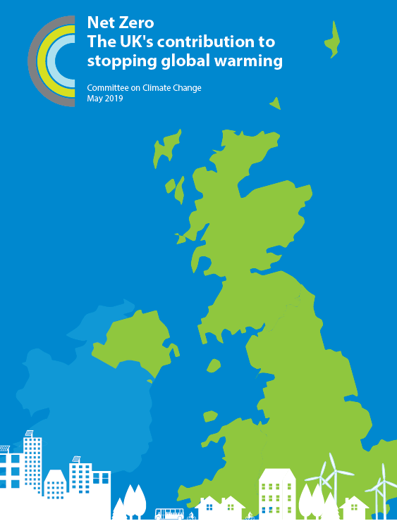
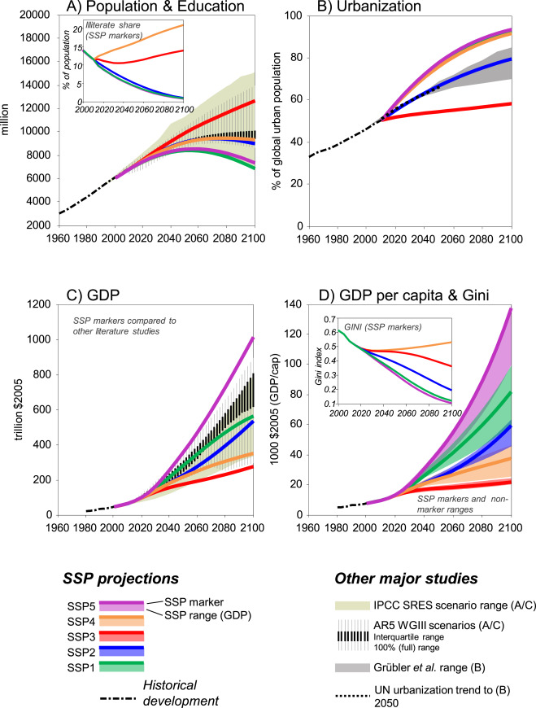
Socioeconomic scenarios

Slide 50
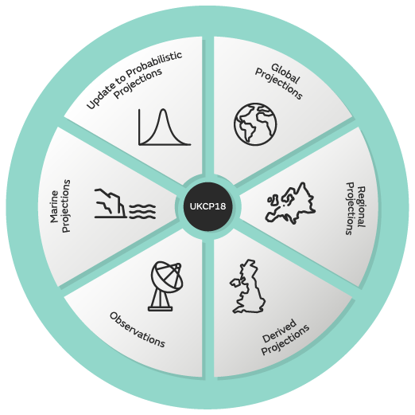

New analysis
Literature on projected impacts and risks (mostly based on
UKCP09, CORDEX, CMIP5)
Water resources, flooding, wildfire, interacting risks
Comparison of hazards projected in UKCP18 with UKCP09
Additional input from UKCR programme
Implications of climate tipping points for UK

Slide 57
57

Slide 60
CCRA3 timeline
21st August : deadline for new evidence
August - October: Second Order Draft writing period
November: Second external review
December - March: Final revisions and approval of Technical Chapters
March onwards: Synthesis Report
Summer 2021: Publication of full Evidence Report (Technical Chapters and Synthesis Report
January 2022: Government report to Parliament

Slide 64
Questions, answers, discussion

Slide 65
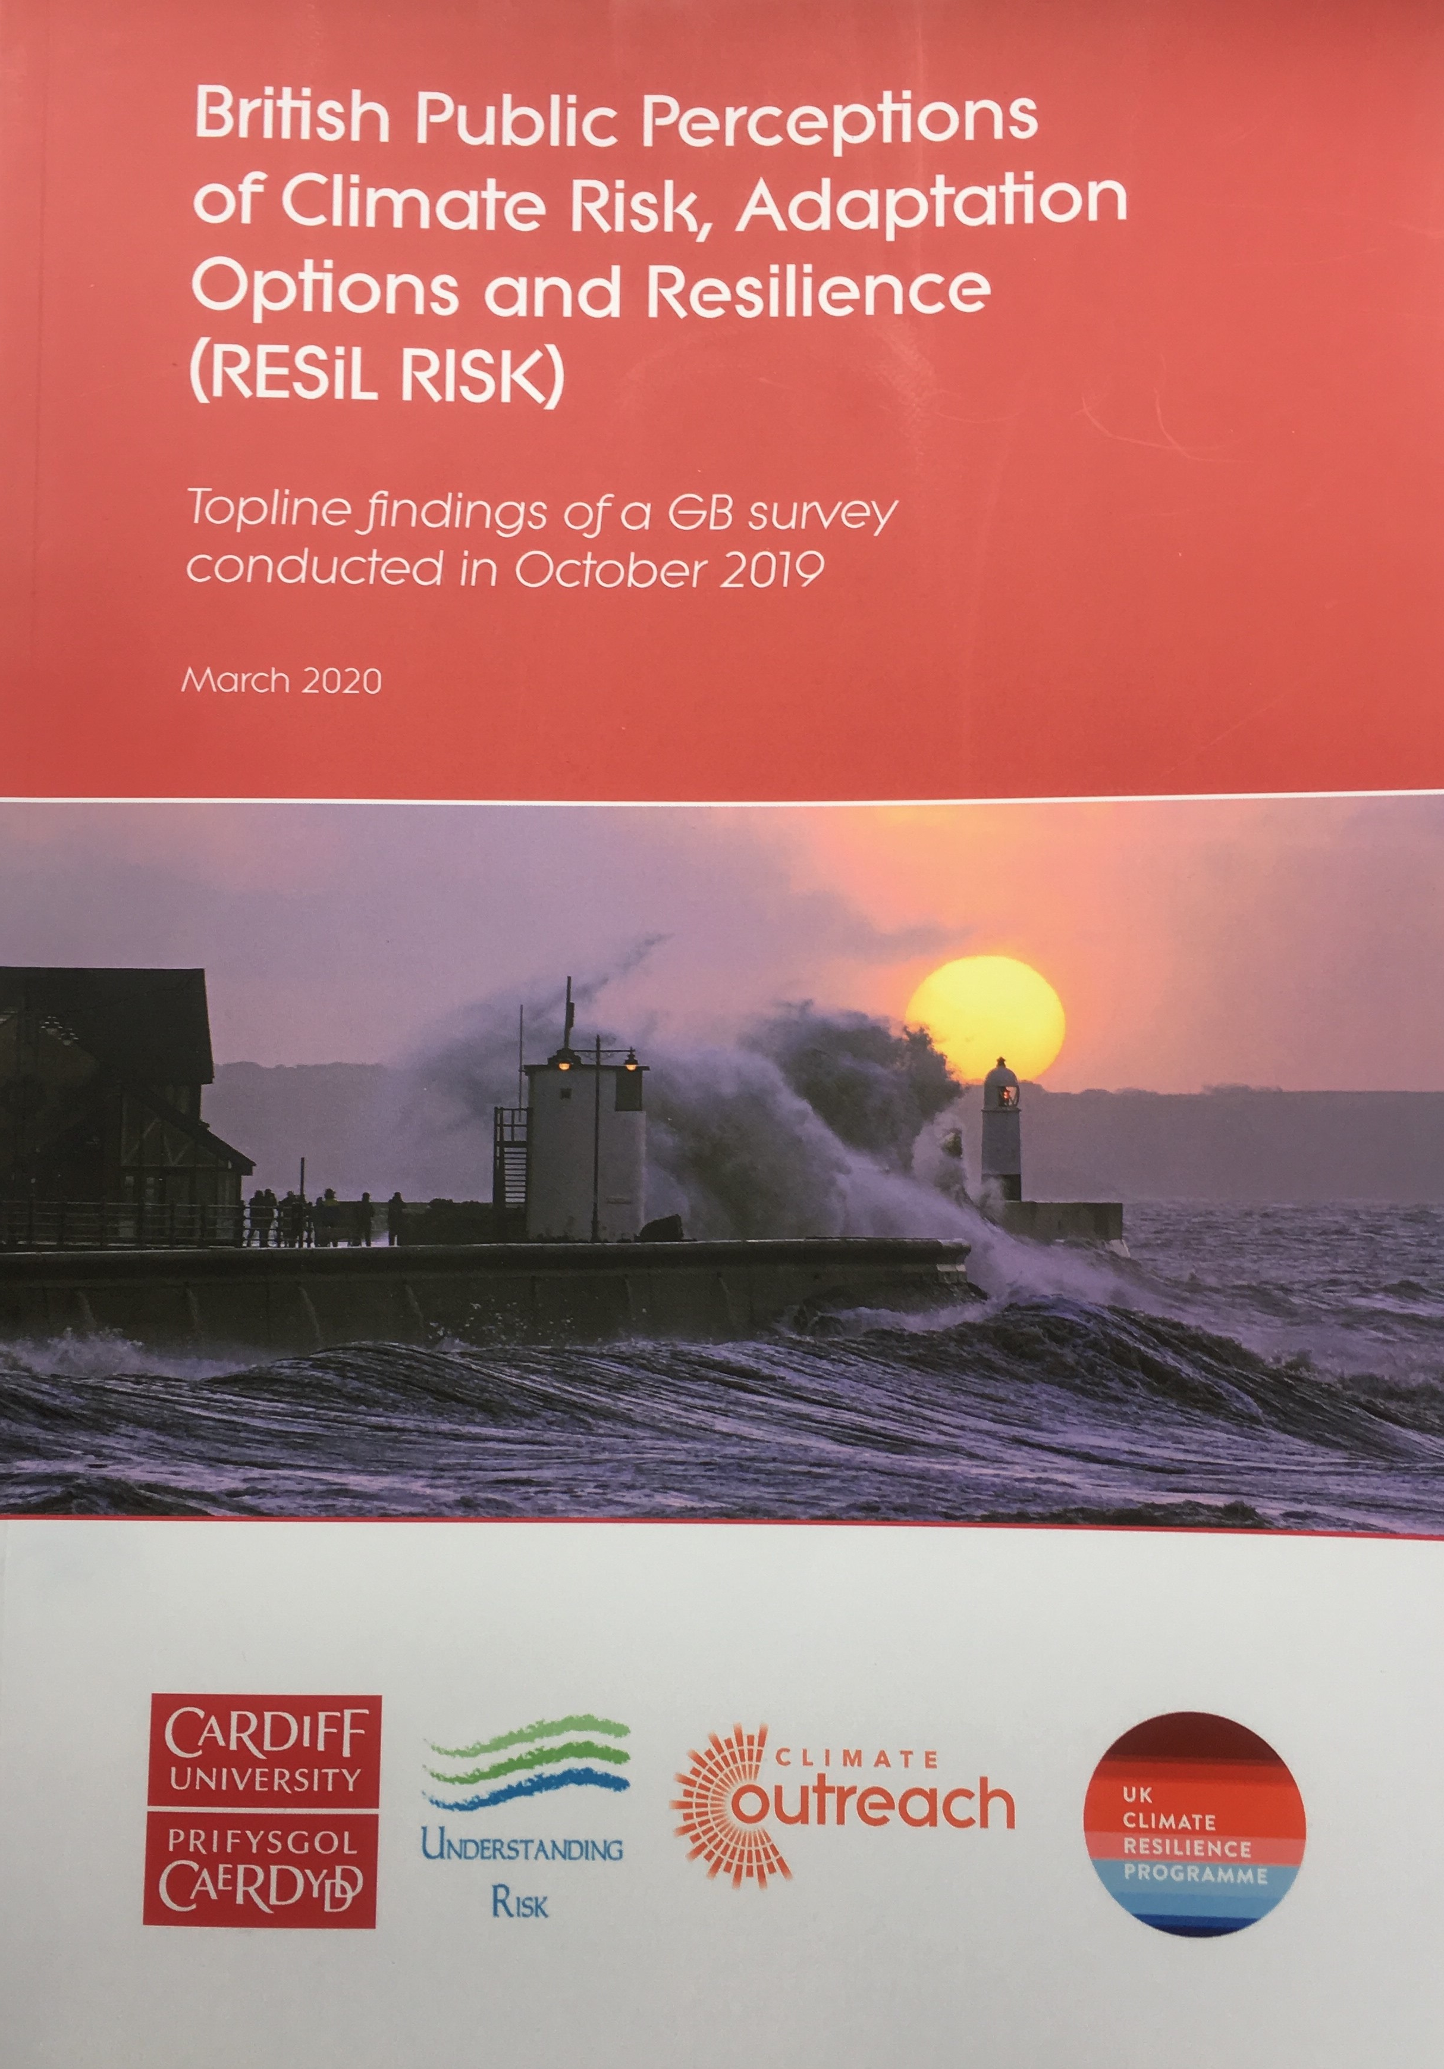


Next webinar:
Wednesday 9th September 12.00-13.00
Speaker: Professor Nick Pidgeon,
Cardiff University
Title: Understanding British perceptions of climate risk and resilience
Register for the seminar: https://us02web.zoom.us/webinar/register/WN_mD6guUkwTyew0yDx5uwtpw
Website: https://www.ukclimateresilience.org/
Notes:
8 more after that on a number of topics…

