Slide 1



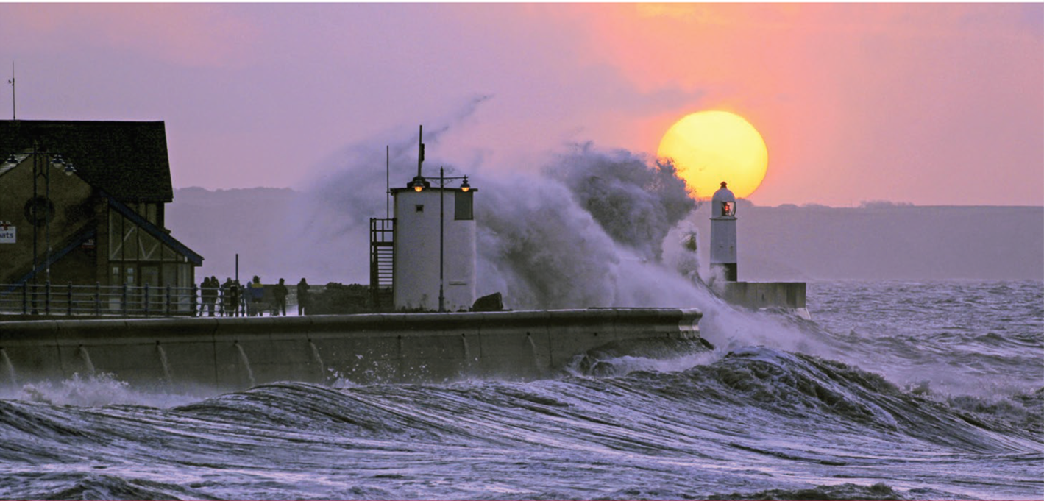

Understanding UK Perceptions of Climate Risk and Resilience (RESiL RISK)
Prof Nick Pidgeon, Dr Katharine Steentjes & Dr Christina Demski (School of Psychology, Cardiff University)

Slide 2

RESiL RISK (February 2019-October 2020)
Project team
Prof. Nick Pidgeon
Dr. Katharine Steentjes
Dr. Christina Demski
Abigail Seabrook
Dr. Adam Corner
The RESiL RISK project is part of the UK Climate Resilience Programme and funded by UKRI/NERC under grant NE/S016449/1

Slide 3

Thank you !
Stakeholder Advisory Board:
Jason Lowe - UK Met Office
Ruth Wolstenholme - Sniffer
Robert Knowles - Welsh Government
Andrew Russell - The UK Committee on Climate Change
Kristen Guida - London Climate Change Partnership
Will Bugler – Acclimatise
Leo Barasi
Andrea Taylor - University of Leeds
Suraje Dessai - University of Leeds - UK Climate Resilience Champion
Irene Lorenzoni - University of East Anglia
Adrian Brügger – University of Bern
Liz Bergere, Frances Pimenta & Olivia Wright - Department of Environment, Food and Rural Affairs
Kate Lonsdale - University of Leeds, UK Climate Resilience Champion

Slide 4
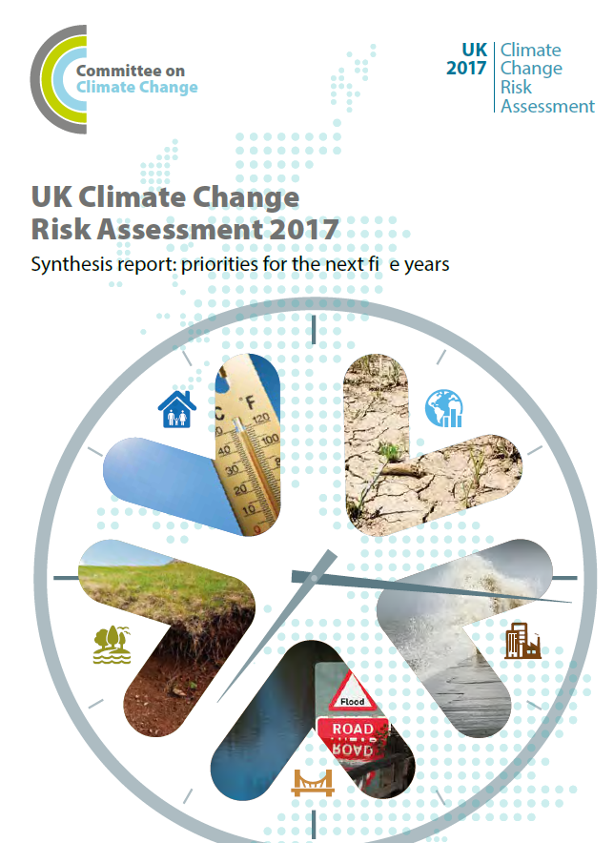
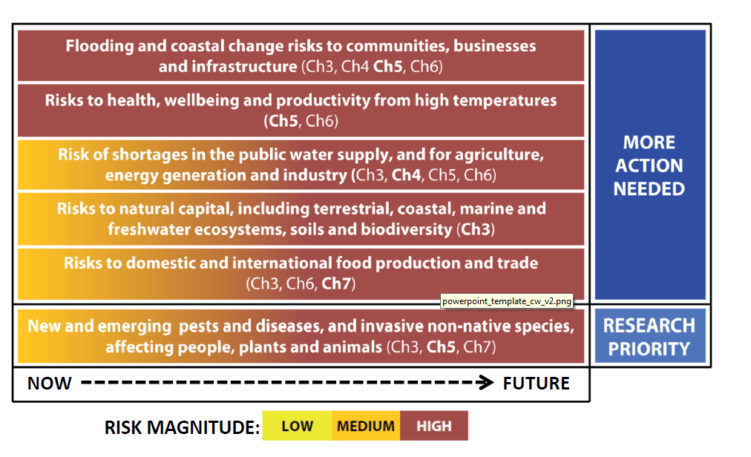
UK Climate Change Risk Assessment
Source: ASC (2016) UK CCRA 2017 – Synthesis Report

Slide 5
Dangerous Climate Change, Risk and Adaptation

Slide 6
RESiL Risk Objectives
1. Investigate public perceptions of climate impacts, risks and resilience
2. Examine the impact of key theoretical constructs on climate adaptation beliefs
3. Examine experimentally how different audiences attribute potential trade-offs between adaptation and mitigation options when faced with the need to enhance climate risk resilience.
4. Provide robust guidance on effective communication and engagement around future UK adaptation and risk resilience.
5. Deliver a methodology and items with which changes in UK climate risk perceptions and climate adaptation beliefs can be monitored.

Slide 7
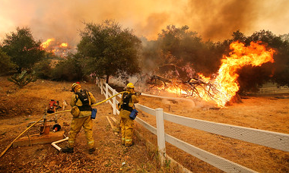
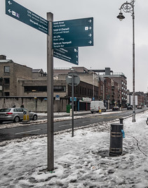
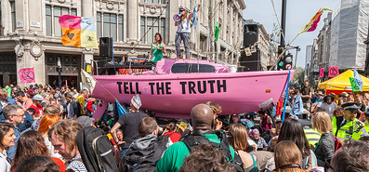
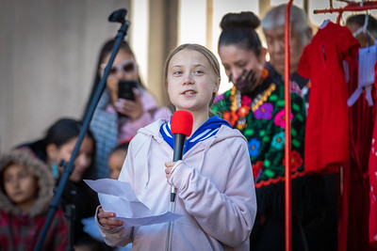
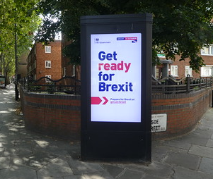
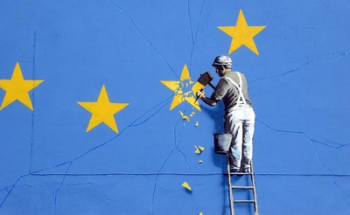
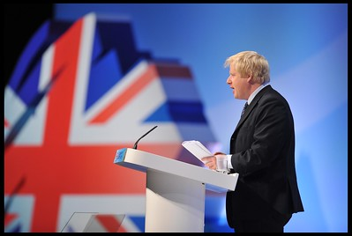
Extreme weather events
Climate change protest
Brexit impasse and the upcoming 2019 election

Slide 8

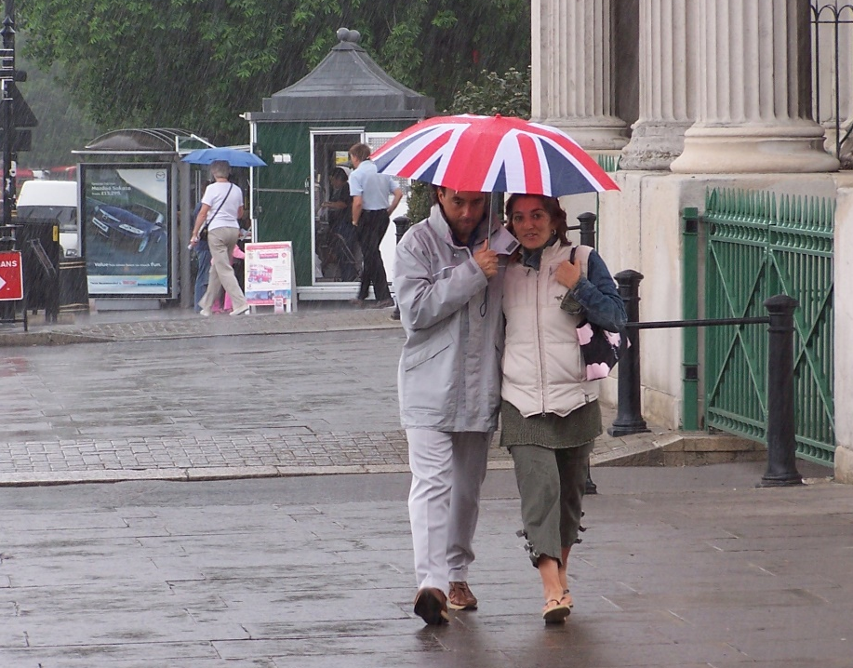

Survey design
Advisory panel meetings, March & October 2019
Pilot with 156 respondents
Data collection
Online survey, using Qualtrics platform and panels
Data collected between 14th and 22nd October 2019
aged ≥18 years, ca. 25 minutes to complete
Sample characteristics
Nationally representative quota sampling
Quotas: gender, age, region, and income
Sample size: 1,401 responses

Slide 9

FINDINGS REPORTS : https://www.ukclimateresilience.org/projects/page/2/

Slide 10
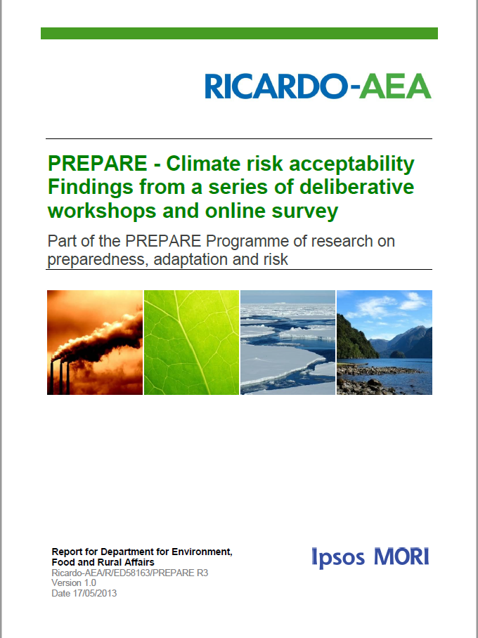
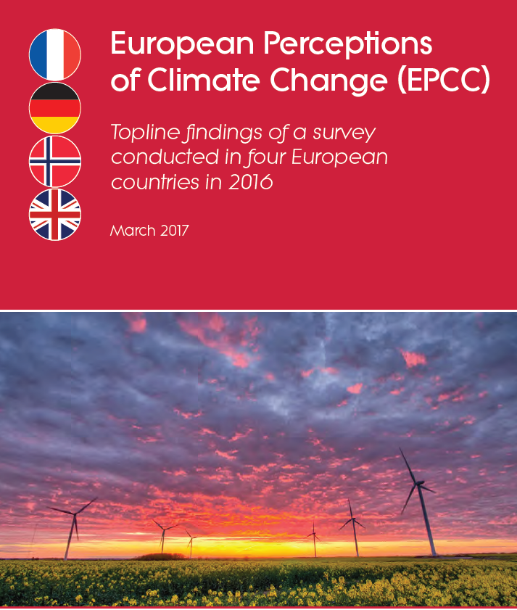
Previous Comparable Surveys
European Perceptions of Climate Change (EPCC, Cardiff University)
2016
PREPARE
(Ricardo-AEA with Leeds University)
2013

Slide 11
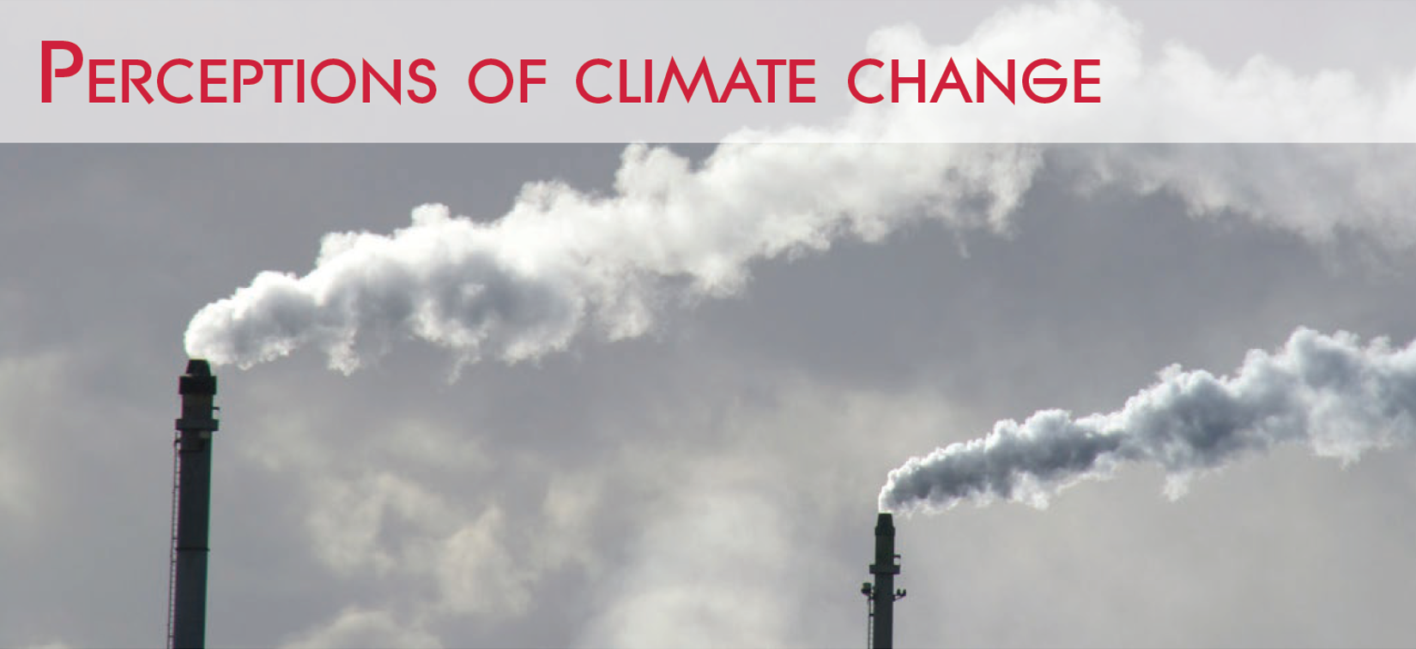

Slide 12
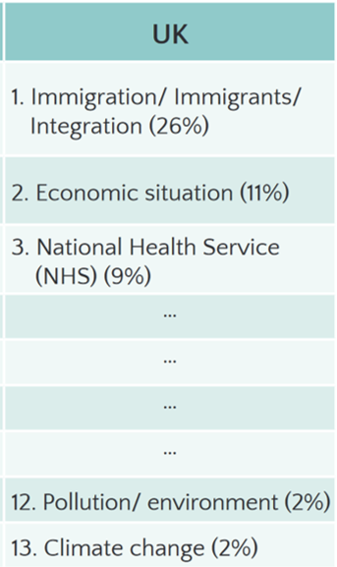
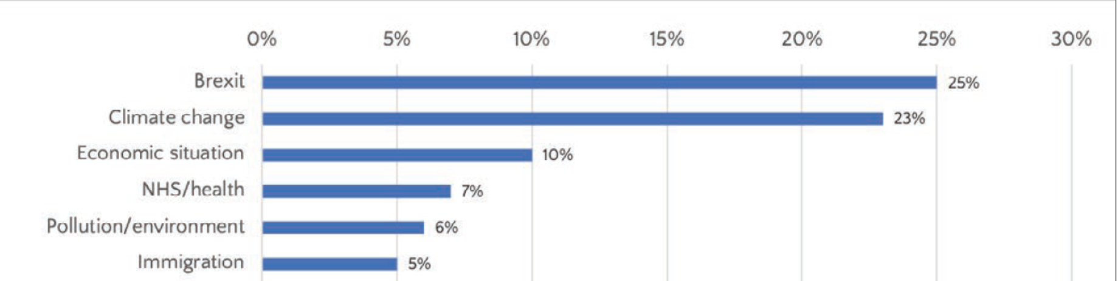

RELEVANCE OF CLIMATE CHANGE
What would you say will be the most important issue facing the UK in the next 20 years?
2016
Brexit
Climate Change
Economic situation
NHS/health
Pollution/environment
Immigration
Main Sample UK 2019 (1,401)
Question 1, page 13

Slide 13
WORRY
How worried, if at all, are you about climate change?
Question 14, page 14

Slide 14
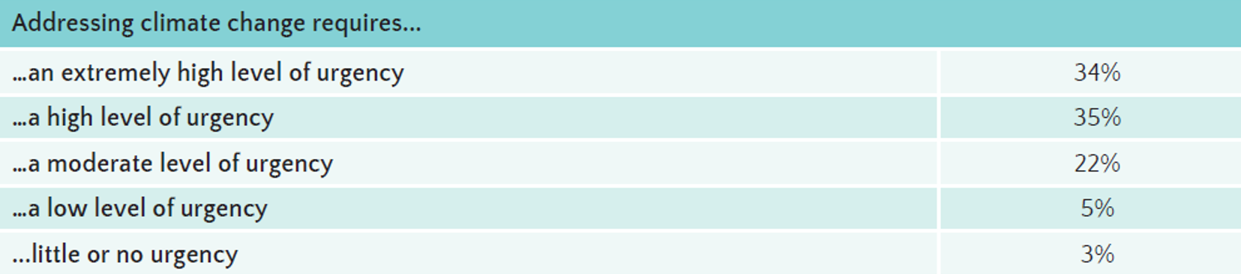
URGENCY
NEW ITEM - Which of these best describes your views about the way in which climate change needs to be addressed?
Question 12, page 14

Slide 15


Slide 16
PSYCHOLOGICAL DISTANCE
When, if at all, do you think we will be feeling the effects of climate change?
Question 7, page 17

Slide 17
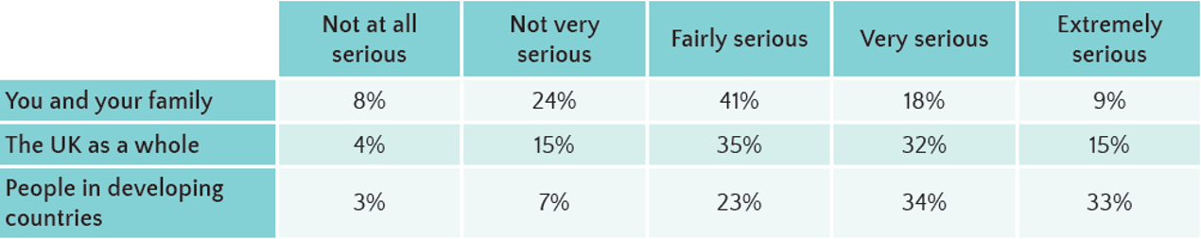
PSYCHOLOGICAL DISTANCE
How serious of a threat, if at all, is climate change to each of the following?
Question 8, page 17

Slide 18


Slide 19
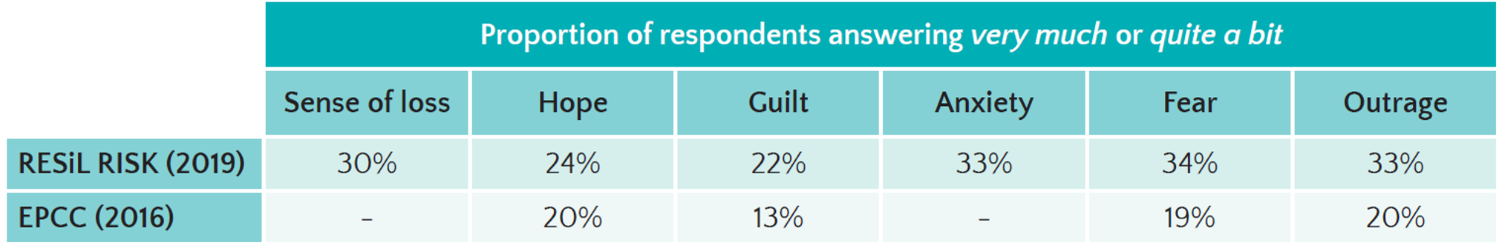
EMOTIONS
When you think about climate change and everything that you associate with it, how strongly, if at all, do you feel each of the following emotions?
Question 33, page 19

Slide 20
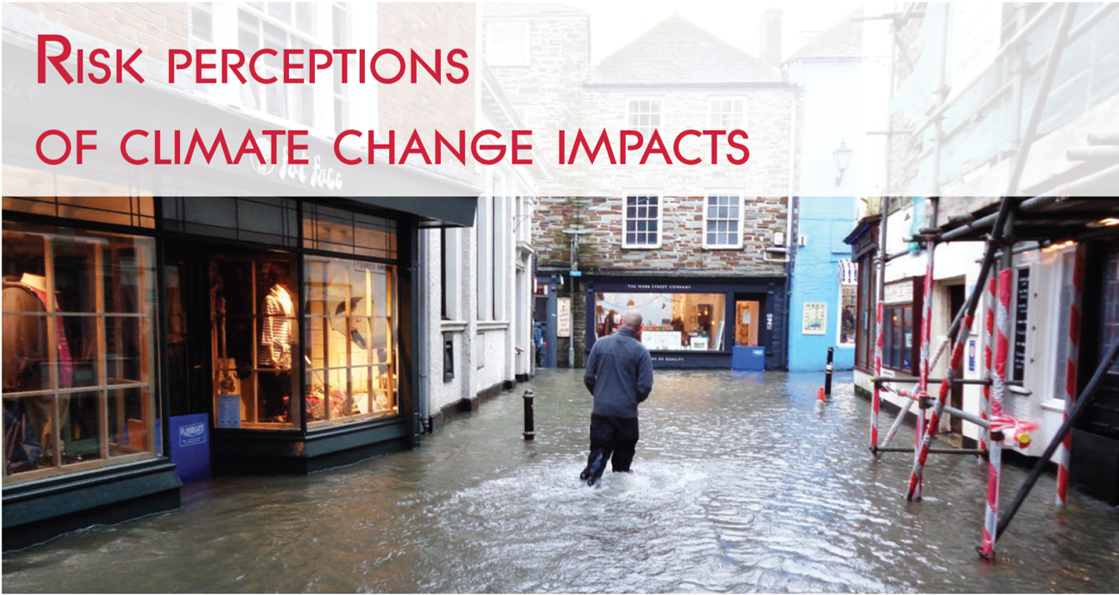

Slide 21
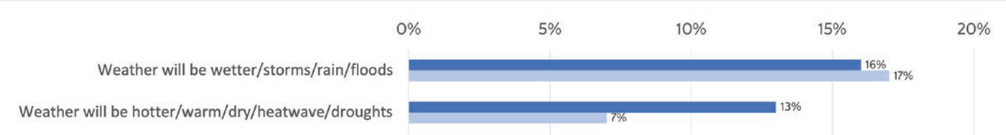
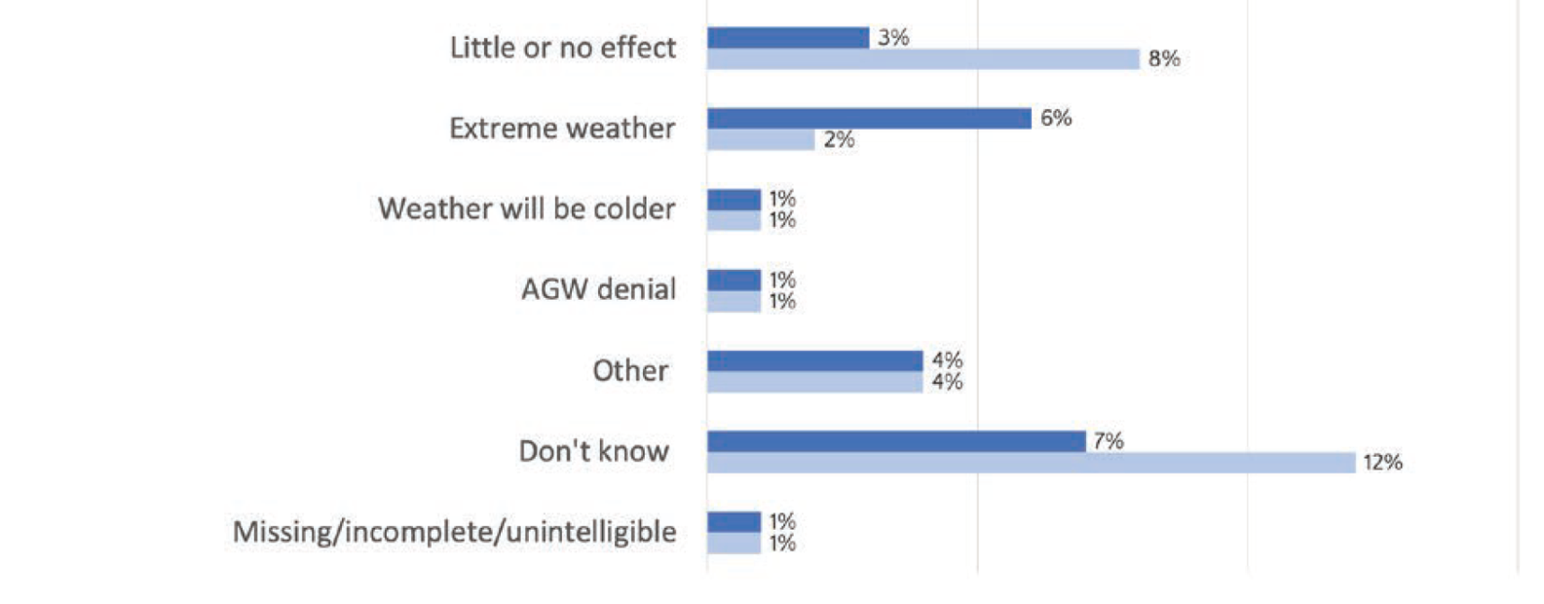
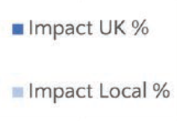
EXPECTED EFFECTS
OPEN ENDED QUESTION: What do you think will be the most important effect of climate change on the UK/on your local community?
Questions 3, 2, page 23

Slide 22
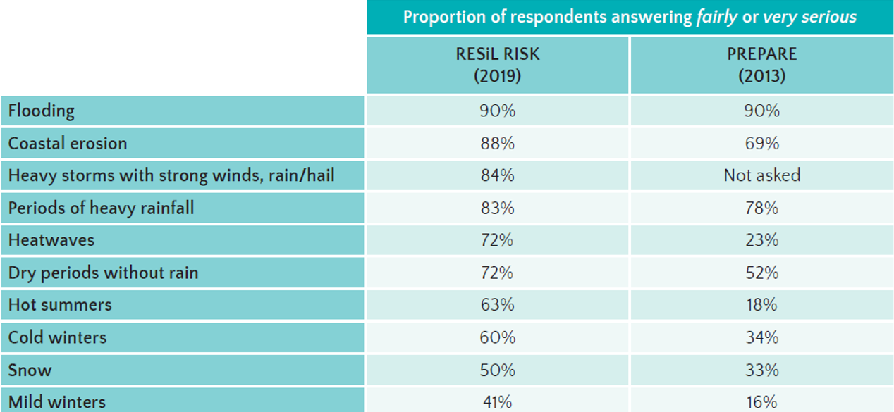
SERIOUSNESS
How serious of a problem do you think the following currently are for the UK, or do you
not think they are a problem at all?
Question 13, page 24

Slide 23
PERSONAL EXPERIENCE
Have you, or someone close to you, ever experienced any of the following extreme
weather events?
Heat wave (discomfort/being unable to sleep)
Heat wave (health significantly affected)
Heat wave (disruption to travel or working)
Question 27, page 26

Slide 24
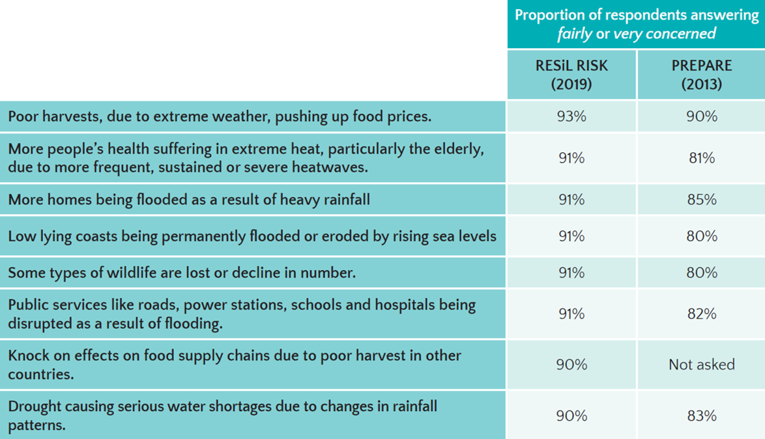
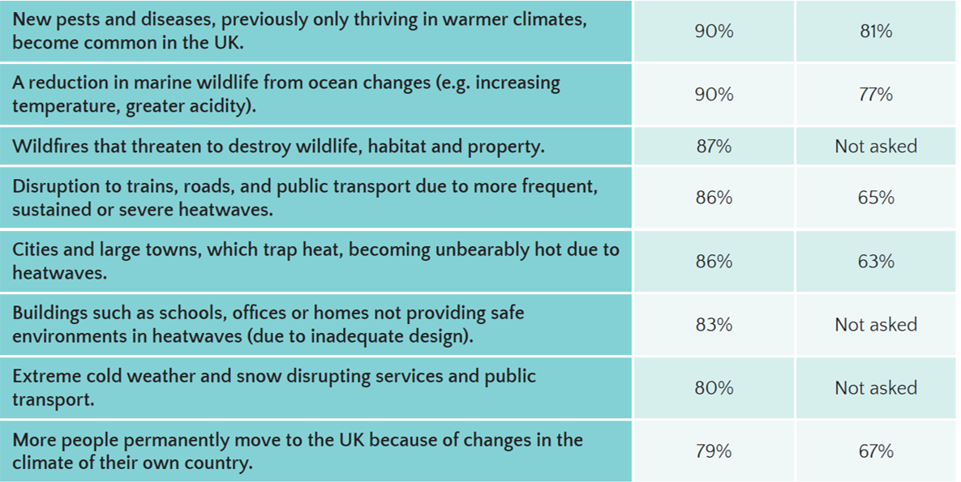
CONCERN ABOUT SPECIFIC IMPACTS
Questions 16, pages 29

Slide 25


Slide 26
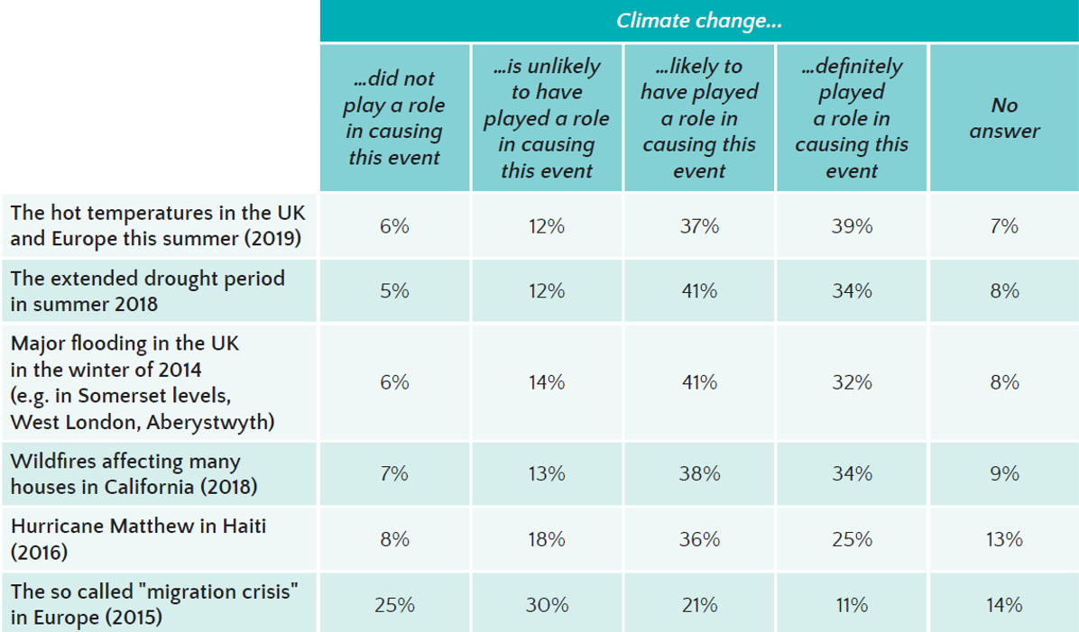
CLIMATE CHANGE & EVENTS
To what extent, if at all, do you think each event was caused by climate change?
Questions 23, pages 30

Slide 27


Slide 28
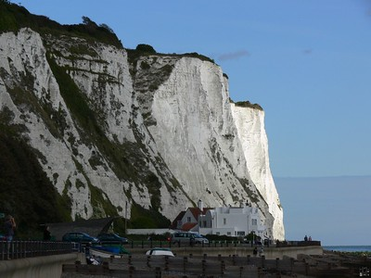

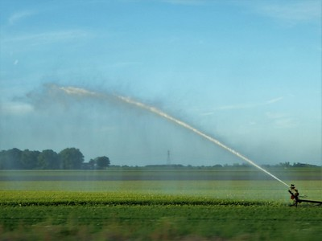
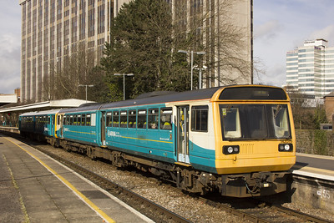
PRIORITIES FOR ADAPTATION
Ideal level of protection per social good/ service
Questions 28,29, pages 32-34

Slide 29
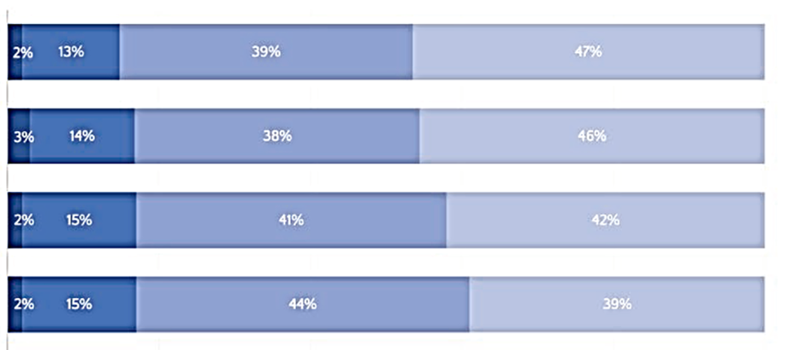
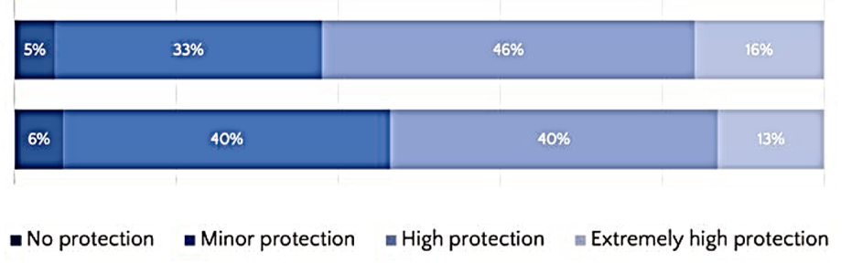
PRIORITIES FOR ADAPTATION
Protection of the most vulnerable people in our society
Ensuring social services are running smoothly
Health and well-being of all UK citizens
Affordable food supplies across the UK
[…]
To ensure the increasing growth of the UK economy
Protection of historical sites and buildings
Questions 28,29, pages 32-34

Slide 30
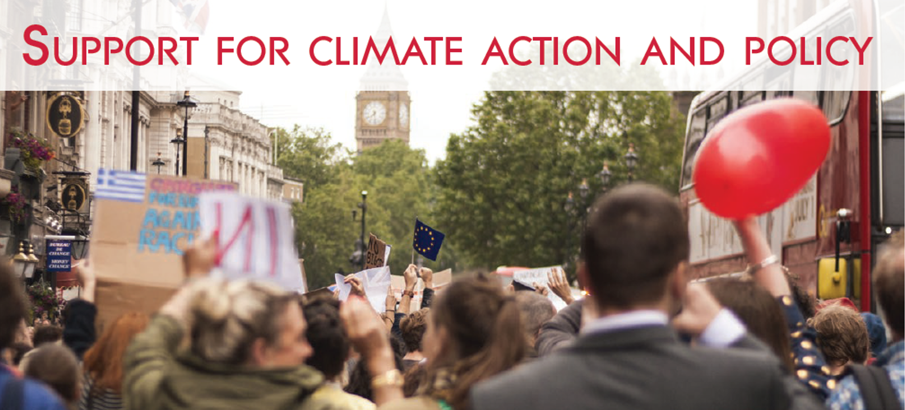

Slide 31
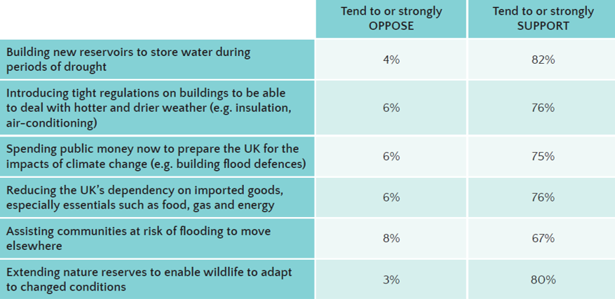
ADAPTATION POLICIES
To what extent do you support or oppose the following policies in the UK?
Question 18, page 36

Slide 32
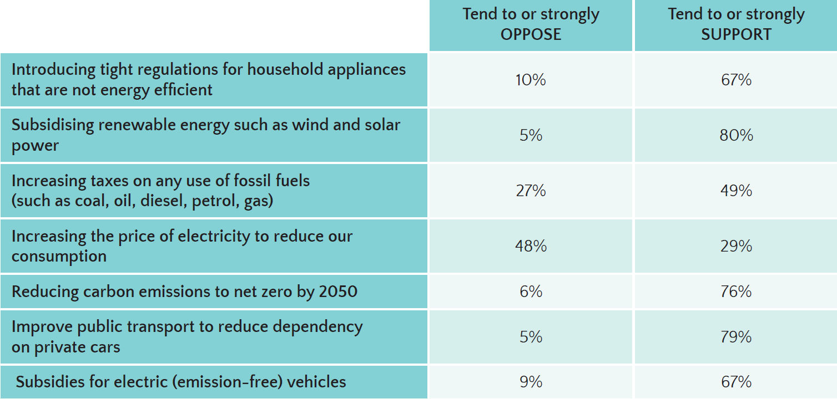
MITIGATION POLICIES
To what extent do you support or oppose the following policies in the UK?
Question 18, page 37

Slide 33
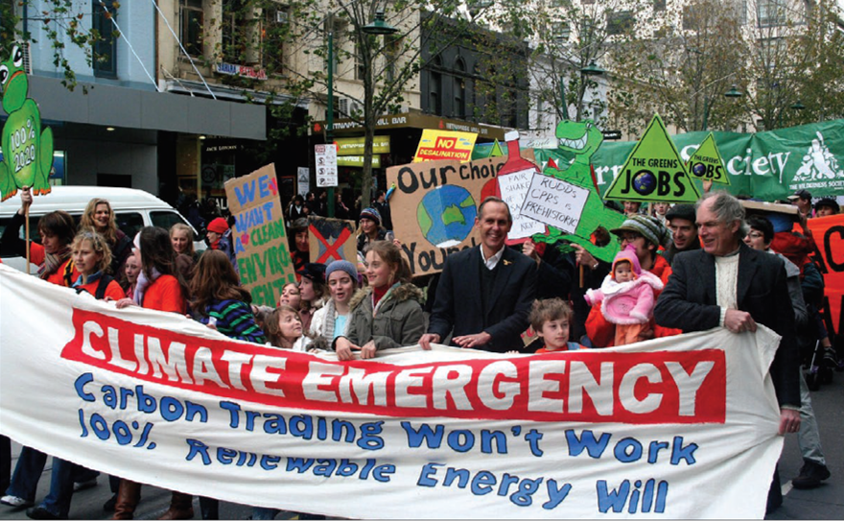
CLIMATE PROTESTS
International protests taking place to raise climate change awareness
29% | 47%
CLIMATE EMERGENCY
A national declaration of climate emergency
14% | 60%
Questions 18,22, pages 37-38

Slide 34


Slide 35
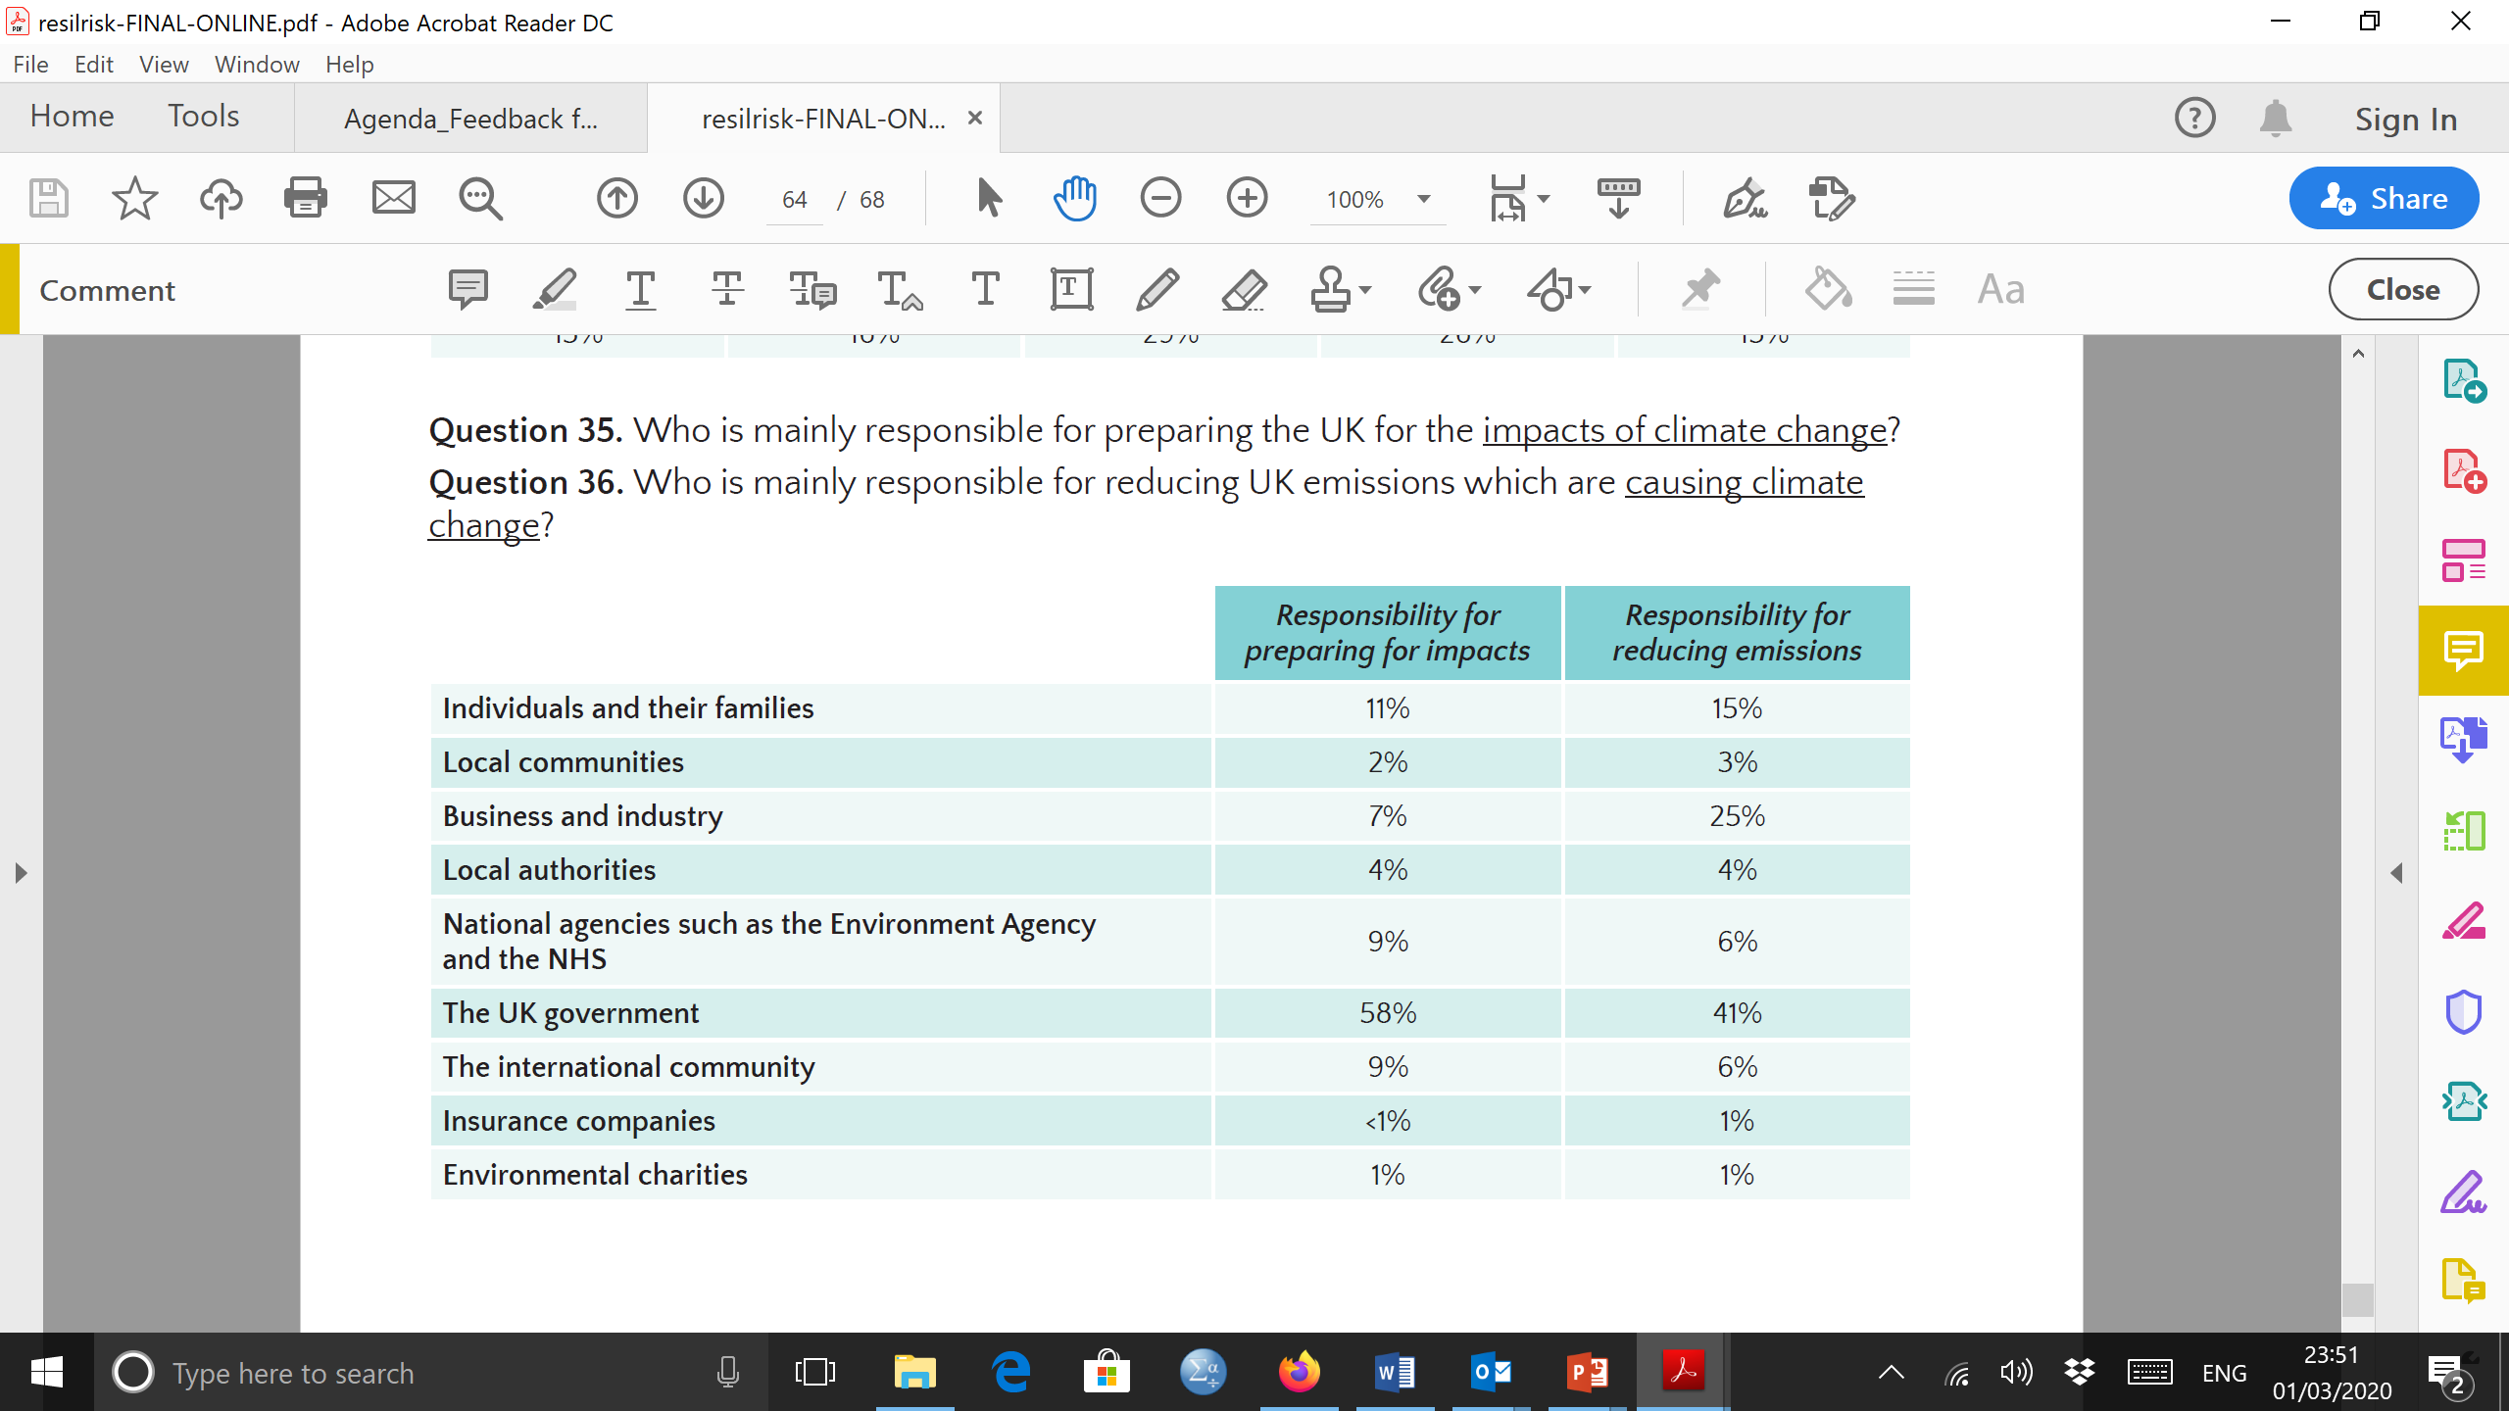
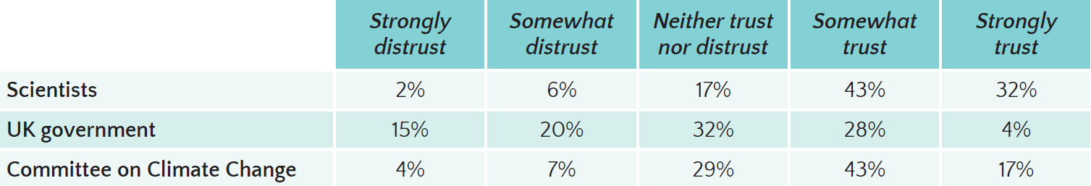
RESPONSIBILITY
Who is responsible for policies in the UK?
TRUST
Trust or distrust as sources of information about climate change?
Questions 35,36, pages 40-41

Slide 36
KEY FINDINGS
Perceptions of climate change
Risk perception & protection
Climate Change 2nd most mentioned top issue facing the UK in the near future.
High levels of worry and urgency associated with climate change
Flooding remains top risk
Perceptions of other climate change risk, especially heat increased – simultaneous increase of heat related experiences
Beliefs & underlying drivers
Climate action & policy
Most people believe that we see the impacts now but don’t feel personally at risk
More feelings of anger, guilt and outrage associated with climate change
Majority support for adaptation policies and many mitigation policies
Support for climate protests quite mixed
Actors & motivations
Main responsibility to act on mitigation and adaptation lies with UK government
Low trust in UK government but government institutions receive higher trust

Slide 37
CURRENT PROJECT STATUS (9TH September 2020)
TECHNICALLY COMPLETED April 2020
BUT – concern about robustness of findings given onset of pandemic
REPETITION OF CORE SURVEY ITEMS + ‘GREEN RECOVERY’ ITEMS
ONLINE, AUGUST 2020, n=1,200
2nd wave data collection now completed – watch this space

Slide 38



Thank you !
pidgeonn@cardiff.ac.uk
Reports https://www.ukclimateresilience.org/projects/page/2/

Slide 40
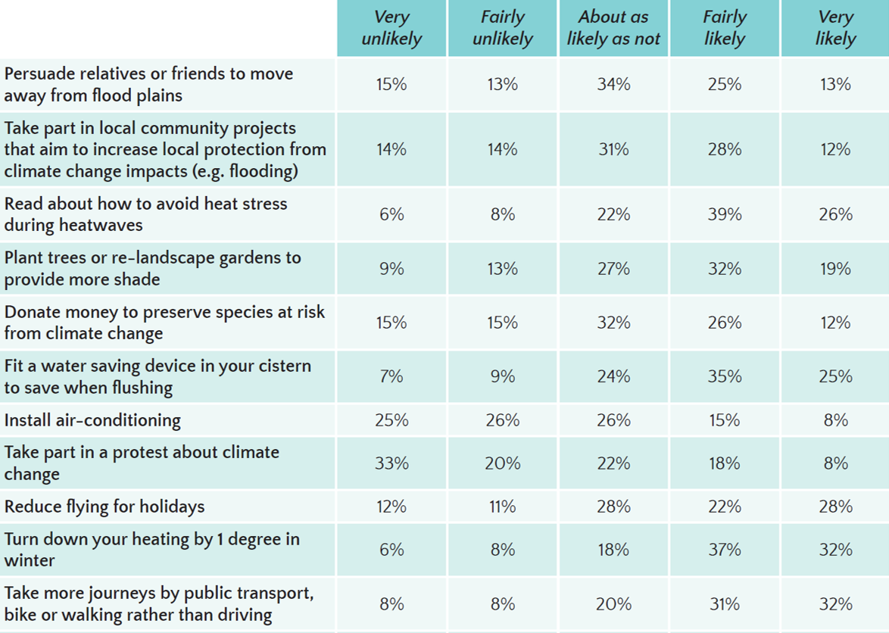
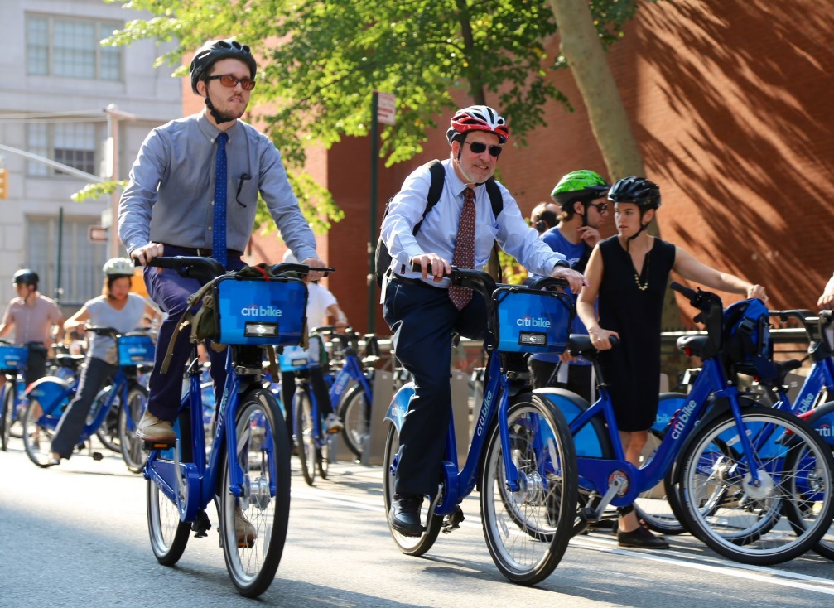
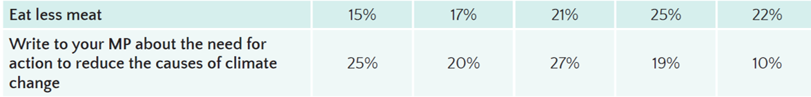
PERSONAL ACTION
Please indicate how likely or unlikely you are to take each action in the future.
Question 21, page 39

Slide 41
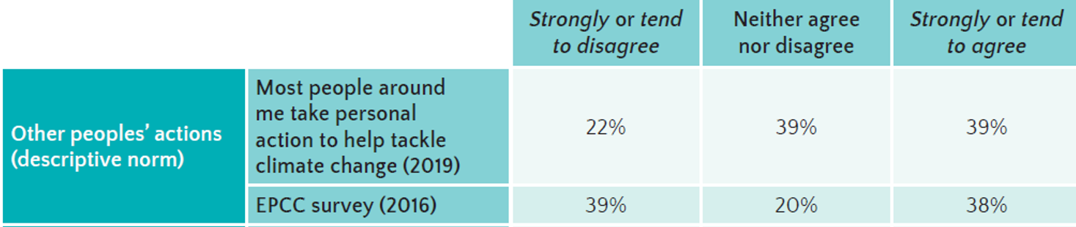
SOCIAL NORMS
To what extent do you agree or disagree with the following statements?
Question 32, page 20

Slide 42
SERIOUSNESS
How serious of a problem do you think the following currently are for the UK, or do you not think they are a problem at all?
LIKELIHOOD FUTURE
How likely or unlikely do you personally think it is that the following will have
become more common in the UK in 2050? Even if you are not sure we are interested in your opinion.
CONCERN FUTURE
How concerned would you be if by 2050 the UK did have…?
Questions 13,14,15, pages 24-25

Slide 43
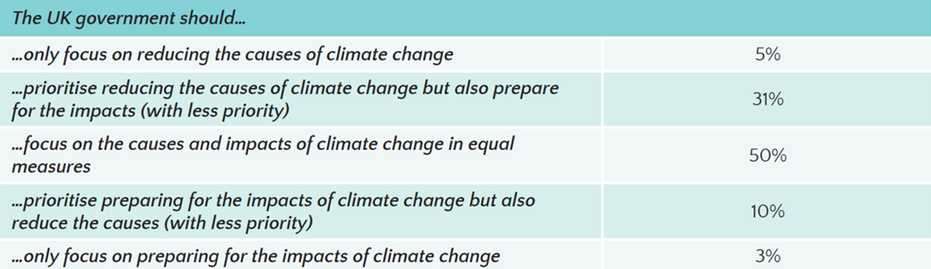
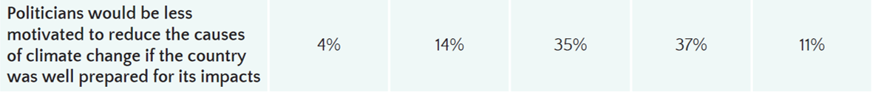
MITIGATION & ADAPTATION
Questions 30,31, pages 42

