Slide 1
SPF UK Climate Resilience Programme Webinar Series 2021
Notes:
This talk examines the feasibility of developing a domestic raintank programme to address urban flood resilience. Drawing on a co-productive study combining qualitative investigation of flood risk authorities and the public with modelling of raintank functionality, we ask: (1) Is there potential for widespread uptake of raintanks and what would be needed in a raintank promotion programme to maximise uptake? (2) What sorts of raintanks could effectively contribute to flood risk mitigation and be acceptable? And (3) is investment in a raintank promotion programme a feasible future option for urban flood managers?

Slide 2
Timing
12:00 | UK Climate Resilience Programme news | Dr Kate Lonsdale UK Climate Resilience Champion​
12.05 | The feasibility of domestic rain tanks contributing to urban flood resilience | Dr Liz Sharp, University of Sheffield
12.30 | Response | Lee Pitcher, Head of Resilience, Yorkshire Water
12.40 | Q&A and discussion | Panellists
13.00 | End
Website: https://www.ukclimateresilience.org/
Notes:
Lee Pitcher is Yorkshire Water’s Head of Resilience and "Living with Water" Board’s General Manager. This partnership has already seen global success with Hull being the only European City and one of five Worldwide to win a Rockefeller Foundation bid to pioneer the City Water Resilience Framework with partners including the World Bank, ARUP and Stockholm Water Institute. In March 2018, SafeMove, a business for which he was Departmental Head picked up the BQF’s Excellence Award for best SME in the UK. With almost 20 years in the Utility Industry, Lee has held roles in Customer Service, Asset and Operational Management.

Slide 3
How to engage
Post questions in the Q&A box at any time
Upvote your favourites
Attendees will remain muted unless enabled to speak by the host​
Webinar (audio and slides) will be shared after the event
Technical problems – use chat
Please note: this webinar is being recorded​
Twitter: @UKCRP_SPF #UKclimateResil
Website: https://www.ukclimateresilience.org/

Slide 4
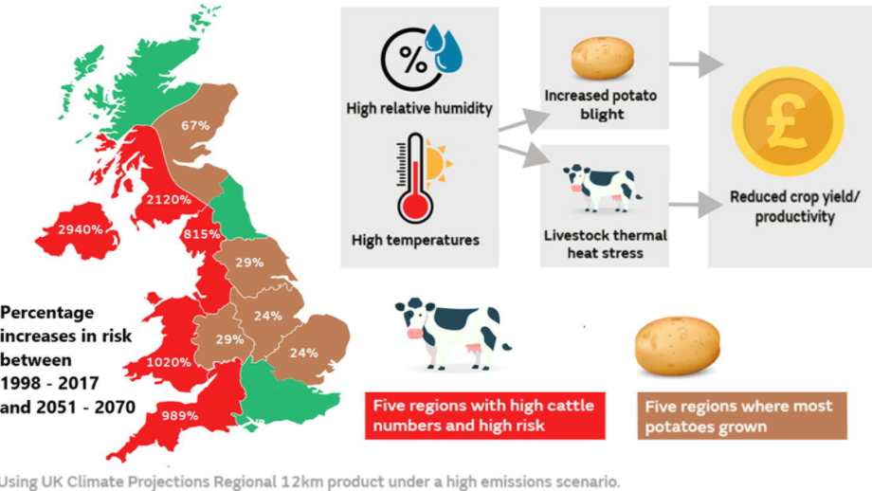
New research from the programme
Programme news
https://www.sciencedirect.com/science/article/pii/S2212096321000115
Notes:
Assessments of current and future climate risk are required for adaptation planning to increase resilience and enable society to cope with future climate hazards. Here we identify case studies of compound hazard events of interest to the UK agricultural sector and present a framework for comparing the frequency and duration of compound events now to those projected in 50 years’ time. We use high resolution (12 km) simulations from the UK Climate Projections to explore how the frequency and duration of instances of potato blight and thermal heat stress to dairy cattle may change locally under RCP 8.5 emissions forcing. We combine hazard (temperature and humidity data) with vulnerability (specific threshold exceedance) and exposure (regional dairy cattle numbers/potato growing area) to estimate risk. Regions where most potatoes are grown, and where the potato blight risk is greatest in both the current and future climate, include the East of England, Yorkshire and the Humber and Eastern Scotland. By 2070, potato blight occurrences may increase by 70 % in East Scotland and between 20 - 30 % across the East of England, the Midlands and Yorkshire and the Humber. Assuming dairy cattle spatial distributions remain the same, the area of greatest risk now and in the future is South West England, with notable increases in risk across Northern Ireland, Wales, the Midlands, North West England and North West Scotland. Dairy cattle heat stress (using a temperature-humidity index) is projected to increase by over 1000 % in South West England, the region with the most dairy cattle. Finally, we consider projected changes to UK seasons, using 2018 as a template, where a cold spring followed by a warm/dry summer resulted in hay/silage shortages. In addition to reduced crop yields in 2018, cattle were kept inside for longer in the cold spring and in the warm/dry summer, due to heat stress and poor grass quality. UK Climate Projections indicate that the annual probability of cold spring/warm summer conditions will decrease in future, but the annual probability of longer dry/warm summers will increase. We conclude that the agricultural sector should consider suitable climate adaptation measures to minimise the risk of dairy cattle thermal heat stress, increased potato blight, and longer dry/warm summer conditions.

Slide 5
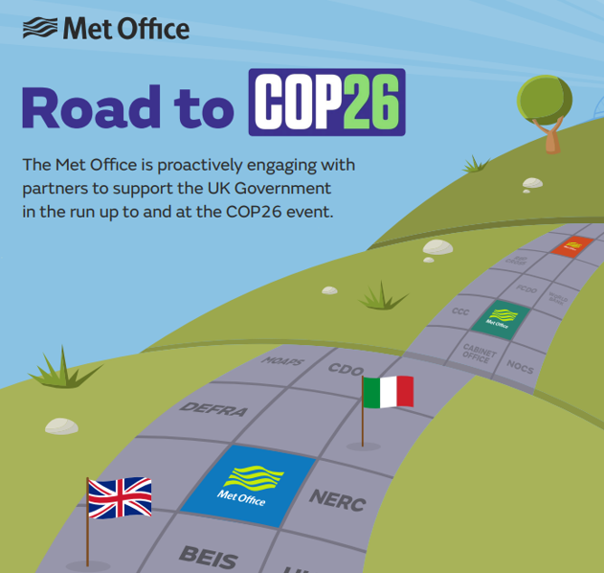
Met Office hackathon Two-day virtual event 16-17 March 2021
Programme news
Opportunity to explore new ways to visualise climate data such as UK Climate Projections (UKCP) and how to combine it with other types of data to produce new and innovative tools. Successful outputs may be showcased at COP26.
3 themes:
Marine and Coastal;
Nature Based Solutions;
Sustainable Development at Home and Abroad.
To register email cop26@metoffice.gov.uk with subject
‘Met Office Hackathon – Keep Me Informed’
Include:
your organisation’s name
theme(s) you are interested in.

Slide 6
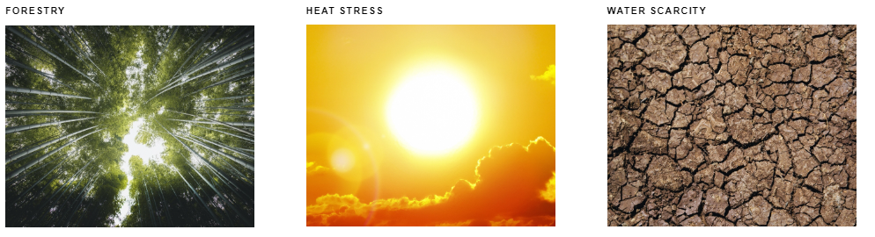
Wider News
Adapt Lock-In https://adaptlockin.eu/
New research
Notes:
Preparing for and coping with the accelerating impacts of climate change requires adaptation in a wide range of policy areas. Yet, despite increasing calls for action, policy change to allow this is often slow. A range of counteracting forces and barriers can make it difficult to embed adaptation objectives into important policies and move them away from ‘business-as-usual’. However, deeper dynamics are also at play, where self-reinforcing mechanisms, feedbacks and path dependencies interact across different spatio-temporal scales and coalesce to establish policy lock-ins.
The aim of this interdisciplinary project is to uncover these lock-in dynamics and examine the extent to which they account for varying levels of climate change adaptation in Germany, the Netherlands and the U.K. (England).

Slide 7
Wider News
4 - 8 October 2021
New dates
Notes:
It is the sixth in the Adaptation Futures international conference series on global adaptation and the first to be held in Asia. Adaptation Futures is the flagship event of the World Adaptation Science Program, which is one of the four components of World Climate Programme (WCP) based on the World Meteorological Organisation Congress XVI Resolution 18. As a premier event in the global adaptation spectrum, Adaptation Futures is a unique platform to facilitate dialogues towards action oriented solutions from a diverse range of stakeholders that includes academia, practitioners, scientists and policy makers from across the world.

Slide 8
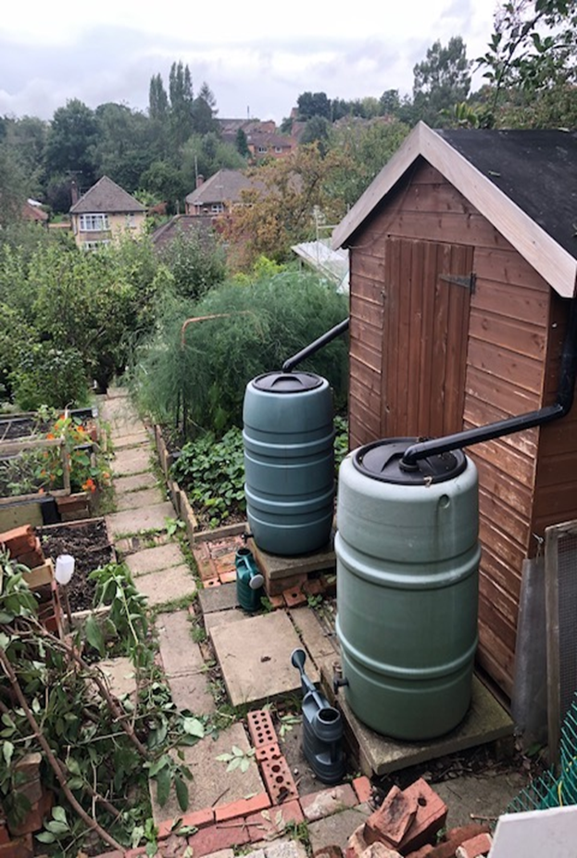
The feasibility of domestic rain tanks contributing to urban flood resilience Dr Liz Sharp, University of Sheffield

Slide 9
The feasibility of domestic raintanks contributing to urban flood resilience
Liz Sharp$, Christine Sefton$, Virginia Stovin*, Ruth Quinn*
$ University of Sheffield, Department of Urban Studies and Planning
*University of Sheffield, Department of Civil Engineering

Slide 10
Introduction

Slide 11
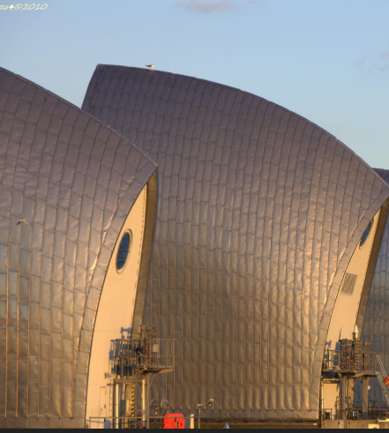
Flood Defence
Protection

Slide 12
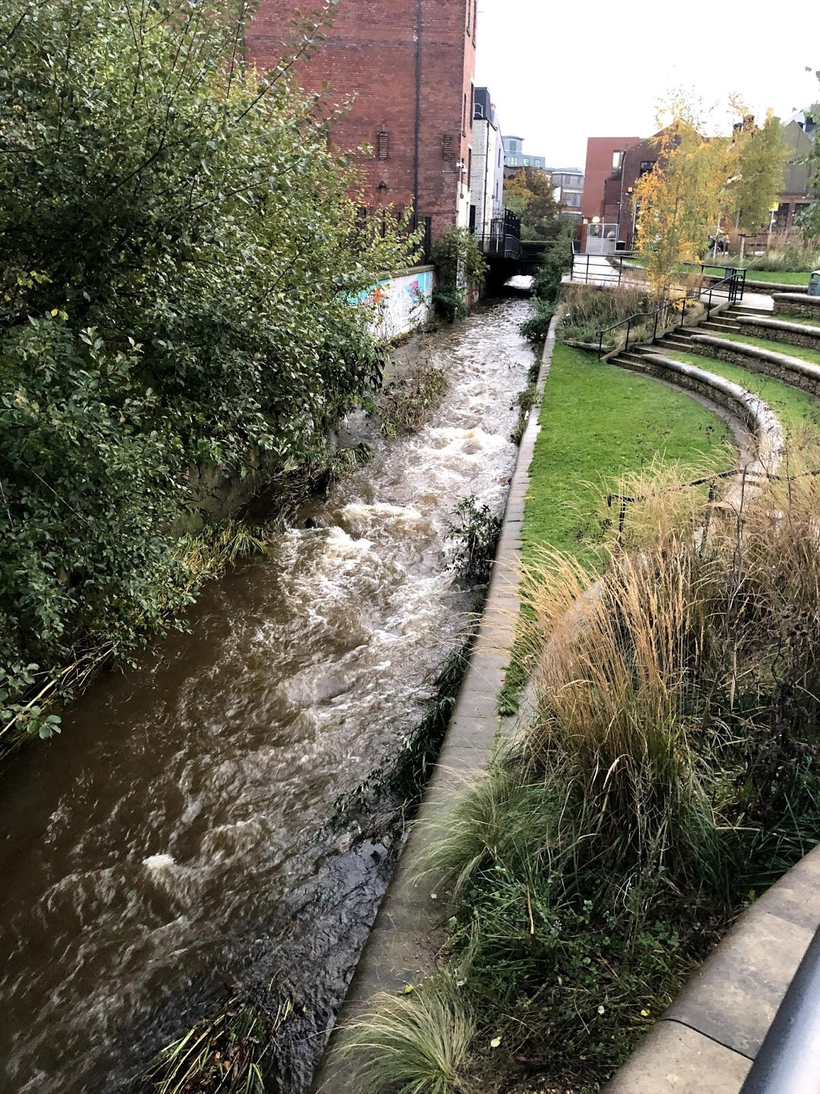
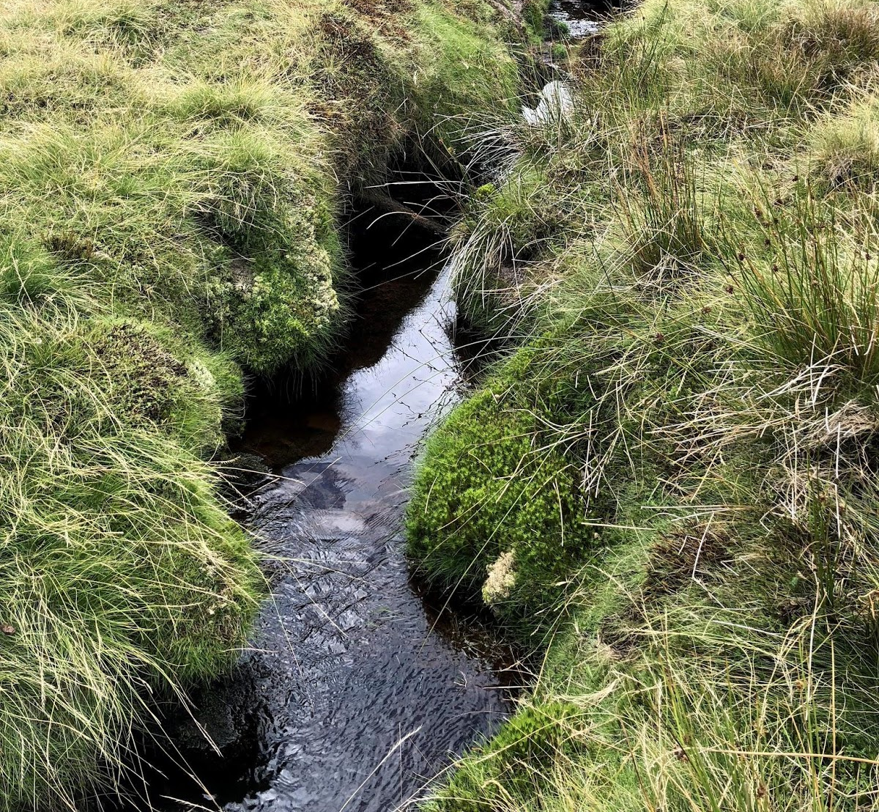
Flood Risk Management
Protection
Prevention
Sustainable Drainage Schemes (SuDS)

Slide 13
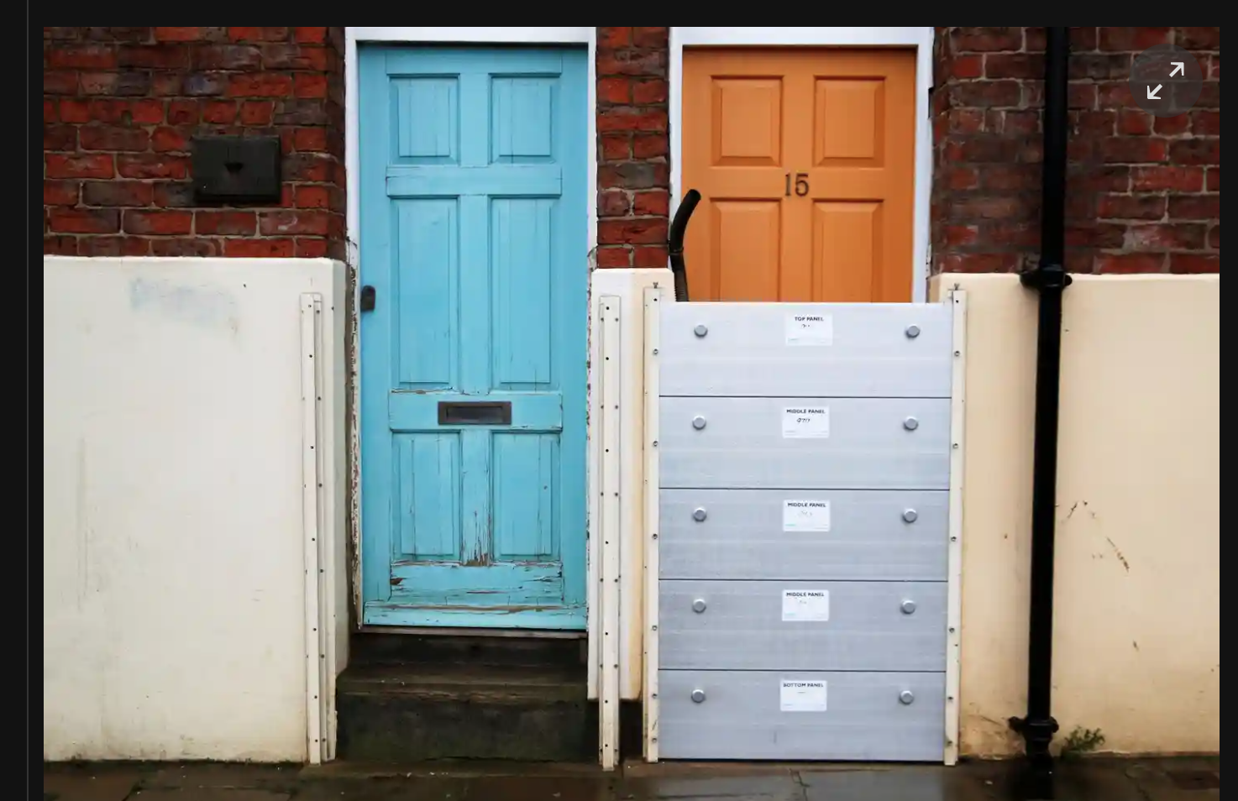
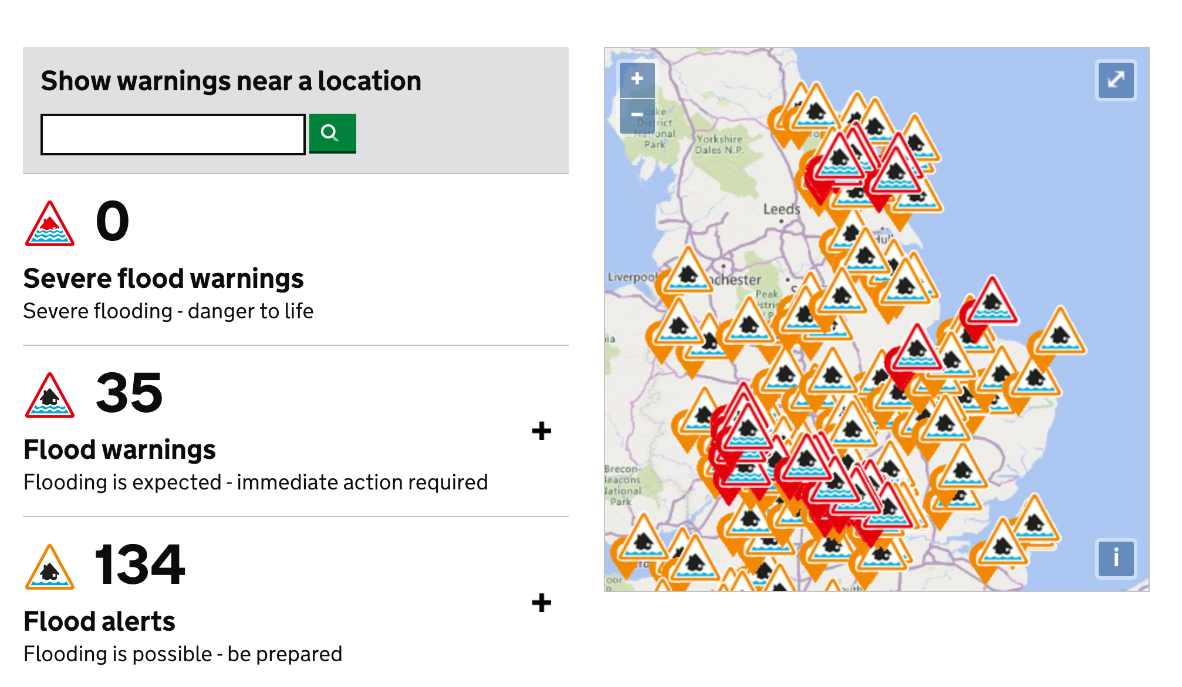
Flood resilience
Protection
Prevention
Preparation & recovery

Slide 14
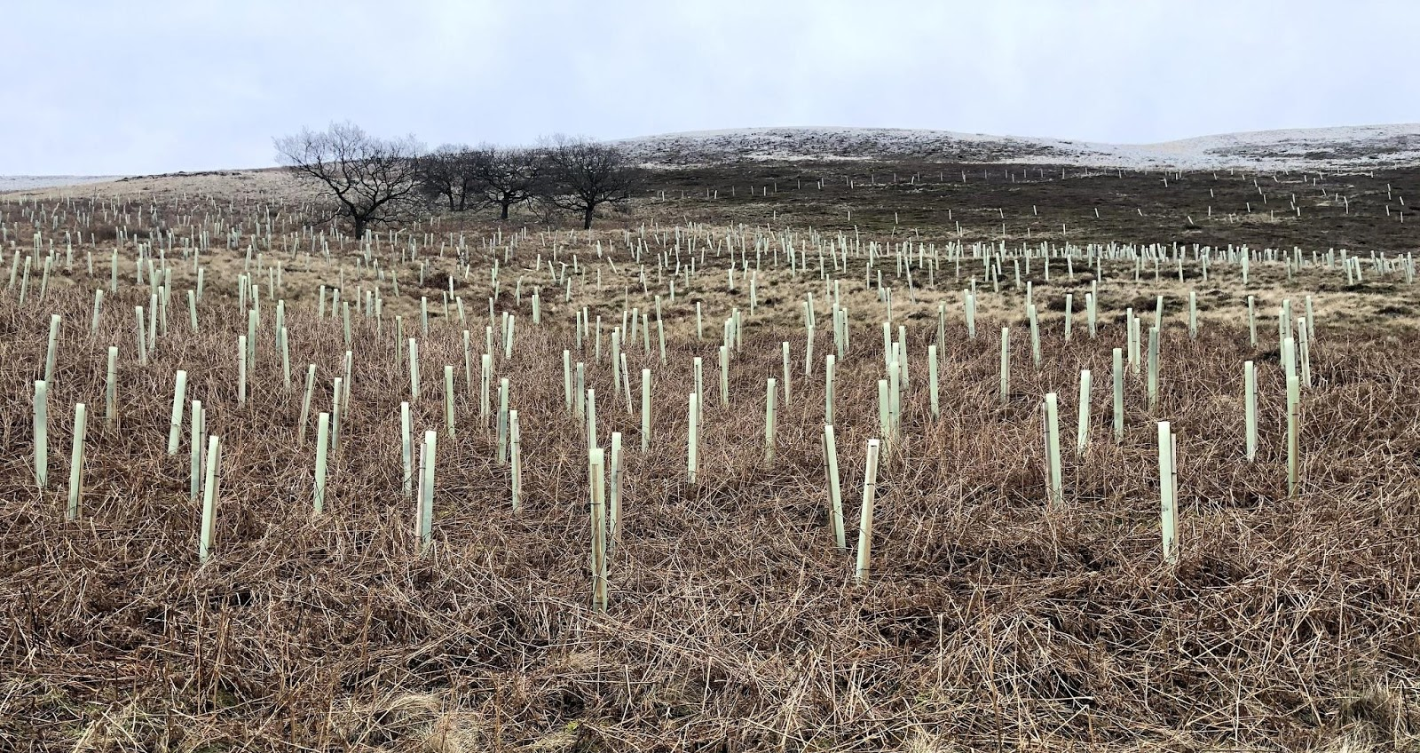
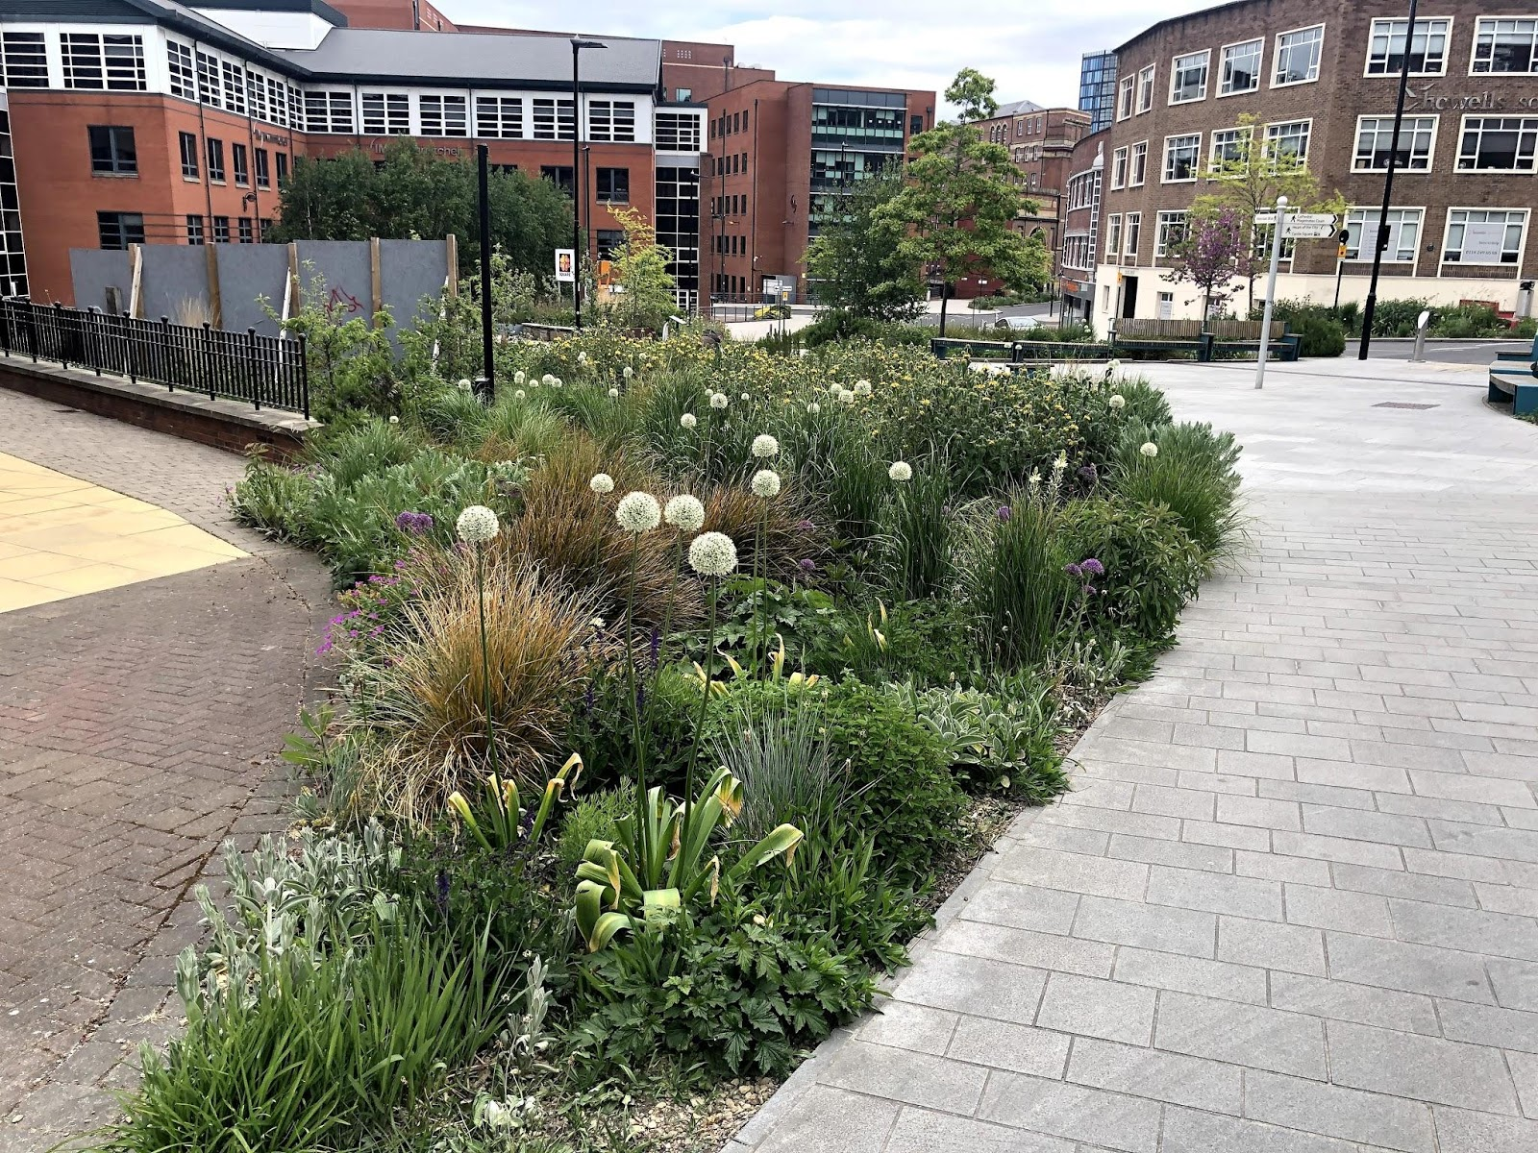
New relationships?

Slide 15
Central question
Would it be feasible for household raintanks to contribute urban flood resilience, and if so, how could it be done?
‘Mobilising Communities for Adaptation’ Funded by UKRI ‘Strategic Priority Fund’ from Jan 2019- Jun 2020
Notes:
So, our central research question was.

Slide 16
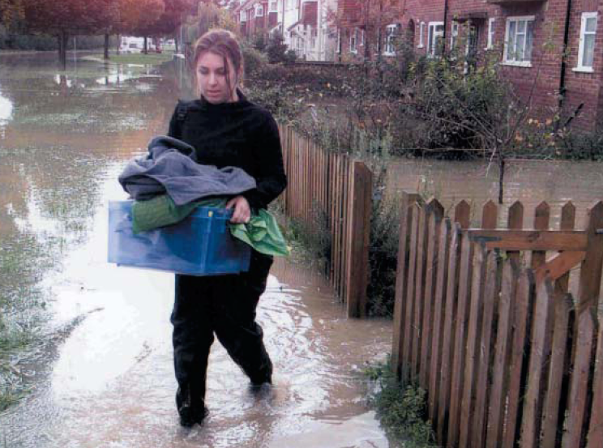
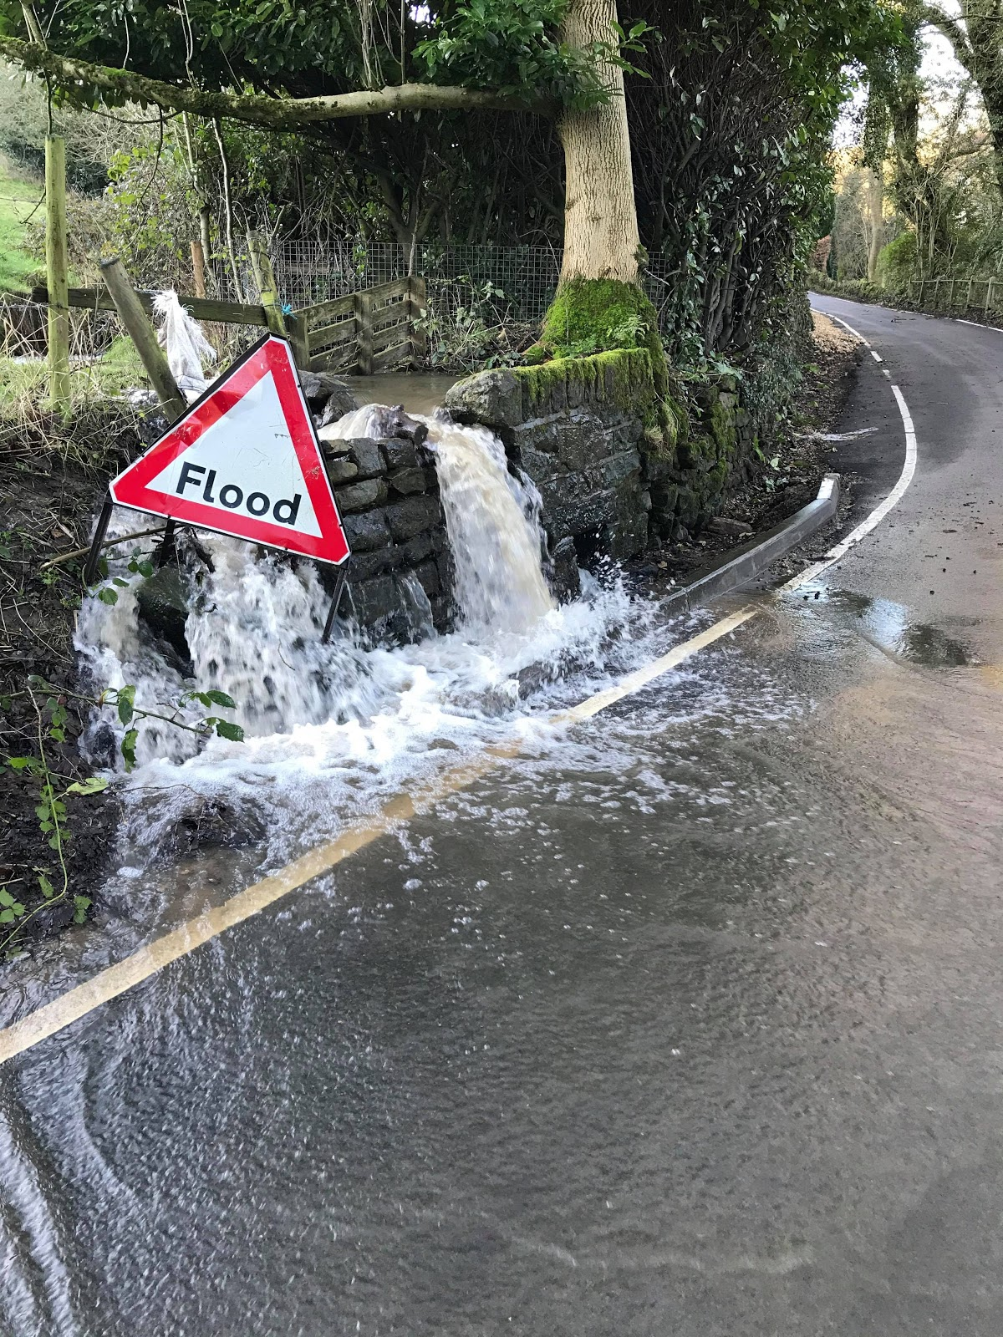
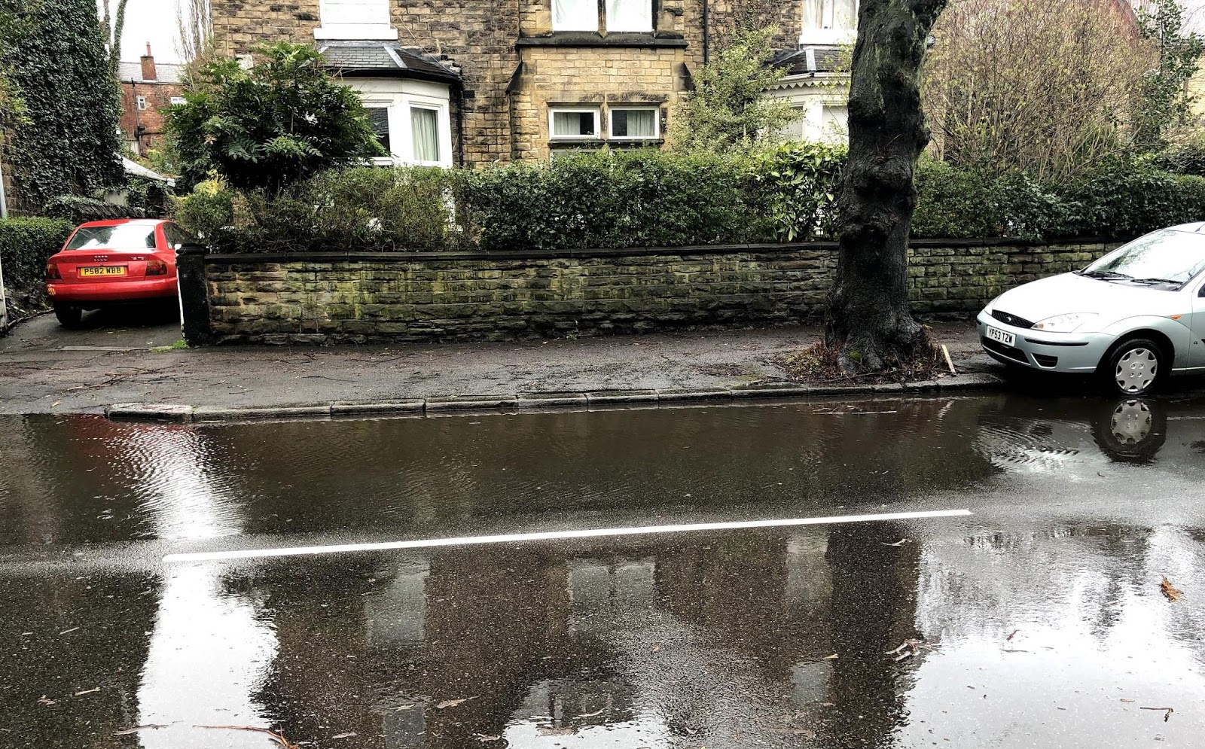
Urban flooding is getting worse
Urban flooding = Surface water flooding + sewer flooding
Notes:
Traditional (pipes and underground storage) responses are expensive, unsuitable for some locations. An alternative is SuDS.

Slide 17
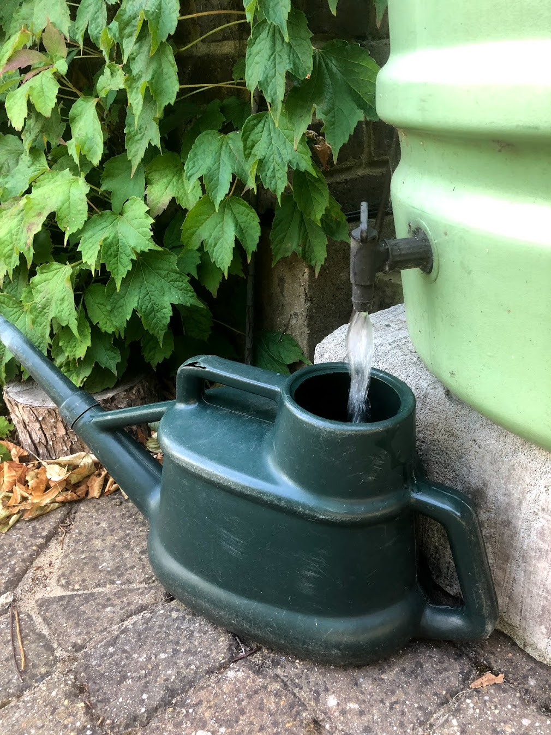
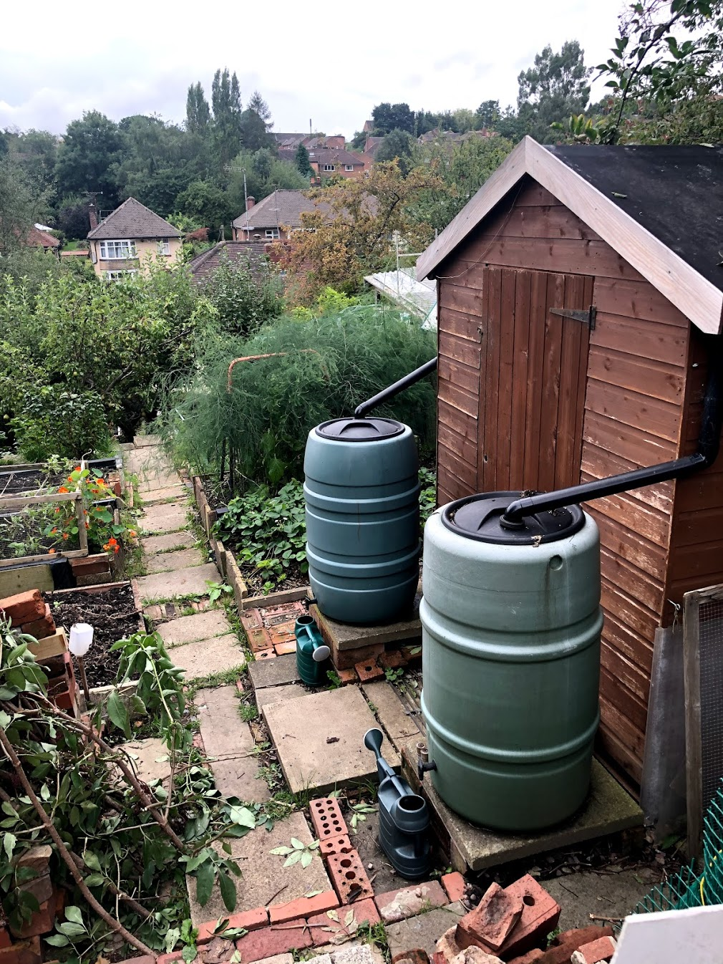
Raintanks as SuDS
Empty?
Sufficiently numerous?
Benefits:
Water supply
Private land
Wellbeing
Learning

Slide 18
Sub-questions
Is there potential for widespread uptake of raintanks and what would be needed in a raintank promotion programme to maximise uptake?
What sorts of raintanks could be effective (in terms of emptying) and acceptable?
Is investment in a raintank promotion programme a feasible future option for urban flood managers?
‘Mobilising communities for Adaptation’ Funded by UKRI ‘Strategic Priority Fund’ from Jan 2019- Jun 2020

Slide 19
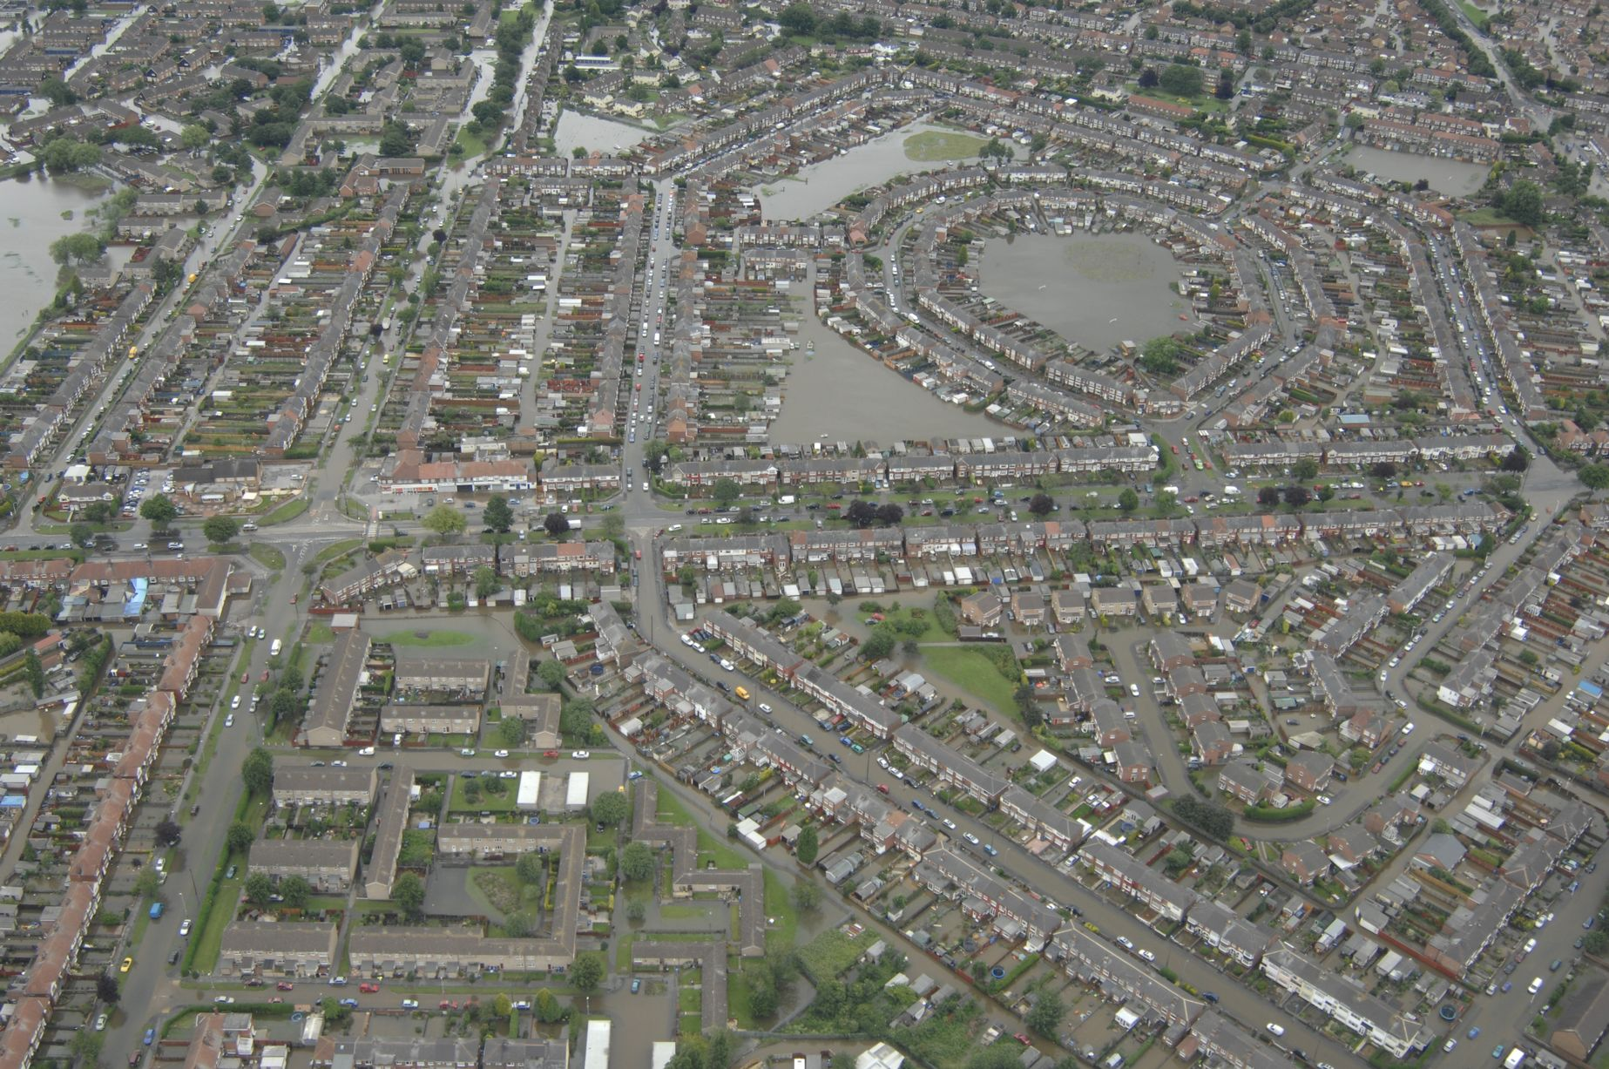
Partner
Urban flood risk;
Investments underway;
Not too far from Sheffield
Hull / Living with Water factsheet
8.600 homes flooded in Hull area in 2007 mostly urban flooding
Hull City among 5% most deprived in UK but East Riding surrounds Hull and is more prosperous
Two councils working with EA and YWS in Living with Water Partnership

Slide 20
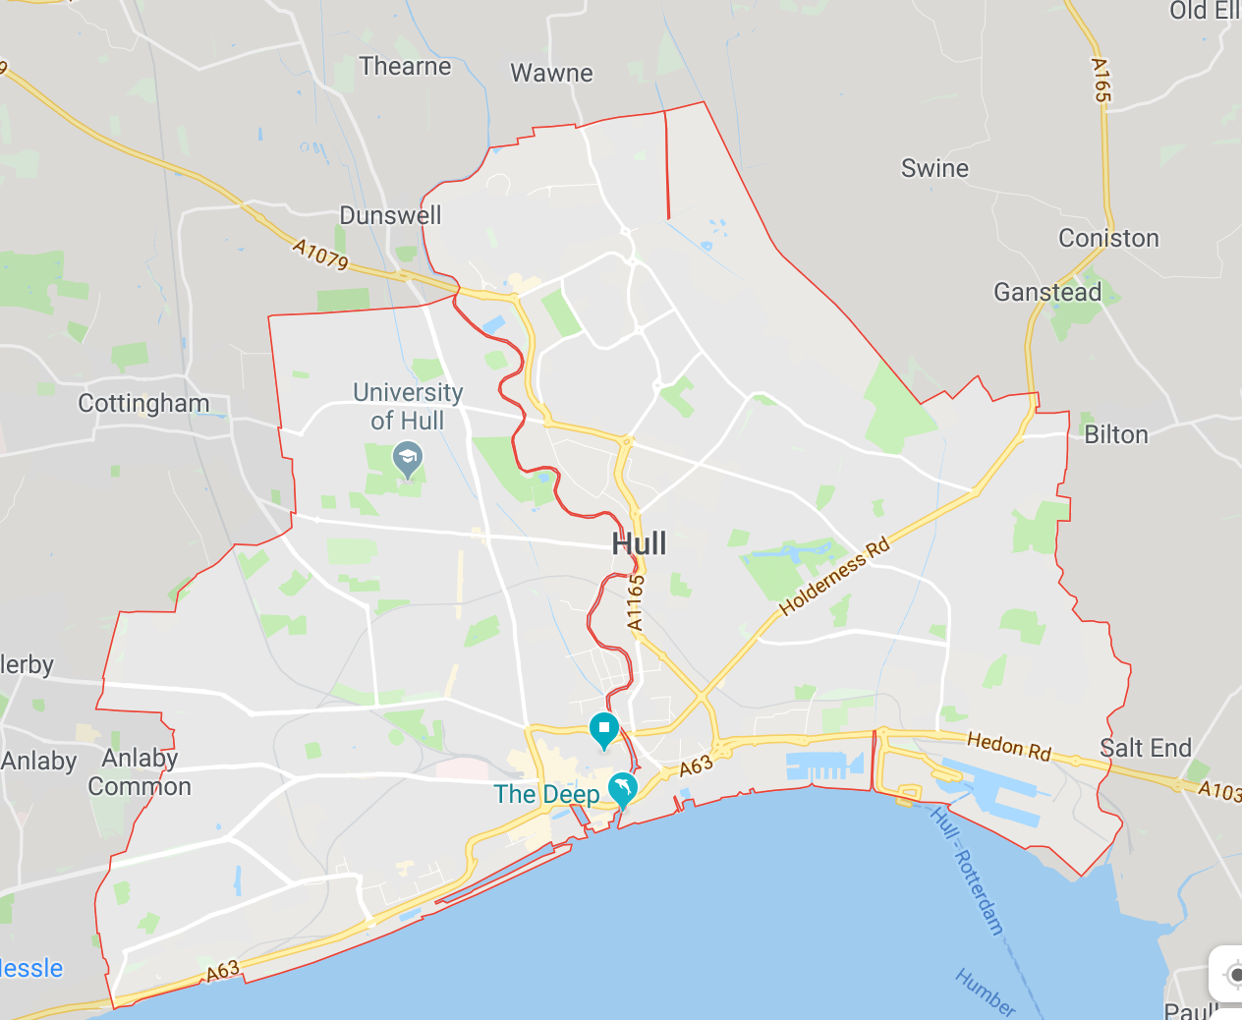
Two case localities
Both subject to flooding in 2007
Contrasting socio-economic status: Derringham – 5% most deprived, Bilton, 40% least deprived
Bilton
Derringham

Slide 21
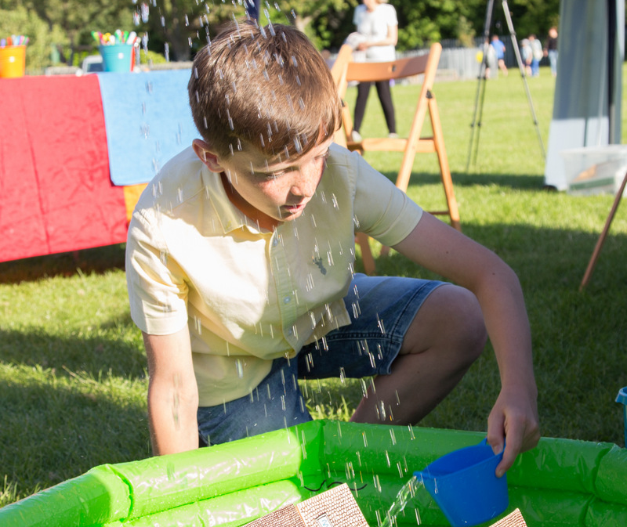
Action research – feasibility study
Action research = learning by doing
Attended community events,
32 interviews with publics and LWW
Modelling runoff reductions.
Disseminating interim findings locally and to LWW board.
Notes:
We sought to work with the LWW partnership to codesign the research and to learn together about the situation.
This was achieved through…

Slide 22
Findings: Is there potential for widespread uptake of raintanks and what would be needed in a raintank promotion programme to maximise uptake?

Slide 23
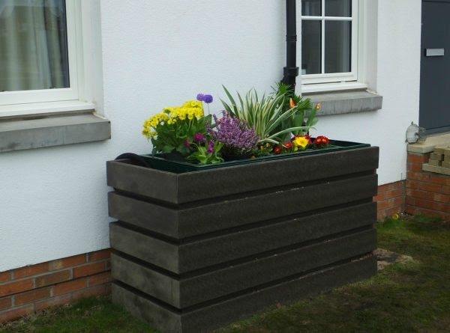
Residents told us they were …
Positive about a rain tank project.
Surprised they could contribute to FRM
Impressed with the idea of a tank planter
Concerned about:
Getting others on board
Top down support
Notes:
Everyone interviewed - happy to install and empty a tank, if tailored to circumstances.
They were positive about the idea of being able to contribute to flood resilience and surprised there was something they could do to improve the situation. They believed that if only other people knew about these things, they too would be enthusiastic.
Of course they also had concerns. They were as aware as any of us how difficult it is to get a message out to people. They also expressed a lack of trust in the local authorities to support such a project.
So their answer to maximizing uptake was …

Slide 24
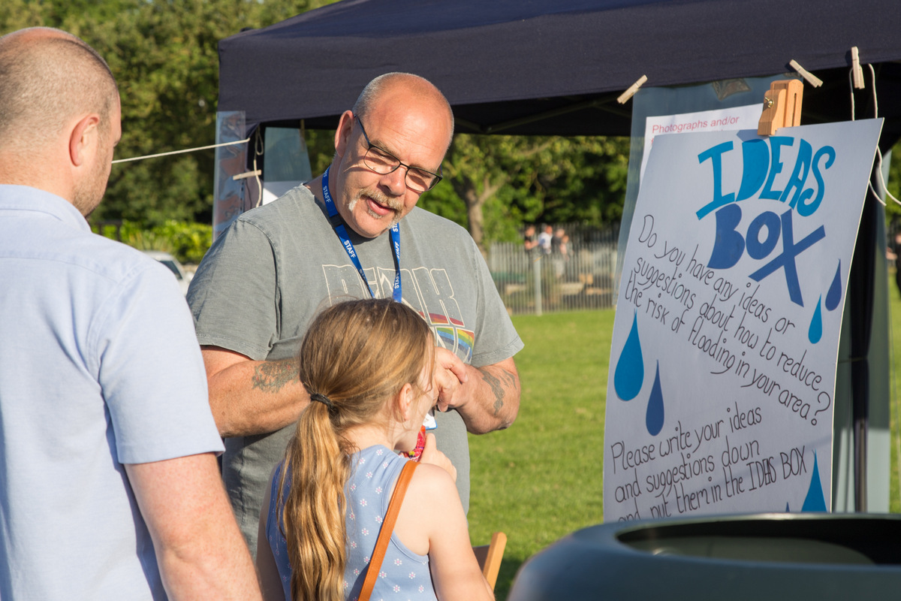
… that raintank promotion would need:
Free raintanks under owner control
Additional raintanks & SuDS fitted in public spaces
Engage communities through:
Face to face conversations
Community groups, local events and collective activity
Notes:
… that a raintank promotion would need to … provide free raintanks to include everyone; give people personal agency and control – hence manual rain-tanks (rather than the smart type they could have chosen – more on tank type in Ruth’s bit); provide evidence everyone – especially the authorities – are doing their bit. They believed that the most effective way to engage communities was by personal interaction i.e. face-to-face conversations and community events. What they described was relationship led communication, beginning with small groups who grew interest by word of mouth and example.

Slide 25
Findings: What sorts of raintanks could be effective (in terms of emptying) and acceptable?

Slide 26
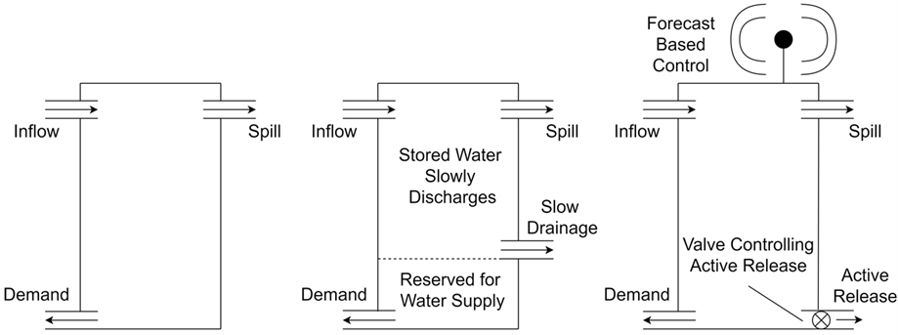
How can the raintank be empty?
Simple
Dual
Smart
Notes:
Rainwater harvesting systems fall into three categories: simple, dual and smart
The market was largely for very simple raintanks
There were a set of SMEs innovating with SMART
A few dual raintanks were produced, but they were thousands of pounds in cost (and don’t need to be)
The effectiveness was expected to increase from left to right

Slide 27
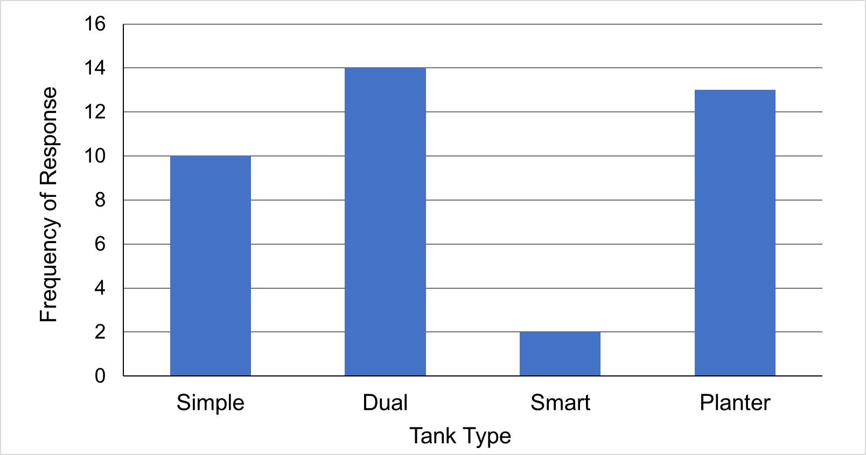
Raintank preferences

Slide 28
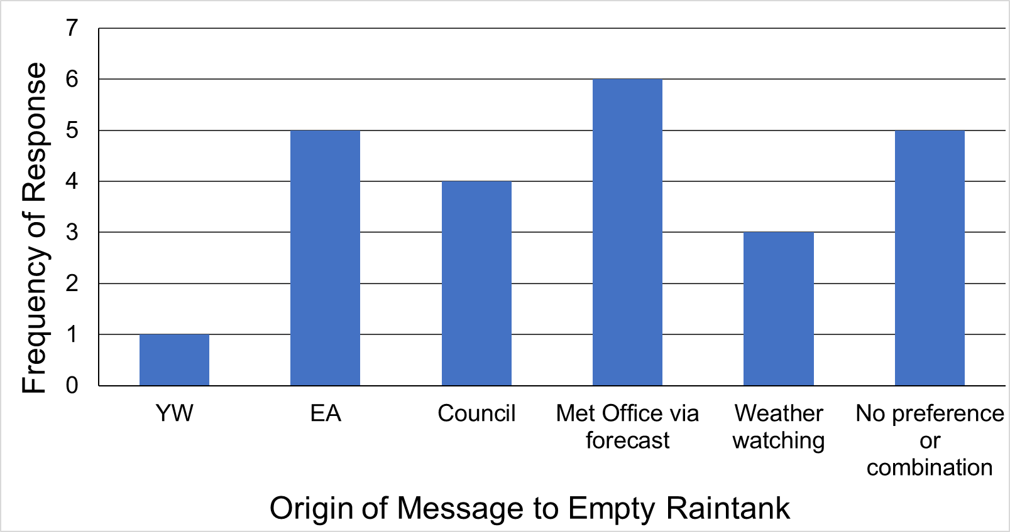
“Empty tank” message origin

Slide 29
Modelling
Modelled typical small raintank on typical terraced house
Considered worst 25 storms in last 25 years, adjusted for climate change
Use four different measures of efficiency in two scenarios
Conclusion:
- Small gains from each system
- Active system and Dual system – different strengths
Raintank Efficiency
(with tank supplying toilet)

Slide 30
Findings: Is investment in a raintank promotion programme a feasible future option for urban flood managers?

Slide 31
Urban flood managers told us they
Enthusiastic – but would prefer to control raintanks
Have concerns about their ability to communicate with the public effectively
Are unsure the resource demands of a raintank project is worth the physical flood resilience it delivers.
Notes:
UFM like the idea of raintank SuDS in theory – but they want to maintain control rather than really share responsibility with the public. They are after all held responsible for the public safety and also know that they are not communicating as effectively with the public as they would wish – (low sign-up for flood warnings). So, while they know that community engagement is important and something they need to do, they are still engineers, and at heart believe in engineering solutions rather than social.

Slide 32
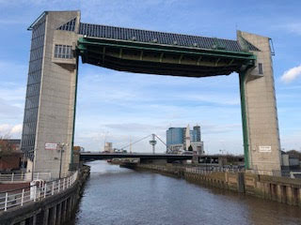
“A lot of these little projects – I’m saying little projects in comparison to the other streams in LWW that are more operational and technical, but they take an awful lot of time to understand, and do, and make successful.”
Urban flood manager - Hull
Notes:
Throughout interviews with UFM, they indicated that their core business was technical solutions, and that these unquestionably took the lion share of resources. However, they also recognized that to do social solutions adequately, it took more understanding and resources than they were able to give.

Slide 33
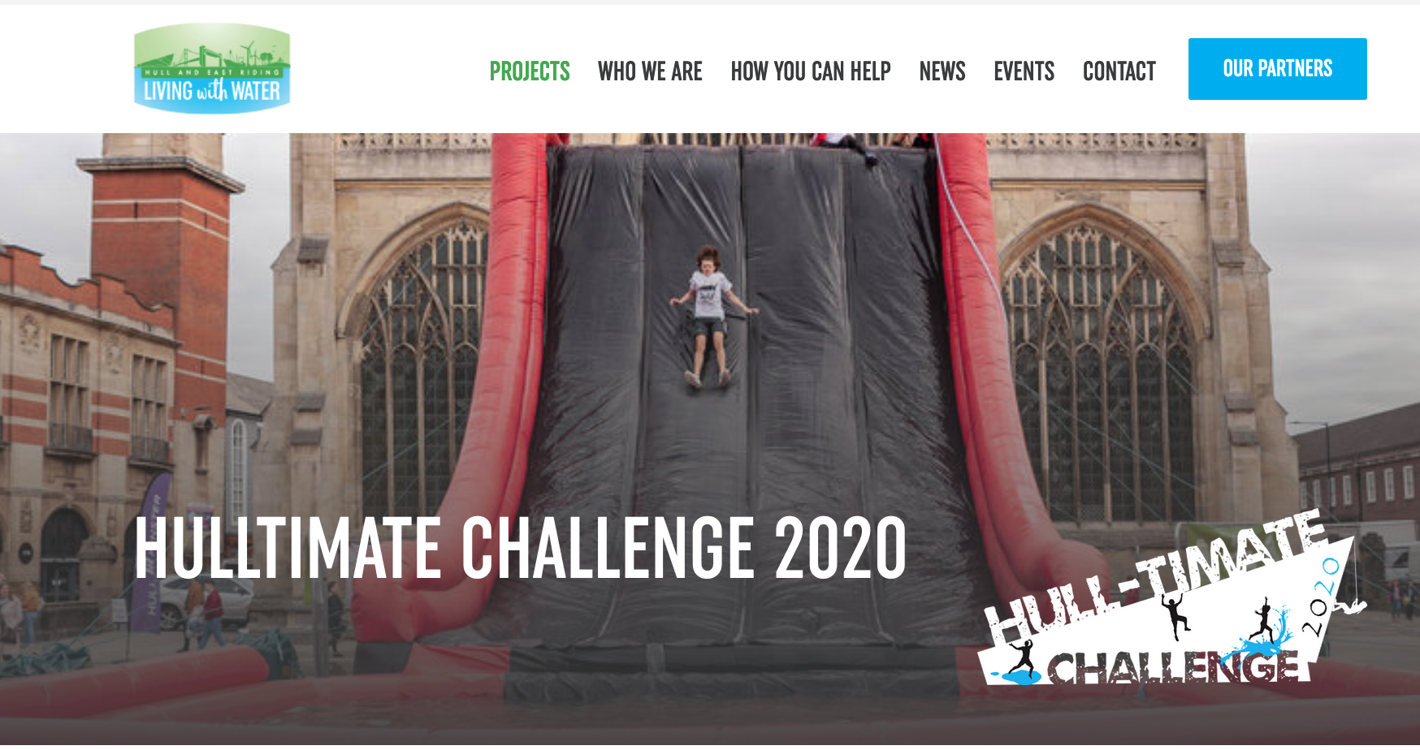
Current communication strategy
Generic information & promotion
Individual household behaviour change
Education of young people through school
Notes:
This is perhaps why they rely on less interactive forms of communication (the antithesis of what the residents said would be effective) – Or perhaps they just lack understanding. For example, we found UFM using the terms community engagement, information campaign and public education interchangeably – as they were synonymous. However, throughout MOCA, we found LWW to be very open to learning.

Slide 34
Learning by doing
“I think MOCA, for me, is helping me understand what ‘right’ looks like, if that makes sense. You and I have discussed how you can bring people with you. You don’t do stuff to people. I think all the organisations involved in trying to help have been guilty of doing that.”
Urban flood manager
Notes:
We did not see that it should be a case of guilt – rather that there needed to be a paradigm shift in order to support these organizations to do flood resilience as it needs to be done.

Slide 35
Future Flood Resilience requires both public and authorities to …
Accept uncertainty
Share responsibility
Develop equitable relationships
Value social + technical solutions equally
Seismic shift in contemporary norms
Public
Authorities
Existing regulatory and funding process
Notes:
If we want the public to accept uncertainty and share responsibility for managing adaptable water assets, then we need institutions that are able to relinquish control and build equitable relationships with communities. For that to happen people and relationship solutions have to be valued equally to engineering solutions. This, we argue, is part of the paradigm shift that is required to realize flood resilience. The magnitude of this change should not be minimised. Such an approach overthrows the contemporary norms of FRM assumed by the public, the authorities, and the existing regulatory and funding processes, in which technically-led authorities solve problems for a passive public. And so, the need for evidence about how resilience works in practice is not just important for LWW and the public of Hull and East Riding, but all water-managing authorities and all the cities and towns under threat of increased flooding across the UK.

Slide 36
Cultural change means all of us
“What we’re looking at is a basic re-think of how we manage water”
Derringham resident
Authorities need to “promote conversations to …develop options for action with the active involvement of the community”
Defra flood resilience review 2020

Slide 37
Conclusions
Urban flood resilience could be enhanced by voluntary emptying and dual function tanks;
Promoting raintank uptake needs a programme of other visible community SuDS;
Raintank & SuDS projects could help individuals’ flood knowledge and sense of community empowerment;
A genuinely collaborative SuDS programme challenges the contemporary norms of flood management

Slide 38
MAGIC postscript
Mobilising Adaptation: Governance of Infrastructure through Coproduction (MAGIC)
Support the coproduction of water storage on public and private land in Derringham and Bilton
Landscape, Public Health, Timebank, & 24 months

Slide 39
Response Lee Pitcher, Head of Resilience, Yorkshire Water

Slide 40
Questions, answers, discussion

Slide 41
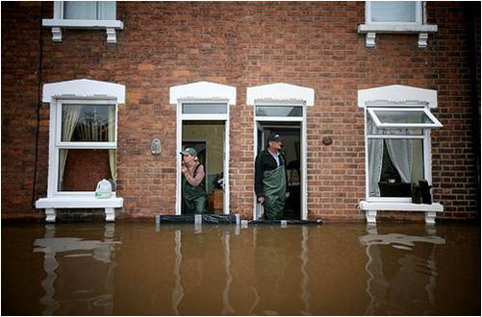
Next webinars:
Wednesday, 24th February, 2021 12.00-13.00
Speaker: Paul Sayers, Sayers and Partners
Title: An event-based assessment of the impact of climate change on future flood risk
Wednesday, 10th March, 2021 12.00-13.00
Speaker: Harriet Orr and Alex Cutler, Environment Agency
Title: Climate resilience and the national flood and coastal erosion risk management strategy
Register on our website:
https://www.ukclimateresilience.org/news-events/climate-resilience-webinar-series-2020-2021/

Slide 42
Contact details Website: www.ukclimateresilience.org Twitter: @UKCRP_SPF YouTube: UK Climate Resilience programme
The UK Climate Resilience programme is supported by the UKRI Strategic Priorities Fund.
The programme is co-delivered by the Met Office and NERC on behalf of UKRI partners AHRC, EPSRC, ESRC.

