Slide 1
ClimaCare: Overheating in care homes Professor Mike Davies University College London (UCL) 24/3/21

Slide 2
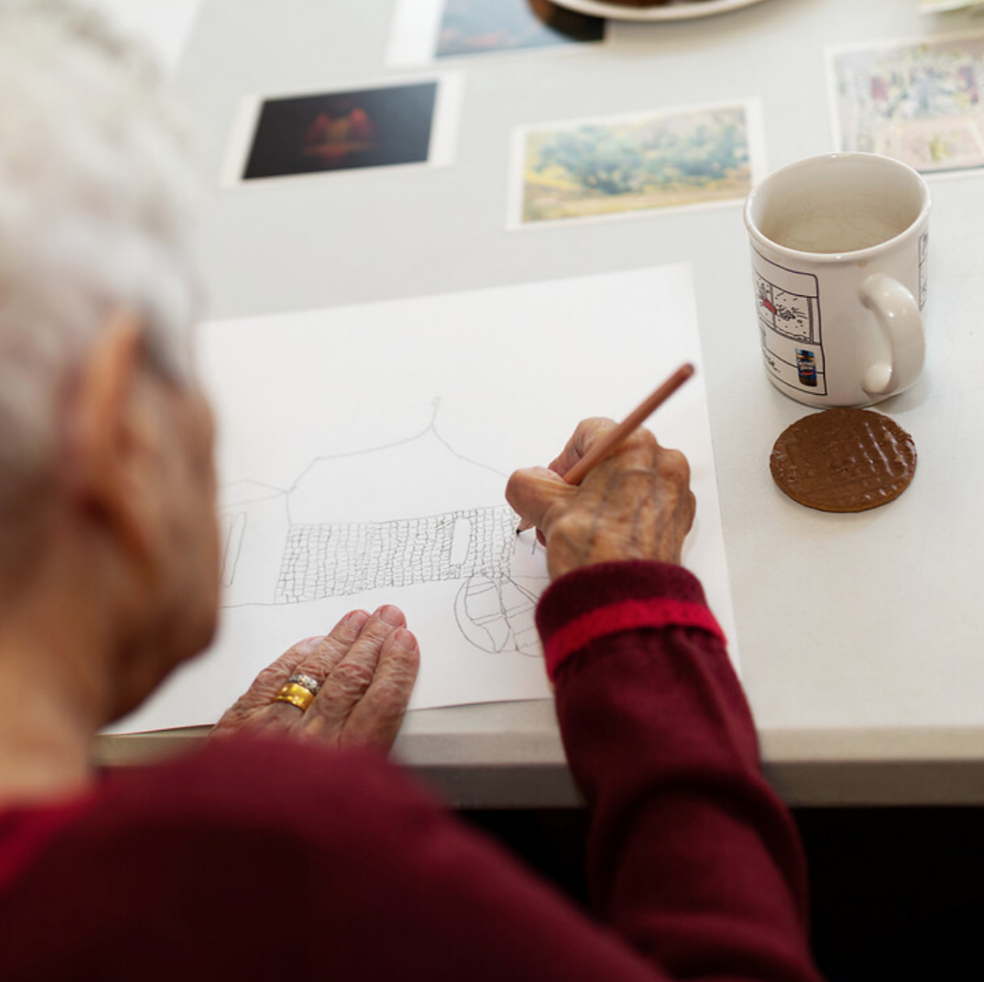
Presentation outline
e title
Background
Project summary
Methods
Preliminary outputs
Next steps
Image credits: © Greater London Authority
2
Notes:
Option 1 layout

Slide 3
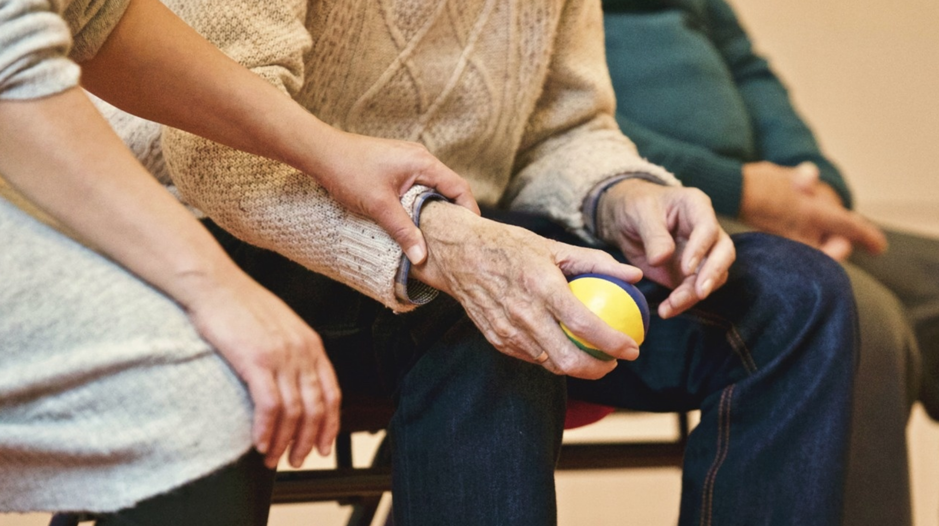
Background
As a result of global climate change:
the UK is expected to experience hotter and drier summers, and
heatwaves are expected to occur with greater frequency, intensity and duration.
3
Notes:
Option 1 layout

Slide 4
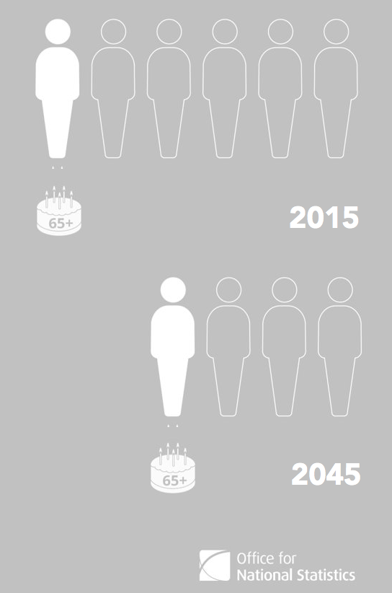
Background
The UK also currently has a rapidly ageing population.
Single-household growth can lead to increased demand for care provision in old age​.
​Older populations are more vulnerable to heat stress.
4
4
Notes:
Option 1 layout

Slide 5
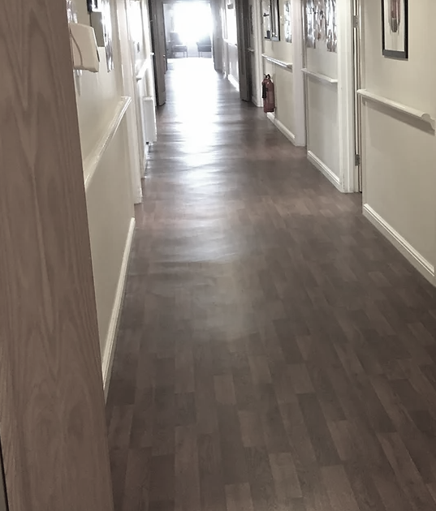
Background
The indoor environment is a principle moderator of heat exposure in older populations, who tend to spend the majority of their time indoors.
Initial evidence indicates that new-build care settings today are already overheating even under non-extreme summers
Such risks will be exacerbated due to ongoing and future climate change.
There is a lack of simple, easy to implement guidance on how to design and retrofit care homes for a changing climate.
5
5
Notes:
Option 1 layout

Slide 6
Project summary
ClimaCare is an interdisciplinary project with the overarching goal of addressing the challenging issue of adapting UK care settings to climate change.
Duration | Project | Title
2019-20 | 1. Pilot (London) | Climate Resilience of Care Settings
2020-22 | 2. Follow-up (UK) | Governing the Climate Adaptation of Care Settings
6
6
Notes:
Option 1 layout

Slide 7
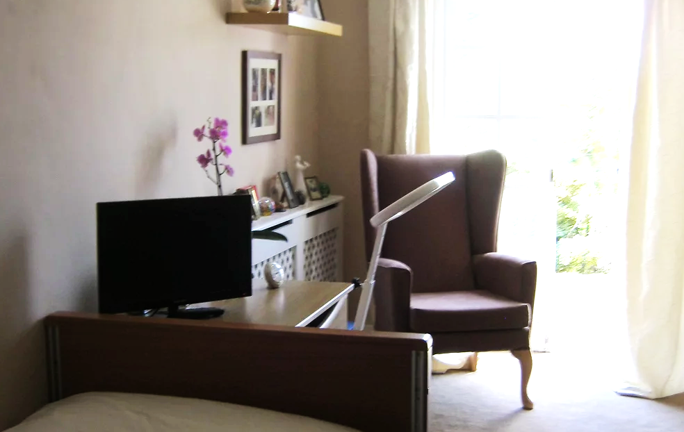
Project summary
ClimaCare pilot project
Aim: Undertake feasibility work by developing novel methods, knowledge and insights that will enable care provision in the UK to become resilient to rising heat stress under climate change
7
7
Notes:
Option 1 layout

Slide 8
Project summary
ClimaCare pilot project
Objectives: | Carry out pilot work in five London care homes (summer thermal monitoring and surveys with frontline care staff, managers and residents) Test approaches for understanding the comfort levels of care home residents Test measurement techniques for assessing the impact of heat exposure on the health of residents Test methods to assess future overheating risks in care settings (building performance simulation) Combine multidisciplinary research perspectives with those of care home practitioners and other stakeholders
8
8
Notes:
Option 1 layout

Slide 9
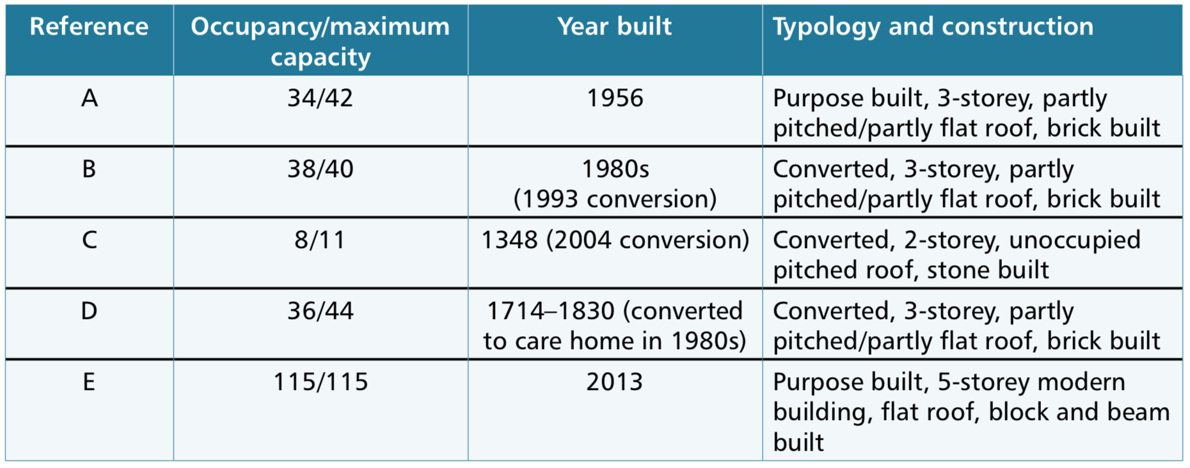
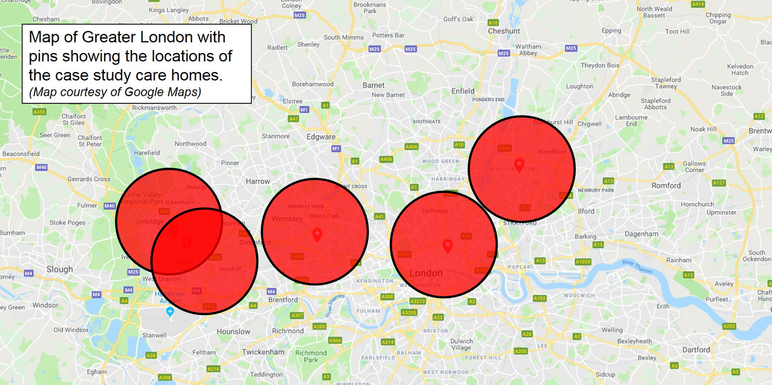
Methods
Case studies: Five London-based care homes recruited with help from the Care Quality Commission (CQC) presenting a range of characteristics in terms of:
occupant capacity,
building typology,
construction age.
9
9
Notes:
Option 1 layout

Slide 10
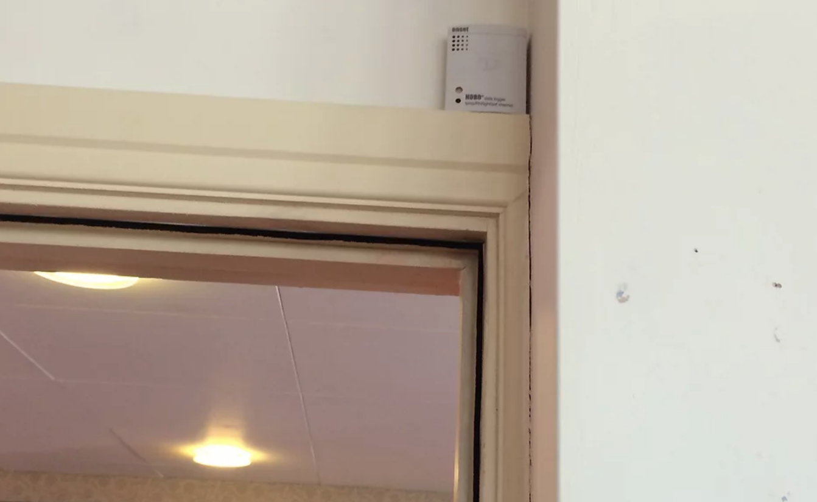
Methods
Environmental monitoring of temperature, relative humidity, CO₂ levels
Survey to record perception of thermal comfort of residents at repeated time points on hot days during the 2019 summer
Semi-structured interviews with care home managers, staff and residents to understand how overheating is currently managed, and assess barriers to implementation of heat risk mitigation strategies
10
10
Notes:
Option 1 layout

Slide 11
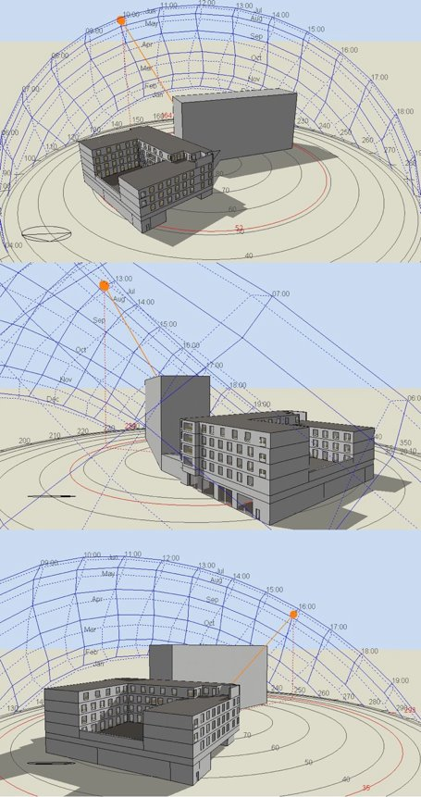
Methods
Dynamic building performance modelling using EnergyPlus V8.9 via DesignBuilder GUI
CIBSE weather files DSY1 based on UKCP09:
one urban (London Weather Centre) and
one peri-urban (London Heathrow)
for different timescales and emissions scenarios (50th percentile):
2020s high emissions
2080s low emissions
2080s high emissions
Building fabric inputs established through building physical surveys
11
11
Notes:
Option 1 layout

Slide 12
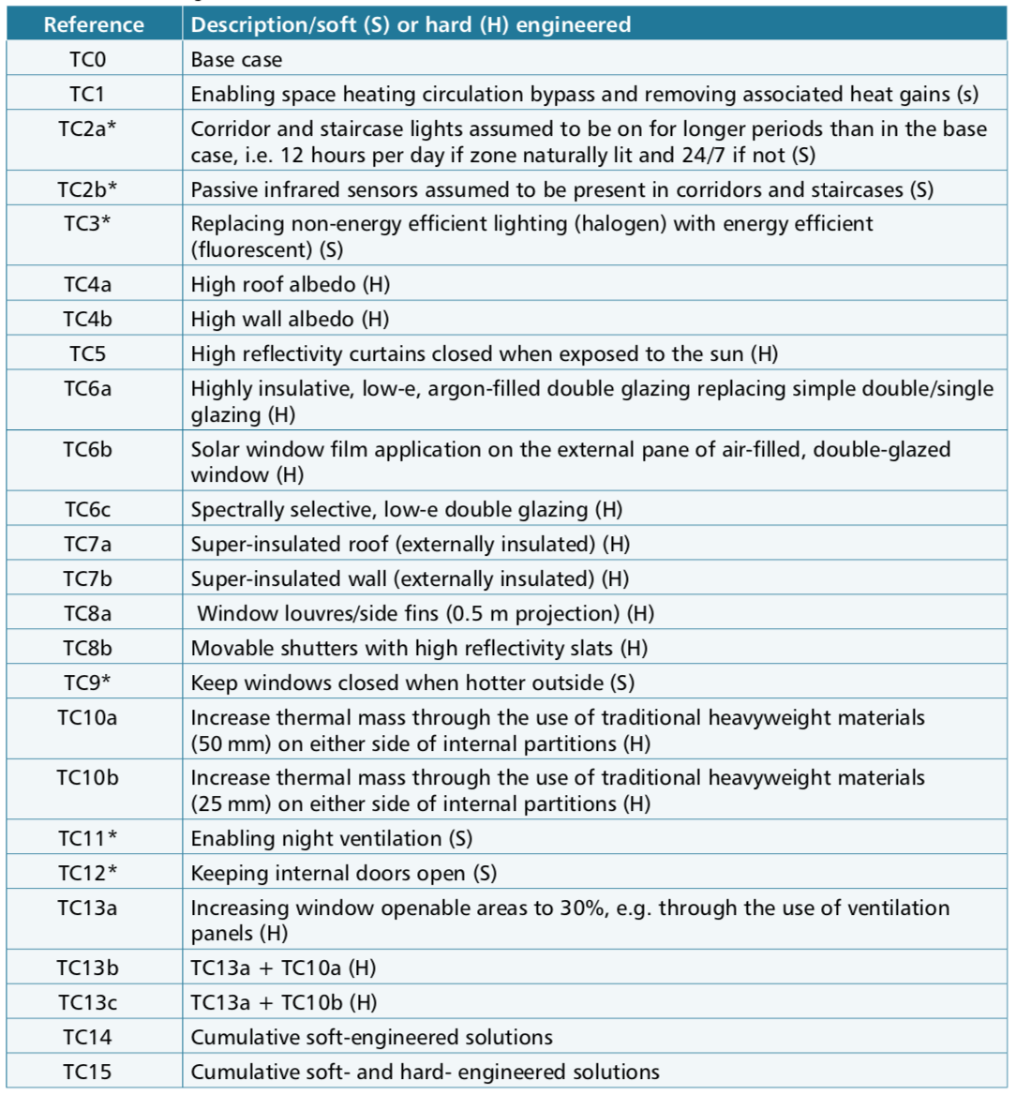
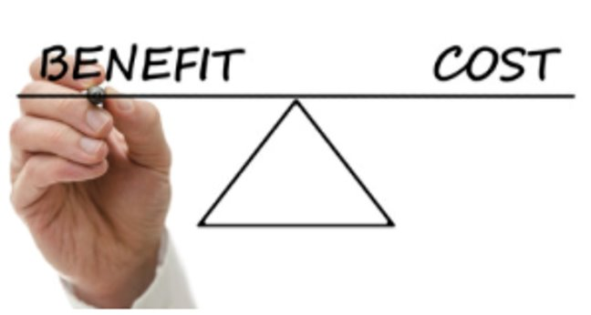
Methods
A. Base case
The interventions tested include both
non-structural (‘soft’) and
structural (‘hard’) engineering solutions.
B. Minimise internal heat generation
C. Keep the heat out
D. Manage heat
E. Passive ventilation
F. Cumulative impact
12
12
Notes:
Option 1 layout

Slide 13
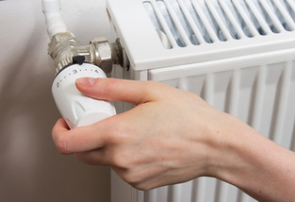
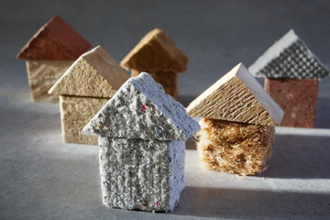
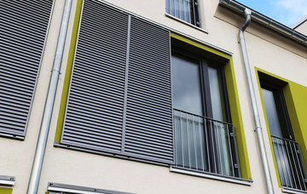
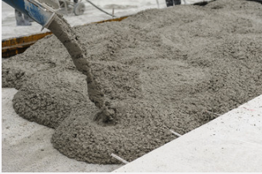
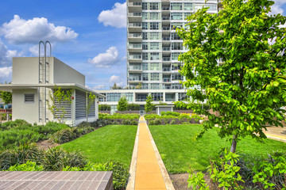
Methods
Internal heat sources & management practices
Building fabric insulation level
External surface albedo
Window solar protection
Thermal mass
Ventilation regimes
Green/blue infrastructure
Active cooling options
Selective application of measures
13
13
Notes:
Option 1 layout

Slide 14
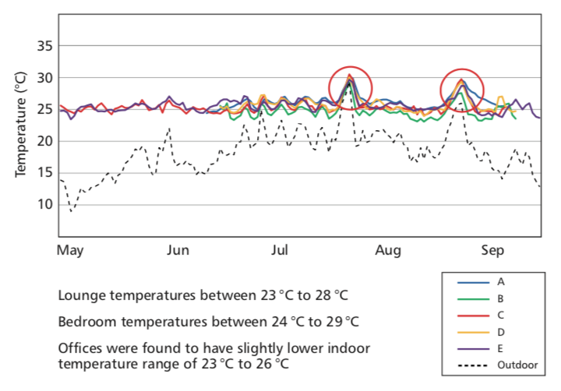
Preliminary outputs (monitoring)
Occupants in older, heavyweight buildings were less likely to feel hot in the summer.
Summer daily temperatures were significantly higher than the 26°C threshold recommended by Public Health England (PHE).
14
14
Notes:
Option 1 layout

Slide 15
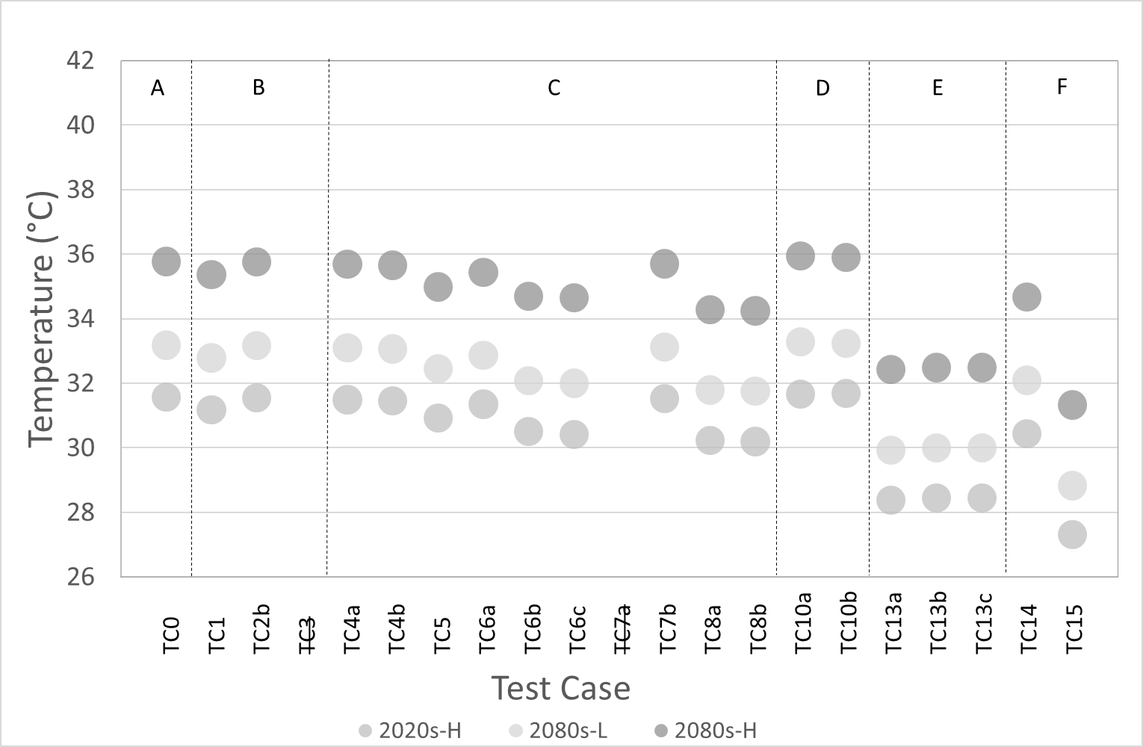
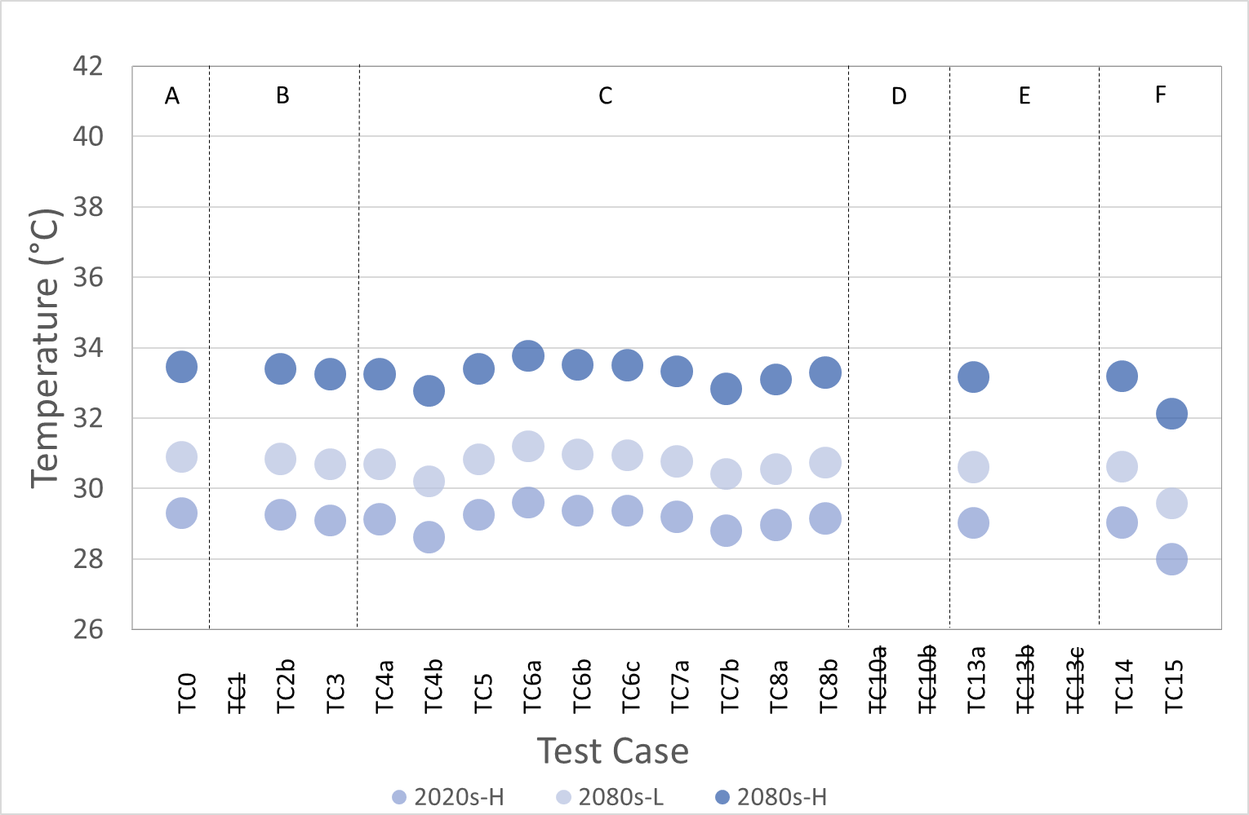
Preliminary outputs (modelling)
Older buildings appear to benefit more from the application of high albedo materials. Newer buildings seem to benefit more from higher ventilation rates and external shading systems.
Resident indoor temperature exposure during a 5-day heatwave period in the newest (left) and oldest (right) case study
15
15
Notes:
Option 1 layout

Slide 16
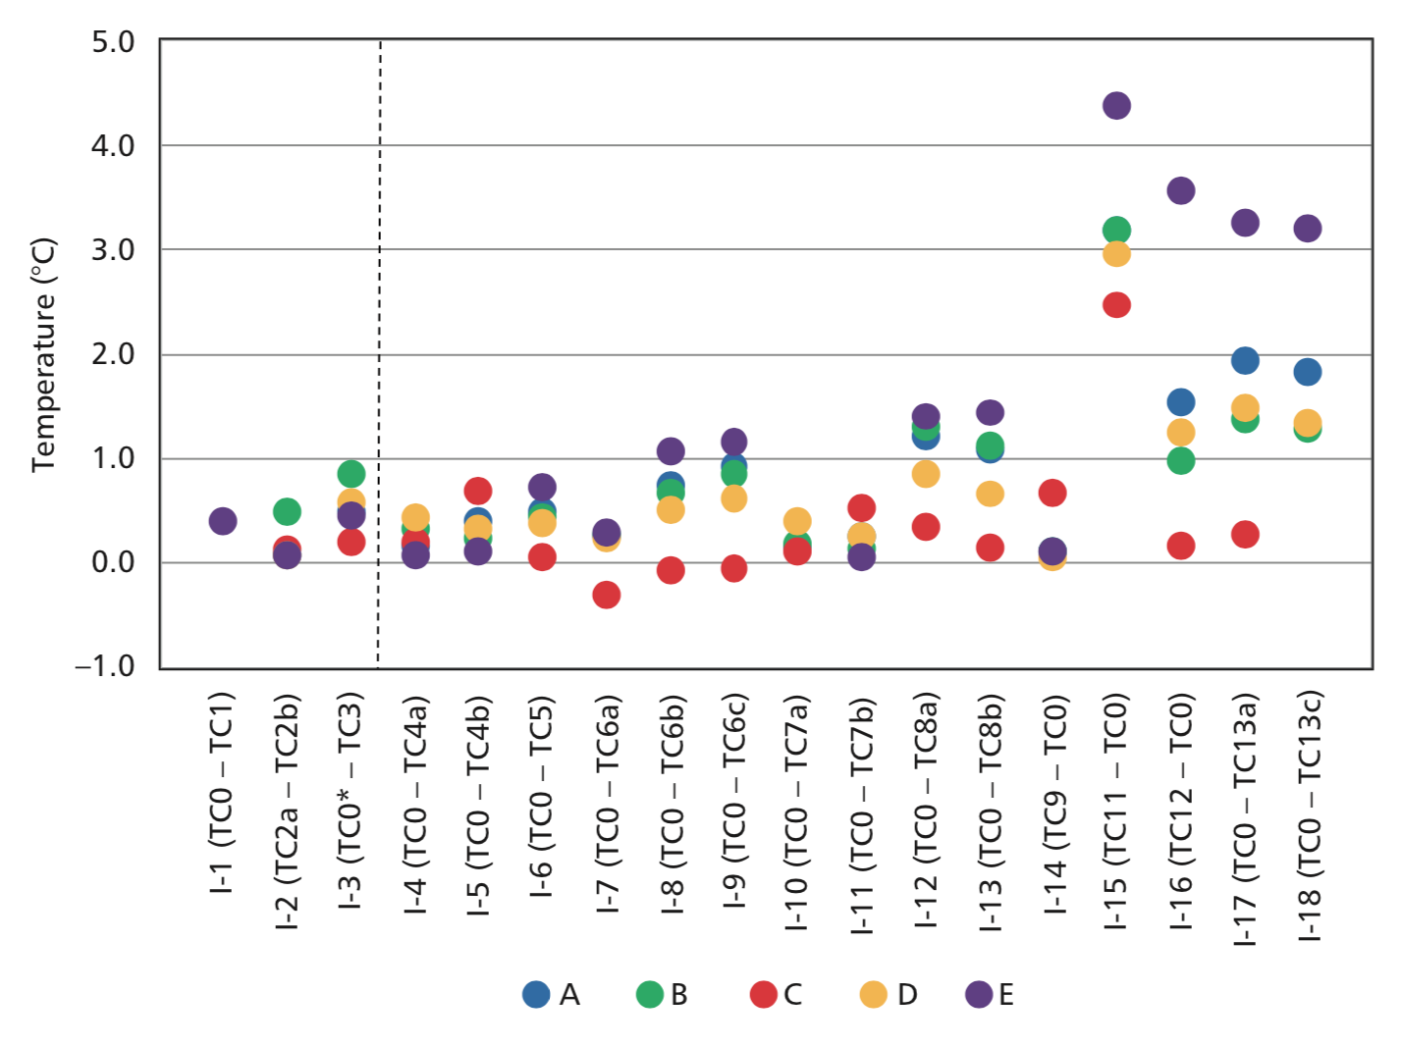
Preliminary outputs (modelling)
The most impactful measures lie in the area of passive ventilation and heat management.
The single most impactful measure for all case studies was the implementation of night ventilation followed by the implementation of increased ventilation rates and the application of internal door rules.
Average impact of individual interventions on the reduction of residents’ temperature exposure during a 5-day heatwave period
16
16
Notes:
Option 1 layout

Slide 17
Key preliminary findings
Mean internal temperatures in the five case studies during the heatwave remained predominantly above the 26 ºC threshold and were projected to remain at significantly higher levels under the future climate scenarios.
The combination of soft- and hard- engineered passive strategies appears to be capable of reducing the residents’ indoor temperature exposure from approximately 1.3 ºC to 4.4 ºC.
Older, heavyweight, single-glazed and well ventilated buildings were found to benefit more from the application of high albedo materials rather than external shading methods, whereas newer and well insulated buildings seem to benefit more from higher ventilation rates and appropriate external shading systems.
Night ventilation emerged as the single most impactful measure, irrespective of building type.
17
17
Notes:
Option 1 layout

Slide 18
Next steps
We plan to quantify climate-related heat risks in care settings nationwide.
The project will generate impact along three main pathways:
Pathway 1 | Pathway 2 | Pathway 3
By providing building construction practitioners responsible for the design and delivery of healthy care homes with improved climate change adaptation design and decision making tools. This will facilitate the development of best practice guidance provided by professional organisations and associations. | By providing policymakers with evidence based recommendations to help revise regulations and policies pertaining to thermal comfort and energy efficiency in care settings. | By providing care home managers, frontline staff and residents with best practice guidelines for the optimum operation of care environments in a warming climate.
18
18
Notes:
Option 1 layout

Slide 19
Next steps
COVID-19
19
19
Notes:
Option 1 layout

Slide 20
Methods
Mortality benefit of building adaptations
to protect care home residents against heat risks
Andrew Ibbetson, Ai Milocevic, Anna Mavrogianni, Eleni Oikonomou, Nishesh Jain, Ioanna Tsoulou, Giorgos Petrou, Rajat Gupta, Michael Davies, Paul Wilkinson, (2021) "Mortality benefit of building adaptations to protect care home residents against heat risks in the context of uncertainty over loss of like expectancy from heat". Climate Risk Management (in press)
20
Notes:
Option 1 layout

Slide 21
Issue
Age and frailty are key determinants of heat-related mortality and morbidity
Direct epidemiological evidence that the elderly residents of care homes are especially vulnerable during heat
However, the life expectancy of elderly care home residents is comparatively short and there are uncertainties about the degree of ‘harvesting’ in heat death
We examined possible implications of these uncertainties for health-related cost-benefit assessment of building adaptations to heat in care homes
21
Notes:
Option 1 layout

Slide 22
Methods
Three methods of estimating mortality risk and life expectancy:
Standard lifetable
Life table scaled to fit care home survival
6 months life expectancy applied to assumed vulnerable population
22
Notes:
Option 1 layout

Slide 23
DRAFT results
Impact of intervention (shading) on mortality and life years lost to heat for a care home of 50 residents: results for one year using DSY1 (‘hot year’) and TRY (‘average year’) weather files
Weather file | Assumption for mortality and life expectancy | Intervention change in indoor daily mean temp. (°C) | Heat deaths averted by intervention | Life years lost to heat |  |  | Monetized value of lost life years averted by intervention* (£)
 |  |  |  | Before intervention | After intervention | Difference (averted life years)
DSY1 (‘hot year’) | E&W life table | -0.90 | 0.07 | 0.99 | 0.70 | 0.29 | 8 800
 | E&W life table scaled to care home survival |  | 0.47 | 2.58 | 1.82 | 0.76 | 22 700
 | 6 months life expectancy for heat deaths |  | 0.28 | 0.49 | 0.35 | 0.14 | 4 200
TRY (‘average year’) | E&W life table | -0.60 | 0.05 | 0.62 | 0.42 | 0.20 | 5 900
 | E&W life table scaled to care home survival |  | 0.31 | 1.61 | 1.10 | 0.51 | 15 300
 | 6 months life expectancy for heat deaths |  | 0.19 | 0.31 | 0.21 | 0.10 | 2 900
* -- based on an assumed valuation of £30 000 per quality-adjusted life year (QALY)
DRAFT
23
Notes:
Option 1 layout

Slide 24
Conclusions
Our results suggest that various physical adaptations have the potential at least to be cost-effective and should be considered as an important complement to operational responses.
Our results also provide evidence that can be used to improve assumptions about the value of the gain in life years in assessing the cost-benefit of specific adaptation measures.
We hope this knowledge will help to improve evidence for decision-makers and lead to an improved programme of heat adaptations in the care setting.
24
Notes:
Option 1 layout

Slide 25
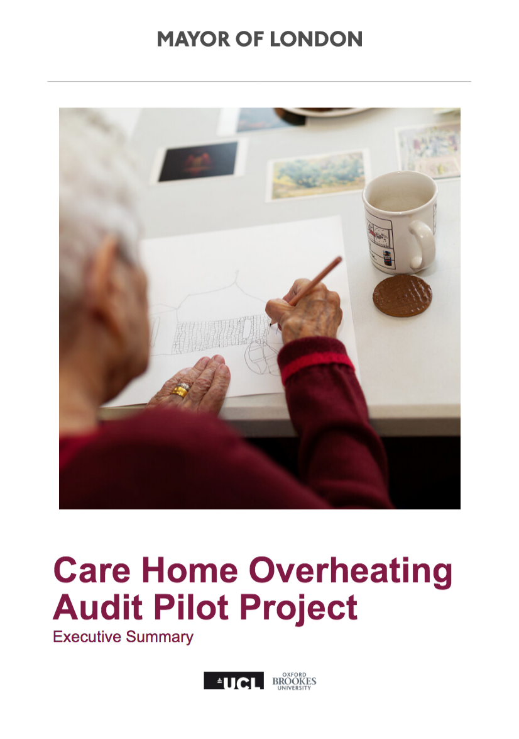
Resources
Website
Reports
climacare.org
25
25
Notes:
Option 1 layout

Slide 26
Publications
Eleni Oikonomou, Anna Mavrogianni, Nishesh Jain, Rajat Gupta, Paul Wilkinson, Alastair Howard, Ai Milojevic, and Mike Davies. “Assessing Heat Vulnerability in London Care Settings: Case Studies of Adaptation to Climate Change.” In 5th Building Simulation and Optimisation Virtual Conference, 2020.
Rajat Gupta, and Alastair Howard. “Summertime Indoor Temperatures and Thermal Comfort in Nursing Care Homes in London.” In 11th Windsor Conference Resilient Comfort, 2020. https://windsorconference.com/wp-content/uploads/2020/05/WC2020_Proceedings_small.pdf.
Rajat Gupta and Alastair Howard. “Monitoring the risk of summertime overheating in modern and older care settings in London.” In CIBSE ASHRAE Technical Symposium, Glasgow, 16-17 April 2020.
Anna Mavrogianni, Mike Davies, Eleni Oikonomou (2021) "Indoor overheating, climate resilience and adaptation of care settings". The Palgrave Handbook of Climate Resilient Societies. In press.
Rajat Gupta, Alastair Howard, Mike Davies, Anna Mavrogianni, Ioanna Tsoulou, Eleni Oikonomou, Paul Wilkinson (2021) "Examining the magnitude and perception of summertime overheating in London care homes". BSERT (in press)
Andrew Ibbetson, Ai Milocevic, Anna Mavrogianni, Eleni Oikonomou, Nishesh Jain, Ioanna Tsoulou, Giorgos Petrou, Rajat Gupta, Michael Davies, Paul Wilkinson, (2021) "Mortality benefit of building adaptations to protect care home residents against heat risks in the context of uncertainty over loss of like expectancy from heat". Climate Risk Management (in press)
Rajat Gupta, Alastair Howard, Mike Davies, Anna Mavrogianni, Ioanna Tsoulou, Nishesh Jain, Eleni Oikonomou, Paul Wilkinson "Monitoring and modelling the risk of summertime overheating and passive solutions to avoid active cooling in London care homes". Energy and Buildings (submitted)
Ioanna Tsoulou, Giorgos Petrou, Nishesh Jain, Eleni Oikonomou, Anna Mavrogianni, Rajat Gupta, Ai Milojevic, Alastair Howard, Paul Wilkinson, and Mike Davies. “Assessing the Current and Future Risk of Overheating in London's Care Homes: The Effect of Passive Ventilation.” In Building Simulation 2021 Conference, 2021 (submitted).
Eleni Oikonomou & Ioanna Tsoulou et al. "Adapting care homes to heat: comparison of building interventions” (in preparation)
Paul Wilkinson & Andrew Ibbetson et al. "Cost-benefit analysis of interventions to protect against heat risks to residents of UK care homes". (in preparation)
26
26
Notes:
Option 1 layout

Slide 27
Contact details Website: climacare.org Email: michael.davies@ucl.ac.uk
The UK Climate Resilience programme is supported by the UKRI Strategic Priorities Fund.
The programme is co-delivered by the Met Office and NERC on behalf of UKRI partners AHRC, EPSRC, ESRC.

