Slide 1
SPF UK Climate Resilience Programme Webinar Series 2021
Notes:
In the coming decades the UK is expected to experience hotter and drier summers, and more frequent and intense heatwaves. The UK also has a rapidly ageing population, with people aged 75 or over expected to account for 13% of the total population by 2035. Older populations can be more vulnerable to heat stress due to underlying chronic health complications. As older people spend much of their time indoors, their exposure to heat is largely governed by the indoor environment. In care homes, poor building design, ineffective heat management, and diverging needs and preferences between staff and residents may contribute to increased indoor heat exposure with detrimental consequences for the health of the most vulnerable residents. This webinar will describe the work to date of the ‘ClimaCare’ project in addressing these issues. We will discuss the monitoring and modelling that we have undertaken and also provide details of some initial work to monetize the health benefits of adaptations designed to protect against heat risks.

Slide 2
Timing
12:00 | UK Climate Resilience Programme news | Dr Kate Lonsdale, UK Climate Resilience Champion
12.05 | Overheating in Care Homes | Professor Mike Davies, University College London
12.25 | Response | April Cole, Care Quality Commission
12.35 | Q&A and discussion | Panellists
13.00 | End
Website: https://www.ukclimateresilience.org/
Notes:
Mike Davies is Professor of Building Physics and Environment at University College London (UCL). His research interests lie in the provision of healthy and comfortable built environments in the context of a changing climate. He was the founding Director of the UCL Institute for Environmental Design and Engineering. He is currently a member of the UK Committee on Climate Change (Adaptation) and Director of the multi-disciplinary Complex Built Environment Systems group at UCL.
April Cole is from the Care Quality Commission. April has worked in the health and care sector since 2002, and specifically policy since 2013. Her background is in public affairs and communications, and she has worked in both the public and private sector in the UK and Australia, including European lobbying for the Royal College of Nursing. At the Care Quality Commission she has worked on surveillance information for the public, the updated technology in care web resource, and consumer rights in social care. She completed her MSc in Health Policy in 2019, focussing on monitoring technologies in adult social care, and is a trained Schwartz Round facilitator.

Slide 3
How to engage
Presentations first then Q&A and discussion
Post questions in the Q&A box at any time
Upvote your favourites
Attendees will remain muted unless enabled to speak by the host​
Webinar (audio and slides) will be shared after the event
Technical problems – chat
Please note: this webinar is being recorded​
Twitter: @UKCRP_SPF #UKclimateResil
Website: https://www.ukclimateresilience.org/

Slide 4
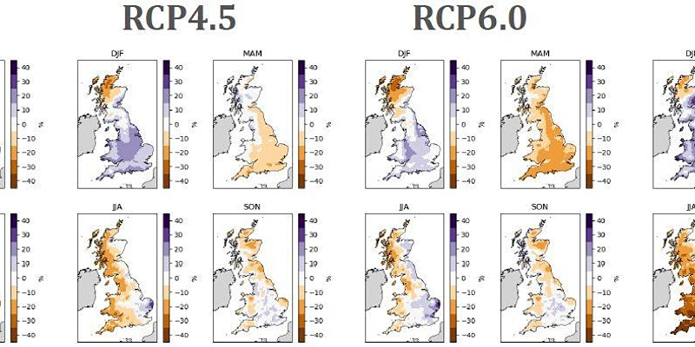
UKCEH Workshop 29 April 10.00 – 12.00
Programme news
UK Climate and Socio-economic Scenario Data Products
A workshop to present and discuss new data and products describing UK climate and socio-economic futures to support future research and policy on UK climate risk and resilience.
https://www.eventbrite.co.uk/e/workshop-on-uk-climate-and-socio-economic-scenario-data-products-tickets-144386472827
Notes:
UKCEH will be hosting an online workshop to describe and make accessible a new set climate and socio-economic scenario datasets and products for the UK, to support future research and policy on UK climate risk and resilience. The datasets and products are based on the most recent set of widely applied scenarios for investigating climate change risk and resilience - the IPCC-community Shared Socio-economic Pathways (SSPs) and Representative Concentration Pathways (RCPs). We have been working to produce downscaled and enriched RCP and SSP datasets and products specifically for the UK. We want now to share these data and products with the community, discuss how they might be used, and gather feedback on how best to make these data and products available.

Slide 5
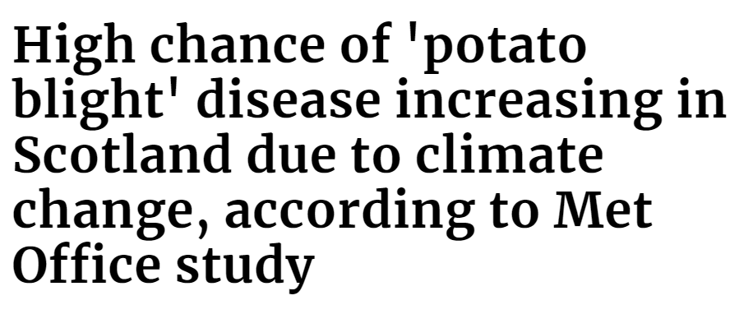
UKCR paper hits the headlines
Programme news
Future climate risk to UK agriculture from compound events by Freya Garry, Dan Bernie, Jemma Davie and Edward was covered by the Scotsman and Farming UK and on the weather blog of the Sun Online, as well as in print versions of The Telegraph and iNews this week.

Slide 6
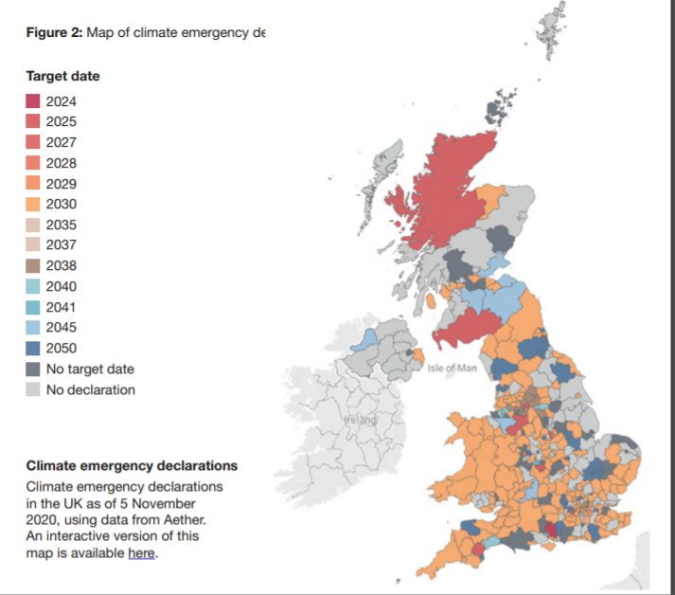
Wider News
There is a strong, vibrant and broad-based support for more climate action at the local level but a lack of capacity and expertise has affected some local authorities ability to respond.
New report
published by
PCAN
3 out of 4 local authorities have declared a climate emergency but these have been followed up with new or updated climate action plans in only 62% of cases
Notes:
There is strong, vibrant and broad-based support for more climate action at the local level in the UK, but a lack of capacity and expertise, exacerbated by COVID-19, has affected some local authorities’ ability to respond.
A new report by the Place-Based Climate Action Network (PCAN) has found that three out of four local authorities have declared a climate emergency but these have been followed up with new or updated climate action plans in only 62% of cases.
However, new institutional models that promote more inclusive, partnership-based approaches to local climate action are taking off, with a growing number of local climate commissions, action networks and participatory forums like climate assemblies and juries.
The report also highlights the role played by local businesses and the financial sector, and the need for a just transition to underpin the response to climate change to ensure people and communities are not left behind.

Slide 7
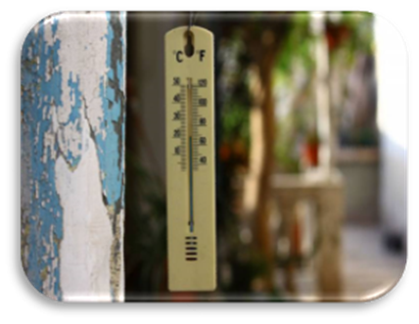
Overheating Care Homes Mike Davies, University College London

Slide 8
Response April Cole Care Quality Commission

Slide 9
Questions, answers, discussion

Slide 10
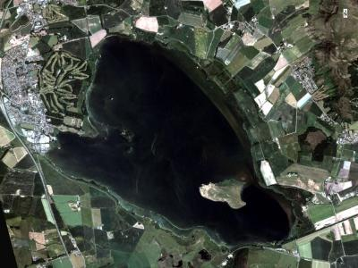
Next webinars:
Wednesday, 21st April, 2021 12.00-13.00
Speaker: Youssef Nassef (UNFCCC Secretariat), Louise Ellis (University of Leeds), Liam Upson (Cabinet Office)
Title: COP 26: Implications for enhancing resilience
Wednesday, 5 May, 2021 12.00-13.00
Speaker: Peter Hunter (University of Stirling)
Title: Delivering resilience to climate-related impacts on water quality through earth observation
Register on our website:
https://www.ukclimateresilience.org/news-events/climate-resilience-webinar-series-2020-2021/

Slide 11
Contact details Website: www.ukclimateresilience.org Twitter: @UKCRP_SPF YouTube: UK Climate Resilience programme
The UK Climate Resilience programme is supported by the UKRI Strategic Priorities Fund.
The programme is co-delivered by the Met Office and NERC on behalf of UKRI partners AHRC, EPSRC, ESRC.

