Slide 1
Exploring the changing structure of spatially coherent widespread flood events across the UK Paul Sayers – Sayers and Partners 24 February 2020

Slide 2
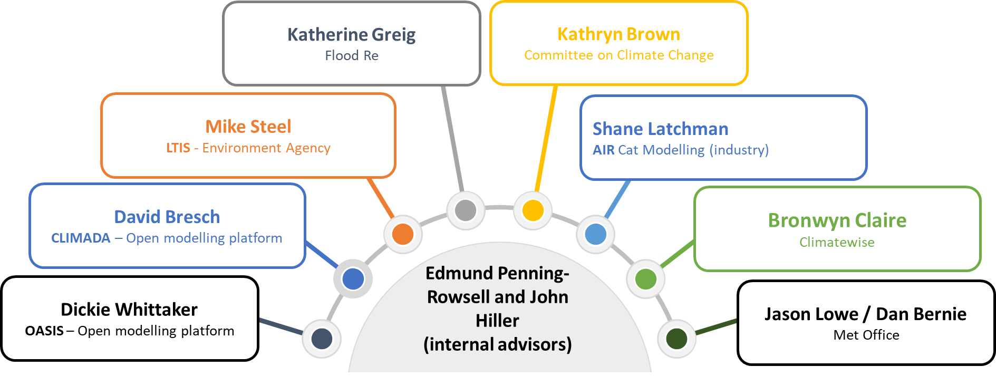
AquaCAT Flood risk estimates combining the best of techniques from catastrophe modelling and future flood risk assessment tools Part way through – due to complete 2021/22
The team and acknowledgements: Comments and reflections from our Advisory Board are gratefully acknowledged together with the support of the UKCRP
Notes:
Option 2 layout

Slide 3
Research objectives
1
Understand spatial coherence of flood events and how this may change in the future based on analysis of UKCP18 data
2
Compare alternative frameworks for quantifying risk (not elaborated here)
Research
Objectives
3
Identify and assemble selected vulnerability and exposure data and assess applicability to UK risks and users (not elaborated here)
4
Apply the spatial events in a national risk assessment to explore the importance of including spatial coherence from a risk perspective
Notes:
Option 1 layout

Slide 4
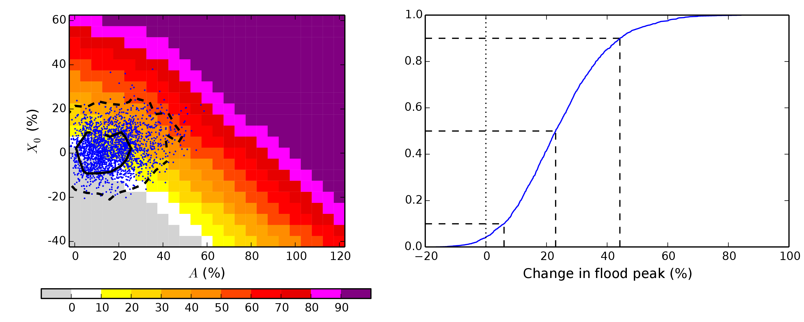
Motivation
UKCP18 is a rich resource
Extensively mined to provide high-resolution insights into future flows at a site (below)
But…
Limited use is made of what it can tell us about changes in spatially coherent (widespread) flood events
Why do we care?
Kay et al., 2020
Notes:
And this is what we use in the CCRA3 flood projections for example

Slide 5
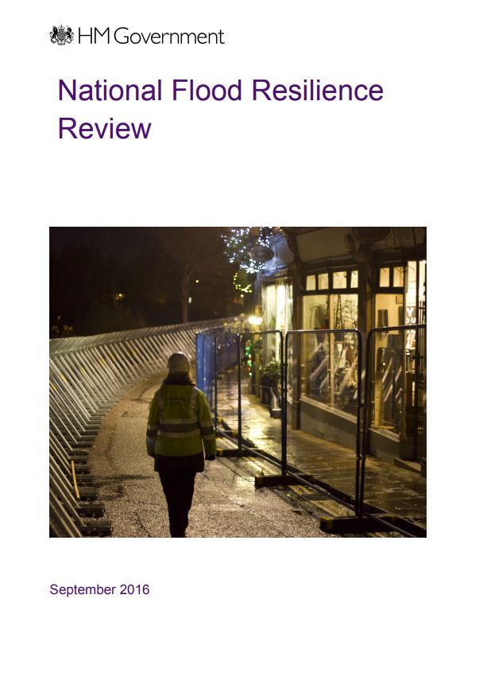
Motivation
Spatial inter-connectiveness…
‘disruption can quickly lead to widespread and serious consequences…..proactive and reactive measures needed to improve resilience of (infrastructure) network’ (Evans et al., 2004) – an issue returned to in National Flood Resilience Review (2016)
Real floods are spatially coherent …
An event-based understanding of risk is common place within the insurance and financial sectors, but public sector understanding of risk often ignores spatial correlations despite research on present day widespread events (Environment Agency, 2011, Lamb et al, 2017).
We are unsighted on future change in spatial events….
Will climate change influence the frequency and severity of widespread events and, if so, what are implications for how, when and where we target our adaptation effort?
Notes:
Option 1 layout

Slide 6
Objective 1 – Spatial flood hazard events
A simplified conventional present-day approach to event simulation
Observations
(e.g., gauged data)
Stochastic event set
(e.g., Heffernan and Tawn)
Event simulation
Event flood footprint
Event impact
Analysis of event damages
Statistical measures of damage
Notes:
Option 1 layout

Slide 7
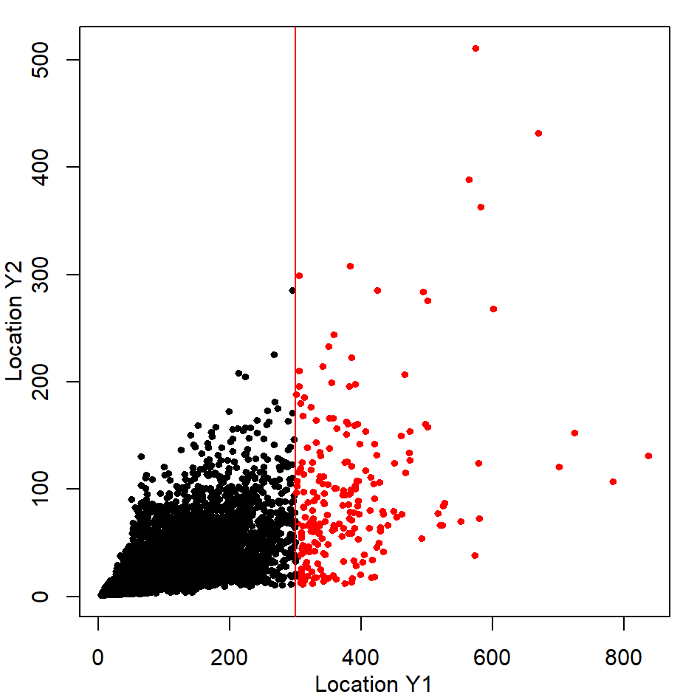
Objective 1 – Spatial flood hazard events
A simplified conventional present-day approach to event simulation
Observations
(e.g., gauged data)
Consider location A. A distribution is fitted at location B conditional on the flow at A being above a threshold and being the most extreme value within the domain (the conditional distribution).
New events are generated by:
1. Picking a location within the domain, Y1, as the most extreme flow for this event.
2. Setting a threshold for this location and using the marginal distribution at Y1 to determine the flows that exceed the set threshold.
3. Use conditional distribution to determine the flow at Y2 conditional on the flow at Y1.
4. Flows at Y1 and Y2 provide a new unseen event (Red dots)
Widely applied (e.g. Wyncoll et al 2013, Lamb et al, 2016)
Stochastic event set
(e.g., Heffernan and Tawn)
AquaCAT Draft

Slide 8
Objective 1 – Spatial flood hazard events
Future climate driven events
“Observations”
(UKCP18 RCM)
Flood hazard simulation
(Grid-to-Grid)
Event extraction
(PoT and footprint)
Stochastic event set
(Empirical Copula and Heffernan and Tawn)
Impact calculations
Analysis of event damages
Statistical measures of damage
Notes:
Option 1 layout

Slide 9
Objective 1 – Spatial flood hazard events
Met Office Hadley RCM
12km daily-timestep data modelled for 12 ensemble members.
Based on RCP8.5 projections (as these are only regional projections available).
Each ensemble member uses a unique set of perturbed parameters
This gives spatially consistent driving data, but one that balances performance for mean floods flows and droughts.
Present and future time slices (30 years each epoch)
Future climate driven events
“Observations”
(UKCP18 RCM)
Flood hazard simulation
(Grid-to-Grid)
Event extraction
(PoT and footprint)
Stochastic event set
(Empirical Copula and Heffernan and Tawn)
Notes:
Option 1 layout

Slide 10
Objective 1 – Spatial flood hazard events
Future climate driven events
Grid-to-Grid Hydrological Model
Is used to translates the RCM outputs to river flows (and undefended inundation proxy) using 15-min time-step and 1km² grid across Great Britain
“Observations”
(UKCP18 RCM)
Flood hazard simulation
(Grid-to-Grid)
Event extraction
(PoT and footprint)
Stochastic event set
(Empirical Copula and Heffernan and Tawn)
(Bell et al)
Notes:
Option 1 layout

Slide 11
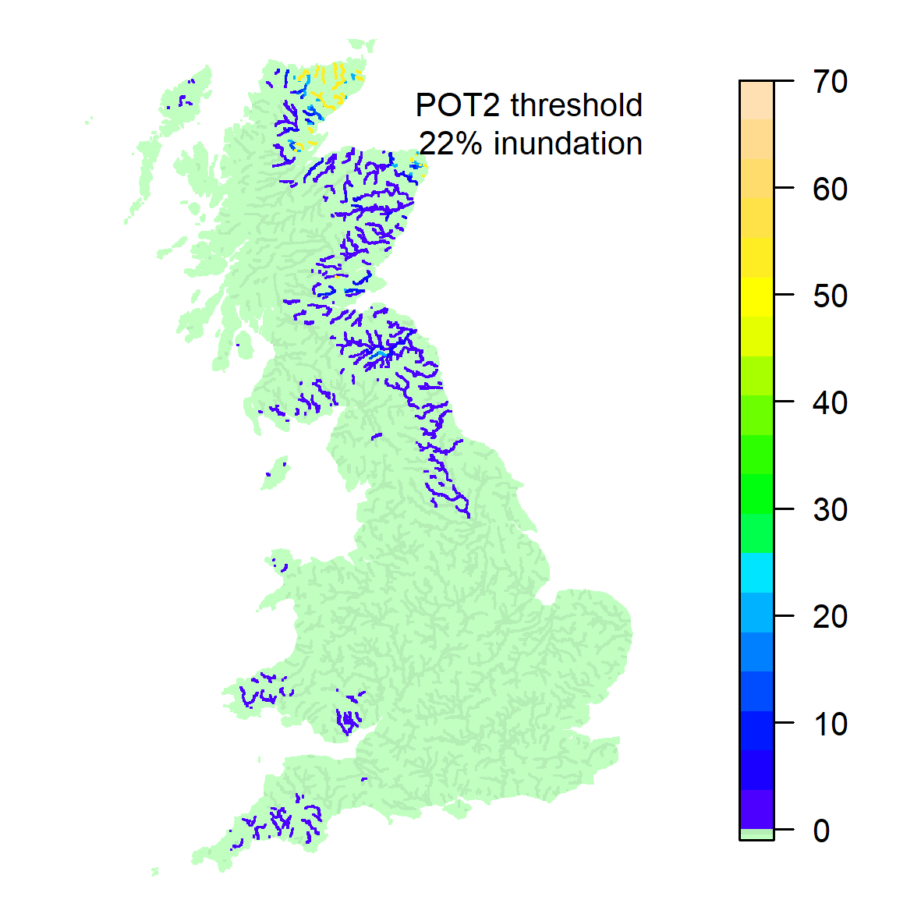
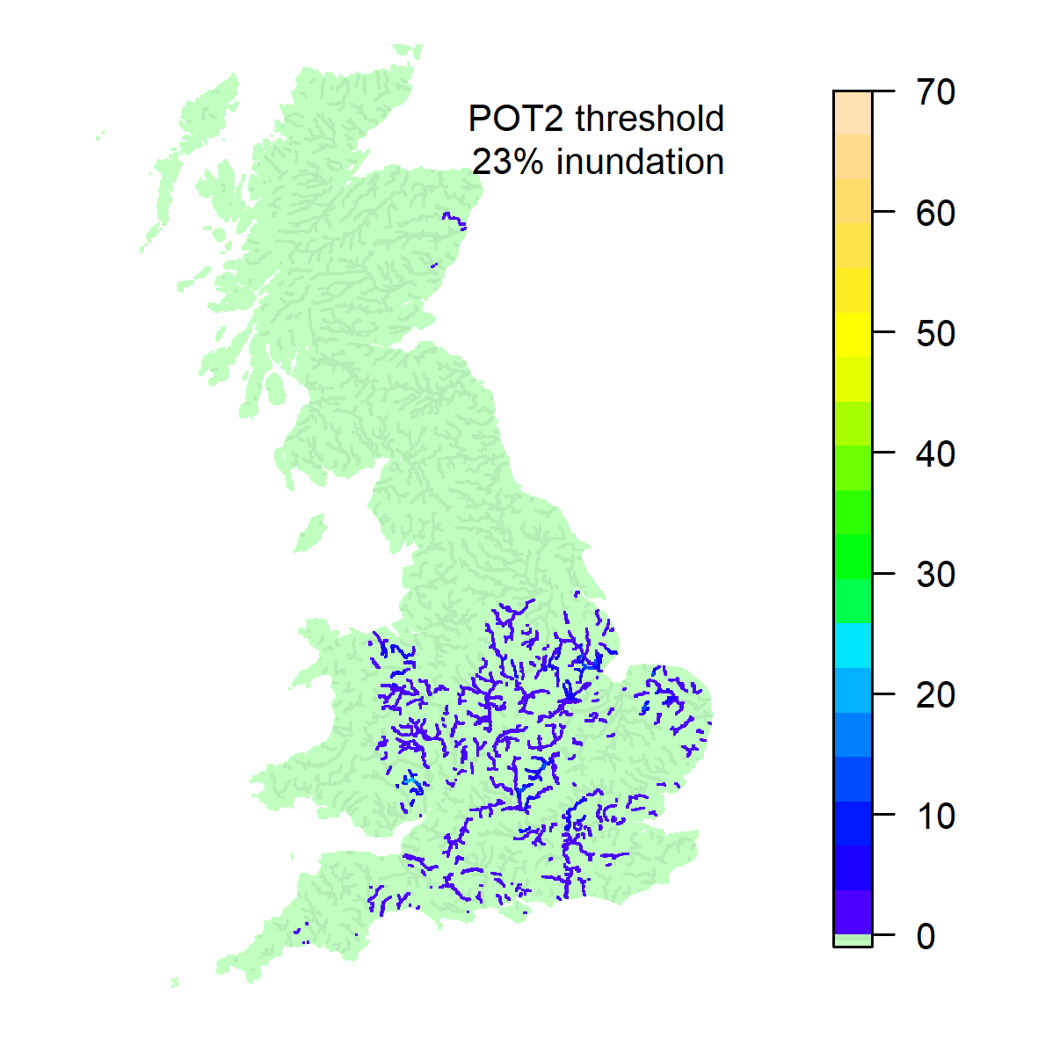
Objective 1 – Spatial flood hazard events
Future climate driven events
“Observations”
(UKCP18 RCM)
Flood hazard simulation
(Grid-to-Grid)
Event extraction
(PoT and footprint)
Stochastic event set
(Empirical Copula and Heffernan and Tawn)
AquaCAT Draft
Two example events from G2G (two of the largest in the G2G simulations)
Each highlighted point is above is a given flood threshold (here 2 events per year at each point)..
Notes:
Option 1 layout

Slide 12
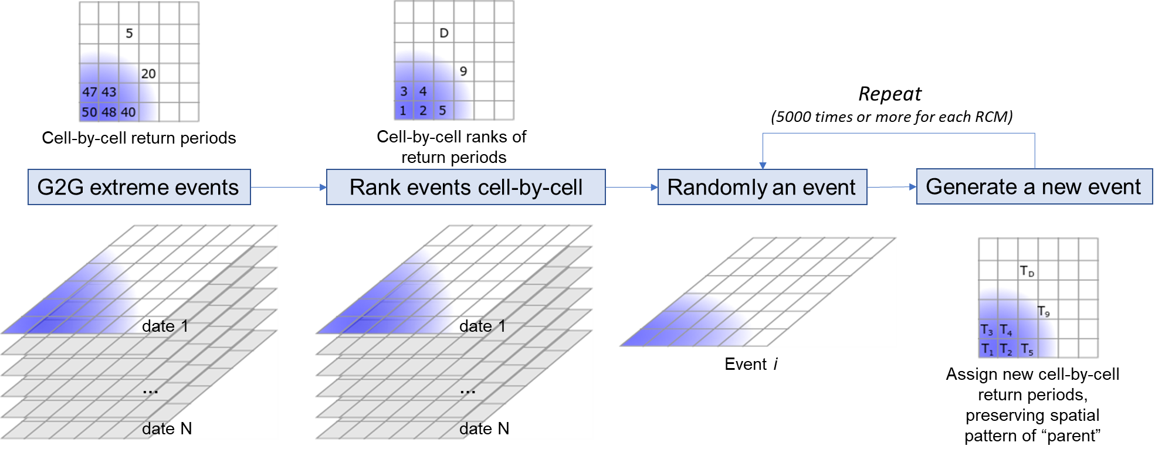
Objective 1 – Spatial flood hazard events
AquaCAT Draft
Future climate driven events
“Observations”
(UKCP18 RCM)
Flood hazard simulation
(Grid-to-Grid)
Event extraction
(PoT and footprint)
Stochastic event set
(Empirical Copula and Heffernan and Tawn)

Slide 13
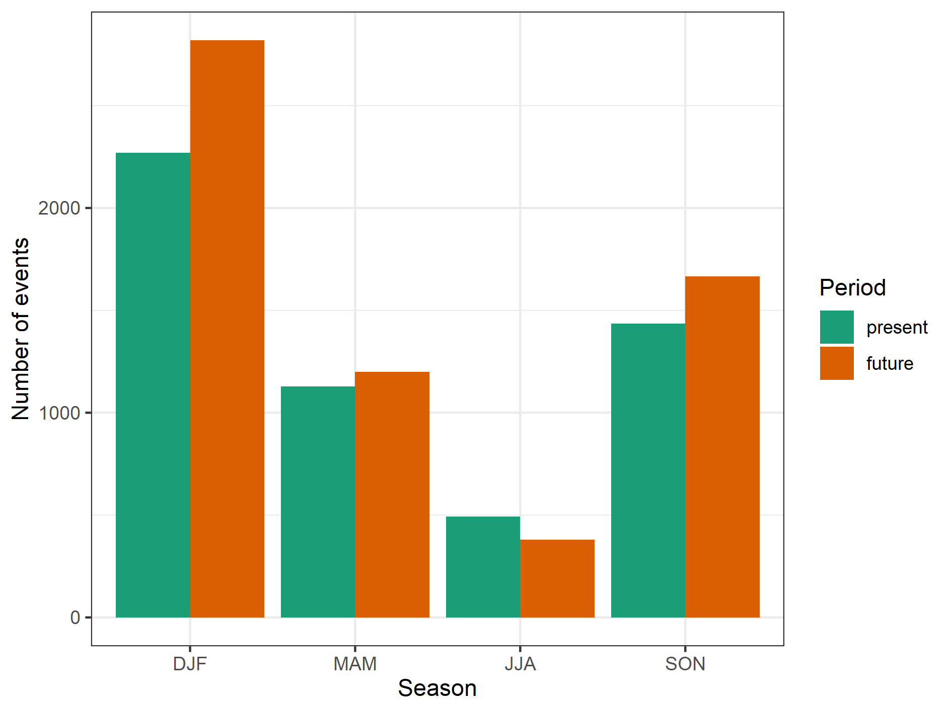
Objective 1 – Spatial flood hazard events
Future climate driven events
Comparing present and future
The overall number of widespread events increases, except in Summer (JJA) where it falls
“Observations”
(UKCP18 RCM)
Flood hazard simulation
(Grid-to-Grid)
Event extraction
(PoT and footprint)
Stochastic event set
(Empirical Copula and Heffernan and Tawn)
AquaCAT Draft
Notes:
Compiling the Grid-to-Grid events for the present and future timeslices there are a few immediate patterns that emerge.
Firstly, we see that the overall number of events increases, except in Summer (JJA) where it falls

Slide 14
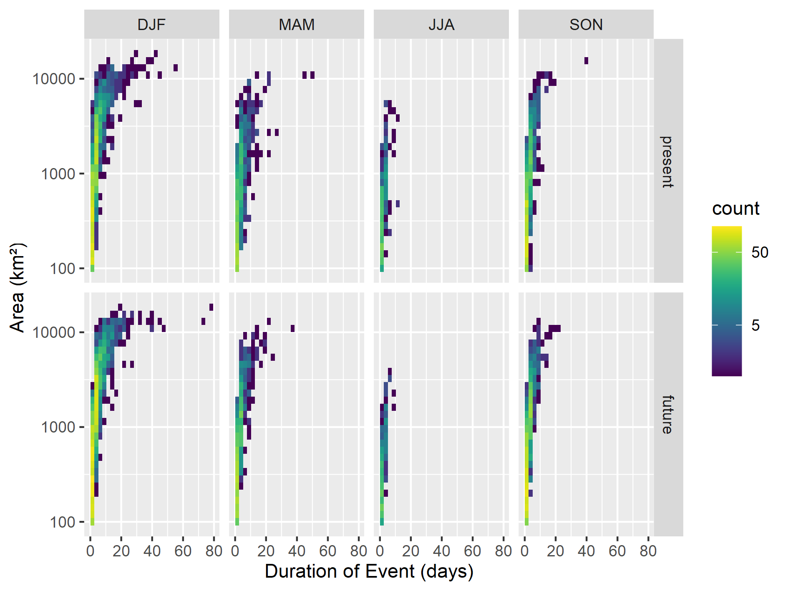
Objective 1 – Spatial flood hazard events
Comparing present and future
And perhaps large scale winter events persist for longer (DLF).
Future climate driven events
“Observations”
(UKCP18 RCM)
Flood hazard simulation
(Grid-to-Grid)
Event extraction
(PoT and footprint)
Stochastic event set
(Empirical Copula and Heffernan and Tawn)
AquaCAT Draft
Notes:
Compiling the Grid-to-Grid events for the present and future timeslices there are a few immediate patterns that emerge.
Firstly, we see that the overall number of events increases, except in Summer (JJA) where it falls

Slide 15
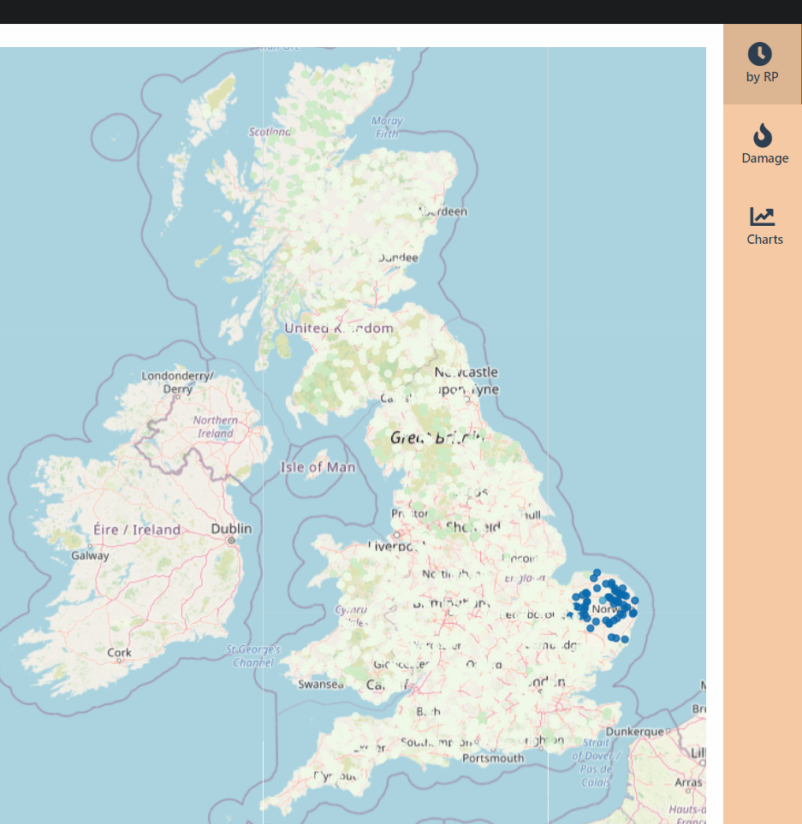
Objective 2 – event-based risks (present and future)
Future climate driven events
“Observations”
(UKCP18 RCM)
Draw event
(i.e spatially coherent hazard event)
Event i
Flood hazard simulation
(Grid-to-Grid)
Event extraction
(PoT and footprint)
Stochastic event set
(Empirical Copula and Heffernan and Tawn)
AquaCAT - Draft
Notes:
Option 1 layout

Slide 16
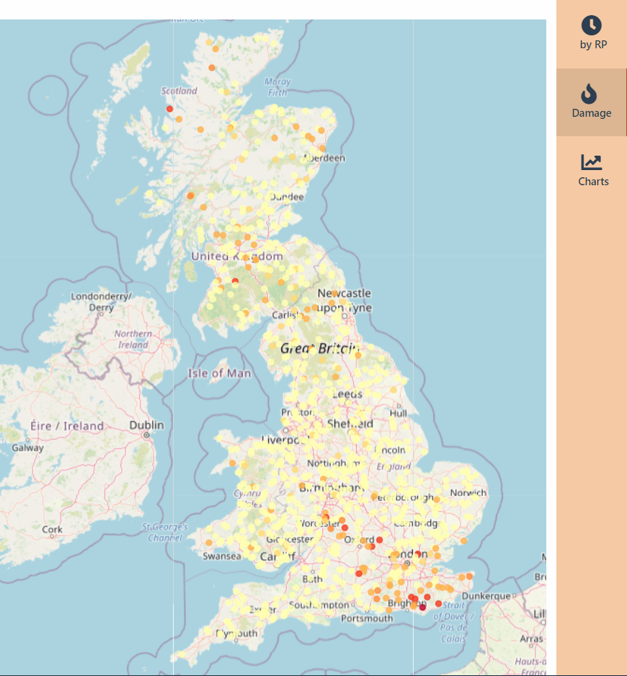
Objective 2 – event-based risks (present and future)
Future climate driven events
“Observations”
(UKCP18 RCM)
Draw event
(i.e spatially coherent hazard event)
Flood hazard simulation
(Grid-to-Grid)
Event extraction
(PoT and footprint)
Stochastic event set
(Empirical Copula and Heffernan and Tawn)
Event damages
(Future Flood Explorer – direct for now)
AquaCAT - Draft
Event j
Notes:
Option 1 layout

Slide 17
Objective 2 – event-based risks (present and future)
Future climate driven events
Repeat
to minimum no. events then until convergence on chosen static
Expected annual or season risk
Extreme ‘event risk’
(i.e., the 1in100 year risk at the spatial scale of interest, say UK or England)
“Observations”
(UKCP18 RCM)
Draw event
(i.e., spatially coherent hazard event)
Flood hazard simulation
(Grid-to-Grid)
Event extraction
(PoT and footprint)
Stochastic event set
(Empirical Copula and Heffernan and Tawn)
Event damages
(Future Flood Explorer)
Statistical measures of damage
Notes:
Option 1 layout

Slide 18
Objective 2 – event-based risks (present and future)
Future climate driven events
Mean (Expected Annual Damage)
AquaCAT – Draft illustration
Notes:
Option 1 layout

Slide 19
Objective next….
Future steps for AquaCAT – event-based present and future risks with adaptation and socio-economic change
“Observations”
(UKCP18 RCM)
Socio-economic change
(e.g. Cambridge Econometrics)
Flood hazard simulation
(Grid-to-Grid)
Event extraction
(PoT and footprint)
Stochastic event set
(Empirical Copula and Heffernan and Tawn)
Impact
(FFE)
Statistical measures of damage
Adaptation (FFE)
Notes:
Option 1 layout

Slide 20
Concluding remarks
About the climate from the Grid-2-Grid and event-set simulation
The overall number of widespread events increases in the future, except in Summer (JJA) where it falls
Perhaps large scale winter events persist for longer in the future
There seems to be limited need for bias correction in the context of spatial structure
About event-based climate risk and adaptation assessment using the Future Flood Explorer
Event-based approaches require highly efficient damage simulation.
Future risks however not only response to climate but also adaptation choices and socio-economic development.
‘High hazard’ and ‘high damage’ may or may not be spatially coherent
Notes:
Option 1 layout

Slide 21
Next steps
Next steps
We will be continuing to work on the research in the coming months with various papers in press
About the opportunity
The research provides a start rather than end – opportunities exist to include network disruption and other hazards sources; as well as continuing to explore the structure of future events and the influence on national investment (for example)
Notes:
Option 1 layout

Slide 22
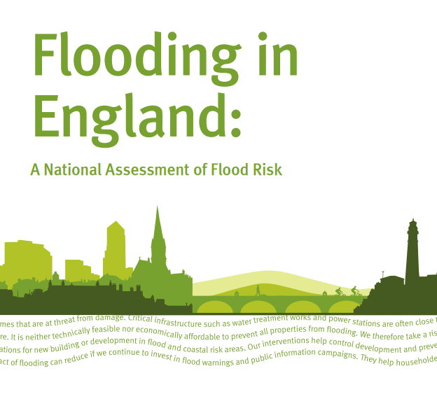
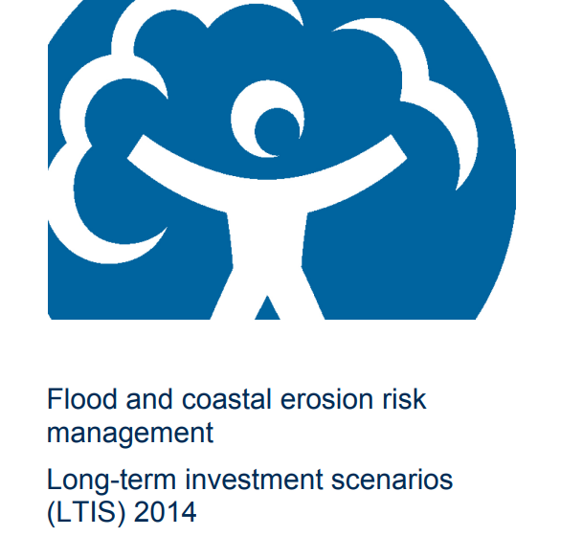
Response – Environment Agency
This research focuses on some of our core questions:
What’s the chance of a big flood/loss somewhere in England each year?
Are there particular strategies that help manage these large scale events better than others?
How will these change with climate change?
How can we use spatial coherence to inform our decisions and activities?
National scale flood incident planning and response, risk assessment and investment - NaFRA2 and LTIS
Communication of risk and resilience
Guidance
Notes:
Option 1 layout

Slide 23
Contact details Website: www.sayersandpartners.co.uk / www.ukclimateresilience.org email: paul.sayers@sayersandpartners.co.uk Twitter: @floodsman @UKCRP_SPF YouTube: UK Climate Resilience programme
The UK Climate Resilience programme is supported by the UKRI Strategic Priorities Fund.
The programme is co-delivered by the Met Office and NERC on behalf of UKRI partners AHRC, EPSRC, ESRC.

