Slide 1
SPF UK Climate Resilience Programme Webinar Series 2021
Notes:
CAT modelling was developed in the late 1980s to capture the spatial correlation of extreme events, with event footprints being used to demonstrate how an extreme event impacts different locations at a similar time. Separately, current approaches to at-site flood risk estimation apply climate change allowances to flood frequency estimates based on observations from the current period. These modified flow frequency estimates are then used to calculate flood risk and associated losses using a variety of means.
The present work brings together these two strands to develop spatially resolved projections of changes in river flow and, together with new analysis of the spatial coherence, to generate a wider collection of plausible events to improve risk modelling of the rarest events. This was achieved by improving known methods to generate extreme, widespread flood events directly based on outputs from the Grid-to-Grid hydrological model (Bell et al., 2009), driven by UKCP18 datasets. These modelled events provided coherent and highly credible descriptions of changes in flow based on spatially coherent climate change information. These small number of widespread extreme events generated directly from Grid-to-Grid have been extended using copula-based methods to generate a collection of plausible “extreme” events based on the climate of 1980-2010 and on climate projections of 2050. The collection of events is then applied to an event based risk analysis using Future Flow Explorer (FFE).

Slide 2
Timing
12:00 | UK Climate Resilience Programme news | Professor Suraje Dessai ​Champion, UK Resilience Programme
12.05 | Simulating spatially coherent widespread flood events across the UK | Paul Sayers, Sayers and Partners
12.30 | Response | Mike Steel, Environment Agency
12.40 | Q&A and discussion | Panellists
13.00 | End
Website: https://www.ukclimateresilience.org/
Notes:
Paul Sayers is a recognised expert on climate, its impact on flood and coastal risks (at a community, city and regional scale) and the development of resilience and adaptation policies and strategies. Paul has over 25 years of experience in all aspects of flood, water and coastal management, including the leading the flood projections for the latest UK climate Change Risk Assessment. Paul has worked in the UK and internationally, including collaborations on strategic responses to climate issues in Australia, China, Malaysia, Indonesia, Guyana, Denmark, Norway, Italy, Netherlands, Canada, Nigeria, Ethiopia, Kenya and the USA (and many others). In addition to his applied research consultancy activities at Sayers and Partners, Paul continues to be part of leading international research groups at the University of East Anglian (the Tyndall Centre) and TU Delft/IHE in the Netherlands. Paul is also an advisor to the Joint Defra/Environment Research Programme (on flood and coastal Asset Management) and is an Associate Fellow of the ODI (Global Risk and Resilience). Paul is also a member of the Editorial Board for the Journal of Flood Risk Management and acts as a reviewer for many others international journals and is currently leading exploration of spatially coherence events within the UK climate Resilience programme and contributing to the development of UKRC funded project, OpenCLIM.
Dr Mike Steel, Environment Agency: Mike is responsible for the Environment Agency’s long-term investment scenarios (LTIS) for flood and coastal risk management. LTIS is an economic assessment showing what future flood and coastal risk management could look like over the next 50 years in England. The latest LTIS study was published in 2019. Mike has previously worked on national flood risk assessment, and the plans to manage flood risk in the Thames Estuary until the year 2100 (TE2100). He has a PhD in hydrology and climate change, and is a Chartered Water and Environment Manager.

Slide 3
How to engage
Presentations first then Q&A and discussion
Post questions in the Q&A box at any time
Upvote your favourites
Attendees will remain muted unless enabled to speak by the host​
Webinar (audio and slides) will be shared after the event
Technical problems – chat
Please note: this webinar is being recorded​
Twitter: @UKCRP_SPF #UKclimateResil
Website: https://www.ukclimateresilience.org/

Slide 4
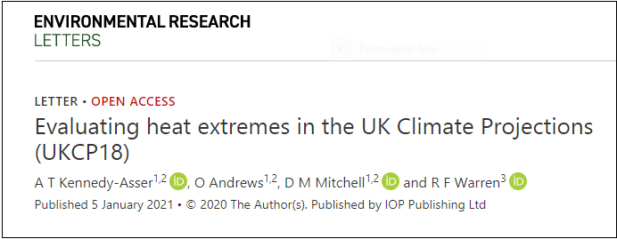
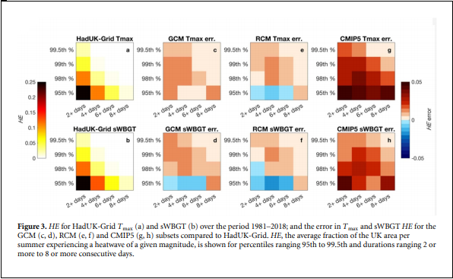
New research from the programme
Programme news
https://www.sciencedirect.com/science/article/pii/S2212096321000115
Notes:
In recent years, UK summer heatwaves have resulted in thousands of excess deaths, with both extreme temperatures and high humidity increasing health risks. Here, the UK Climate Projections 2018 (UKCP18) are compared to observational (HadUK-Grid) and reanalysis data (ERA5) to quantify model performance at capturing mean, extremes (95th to 99.5th percentiles) and variability in the climate state and heat stress metrics (simplified wet bulb global temperature, sWBGT; Humidex; apparent temperature). Simulations carried out for UKCP18 generally perform as well as or better than CMIP5 models in reproducing observed spatial patterns of UK climate relating to extreme heat, with RMSE values on average ~30% less than for the CMIP5 models. Increasing spatial resolution in UKCP18 simulations is shown to yield a minor improvement in model performance (RMSE values on average ~5% less) compared to observations, however there is considerable variability between ensemble members within resolution classes. For both UKCP18 and CMIP5 models, model error in capturing characteristics of extreme heat generally reduces when using heat stress metrics with a larger vapour pressure component, such as sWBGT. Finally, the 95th percentile of observed UK summer temperature is shown to have ~60% greater interannual variability than the summer mean over the recent past (1981–2000). This effect is underestimated in UKCP18 models (~33%) compared to HadUK-grid and ERA5. Compared to projected future changes in the global mean temperature, UK summer mean and 95th percentile temperatures are shown in increase at a faster rate than the global mean.

Slide 5
Met Office hackathon Two-day virtual event 16-17 March 2021
Programme news
Opportunity to explore new ways to visualise climate data such as UK Climate Projections (UKCP) and how to combine it with other types of data to produce new and innovative tools. Successful outputs may be showcased at COP26.
3 themes:
Marine and Coastal;
Nature Based Solutions;
Sustainable Development at Home and Abroad.
To register email cop26@metoffice.gov.uk with subject
‘Met Office Hackathon – Keep Me Informed’
Include:
your organisation’s name
theme(s) you are interested in.

Slide 6
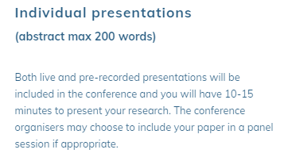
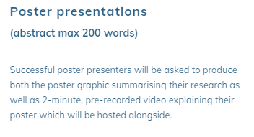
Wider News
Inviting contributions exploring the frontiers of adaptation and resilience research and its application to policy.
International perspectives and contributions that offer practical solutions or will impact on future policy are of particular interest.
Deadline likely to be extended until 5th March
More info at: https://climateexp0.org/adaptation-resilience-submissions/
Notes:
Preparing for and coping with the accelerating impacts of climate change requires adaptation in a wide range of policy areas. Yet, despite increasing calls for action, policy change to allow this is often slow. A range of counteracting forces and barriers can make it difficult to embed adaptation objectives into important policies and move them away from ‘business-as-usual’. However, deeper dynamics are also at play, where self-reinforcing mechanisms, feedbacks and path dependencies interact across different spatio-temporal scales and coalesce to establish policy lock-ins.
The aim of this interdisciplinary project is to uncover these lock-in dynamics and examine the extent to which they account for varying levels of climate change adaptation in Germany, the Netherlands and the U.K. (England).

Slide 7
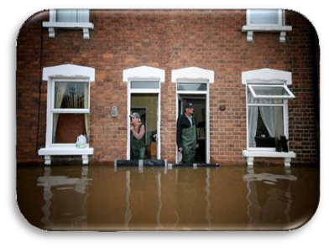
Simulating spatially coherent widespread flood events across the UK Paul Sayers, Sayers and Partners

Slide 8
Response Mike Steel, Environment Agency

Slide 9
Questions, answers, discussion

Slide 10
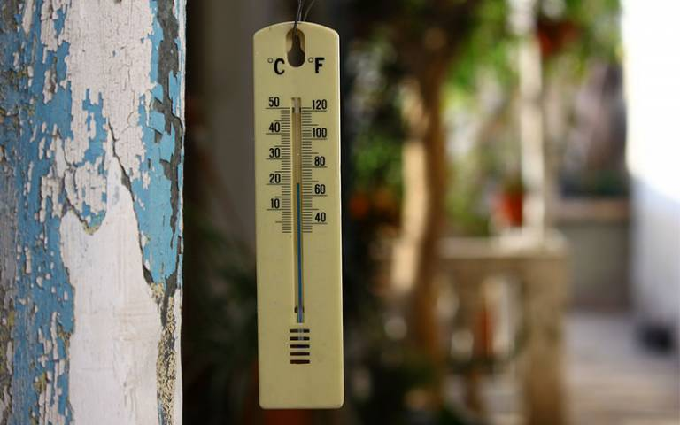
Next webinars:
Wednesday, 10th March, 2021 12.00-13.00
Speaker: Harriet Orr and Alex Cutler, Environment Agency
Title: Climate resilience and the national flood and coastal erosion risk
management strategy
Wednesday, 24th March, 2021 12.00-13.00
Speaker: Mike Davies, University College London
Title: Overheating in Care Homes
Register on our website:
https://www.ukclimateresilience.org/news-events/climate-resilience-webinar-series-2020-2021/

Slide 11
Contact details Website: www.ukclimateresilience.org Twitter: @UKCRP_SPF YouTube: UK Climate Resilience programme
The UK Climate Resilience programme is supported by the UKRI Strategic Priorities Fund.
The programme is co-delivered by the Met Office and NERC on behalf of UKRI partners AHRC, EPSRC, ESRC.

