Slide 1
SPF UK Climate Resilience Programme Webinar Series 2021 COP26: Implications for Enhancing Resilience
Notes:
In the coming decades the UK is expected to experience hotter and drier summers, and more frequent and intense heatwaves. The UK also has a rapidly ageing population, with people aged 75 or over expected to account for 13% of the total population by 2035. Older populations can be more vulnerable to heat stress due to underlying chronic health complications. As older people spend much of their time indoors, their exposure to heat is largely governed by the indoor environment. In care homes, poor building design, ineffective heat management, and diverging needs and preferences between staff and residents may contribute to increased indoor heat exposure with detrimental consequences for the health of the most vulnerable residents. This webinar will describe the work to date of the ‘ClimaCare’ project in addressing these issues. We will discuss the monitoring and modelling that we have undertaken and also provide details of some initial work to monetize the health benefits of adaptations designed to protect against heat risks.

Slide 2
Timing
12:00 | UK Climate Resilience Programme news | Professor Jason Lowe OBE, Head of Climate Services, Met Office
12.05 | COP26: Implications for Enhancing Resilience | Youseff Nassef, UNFCCC Liam Upson, Cabinet Office Louise Ellis, University of Leeds
12.35 | Q&A and discussion | Panellists
13.00 | End
Website: https://www.ukclimateresilience.org/
Notes:
Youseff Nassef is Director, Adaptation at UNFCCC.
Liam Upson is the Adaptation and Resilience campaign lead in COP26 Unit within the Cabinet Office. He previously worked in Defra on domestic climate adaptation policy, including the Adaptation Reporting Power, as well as in DFID on climate change policy and programming.
Louise Ellis is Director of Sustainability at University of Leeds

Slide 3
How to engage
Presentations first then Q&A and discussion
Post questions in the Q&A box at any time
Upvote your favourites
Attendees will remain muted unless enabled to speak by the host​
Webinar (audio and slides) will be shared after the event
Technical problems – chat
Please note: this webinar is being recorded​
Twitter: @UKCRP_SPF #UKclimateResil
Website: https://www.ukclimateresilience.org/

Slide 4
New video from the CREWS-UK Programme
Programme news
CHARACTERISING AND ADAPTING TO CLIMATE RISKS IN THE UK WINE SECTOR
The CREWS-UK team are analysing climate trends and ways to support climate change adaptation to capitalise on heightened climate suitability.
Wine grapes have an optimum growing season temperature range of a few degrees.
Vines can live for decades so decisions taken now are critical for long term resilience.
https://www.youtube.com/watch?v=melyyl6LhLY

Slide 5
Funding Opportunity: Embedded Researchers
Programme news
UK Research and Innovation (UKRI) is inviting applications from UK based academic researchers and non-academic host organisations to submit for Embedded Researcher projects as part of the UK Climate Resilience Programme.
Deadline for host organisations to submit a research pitch is the 21 May
Host organisations from Round 1:
Space4Climate
Environment Agency
Department of Education
Bristol City Council
Anglian Water
Manchester Climate Change Agency
https://www.ukclimateresilience.org/about/funding/funding-opportunities/
Notes:
This is a call for the second cohort of embedded researchers. Any area relating to climate resilience in the UK is eligible for this scheme. Applications from underrepresented areas in the Programme are encouraged e.g. health and wellbeing, tourism, finance.
You can request support for your salary, and travel and subsistence, for projects lasting no more than 12 months. The full economic cost can be up to £84,000. UKRI will fund 80% of this.
The anticipated start date for projects is 1 November 2021.
Final applications from host organisations and their proposed researchers must be received by 22nd July 2021, 16:00 UK time.

Slide 6
Conference
The abstract submission deadline for the poster session has been extended to Friday 23 April.
Follow us on #ClimateScienceConfererence
Met Office Science Conference
Register now https://bit.ly/2P21Q7g

Slide 7
UK Centre For Greening Finance & Investment CGFI
New national centre
CGFI began its work at the start of April 2021 ahead of COP26.
It’s a new national centre to accelerate the adoption and use of climate and environmental data and analytics by financial institutions internationally. It will unlock opportunities for the UK to lead in greening finance and financing green.
A consortium led by the University of Oxford Smith School of Enterprise and the Environment
https://ukcgfi.org/

Slide 8
COP26: Implications for Enhancing Resilience Yousef f Nassef, UNFCCC Secretariat Liam Upson, Cabinet Office Louise Ellis, University of Leeds

Slide 9
ADAPTATION CAMPAIGN COP 26
Climate change is happening now and practical action is urgently required to minimize and avert loss and damage. We need a step-change on adaptation and resilience, collaborating with governments, business, and CSOs to prepare for climate risks, mobilise further action, and increase adaptation financing.
Impact: People throughout the world, especially in developing countries, are able to thrive in the face of climate shocks, stresses and changes to our climate, with no-one left behind.
COP26 Objective: Through our COP26 Presidency the UK will encourage greater political ambition, tools, finance, coordination and commitments to build resilience through support to practical adaptation and disaster preparedness and response. We will develop activities across three key components through our adaptation and resilience campaign. Central to this will be a campaign (“Adaptation Action Coalition”) focussed on adaptation best practice and on actions to avert, minimize and address loss and damage and help create the environments and partnerships necessary to provide countries with the financial and technical tools, and the political attention needed to take action.
1
Plan
Plan, anticipate and respond to climate change, by enhancing disaster preparedness and embedding climate risk across all investments.
2
Act
Take action to reduce vulnerability in key priority sectors, strengthening resilience of people, nature and the economy by working and learning from others.
3
Finance
Significantly increase overall quantum of finance and improve quality and access of finance to local institutions and those most vulnerable.

Slide 10
COP26 ADAPTATION CAMPAIGN DELIVERABLES
Goals
Initiatives/deliverables
Negs outcome
1
Plan
Significantly improve disaster preparedness
Disaster Risk Finance:
Premium Subsidy, Development Insurance and Public Asset protection
Architecture reform: Global Crisis Lookout
Key partnerships: Risk-Informed Early Action Partnership (REAP), Coalition for Climate Resilient Investment (CCRI)/Coalition on Disaster Resilient Infrastructure (CDRI), InsuResilience
Adaptation planning:
Publication of National Adaptation Plans and Adaptation Communications
DRR efforts scaled-up to minimise, avert and address L&D.
AComms submitted to the UNFCCC to inform Global Stocktake
Support and encourage national adaptation planning and decision making
Act
2
Collaborate with State partners to deliver a step-change in A&R action on the ground
Advance action on A&R: countries & non-state actors, through:
Adaptation Action Coalition
The UN Group of Friends on Adaptation and Resilience.
Support and solidarity for LIFE AR (Least-Developed Country Initiative on Effective Adaptation and Resilience), Climate Visions.
Race to Resilience
Adaptation Research Alliance to facilitate evidence informed action
Action by state and non-state actors enhance adaptive capacity, strengthen resilience and reduce vulnerability to climate change
Mobilise and advance action on A&R through business, civil society and cities
Finance
3
Significantly increase overall quantum and quality of public and private adaptation financing
Increasing volume and improving quality of adaptation financing
Development Finance Institutions Accelerator Initiative
Mobilising (and improving the quality of) private financing;
Mobilising and improving access to public financing; influencing budgets, procedures and governance in MDBs, NDBs & DFIs (including the UNFCCC funds) towards adaptation, overall lobbying of donors on adaptation.
Increased volume and access to finance helps facilitate activities above
Improve access to adaptation finance for local institutions

Slide 12
Questions, answers, discussion

Slide 13
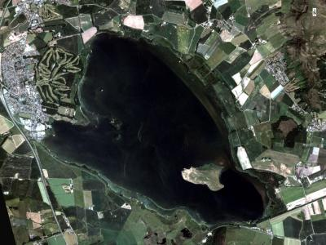
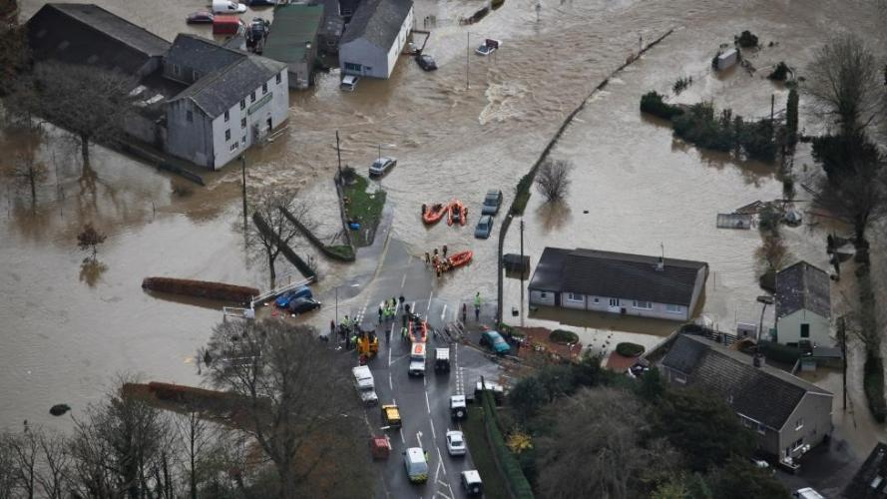
Next webinars:
Wednesday, 5th May, 2021 12.00-13.00
Speaker: Peter Hunter (University of Stirling)
Title: Delivering resilience to climate-related impacts on water quality through earth observation
Wednesday, 19th May, 2021 12.00-13.00
Speaker: Dapeng Yu (Loughborough University)
Title: Surface water flood ‘nowcasting’ for emergency services in a changing climate
Register on our website:
https://www.ukclimateresilience.org/news-events/climate-resilience-webinar-series-2020-2021/

Slide 14
Contact details Website: www.ukclimateresilience.org Twitter: @UKCRP_SPF YouTube: UK Climate Resilience programme
The UK Climate Resilience programme is supported by the UKRI Strategic Priorities Fund.
The programme is co-delivered by the Met Office and NERC on behalf of UKRI partners AHRC, EPSRC, ESRC.

