Slide 1
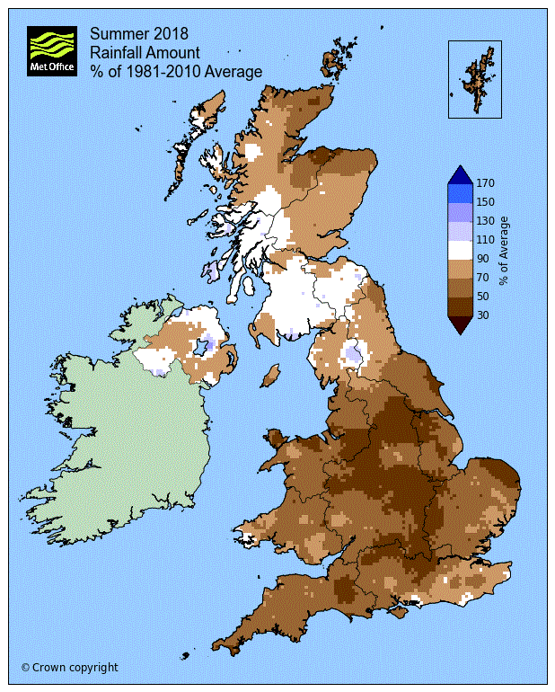
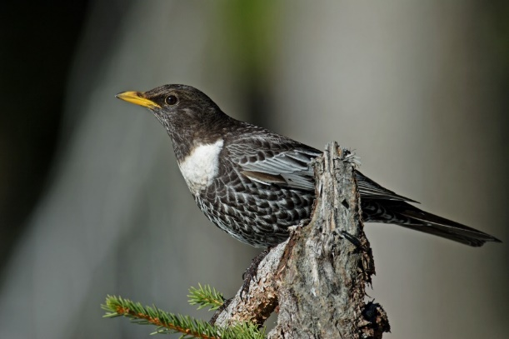
The 3rd UK Climate Change Risk Assessment Technical Report
Richard Betts
UK Climate Resilience Programme Webinar 30th June 2021

Slide 2
Assessing climate risks is a requirement of the 2008 Climate Change Act
56 : Report on impact of climate change
It is the duty of the Secretary of State to lay reports before Parliament containing an assessment of the risks for the United Kingdom of the current and predicted impact of climate change [every five years]
57 : Advice of Committee on Climate Change on impact report
(1) It is the duty of the Committee on Climate Change to advise the Secretary of State on the preparation of each of the Secretary of State’s reports under section 56.

Slide 3
The CCRA3 Independent Assessment
CCRA3 Advice Report
CCRA3 Supporting reports:
Flood risks
Water availability
Wildfire
Land use and emissions
Thresholds
Earth system tipping points
Human behaviour
Interacting risks
Socioeconomic dimensions
Valuation
Projections comparison
Improving accessibility
CCRA3 National Summaries and Factsheets
CCRA3 Technical Report
UKCP18 and other climate science
Impacts research
Adaptation research

Slide 4
CCRA3 Technical Report
36 months in the making
14 Lead Authors
42 Contributing Authors
17 Additional Contributors (CCC and Expert Advisory Panel)
1461 pages
2895 references

Slide 5
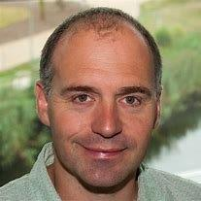
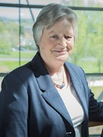
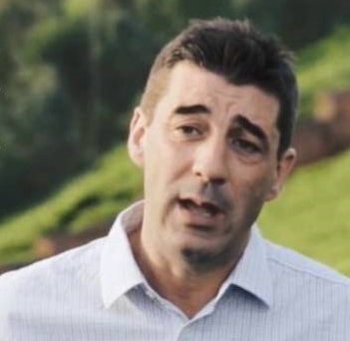
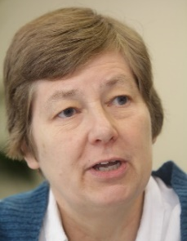
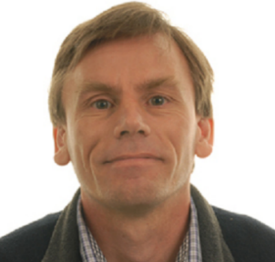
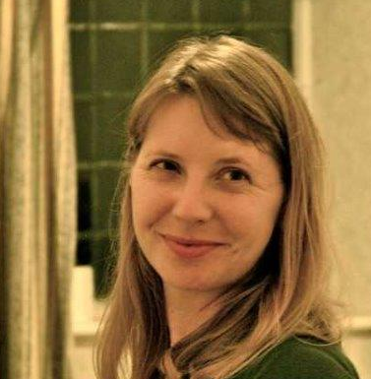
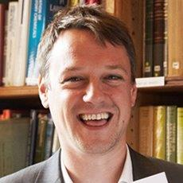
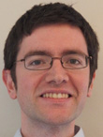
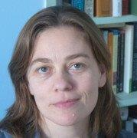
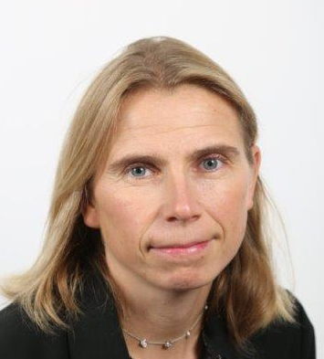
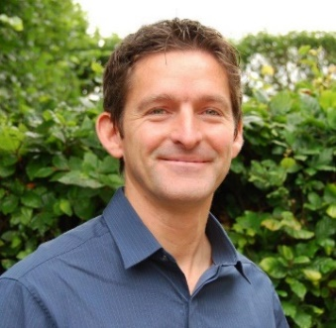
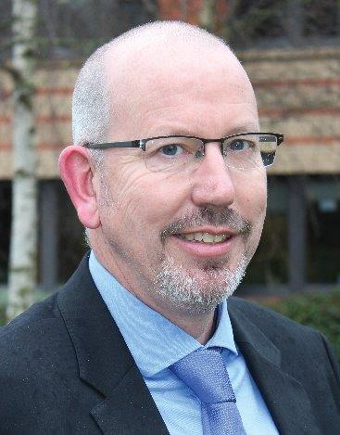
CCRA3 Technical Report lead authors
Prof Richard Betts (University of Exeter and Met Office – Project Director); Prof Dame Julia Slingo (University of Exeter & University of Bristol); Paul Watkiss (Paul Watkiss Associates); Dr Pam Berry (University of Oxford); Dr Iain Brown (University of Dundee); Dr Ruth Wood (University of Manchester); Prof Lee Chapman (University of Birmingham); Dr David Jaroszweski (University of Birmingham); Dr Sari Kovats (London School of Hygiene and Tropical Medicine); Rachel Brisley (JBA Consulting); Dr Swenja Surminski (London School of Economics); Prof Andy Challinor (University of Leeds); Prof Tim Benton (University of Leeds and Chatham House)

Slide 6
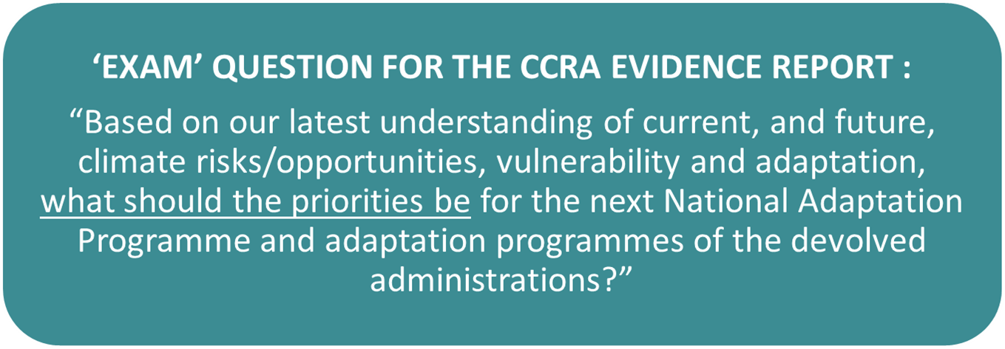
The CCRA “exam question”
To answer:
Identify a comprehensive set of risks of concern to policymakers
Assess the urgency of additional adaptation for each risk

Slide 7
61 risks / opportunities in 5 categories
Natural environment
and assets
Infrastructure
Health, communities
and built environment
Business and industry
International
dimensions
Example:
Risks to agriculture from pests, pathogens and invasive species
N1 | N2 | N3 | N4 | N5 | N6 | N7 | N8 | N9
N10 | N11 | N12 | N13 | N14 | N15 | N16 | N17 | N18
Example:
Risks to infrastructure services from river and surface water flooding
I1 | I2 | I3 | I4 | I5 | I6 | I7 | I8 | I9
I10 | I11 | I12 | I13
Example:
Risks to health and wellbeing from high temperatures
H1 | H2 | H3 | H4 | H5 | H6 | H7 | H8 | H9
H10 | H11 | H12 | H13
Example:
Risks to businesses from water scarcity
B1 | B2 | B3 | B4 | B5 | B6 | B7
Example: Risks to the UK from international violent conflict resulting from climate change impacts overseas
ID1 | ID2 | ID3 | ID4 | ID5 | ID6 | ID7 | ID8 | ID9
ID10

Slide 8
3 steps for assessing urgency of adaptation
What is the current and future
level of risk / opportunity?
Is the risk / opportunity being managed with current adaptation?
Are there benefits of further adaptation action in the next 5 years?
England, Northern Ireland, Scotland,
Wales (UK-wide for international risks)

Slide 9
What is the current and future
level of risk / opportunity?

Slide 10
What is the current and future
level of risk / opportunity?
Global temperature change (°C) relative to 1850-1900
Scenario 1:
Minimum level of future climate change with mitigation

Slide 11
Scenario 2:
Potential future climate change on current trajectory
What is the current and future
level of risk / opportunity?
?
Global temperature change (°C) relative to 1850-1900

Slide 12
Emissions scenarios associated
with the Representative Concentration Pathways (RCPs)

Slide 16
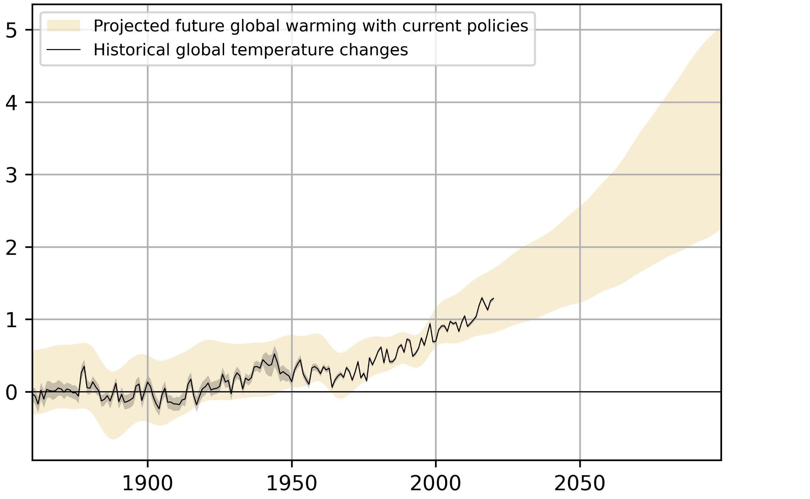
Future global warming consistent with current policies
95th percentile RCP6.0
UKCP18 global probabilistic projections
What is the current and future
level of risk / opportunity?
5th percentile RCP4.5
Global temperature change (°C) relative to 1850-1900

Slide 17
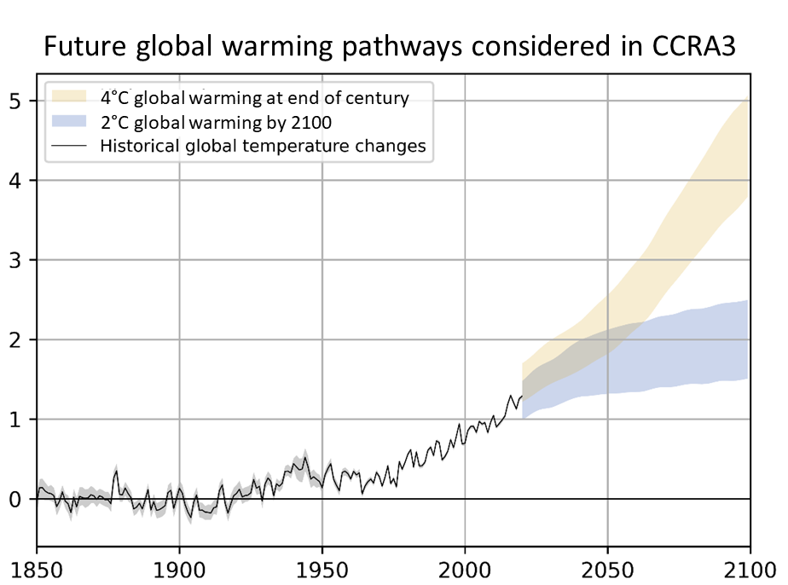
What is the current and future
level of risk / opportunity?
Global temperature change (°C) relative to 1850-1900

Slide 18
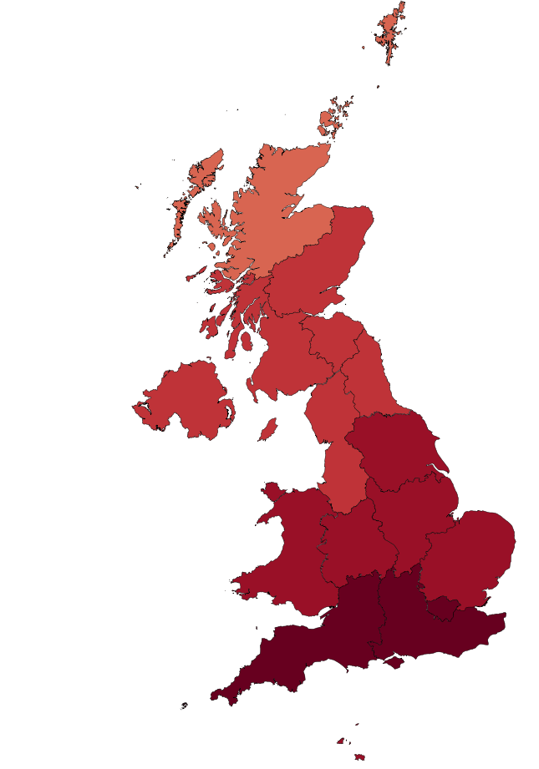
Risks to health and well-being from high temperatures: More Action Needed
Annual mean maximum air temperature change (°C)
4°C global warming in the 2080s
(UKCP18 RCP6.0 90th percentile)
Global warming | Number of heat-related deaths per year
Present-day | 2,000
2°C | 7,000
4°C | 13,000
Notes:
UKCP18 projections - All changes are from a 1981-2000 baseline
Present day is RCP2.6, 50th %
2C scenario is RCP 2.6, 50th %
4C scenario is RCP 6.0, 50th %

Slide 19
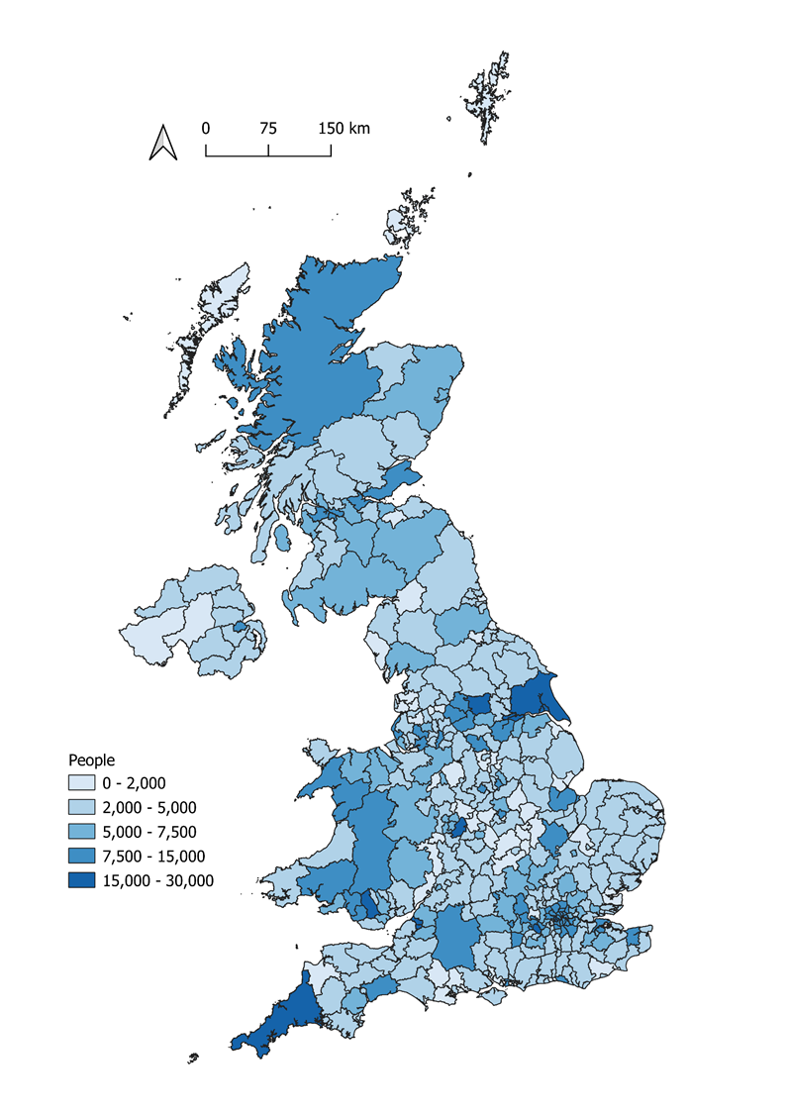
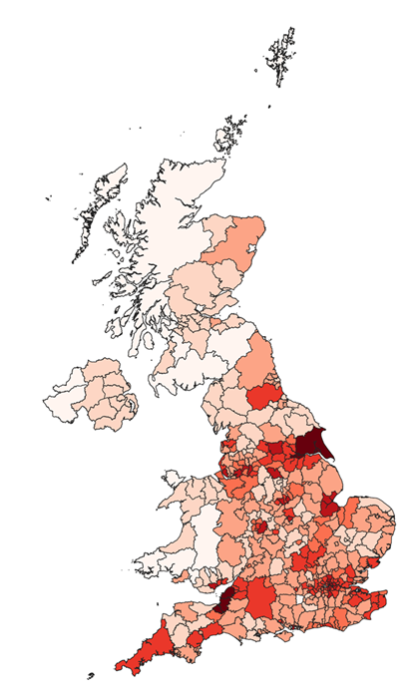
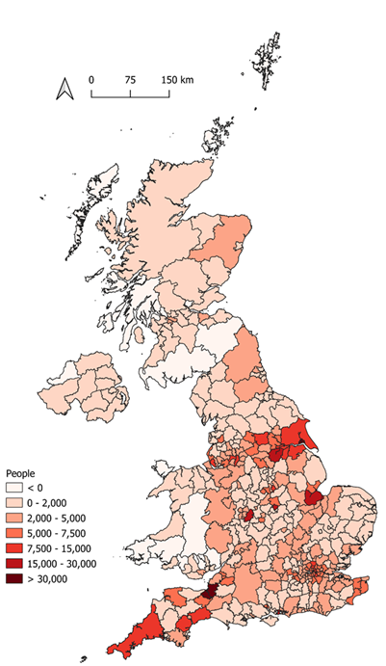
Projections of future flood risk
2050s on a pathway to
2°C global warming by
end of century
2080s on a pathway to
4°C global warming at
end of century
Present Day
0 – 2,000
2,000 – 5,000
5,000 – 7,500
7,500 – 15,000
15,000 – 30,000
<0
0 – 2,000
2,000 – 5,000
5,000 – 7,500
7,500 – 15,000
15,000 – 30,000
> 30,000
Sayers et al. 2020
Risks to infrastructure services from surface water flooding: More Action Needed
Risks to people, communities and building from flooding: More Action Needed
Risks to businesses from flooding: More Action Needed
Notes:
People exposed to 1in75 year flood hazard or more frequent – for fluvial, coastal and surface water combined
-Present day level
-2C, 2050, low population, no additional adaptation
-4C, 2080, low population, no additional adaptation

Slide 20
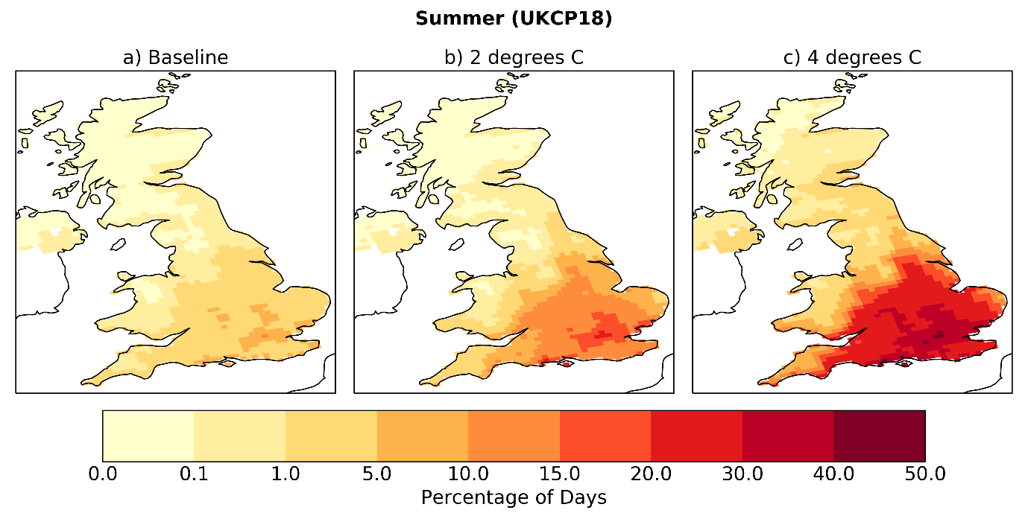
2°C global warming
4°C global warming
Present day
Wildfire risk:
percentage of summer days with Fire Weather Index above “very high”
Perry et al (2021)

Slide 21
Increase in runoff, debris & pollution
Reduction in water quality
Water supply interruptions
Reduction in summer mean rainfall
Soil erosion
Poor visibility
Increase in sediment in water courses
Increase in flood risk
Widfires and the natural environment: interacting and cascading risks
Increase in carbon emissions
Drought
Species & habitat loss
Damage to upland peat
Wildfire
Impacts on heritage & archaeology
Loss of natural capital
Extreme summer temperatures
Crop & forage impacts
Fallen trees, canopy damage
Habitat degradation
Damage/disruption
Water demand to put out fires
Poor air quality
Climate Driver nodes
Reduction in forestry productivity
Hazardous event nodes
Transport delays/damage
Permanent loss of ancient woodland
Impact nodes
Health impact
Competing demand

Slide 22
Which risks are we prepared for?
Natural environment
and assets
Infrastructure
Health, communities
and built environment
Business and industry
International
dimensions
N1 | N2 | N3 | N4 | N5 | N6 | N7 | N8 | N9
N10 | N11 | N12 | N13 | N14 | N15 | N16 | N17 | N18
I1 | I2 | I3 | I4 | I5 | I6 | I7 | I8 | I9
I10 | I11 | I12 | I13
H1 | H2 | H3 | H4 | H5 | H6 | H7 | H8 | H9
H10 | H11 | H12 | H13
B1 | B2 | B3 | B4 | B5 | B6 | B7
ID1 | ID2 | ID3 | ID4 | ID5 | ID6 | ID7 | ID8 | ID9
ID10

Slide 23
Only 7 of 61 risks / opportunities scored “sustain current action” or “watching brief”
Natural environment
and assets
Infrastructure
Health, communities
and built environment
Business and industry
International
dimensions
N1 | N2 | N3 | N4 | N5 | N6 | N7 | N8 | N9
N10 | N11 | N12 | N13 | N14 | N15 | N16 | N17 | N18
I1 | I2 | I3 | I4 | I5 | I6 | I7 | I8 | I9
I10 | I11 | I12 | I13
H1 | H2 | H3 | H4 | H5 | H6 | H7 | H8 | H9
H10 | H11 | H12 | H13
B1 | B2 | B3 | B4 | B5 | B6 | B7
ID1 | ID2 | ID3 | ID4 | ID5 | ID6 | ID7 | ID8 | ID9
ID10

Slide 24
34 of 61 risks / opportunities scored
“more action needed”
Natural environment
and assets
Infrastructure
Health, communities
and built environment
Business and industry
International
dimensions
N1 | N2 | N3 | N4 | N5 | N6 | N7 | N8 | N9
N10 | N11 | N12 | N13 | N14 | N15 | N16 | N17 | N18
I1 | I2 | I3 | I4 | I5 | I6 | I7 | I8 | I9
I10 | I11 | I12 | I13
H1 | H2 | H3 | H4 | H5 | H6 | H7 | H8 | H9
H10 | H11 | H12 | H13
B1 | B2 | B3 | B4 | B5 | B6 | B7
ID1 | ID2 | ID3 | ID4 | ID5 | ID6 | ID7 | ID8 | ID9
ID10

Slide 25
Summary
The Paris Agreement goals of limiting warming to between 1.5°C and 2°C are the minimum warming we can expect, and hence adaptation will be needed
But 4°C global warming this century is within the range consistent with current worldwide policies – assessing adaptation to this is therefore prudent
The CCRA3 Technical Report assessed the magnitude of 61 climate risks (and opportunities) to the UK with current climate and on pathways to 2°C and 4°C global warming this century
Of the 61 risks / opportunities, only 7 will be managed with current adaptation
34 of the 61 risks need more action on adaptation
Remainder require further investigation

