Slide 1
SPF UK Climate Resilience Programme Webinar Series 2021
Website: https://www.ukclimateresilience.org/

Slide 2
Timings
12:00 | UK Climate Resilience Programme news | Prof Suraje Dessai, UK Climate Resilience Programme
12.05 | UK’s Third Climate Change Risk Assessment (CCRA3) | Richard Betts, University of Exeter and Met Office
12.30 |  | Kathryn Brown, Committee on Climate Change
12.45 | Q&A and discussion | Panellists
13.00 | End
Website: https://www.ukclimateresilience.org/
Notes:
Professor Richard Pywell
Prof Richard Pywell leads Biodiversity research at UK Centre for Ecology & Hydrology. He has 30 years’ experience of research, monitoring and evaluation of agri-environmental policies in the UK and Europe. His research focuses on restoring and managing natural capital within intensively managed agricultural ecosystems in order to enhance the delivery of ecosystem services and livelihoods. He works closely with academics, practitioners, policy-makers and the farming industry to co-design solutions to pressing environmental challenges. He currently leads the Achieving Sustainable Agricultural Systems (ASSIST) research programme – a major government-funded research programme to develop efficient and sustainable farming systems that are resilient to future environmental change.
Stakeholder biography
Julian Gold, Farm Manager, Hendred Estate, Oxfordshire
After a short spell on the family, Julian has spent 34 years managing farms and large estates in the UK and overseas. He is FACTS and BASIS trained Farm Manager, and has a commitment to producing food in an efficient and environmentally sustainable manner. Julian is often featured in the farming press and he is frequently asked to speak at farming conferences. He is keen to improve the flow of knowledge between farmers and the scientific community. Julian was one of the first designated AHDB Monitor Farms designed to improve farmer to farmer knowledge exchange and he plays a key role in the ASSIST- Achieving Sustainable Agricultural Systems programme (a UKRI-funded programme to increase sustainability of food production and resilience to climate change). Julian is on the committee of SEESOIL (South East England branch of the British Society of Soil Scientists) and was awarded Soil Farmer of the Year in 2019.

Slide 3
How to engage
Presentations first then Q&A and discussion
Post questions in the Q&A box at any time
Upvote your favourites
Attendees will remain muted unless enabled to speak by the host​
Webinar (audio and slides) will be shared after the event
Technical problems – chat
The webinar is being recorded​
Twitter: @UKCRP_SPF #UKclimateResil
Website: https://www.ukclimateresilience.org/

Slide 4
UK socioeconomic scenarios for climate research and policy
Programme news
The UK-SSP project has developed shared socioeconomic pathways (SSPs) for the UK, to help answer key questions about the country’s resilience to climate change.
These project outputs are available on the UK Climate Resilience Website:
UK-SSP narratives & systems diagrams
Semi-quantitative trends
Quantified projections
Scenario visualisations
Relevant publications
https://www.ukclimateresilience.org/products-of-the-uk-ssps-project/

Slide 5
BSI Webinar 21 July 14.00 – 15.30
Webinar
Adaptation to climate change - Using adaptation pathways for decision making
With an introduction from the Adaptation sub-Committee of the UK’s Climate Change Committee, the webinar includes how adaptation to climate change should be approached – moving from policy to implementation. It will introduce a new British Standard BS 8631:2021 Adaptation to climate change. Using adaptation pathways for decision making. Guide, which helps organizations create long-term plans and make decisions within the uncertainty and risks of a changing climate.
https://www.bsigroup.com/en-GB/our-services/events/webinars/2021/bs-8631-adaptation-to-climate-change/form/
Notes:
Agenda
14:00 - 14:05 Welcome and introduction - Lesley Wilson, Lead Standards Development Manager, British Standards Institution (BSI)
14:05 - 14:20 Adaptation, policy and context - Rosalyn Schofield, member of the Adaptation Committee, Climate Change Committee (CCC)
14:20 - 14:35 Implementing adaptation across the City of London using pathways - Janet Laban, Senior Sustainability Planner, City of London Corporation
14:35 - 15:55 An introduction to what’s inside BS 8631 - Tim Reeder, Independent Advisor, London Climate Change Partnership (LCCP)
15:55 - 15:25 Q&A and panel discussion - Chaired by Geoff D'arch, Water Resources Strategy Manager, Anglian Water Services alongside Tim Reeder, Independent Advisor, London Climate Change Partnership (LCCP), Rosalyn Schofield, member of the Adaptation Committee, Climate Change Committee (CCC), Peter von Lany, Senior Associate Director, Jacobs & Fellow of the Institution of Civil Engineers, Janet Laban, Senior Sustainability Planner, City of London Corporation
15:25 - 15:30 Wrap up and end of the webinar

Slide 6
London Climate Action Week 26 June to 4 July
Event
London Climate Action week is harnessing the power of London for global climate action. LCAW is the annual event bringing together world-leading climate professionals and communities across London and beyond to find practical solutions to climate change.
TODAY at 3pm
Creating an urban heat data service for London
Funded by the UKCR programme, the Met Office is developing a prototype urban climate service to meet urban user needs for managing heat risks in cities.
https://www.londonclimateactionweek.org/events
https://www.eventbrite.co.uk/e/creating-an-urban-heat-service-for-london-tickets-158701573679

Slide 7
UK’s Third Climate Change Risk Assessment (CCRA3)
Richard Betts,
University of Exeter and Met Office
Kathryn Brown,
Committee on Climate Change
Notes:
Professor Richard Pywell
Prof Richard Pywell leads Biodiversity research at UK Centre for Ecology & Hydrology. He has 30 years’ experience of research, monitoring and evaluation of agri-environmental policies in the UK and Europe. His research focuses on restoring and managing natural capital within intensively managed agricultural ecosystems in order to enhance the delivery of ecosystem services and livelihoods. He works closely with academics, practitioners, policy-makers and the farming industry to co-design solutions to pressing environmental challenges. He currently leads the Achieving Sustainable Agricultural Systems (ASSIST) research programme – a major government-funded research programme to develop efficient and sustainable farming systems that are resilient to future environmental change.
Stakeholder biography

Slide 8
Questions, answers, discussion

Slide 9
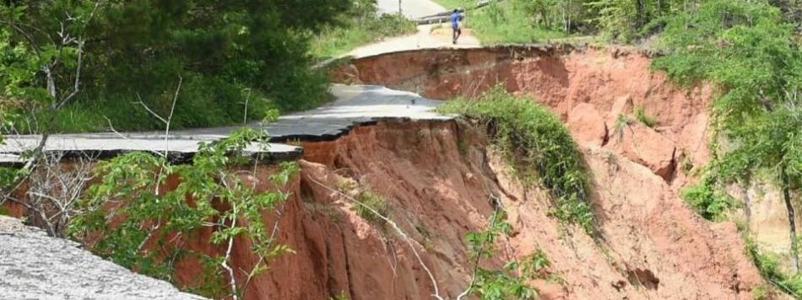
Next webinars:
Wednesday, 14th July, 2021 12.00-13.00
Speaker: Louise Wilson and Nicola Golding, Met Office
Title: Framing the Framework: Addressing the need for a UK National Framework For Climate Services
Wednesday, 21st July, 2021 12.00-13.00
Speaker: James Cooper, University of Liverpool
Title: Erosion Hazards in River Catchments
Register on our website:
https://www.ukclimateresilience.org/news-events/climate-resilience-webinar-series-2020-2021/

Slide 10
Contact details Website: www.ukclimateresilience.org Twitter: @UKCRP_SPF YouTube: UK Climate Resilience programme
The UK Climate Resilience programme is supported by the UKRI Strategic Priorities Fund.
The programme is co-delivered by the Met Office and NERC on behalf of UKRI partners AHRC, EPSRC, ESRC.

