Slide 1
Introduction to the
Race to Resilience
UKCR webinar 19 May 2021
1

Slide 2
Today
Introduction to High Level Champions
Why a Race to Resilience Campaign
Overview of the Campaign
Race to Resilience metrics framework
2

Slide 3
I. Introduction to the Champions
3

Slide 4
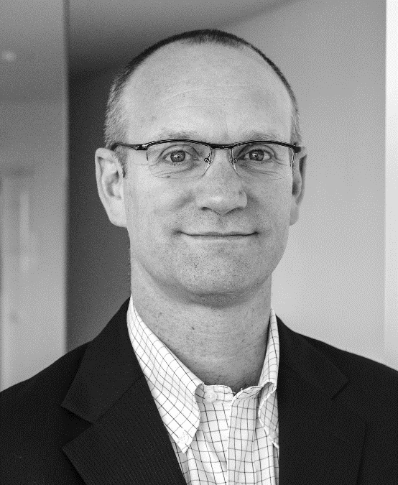
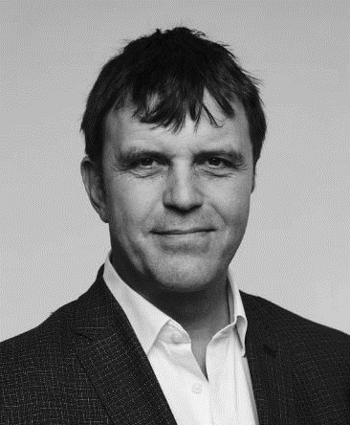
Who are the UN High Level Climate Action Champions, and what do they do?
Established at Paris COP21 to accelerate climate action by businesses, investors, cities, regions and civil society and to facilitate collaboration with States to achieve the goals of the Paris Agreement.
They lead the Marrakesh Partnership – a global set of NSA initiatives and organizations
They are appointed by COP Presidencies
Current Champions (left) have set up a team to help them deliver action under two campaigns Race to Zero and Race to Resilience
Gonzalo Muñoz
4
Nigel Topping

Slide 5
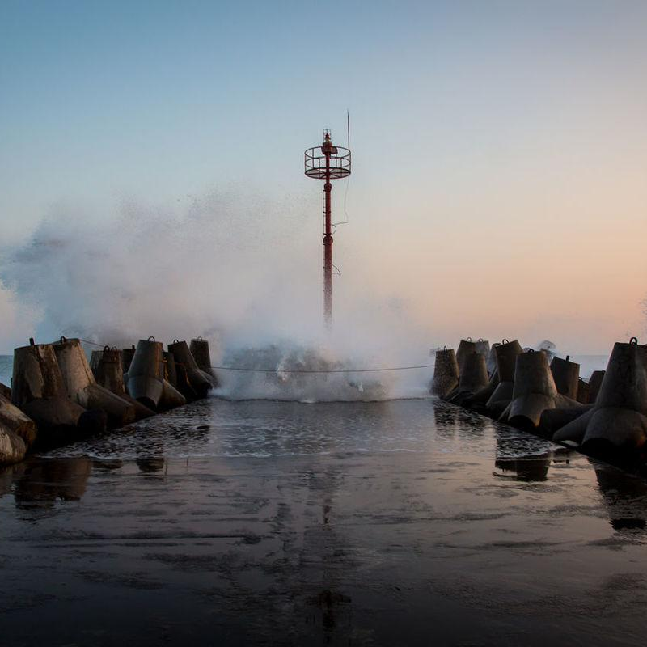
5+1 key Climate Champions priorities
1
2
3
6
Deliver a 10x increase in net-zero and resilience commitments from NSAs
Drive breakthrough industrial systems transformation for 10 sectors
Win the narrative battle on climate action and progress
Refresh the Marrakech partnership for Global Climate Action for the next 5 years and beyond
4
5
Support diplomatic efforts through non-state actor channels
Enhance engagement and agency across NSA groups

Slide 6
Sector work and pathways
Sector teams all developing pathways to 1.5 degree resilient world
Land Use (Food & Agriculture, Land Use)
Oceans & Coastal Zones
Water
Human Settlements (Built environment, Cooling)
Transport (ICE, Aviation, Shipping)
Energy (Clean Power, Oil & Gas, Hydrogen)
Industry (steel, aluminium, cement, chemicals, plastics, metals & mining, FMCG, retail, apparel, healthcare, mobile/ICT)
Resilience (a cross-cutting theme)
Finance (a cross-cutting theme)
6

Slide 7
II. Why a Campaign on Resilience?
7

Slide 8
As adapting to climate change and building resilience is critical now …
Total population exposed to climate hazards today, Billions
3.5
2.5
3.5b
people are exposed to five major climate hazards today
1.2
1.0
Many are exposed to multiple hazards
Total
Heat
Drought
Flooding
8

Slide 9
As the Challenge will increase …
Total population exposed to climate hazards, Billions
4.5b
3.5b
1 billion
2%
More people will be exposed to climate hazards, of which nearly half will be exposed to high severity hazards
43%
Today [1.0C]
2.0C World based on 2050 population
9

Slide 10
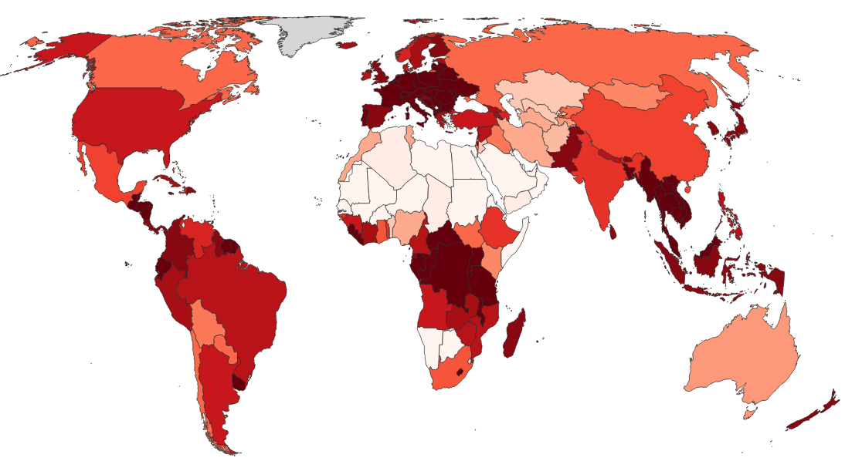
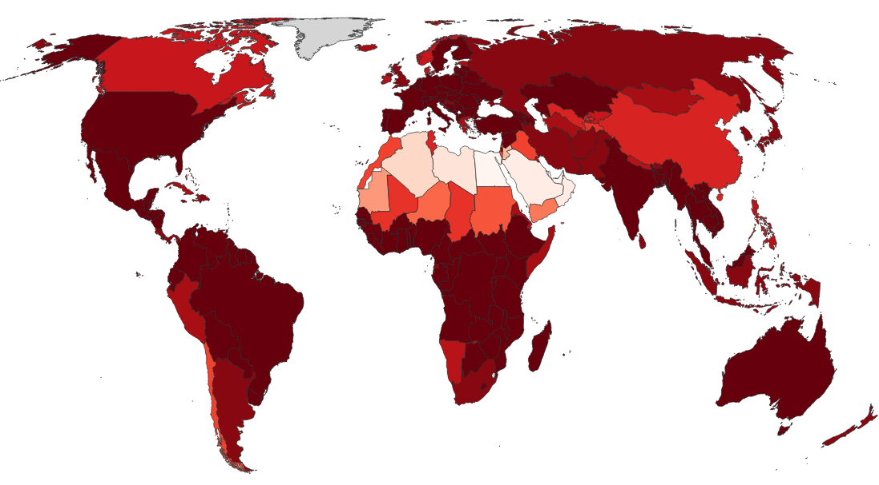
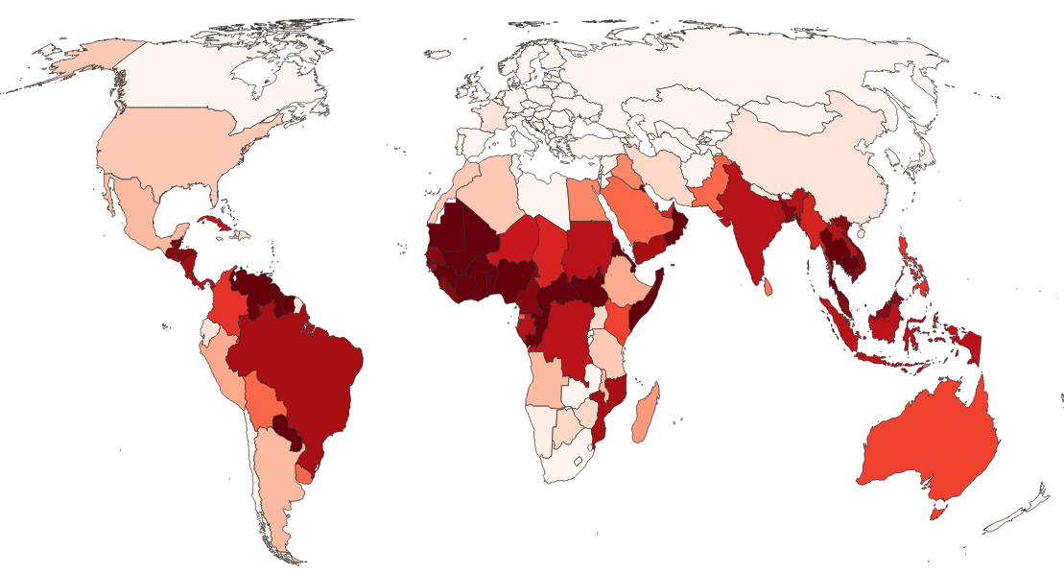
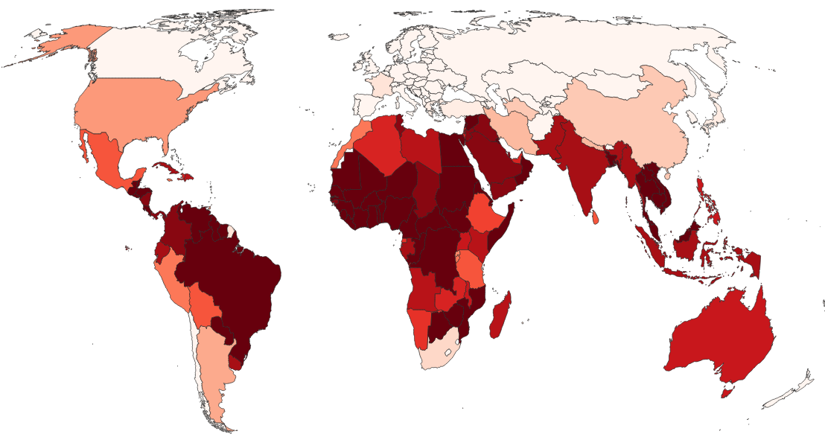
As everyone is exposed …
Will update right hand side stats to insights about expansion of hazard footprint into higher income countries
Proportion of country landmass exposed to climate hazard, %
Today [1.0C]
2.0C World
50%
Drought
Increase in total land exposed to droughts between today and a 2.0C World
55%
Heat Stress
Increase in total land exposed to heat waves between today and a 2.0C World
0% 100%
10

Slide 11
Impacting economies everywhere
% GDP loss due to climate change in 2.0C world
11%
Drop in global GDP in a 2.0C world by 2050
ASEAN
Middle East & Africa
Oceania
South America
Advanced Asia
Europe
North America
11
Source: Swiss Re Institute (2021)

Slide 12
But most vulnerable are most exposed …
Population exposed to a
severe level of hazard
2.8
1.0
0.7
55%
13%
27%
Low vulnerability
[1/3 of the world]
Medium vulnerability
[1/3 of the world]
High vulnerability
[1/3 of the world]
12

Slide 13
And yet they are the least responsible…
CO2 emissions (metric tons per capita) by country vulnerability
2006 – 2016 average
9%
Of global CO2 emissions between 2006 – 2016
Low vulnerability
[1/3 of the world]
Medium vulnerability
[1/3 of the world]
High vulnerability
[1/3 of the world]
13

Slide 14
Hence we need ……
14

Slide 15
III. Overview of the Campaign
15

Slide 16
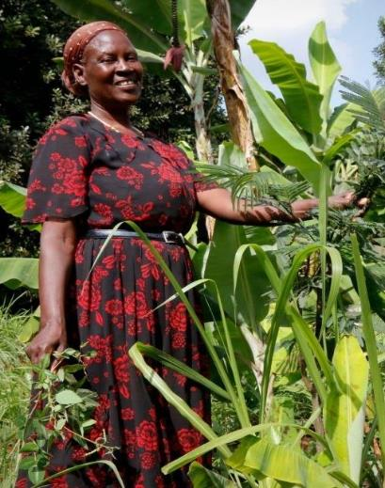
What is the Race to Resilience?
An inclusive global Non-State Actor Campaign to mobilise action on climate resilience for vulnerable communities.
The equal sibling campaign to Race to Zero.
Launched by COP 26 President at the Climate Adaptation Summit in January.
Credit: World Agroforestry Centre
16
Notes:
Both respond to COP26 (and UN Sec General) priorities on adaptation and resilience:
Adaptation Action Coalition to drive action by states.
Global Goal on Adaptation – State-led
R2R supports both by driving action by non-state actors.

Slide 17
What is the R2R Vision and Goal?
Vision by 2050, to live in a world where all communities thrive in the face of the multiple risks and uncertainty posed by climate change.
Goal to catalyse action by non-state actors that builds the resilience of 4 billion people from groups and communities who are vulnerable to climate risks by 2030.
Thousands of businesses, investors, cities, communities, civil society, knowledge and international organisations joining and raising ambition and achieving targets.
17

Slide 18
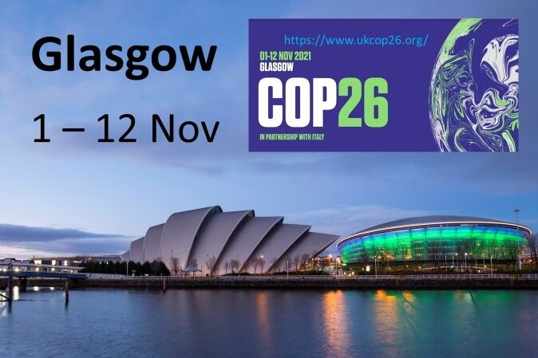
Race to Resilience and COP Presidency
Adaptation Action Coalition aims to support and mobilise action by states.
Race to Resilience aims to mobilse action by non state actors.
Both responds to COP26 Presidency (and UNSG) priorities on adaptation and resilience.
Champions Team working closely with FCDO and COP26 Unit including in Glasgow.
18

Slide 19
Race to Resilience themes
Focus on communities, cities and businesses from all countries to build their resilience to climate shocks and stresses.
Urban: Cities, industrial communities and informal settlements become healthy, safe and thriving spaces that support resilient livelihoods and allow for green recovery post COVID-19.
Rural: Smallholder farmers, rural entrepreneurs, and industries across food and ag. supply chains are adaptive, equitable, and are equipped to thrive in the face of climate change whilst protecting nature.
Coastal: Safeguard coastal and riverine cities, communities and businesses through increased investment in adaptation and resilience and protection of natural ecosystems that support those livelihoods and economies.
Finance & Disaster Risk Reduction & Knowledge & Inclusion (esp women and girls) cut across all these themes.
19
Notes:
Initiatives will be asked to explore how nature base solutions can be used to deliver resilience. For example:
Maintaining wetlands, mangroves & coral reefs for coastal resilience.
Regenerative agriculture e.g. through agro-forestry, maintenance of soil health, and zero tillage.
Protection of catchments to maintain clean water supplies.

Slide 20
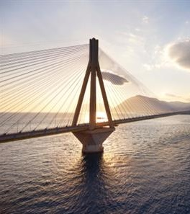
How does Race to Resilience work?
Initiatives must set new goals, demonstrating raised ambition and be open to new members.
Rally non-state actors to join the Race to Resilience initiatives or set up new ones.
Create milestone moments throughout 2021 to place resilience on the agenda for COP26
Foster an inclusive space for knowledge sharing and collaboration between initiatives and their members
Drive investment towards resilience
20
Notes:
By mobilising action and private finance from developed and developing country to influence trillions not billions of investments.
Asking initiatives involving investors and asset managers to invest in resilience.
We want to help mobilise private sector investment to contribute to the $100bn but the aim of R2R is to be more ambitious!

Slide 21
Who can join the Race to Resilience?
If you are a member of a R2R initiative and/or R2R accelerator.
If you are an initiative led by non-state actors
If you share the
Vision and Goal.
Race to Resilience Criteria
Pledge: to translate targets, directly or indirectly, into the numbers of people from vulnerable communities who will be made more resilient to climate risks
Plan: to use the best knowledge and scientific evidence, and share a plan by COP26 to take action towards this commitment with interim targets and milestones
Proceed: To take immediate action to pursue commitment in support of Race to Resilience, and have an active secretariat able to monitor members
Publish: Agree to report back on progress annually starting at COP26
21
Notes:
R2R partner initiatives must confirm their commitment to delivering inclusive and equitable action.
Initiatives will be asked to report on the progress they are making to achieve inclusive outcomes.

Slide 22
Current status of the Race to Resilience
21 Initiatives:
3 Coastal
2 Urban
8 Rural
4 Disaster Risk Reduction
3 Finance
1 Knowledge Sharing
1,500 members
Private sector leaders eg The Coca-Cola Company
Major NGOs eg The World Wildlife Fund
Global Reach:
Initiatives taking action in over 100 countries across five major geographic regions
Example Initiative: Global Mangrove Alliance
Brings NGOs, governments, industry, local communities and funders towards a common goal of halting mangrove degradation and increasing mangrove cover by 20% by 2030.
5 Coordinating members: IUCN, The Nature Conservatory, World Wildlife Fund, Conservation International and Wetlands International
22
Notes:
Metric framework developed
6. Analytics on mapping vulnerability
7. Designing and setting up: Technical Peer Review and Methodological Group. University of Chile, IIED and Uni of Maryland
8. Working on plans for COP26

Slide 23
Approved R2R initiatives
Agriculture for 1.5 Cities Race to Zero (Resilience) Coalition Climate-KIC - Forging Resilient Regions Coalition for Climate Resilient Investment Efficiency for Access Coalition Extreme Heat Resilience Alliance Global EverGreening Alliance Global Mangrove Alliance Initiative 20x20 Insurance Development Forum InsuResilience Global Partnership | Just Rural Transition NbScale4Resilience Ocean Risk and Resilience Action Alliance One Planet Business for Biodiversity RegionsAdapt (Regions4) Resilient Housing Risk-informed Early Action Partnership The Climakers UN ARISE Water Resilience Coalition
23

Slide 24
IV. Metrics Framework
24

Slide 25
A metrics framework is critical for success of the campaign
Enable ambitious campaign goals to mobilise action
Record and track initiative pledges and results
Identify gaps to be filled by new and existing initiatives
Ensure reliable and credible data to safeguard impact
Ability for impact beyond the campaign by laying the foundation for a widely adopted measurement framework that supports engagement by businesses, investors and other key actors
25
Notes:
A metrics framework is critical for success of the campaign. We have several aims
Enable ambitious campaign goals from you all and mobilise action
Record and track pledges and results
Identify gaps to be filled by new and existing initiatives
Ensure that the data is reliable and impact of the campaign is credible
Beyond this, we believe there is a space that this framework could fill by becoming a widely adopted measurement framework that supports engagement by businesses, investors and other key actors

Slide 26
A challenge for R2R campaign is how to measure progress towards our ambitious target
Resilience is a complex, multifaceted concept covering a range of hazard types, socioeconomic circumstances and units of engagement
No consensus on definitions of resilience or other key concepts such as adaptation with numerous versions being used by different actors
No universally agreed measurement approach for resilience or attributing resilience to project or programme activities or policy support
Significant barriers for non-specialist actors (especially the private sector) in effectively measuring resilience and adaptation
26
Notes:
There are some challenges to implement this that you will no doubt be aware of. These include
The fact that resilience is a complex, multifaceted concept covering a range of hazard types, socioeconomic circumstances and units of engagement
There is no consensus on definitions of resilience or other key concepts such as adaptation with numerous versions being used by different actors
Neither is there a universally agreed measurement approach for resilience or attributing resilience to project or programme activities or policy support
There are also significant barriers for non-specialist actors (especially the private sector) in effectively measuring resilience and adaptation
These were all things we were aware of when we put together this framework.

Slide 27
We have developed metrics for the campaign that act as the first universal framework to capture resilience outcomes
ILLUSTRATIVE 2030 FIGURES
Key target groups for resilience building
Proposed metrics with illustrative figures
4B
A1. People with increased resilience
10m
A2. Companies with increased resilience
Resilient individuals
150
A3. Countries with increased resilience
5k
A4. Cities with increased resilience
200k
A5. Hectares of natural system with increased resilience
Companies
Countries and regions
Individuals and communities
Cities
Natural systems
$50B
B6. Finance mobilised by initiatives and breakthroughs
$20B
C2. Finance deployed into climate resilience initiatives
10k
C3. Organisations signed up across R2R initiatives
27
Notes:
We have developed metrics for the campaign that act as the first universal framework to capture resilience outcomes
The key metric is resilient individuals - remembering that our overall goal for the campaign is “by 2030: to catalyse action by non-state actors that builds the resilience of 4 billion people from groups and communities who are vulnerable to climate risks.”
We are also measuring companies, countries and regions, cities and natural systems
If all goes well we would like in 2030 to see a dashboard such as this on the right that shows the impact you have all made through this campaign.
Here you can see we have illustrative figures with the numbers of people, companies, countries, cities, hectares of natural systems, finance mobilised and deployed, and numbers of organisations signed up across all Race to Resilience initiatives.

Slide 28
Future pledges and outcomes of initiatives will be mapped against our latest understanding of the resilience need
ILLUSTRATIVE PLEDGE AND ACTION DATA
Resilience…
Need
Pledge
Action
People exposed to climate hazards in 2.0C world
Pledged people with increased resilience
Reported people with increased resilience
Drought total
1.2b
500m
100m
Drought Asia
444m
200m
50m
Drought India
170m
50m
20m
Male
85m
23m
14m
Female
85m
27m
16m
Data from analytics workstream
Framework from metrics workstream
28
Notes:
Future pledges and outcomes of initiatives will be mapped against our latest understanding of the resilience need. We have done a separate piece of analytics work looking at resilience needs - that is what is shown here on left.
We would like to compare the pledges and actions with that need, and show for example what our pledges add up to, and where there are gaps.
For example here we have shown the number of people vulnerable to drought ina 2 degree world, broken down into those in Asia, in India, and by gender. We hope to compare this to the pledges you are making, and in time, the actions you have taken.
This is why we are asking for segmented data from you where it is possible for you to give it.

Slide 29
The framework has been developed through interviews with 25+ experts and initiatives
Framed the metrics use case
Developed metrics
Testing with initiatives
Further Iteration
Literature review including case-studies of 11 frameworks and a metric landscape mapping
Interviewed 25+ experts and initiative members including investors, business alliances, practitioners and academics
Road-tested metrics with 11 initiative members representing a broad range of initiative types
Surveyed first batch 21 initiatives
Convened 11 member technical working group to iterate and validate metrics
Working group led by IIED and the University of Maryland and includes some initiative representatives to advise on deployment of the framework
Scoping of R2R campaign metric requirements
Produced and tested design choice hypotheses through follow-up meetings
Iterated metrics framework based on feedback
Identification of best practices and key challenges in the measurement of climate resilience
Finalised design choices and developed metrics
Developed list of guiding design principles
29

Slide 30
Technical & Methodological Advisory Group
Role is to validate the content of the R2R Metrics Framework
Produce a suggested deployment process for its application by partner initiatives
Do this at three stages
1. In advance of consultation phase with initiatives (done)
2. In advance of official request to initiatives to apply matrix
3. After COP26
Lead by IIED & University of Maryland
Members representing initiatives e.g. GRP, InsuResilience, South South North, CDC, OP2B
30
Notes:
We have set up a technical and methodological advisory group.
Their role is to
validate the content of the Race to Resilience Metrics Framework
and to produce a suggested deployment process for its application by partner initiatives
They are going to do this at three stages
1. In advance of consultation phase with initiatives (which they have already done)
2. In advance of official request to initiatives to apply matrix
3. After COP26
Lead by Aditya Bahadur and Emilie Beauchamp at IIED & Prof Anand Patwardhan at University of Maryland
It also has some members representing initiatives e.g. GRP, InsuResilience, South South North, CDC, OP2B

Slide 31
Advisory Group members
Affiliation | Name | Role
IIED | Aditya Bahadur | Co-lead
IIED | Emilie Beauchamp | Co-lead
University of Maryland | Anand Patwardhan | Co-lead
Global Resilience Partnership | Simone Verkaart | Member
Global Resilience Partnership | Albert Norström | Member
CDC | Chiara Trabacchi | Member
InsuResilience | Daniel Stadtmueller | Member
InsuResilience | Kay Tuschen | Member
South South North | Shehnaaz Moosa | Member
Global Covenant of Majors | Shannon McDaniel | Member
One Planet Business for Biodiversity | Florence Jeantet | Member
31
Notes:
This is the make up of the advisory group.
There are more to be added based on requests from the group itself - including more members representing grassroots and Global South voices

Slide 32
VI. How can you engage in R2R?
32

Slide 33
As R2R member as part of an R2R partner initiative.
Join an initiative that is already a R2R initiative.
Ask initiatives you part of, to take/increase action on resilience so these can qualify to join R2R.
If there are no initiatives in a region/sector to join look to set up a new one.
Helping organise and convene R2R events inc at COP26
Share and benefit from knowledge on best practice on resilience for communities and locally led action.
Collaborate to identify new opportunities for transformative actions to build resilience.
33

Slide 34
For more information on the Race to Resilience please visit
https://racetozero.unfccc.int/race-to-resilience/
or send us email to resilience@climatechampions.team
34

