Slide 1
SPF UK Climate Resilience Programme Webinar Series 2021
Website: https://www.ukclimateresilience.org/

Slide 2
Timings
12:00 | UK Climate Resilience Programme news | Professor Jason Lowe OBE​ Head of Climate Services, Met Office​
12.05 | Framing the Framework: Addressing the need for a UK National Framework for Climate Services | Louise Wilson and Nicola Golding Met Office
12.20 | International perspectives | Dr Karl Braganza, Australian Bureau of Meteorology Keith Lambkin, Irish Meteorological Service Roger Street, University of Oxford Dr Christopher Jack University of Cape Town
12.50 | Q&A and discussion with the panellists | Chaired by Professor Chris Hewitt, Met Office and University of Southern Queensland
13.15 | End
Website: https://www.ukclimateresilience.org/
Notes:
Professor Richard Pywell
Prof Richard Pywell leads Biodiversity research at UK Centre for Ecology & Hydrology. He has 30 years’ experience of research, monitoring and evaluation of agri-environmental policies in the UK and Europe. His research focuses on restoring and managing natural capital within intensively managed agricultural ecosystems in order to enhance the delivery of ecosystem services and livelihoods. He works closely with academics, practitioners, policy-makers and the farming industry to co-design solutions to pressing environmental challenges. He currently leads the Achieving Sustainable Agricultural Systems (ASSIST) research programme – a major government-funded research programme to develop efficient and sustainable farming systems that are resilient to future environmental change.
Stakeholder biography
Julian Gold, Farm Manager, Hendred Estate, Oxfordshire
After a short spell on the family, Julian has spent 34 years managing farms and large estates in the UK and overseas. He is FACTS and BASIS trained Farm Manager, and has a commitment to producing food in an efficient and environmentally sustainable manner. Julian is often featured in the farming press and he is frequently asked to speak at farming conferences. He is keen to improve the flow of knowledge between farmers and the scientific community. Julian was one of the first designated AHDB Monitor Farms designed to improve farmer to farmer knowledge exchange and he plays a key role in the ASSIST- Achieving Sustainable Agricultural Systems programme (a UKRI-funded programme to increase sustainability of food production and resilience to climate change). Julian is on the committee of SEESOIL (South East England branch of the British Society of Soil Scientists) and was awarded Soil Farmer of the Year in 2019.

Slide 3
How to engage
Presentations first then Q&A and discussion
Post questions in the Q&A box at any time
Upvote your favourites
Attendees will remain muted unless enabled to speak by the host​
Webinar (audio and slides) will be shared after the event
Technical problems – chat
The webinar is being recorded​
Twitter: @UKCRP_SPF #UKclimateResil
Website: https://www.ukclimateresilience.org/

Slide 4
Embedded Researchers: Deadline 22 July 2021, 16.00 UK time
Funding Opportunity
A variety of organisations have submitted pitches to the UK Climate Resilience Programme Embedded Researcher scheme. These are available to view on the UKCR website.
Action Hampshire Climate Northern Ireland
Orkney Islands Council 1 Orkney Islands Council 2
Ministry of Defence EDF
Science Museum Time and Tide Bell
Arup Greener NHS
UKRI have increased the funding for the scheme and there are now a minimum of 5 Embedded Researcher projects rather than the previous 3
https://www.ukclimateresilience.org/about/funding/funding-opportunities/
Notes:
UK Research and Innovation (UKRI) is inviting applications from UK based academic researchers and non-academic host organisations to submit for Embedded Researcher projects as part of the UK Climate Resilience Programme.

Slide 5
Breakfast Briefing Thursday 15 July 09.30 to 10.30
Event
UK Climate Change Adaptation and Power Sector Resilience Breakfast Briefing
Bringing together key stakeholders to discuss one of the UK’s priorities of demonstrating high adaptive capacity and resilience to climate change in the run up to COP 26.
Confirmed speakers include:
Katie Jenkins, Defra
Cara Labuschagne, CCC
Liam Upson, Cabinet Office
David Howlett, Race to Resilience Team
Nicola Smith, SSE
https://www.energy-uk.org.uk/events/category/uk-climate-change-adaptation-and-power-sector-resilience.html

Slide 6
Framing the Framework: Addressing the need for a UK National Framework for Climate Services
Louise Wilson and Nicola Golding, Met Office
Notes:
Professor Richard Pywell
Prof Richard Pywell leads Biodiversity research at UK Centre for Ecology & Hydrology. He has 30 years’ experience of research, monitoring and evaluation of agri-environmental policies in the UK and Europe. His research focuses on restoring and managing natural capital within intensively managed agricultural ecosystems in order to enhance the delivery of ecosystem services and livelihoods. He works closely with academics, practitioners, policy-makers and the farming industry to co-design solutions to pressing environmental challenges. He currently leads the Achieving Sustainable Agricultural Systems (ASSIST) research programme – a major government-funded research programme to develop efficient and sustainable farming systems that are resilient to future environmental change.
Stakeholder biography

Slide 7
Questions, answers, discussion

Slide 8
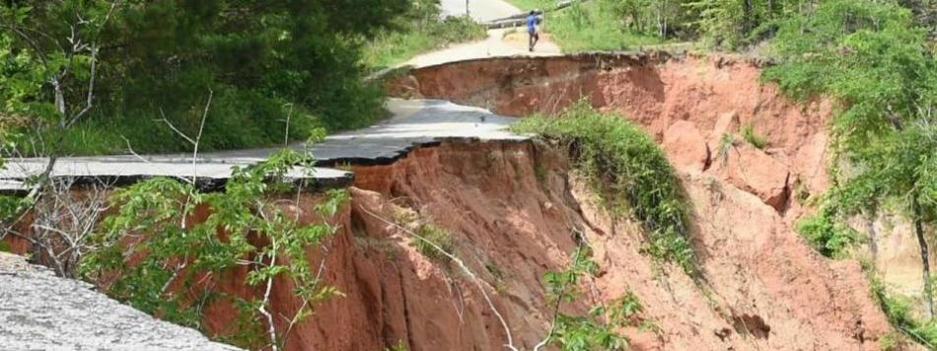
Next webinars:
Wednesday, 21st July, 2021 12.00-13.00
Speaker: James Cooper, University of Liverpool
Title: Erosion hazards and economic damage to critical infrastructure in river catchments: Impact of a warming
Wednesday, 29th September, 2021 12.00-13.00
Speaker: Rachel Perks, Met Office
Title: Coastal Defender
Register on our website:
https://www.ukclimateresilience.org/news-events/climate-resilience-webinar-series-2020-2021/

Slide 9
Contact details Website: www.ukclimateresilience.org Twitter: @UKCRP_SPF YouTube: UK Climate Resilience programme
The UK Climate Resilience programme is supported by the UKRI Strategic Priorities Fund.
The programme is co-delivered by the Met Office and NERC on behalf of UKRI partners AHRC, EPSRC, ESRC.

