Slide 1
Framing the Framework: Addressing the need for a UK National Framework For Climate Services UKCR Webinar Nicola Golding, Louise Wilson July 2021

Slide 2
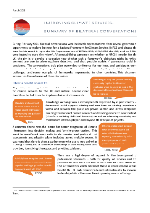
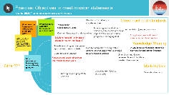
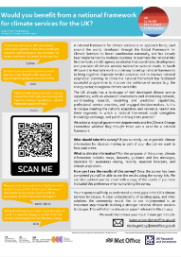
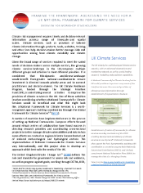
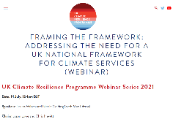
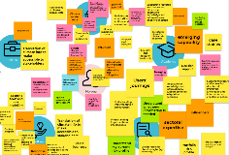
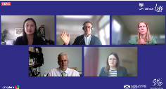
A National Framework for Climate Services could address gaps in the provision of climate services in the UK.
Rapid Lit review
Met Office Conference
2021
Jan
Feb
Mar
Apr
May
Start focused:
Bilateral Conversations
Go broad: Engagement Workshops
June
Jul
…
1
2
3
4
5
6
Civil Service Live Session
UKCR Forum
UKCR Webinar
The future of climate services: informing security and prosperity

Slide 3
AIM: Stocktake of climate service capability and identification of current gaps and potential solutions which could be supported by a framework.
82 participants from 64 organisations across the UK
39
43
How well are things working currently: are there gaps that require national level intervention to bridge?
Where should any future effort be directed? Is there demand?
Notes:
Male and Female by Lyle King Red from the Noun Project

Slide 4
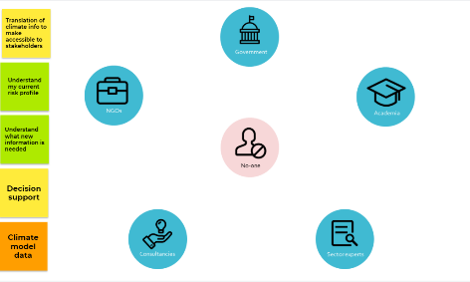
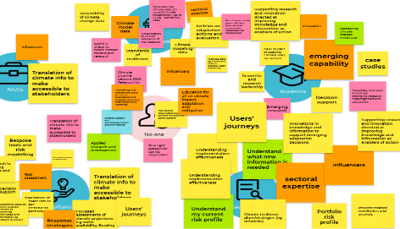
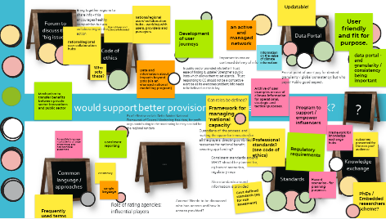
FORMAT: A series of 2-hr workshops, all identical. Hold workshops on different days of the week to provide many opportunities for people to attend amongst their other calendar commitments. Use technology to make the workshops as participatory as possible, providing lots of opportunity for participants to provide their input.

Slide 5
“National scenarios for disclosure and regulation”
“Collaborative forums between industries”
“The role of climate services in climate justice”
“Link between impacts and adaptation communities at local and regional level”
“Data and knowledge portals: signposting to existing information and experts”
“Help to put climate risk on an appropriately weighted playing field with climate risk”
“View of what work is coming up to enable us to plan ahead in terms of assessment”
“Common definition of how to measure resilience!”
“Balance between 'confusion' from academia and 'limited picture' from consultants”
“We need impact data and maps. Customers should not have to pay twice - once through taxation and again through their bills”
Notes:
Put the code in the meeting chat

Slide 6
Awareness
Signposting to existing datasets
‘Who’s who and what’s what’: Linking up with experts
Knowledge Exchange
Do this regionally
Training on new techniques, using climate information in practice
Standards & Guidance
Climate info should feed into updated standards: needs a process
Who should be the regulator?
Do it by sector/industry
Share within and between fields
Share failures
Need for common language and understanding
Awareness of what is ‘on the horizon’
Better aligning research pipelines and funding so good ideas do not ‘wither on the vine’
Stocktake of current activity
Common data formats and types, as well as common tools and approaches
Translation beyond knowledge or data portals
* Interim findings, full synthesis still under development
Notes:
Eye by Alice Design from the Noun Project
exchange by Gregor Cresnar from the Noun Project
standard by Adrien Coquet from the Noun Project

Slide 7
Ethics
Important when working with multiple organisations from public and private sectors
Roles
Desire for government to provide regulation
Solutions
Sharing case studies and demonstrations
Who pays for data and information services?
Are clearer boundaries needed and desirable?
Forums for sharing questions and issues where the community can respond
Protect people speaking within a forum and enabling information exchange
Strong ‘public good’ focus
User journeys / profiles / archetypes
Bringing in vulnerable groups
Bringing in social impacts and ensuring vulnerable groups have equitable access to decision-making
Hackathons
Story boards to illustrate risks
Buy-in from popular press
* Interim findings, full synthesis still under development
Notes:
trust by Chanaky from the Noun Project
Shield by Adrien Coquet from the Noun Project
Idea by Adrien Coquet from the Noun Project

Slide 8
Next steps
Synthesise workshop information
Full synthesis in development
Write the position paper (Mar 2022)
Draft recommendations for a framework
Draft a roadmap including activities to build awareness and desire for recommendations
‘Prime’ the environment for the position paper
Potential Opportunities
Identify quick wins (outside a framework), for example:
How-to YouTube videos
Stocktake type activities
Glossaries of language and jargon
Capability mapping
Signposting

Slide 9
Contact details Louise Wilson: Louise.Wilson @metoffice.gov.uk Nicola Golding: Nicola.Golding@metoffice.gov.uk Website: www.ukclimateresilience.org Twitter: @UKCRP_SPF YouTube: UK Climate Resilience programme
The UK Climate Resilience programme is supported by the UKRI Strategic Priorities Fund.
The programme is co-delivered by the Met Office and NERC on behalf of UKRI partners AHRC, EPSRC, ESRC.

Slide 10
Dr Karl Braganza Australian Bureau of Meteorology
National Climate Services Manager

Slide 11
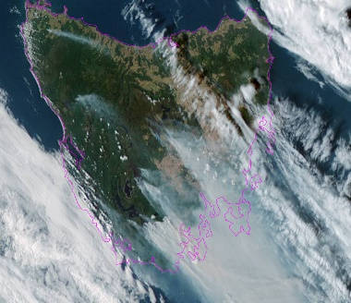
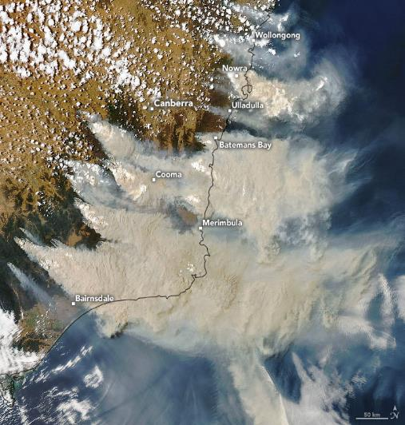
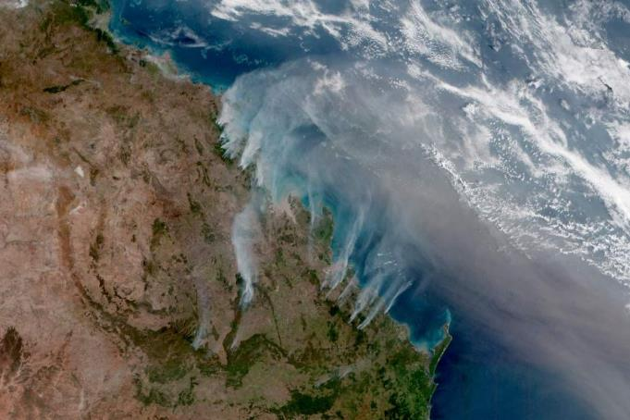
Unprecedented Bushfires
Changes already happening in Australia
29 January 2019
4 January 2020
Bushfire plumes from the Himawari 8 Japanese weather satellite
29 November 2018
Notes:
tmax high 201811201812 map qld altcol upper pngsep

Slide 12
The National Resilience and Recovery Agency (NRRA)
An Enhanced Emergency Management Australia (EMA)
The Australian Climate Service (ACS)
Response to Royal Commission into National Natural Disaster Arrangements

Slide 13
Emergency Management Australia
(EMA)
National Resilience and Recovery Agency
(NRRA)
Data, Information, Expertise
Australian Climate Service
Data, Information, Expertise
Bureau of Meteorology
BOM
Australian Bureau of Statistics
ABS
Geoscience Australia
GA
Commonwealth Scientific and Industrial Research Organisation
CSIRO

Slide 14
Exposure, vulnerability and decision-making data
Support integration of future uncertainties and disaster risks in management, planning and investment decisions.
Seamless weather and climate data
Routine schedule for running high-resolution regional reanalysis and future downscaling, using a set-up of the BoM operational weather and seasonal forecast model. Seamless risk narratives.
Seamless risk data and information
Derived from physical modelling and vulnerability assessments to inform disaster analysis, recovery, and future projected natural hazard and climate impact and risk scenarios.
Knowledge brokering, decision-making assessments and consulting services
Deep industry engagement to support decision making, and facilitate awareness, understanding and adoption of the Service's data and information for a more resilient Australia.
Nationally standardised methods
An overarching framework to analyse natural disaster risk, including the measurement and tracking of resilience in Australia to enable a uniform approach to natural disaster management across jurisdictions and the private sector.
What does the Service look like?

Slide 15
Resilience, Reconstruction and Risk Reduction
Properly constructed narrative scenarios will see each element of information improve every sphere of decision-making
Strategic decisions aimed at resilience that improves tactical and operational environments
Strategic
Tactical
Prevention and Preparedness
Relief and Recovery
Operational
More tactical options for prevention and preparedness, increased degrees of freedom for less stressed operations
Greatly reduced downtime and recovery costs
Response
Notes:
An analogy for the PPRRRRR

Slide 16
Australian Climate Service
Better hazard, risk and impact information:
Improved access to exposure and vulnerability data
National ensembles of physical hazard modelling
Risk and impact modelling and information
Socio-economic modelling of damage, loss, value and opportunity
Investment and modelling for cost-benefit of betterment and disaster risk reduction
Tactical and strategic decision-making focus
Commonwealth Customers
Emergency Management Australia
Natural Resilience, Relief and Recovery Agency
CSIRO
CSIRO
ABS
EMA common operating picture
BOM
Bureau of Meteorology
Weather Modelling
Forecast and Warning Products
(Response)
Joint Tsunami Warning Centre
GA
Tsunami
Geoscience Australia
Geo Hazard Products
Geological Hazards
Near real-time feed

Slide 17
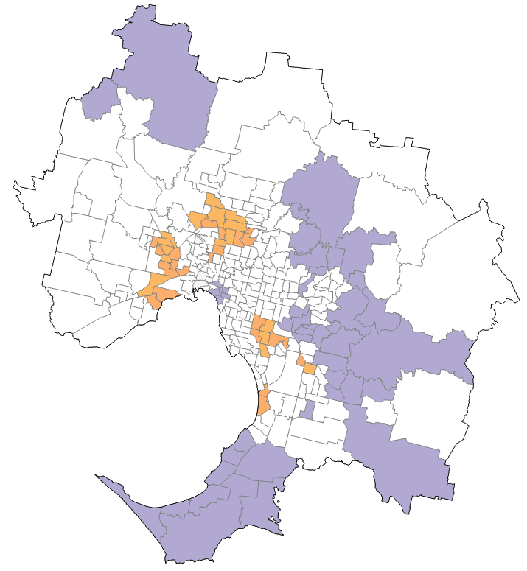
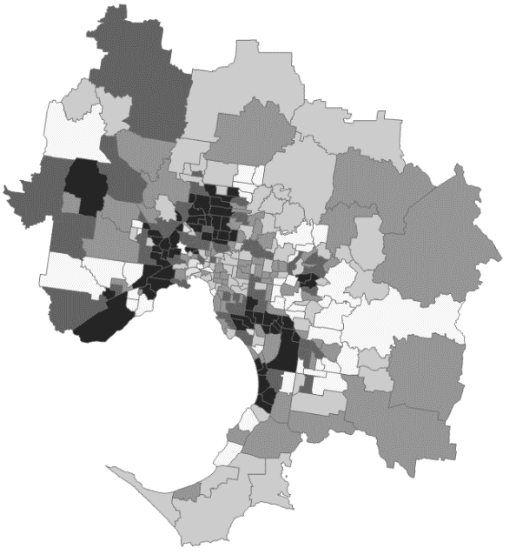
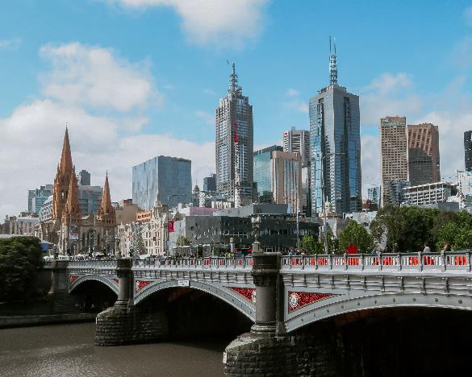
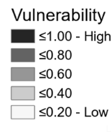
Health outcomes and heat vulnerability
Greater Melbourne
Heat vulnerability and health outcomes
Heat Vulnerability Index (HVI)
Boundaries based on Australian Statistic Geography Standard (ASGS) Statistical Area Level 2 (SA2) geography

Slide 18
Keith Lambkin Met Éireann
Senior Climatologist, Climate Services, Research and Applications Division

Slide 19
Towards Standardised National
Climate Services in Ireland
Framing the Framework: Addressing the need for a UK National Framework For Climate Services (webinar)
14th July 2021
Keith Lambkin
Senior Climatologist
Met Éireann – The Irish Meteorological Service
Keith.Lambkin@met.ie

Slide 20
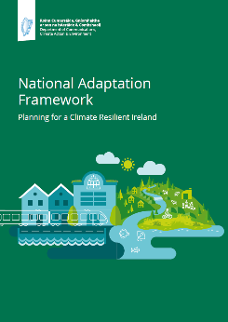
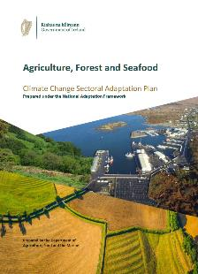
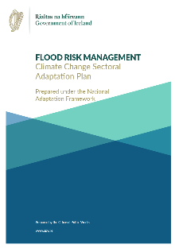
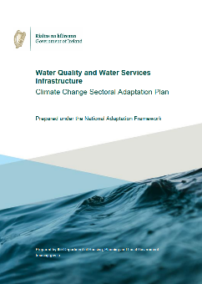
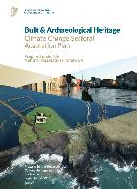
Adaptation Plans
Aims:
Standardising national climate projections for Ireland.
Developing climate services to meet the Irish adaptation sector’s climate information requirements.

Slide 21
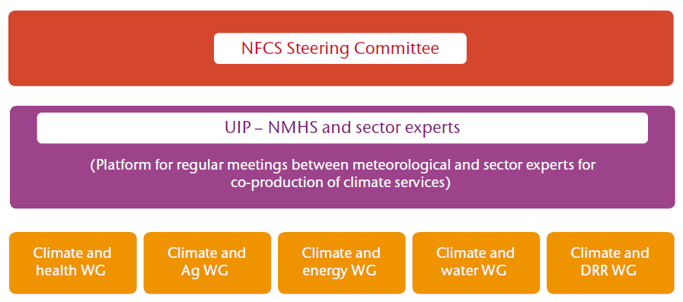
National Framework for
Climate Services
Adapted from Fig 3 WMO No. 1206
The most common governance structure of NFCS
Example of a possible governance structure for an Irish National Framework of Climate Services (NFCC)

Slide 22
Roger Street University of Oxford
Associate Fellow of Green Templeton College and Honorary Research Associate at the Environmental Change Institute

Slide 23
At your Service
Tuesday, 08th June 12:00-14:30
Climate knowledge and information as enablers for climate action: Key Relevant Messages
Roger Street and Inès Alterio
Adaptation Challenge Topic co-champions

Slide 24
ECCA2021 ‘At your Service’
Exploring current status and means of enhancing the use and development of knowledge and information as enablers of climate action (adaptation, resilience and mitigation), including:
How these enablers are and could better inform and inspire the actions needed to address today’s climate challenges and those foreseen as we move to a climate-resilient and zero-carbon future.
Connections and collaborations that could facilitate addressing the associated challenges and opportunities that these enablers offer
Focus on solutions – identifying and implementing action.

Slide 25
Current Situation - Highlights
Knowledge and information are primarily developed based on a siloed (climate hazard) perspective and have been developed based on climate science and varied understandings of users’ needs
That available failing to create trust and to create an appetite for this knowledge and information with barriers to picking up CS including:
That available is not easy to use and not always produced to ‘high enough’ or agreed standard often leading to misuse and unintended consequences
Not linking climate knowledge and information with that needed to inform action (adaptation and resilience)
Huge gap between what is actually required and what is or can be provided - user focus is in its infancy
Co-X (co-design, co-production and co-evaluation) are recognised concepts but not well understood, embraced or delivered in practice

Slide 26
On Sharing Knowledge
Democratising climate knowledge and information – bringing knowledge and information to those that need
Work with national or regional knowledge and information platforms as an effective way of enhancing impacts and knowledge sharing
Translating climate knowledge and information so that what is provided is closer to the skills and requirements of targeted users
Much has been learnt on the best way to interact with the intended users – Co-X (co-design, co-production and co-evaluation) approaches
There is now a need to upscale what has been learnt and for knowledge and lessons learnt to be shared

Slide 27
Implementation of Adaptation and Resilience Strategies and Plans
Knowledge and information needs to be reimagined:
Supports making adaptation / resilience smarter and systemic, and enabling implementation in a timely fashion
Development and use better reflect societal and political priorities and an agreed vision – support moving us towards a Paris Agreement lifestyle and wellbeing.
Decisions are seldom taken just to address climate impacts, but more bout that needed to inform the complexity of decisions needed
Integration of knowledge, data and information from climate and non-climate sources

Slide 28
Creating Connections and Collaboration
Coordination, knowledge exchange and networking are essential to effective knowledge sharing, building trust and capacities
Work with national or regional knowledge and information platforms and hubs as an effective way of enhancing impacts and knowledge sharing
Need to bring the user communities and CS community closer together
Collaborating to develop the right knowledge and tools, and dissemination platforms
Enhanced efforts supported by investments in knowledge and information translation (user-friendly and relevant)
Establishing and supporting existing and new partnerships (private and public sectors) where data and knowledge providers interact – sharing knowledge, experiences and collaborating to address challenges
Improving roles of those along the value chain, including addressing concerns related to equity and inclusion (e.g., enhanced democratising, sharing and access to knowledge)

Slide 29
Implementing Action
Need to consider users’ (decision-makers’) journeys in the development and delivery of knowledge and information – more than just case studies
Target understanding solutions rather than just understanding impacts and risks
Knowledge and information provided are consistent with that needed to support decision-making processes and implementing actions
Support for iterative decision-making processes
Based on continuous learning and improvement
Including supporting transitional towards transformational adaptation
Build trust by co-developing QA/QC, and agreed standards and ethics considerations
Periodic / regular assessment of knowledge and information as enablers for implementing climate action with a supportive taxonomy of use cases and users’ journey

Slide 30
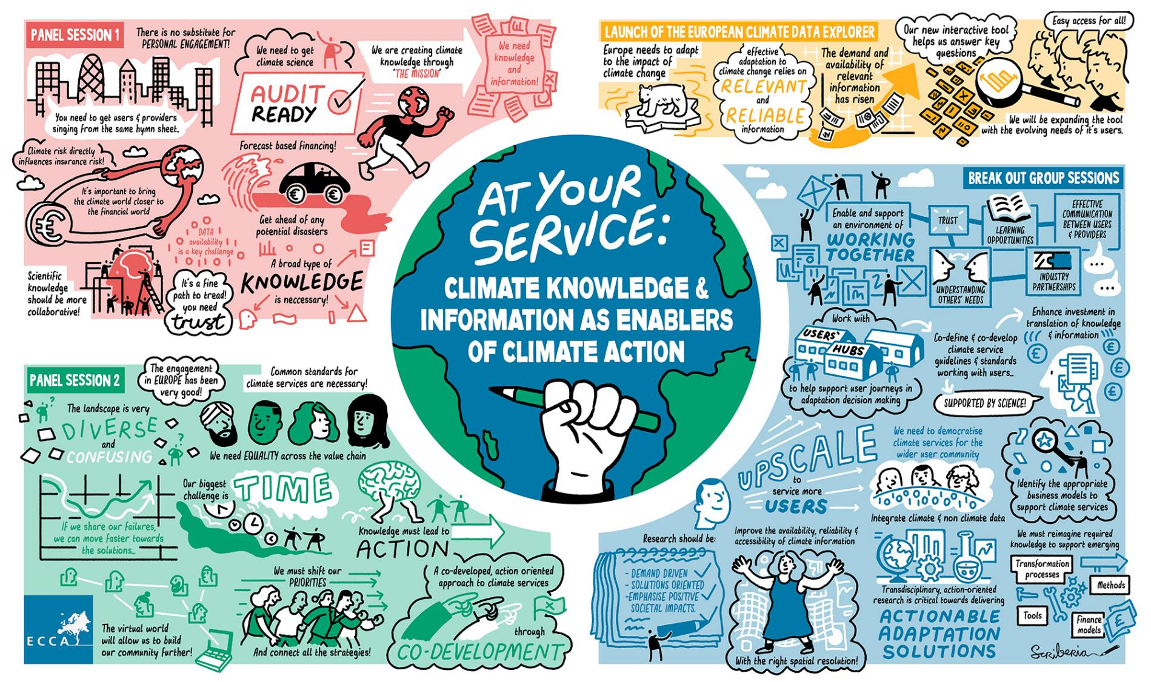

Slide 31
For Discussion
To what extent should a UK national framework for climate services reflect the results of the deliberations from the ‘At your Service’ webinar?
Are there elements missing that require further attention or detailed discussions to better inform the UK framework?

Slide 32
Christopher Jack University of Cape Town
Deputy Director, Climate System Analysis Group (CSAG)

Slide 33
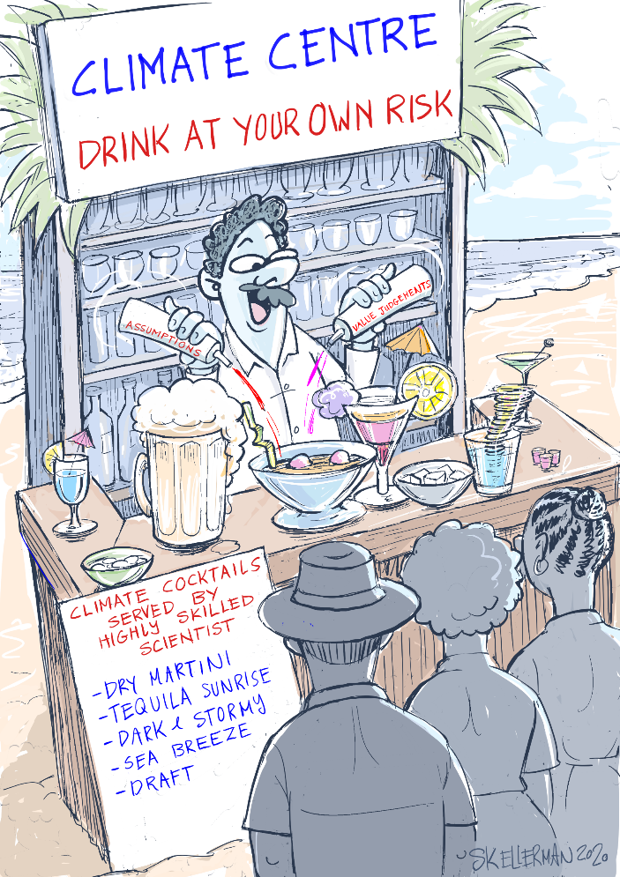
The climate services landscape - an “African” perspective
International data services
International commercial services
International applied research/services
Climate services “prototypes”
Climate services “prototypes”
Private sector
Government
Cartoon from CSAG led dialogues on climate services ethics
National Met. Services
Local services
Local universities
National/local data
Local research, multi-disciplinary expertise
Sectoral/industry focus

Slide 34
The climate services landscape - an “African” perspective
International data services
International commercial services
?
?
International applied research/services
Climate services “prototypes”
Climate services “prototypes”
Private sector
Government
?
?
?
Cartoon from CSAG led dialogues on climate services ethics
National Met. Services
Local services
Local universities
National/local data
Local research, multi-disciplinary expertise
Sectoral/industry focus

Slide 35
The climate services landscape - an “African” perspective
International data services
International commercial services
Authority?
International applied research/services
?
?
Cost?
Climate services “prototypes”
Climate services “prototypes”
Private sector
Latest science?
Government
?
?
?
Mandate?
Trust?
Cartoon from CSAG led dialogues on climate services ethics
National Met. Services
Local services
Local universities
National/local data
Local research, multi-disciplinary expertise
Sectoral/industry focus

Slide 36
The climate services landscape - an “African” perspective
International data services
Do we even have an information deficit problem?
Do we create and/or perpetuated that narrative?
International commercial services
International applied research/services
Climate services “prototypes”
Climate services “prototypes”
Private sector
Government
Cartoon from CSAG led dialogues on climate services ethics
National Met. Services
Local services
Local universities
National/local data
Local research, multi-disciplinary expertise
Sectoral/industry focus

Slide 37
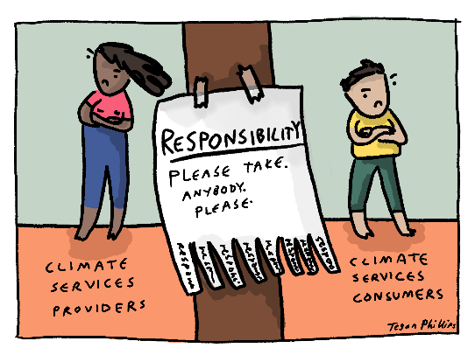
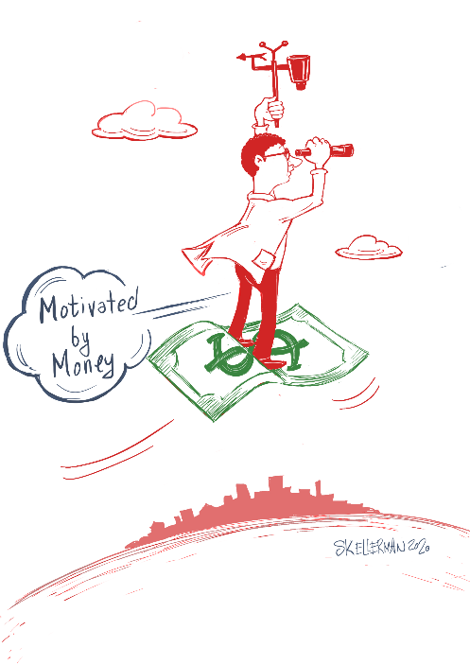
The climate services landscape - an “African” perspective
We can’t avoid a competitive “market place”…
the alternatives are very likely worse
Legislation – Nationally approved/mandated providers
“One stop shops” – who gets to set up shop?
Can we define/mandate “best practice”?
But a competitive “open market” is vulnerable to perverse incentives
“… we provide an AI approach to forecast the maximum daily precipitation in each week up to six months ahead”
Cartoon from CSAG led dialogues on climate services ethics

Slide 38
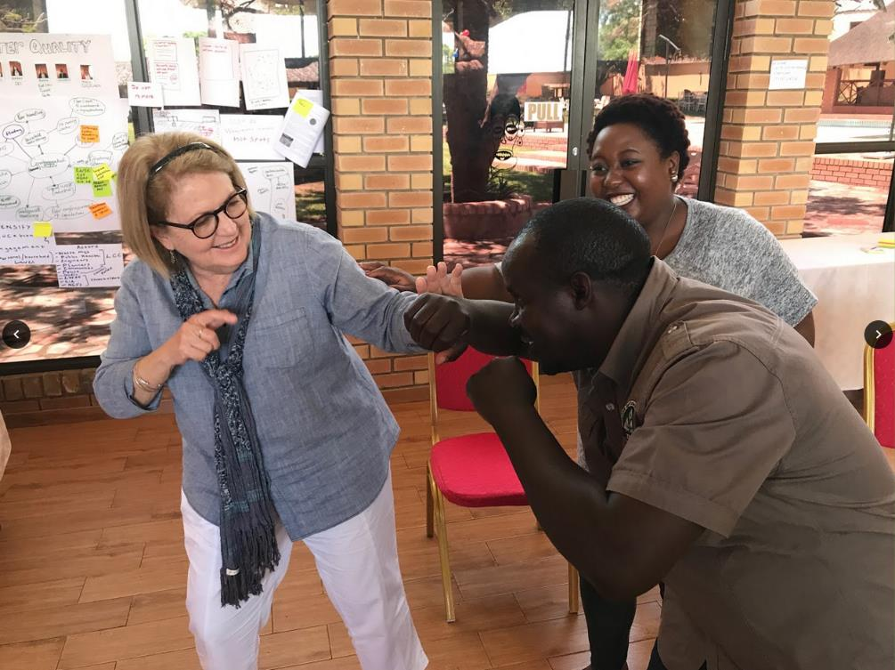
The climate services landscape - an “African” perspective
A national climate services dialogue platform
Support open and transparent dialogue and debate over methods and approaches
Support decision makers and build capacity to scope requests for services and interrogate offerings
Facilitate and coordinate international participation in the landscape

Slide 39
Go to www.menti.com and use the code 1758 8663
Please rank the priority of the following statements:
Stocktake of current services and activities (a who’s who and a what’s what)
Establishing a working group to progress work on establishing roles and responsibilities, including standards, ethics and regulation
Enhancing engagement within and between groups undertaking adaptation in both the public and private sectors
Enhancing engagement between those using and those providing climate services
Creation of data and knowledge portals that signpost to existing products
Creation of guidance material which can be applied across sectors on how to apply climate information to decision making
I have a better idea that is not listed here! (Please write your idea in the chat)
Notes:
Put the code in the meeting chat
https://www.mentimeter.com/s/35d090e4dfca4038970f92a8a51495c9/faf5b29e7e55/edit

