Slide 1



SPF UK Climate Resilience Programme
Webinar Series 2021
Website: https://www.ukclimateresilience.org/

Slide 2




Timings
12:00 | UK Climate Resilience Programme news | Professor Suraje Dessai,​ UK Climate Resilience Champion
12.05 | UK Government Approaches for Domestic Adaptation and Resilience | Andrew Carr and Chris Bishop DEFRA
12.35 | Q&A | Chaired by Suraje Dessai
13.00 | End
Website: https://www.ukclimateresilience.org/
Notes:
Chris Bishop is Head of Climate Economics at the Department for Environment, Food and Rural Affairs, leading on delivery of critical advice to support Defra’s transition to Net Zero, whilst also supporting efforts to ensure adaptation endeavours are effectively economically scrutinised.
Andrew Carr is Head of Adaptation Science at the Department for Environment, Food and Rural Affairs, leading on government delivery of the CCRA, and managing research projects which aim to progress government adaptation efforts, whilst ensuring scientific evidence underpins departmental climate activities. Previously, Andrew led on Earth Observation and Climate at Defra, and has worked on climate research internationally in China and Uganda.

Slide 3

How to engage
  Presentations first then Q&A and discussion
  Post questions in the Q&A box at any time
  Upvote your favourites
  Attendees will remain muted unless enabled to speak by the host​
  Webinar (audio and slides) will be shared after the event
  Technical problems – chat
  The webinar is being recorded​
Twitter: @UKCRP_SPF #UKclimateResil
Website: https://www.ukclimateresilience.org/

Slide 4





New UKCR Publications
Publication
Climate change over UK cities: the urban influence on extreme temperatures in the UK climate projections
By William J Keat, Elizabeth J Kendon and Sylvia I Bohnenstengel
Published 29 September 2021
Increase in the frequency of extreme daily precipitation in the United Kingdom in autumn
By Daniel Cotterill, Peter Stott, Nikolaos Christidis and Elizabeth Kendon.
Published September 2021
Indicators of climate risk in the UK at different levels of warming
By Nigel W Arnell, Anna Freeman, Alison L Kay, Alison C Rudd and Jason A Lowe
Published 20 September 2021

Slide 5
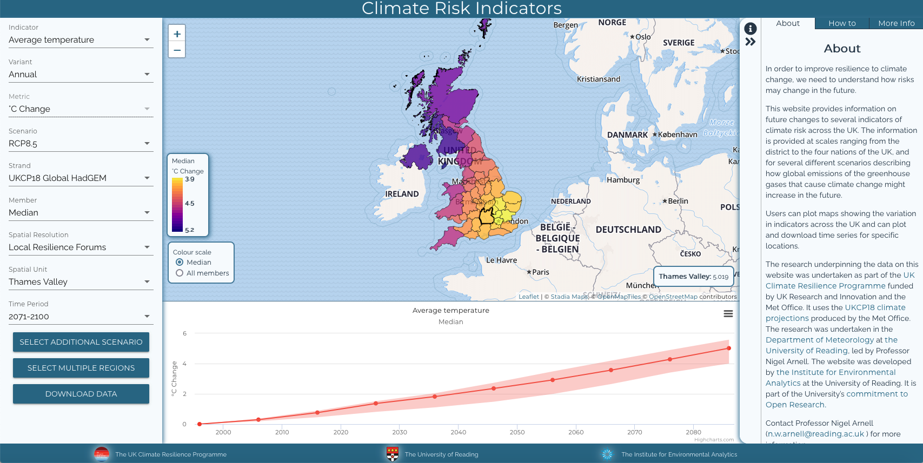
Project News
Climate risk indicators decision support tool – going on-line shortly
Example indicators: climate, heat extremes (tropical nights), transport (road melt risk), agriculture (growing season length), wildfire (Met Office fire danger)
Variations: Annual/seasons, RCPs/warming levels, UKCP18 global, regional and probabilistic, multiple spatial resolutions (nation to 12x12km) and time periods
Notes:
Or you can find the link on the UKCR website project page: https://www.ukclimateresilience.org/projects/improving-climate-hazard-information/

Slide 6


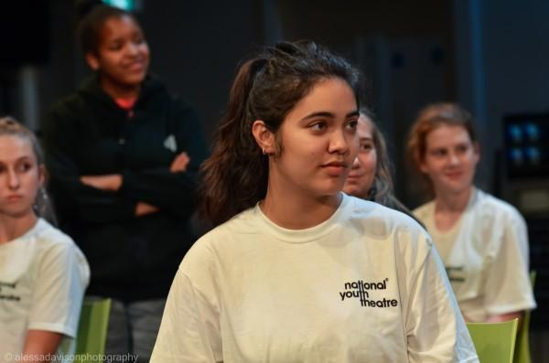
UKCR at
COP 26
The Risky Cities project team (funded by the AHRC and the UK Climate Resilience Programme) will be at COP delivering our co-created theatrical intervention with the National Youth Theatre called ‘On the Edge’. This takes place Friday 5th November in the Green Zone (south tower).
The Project is enabling the voices of young people from marginalised communities to be heard in this international setting. A creative exploration of young people’s eco-anxiety in the face of climate uncertainty through a performance of spoken word, poetry, music and short film.
Notes:
“On The Edge” incorporates the double meaning of young people’s eco-anxiety and of coastal communities, both their marginalisation and their ability to look outwards (to the sea and the windfarms located there) to where the solutions may be found, with an emphasis on green recovery jobs.
On The Edge will be led by Adeola Yemitan, NYT Member, Actor, Writer & winner of the 2021 Samsung Spotlight competition for young performers; Paul Roseby OBE, NYT’s Chief Executive & Artistic Director; and Professor Briony McDonagh, Professor of Environmental Humanities at the University of Hull’s Energy & Environment Institute.

Slide 7


Wider news
FORUM ON SCENARIOS FOR CLIMATE AND SOCIETAL FUTURES
20-22 June 2022
Intl Institute for Applied Systems Analysis (IIASA), Laxenburg, Austria
ADAPT, SURVIVE, THRIVE: LOCAL INITIATIVES WITH GLOBAL IMPACT
Thursday, 21 October
08:30 - 10:30
Host: Lee Pitcher, Living with Water Partnership/Chair, Absolutely Cultured
Register here:
https://thewaterline.global/summit-2021/
The Waterline Summit
Forum on Scenarios for Climate and Societal Futures
Open to anyone using, developing, or interested in scenarios to carry out research or policy analysis related to climate change and sustainability.
Submit your proposals for sessions here by 15th November): https://scenariosforum.org/call-sessions/

Slide 8
Wider news
New adaptation reports
Adapt or die, says Environment Agency
With less than three weeks to COP26, Environment Agency warns that adaptation – becoming resilient to the effects of climate change – is just as vital as mitigation
EA’s third adaptation report
Seven in every eight UK organisations unprepared for impacts of climate change
https://www.cccep.ac.uk/

Slide 9

UK Government Approaches for Domestic Adaptation and Resilience
Andrew Carr and Chris Bishop (DEFRA)

Slide 10
Questions, answers, discussion

Slide 11
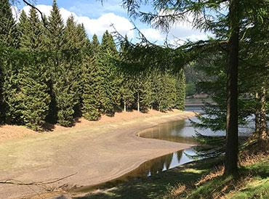
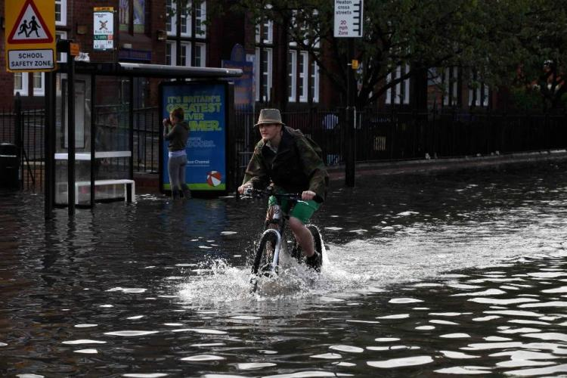


Next webinars:
Wednesday, 17th November, 2021 12.00-13.00
Speaker: Jamie Hannaford (UK Centre for Hydrology and Ecology)
Title: Enhanced future FLows and Groundwater (eFLaG): a climate service to enhance the resilience of the water sector to drought events
Wednesday, 24th November , 2021 13.00-15.00
Speaker: Hayley Fowler, Murray Dale, Lizzie Kendon and others
Title: FUTURE-DRAINAGE workshop on new climate uplifts and implications for surface water flooding in the UK
Register on our website:
https://www.ukclimateresilience.org/news-events/climate-resilience-webinar-series-2020-2021/
Notes:
24 Nov 1-3pm, titled FUTURE-DRAINAGE, with Hayley Fowler, Murray Dale, Lizzie Kendon and others

Slide 12
Contact details
Website: www.ukclimateresilience.org
Twitter: @UKCRP_SPF
YouTube: UK Climate Resilience programme
The UK Climate Resilience programme is supported by the UKRI Strategic Priorities Fund.
The programme is co-delivered by the Met Office and NERC on behalf of UKRI partners AHRC, EPSRC, ESRC.

