Slide 1
SPF UK Climate Resilience Programme
Webinar Series 2021
Website: https://www.ukclimateresilience.org/

Slide 2
Timings
12:00 | UK Climate Resilience Programme news | Dr Kate Lonsdale, UK Climate Resilience Champion
12.05 | Understanding the microbial communities of resilient peatlands | Professor Martin Evans, University of Manchester
12.25 | Response | Tim Thom, Yorkshire Peat Partnership
12.35 | Q&A | Panel
13.00 | End
Website: https://www.ukclimateresilience.org/
Notes:
Martin Evans is Professor of Geomorphology at the University of Manchester. He works on peatland erosion and restoration and the links between these processes and peatland ecosystems services with a particular focus on carbon cycling and natural flood management. He was PI for a NERC climate resilience grant on which aimed to bring together peatland scientists, microbiologists and modellers to explore the role of microbial processes in supporting the role of peatlands in climate resilience.
Tim Thom established and now manages the Yorkshire Peat Partnership which is carrying out restoration work across all of Yorkshire’s upland peatlands. Tim is also a founder member of the Great North Bog coalition which is working to scale up the speed and amount of peatland restoration taking place across the north of England. The Yorkshire Peat Partnership strives to be an evidence-led organisation and is part of a number of research-focused groups to help develop that evidence. Tim works closely with the University of Manchester as an Honorary Senior Research Fellow.

Slide 3
How to engage
Presentations first then Q&A and discussion
Post questions in the Q&A box at any time
Up-vote your favourites
Attendees will remain muted unless enabled to speak by the host​
Webinar (audio and slides) will be shared after the event
Technical problems – chat
The webinar is being recorded​
Twitter: @UKCRP_SPF #UKclimateResil
Website: https://www.ukclimateresilience.org/

Slide 4
Programme News
COP 26
Building resilience in a low carbon world
UKCR’s joint event with Future Climate For Africa discussed the use of scientific and technical advances in understanding climate risks and developing locally-appropriate responses.
https://www.youtube.com/watch?v=4_jLqV6Rzwo
Climate Risk and Adaptation: How We Understand and Respond to Climate Change Hazards
This event showcased the UK’s steps to collaboratively build adaptive capacity and reduce climate risk to communities.
https://www.youtube.com/watch?v=9_KDjGm7_6M
Harnessing Science for Adaption
In this Met Office Science Pavilion event, our co-Champion, Suraje Dessai spoke about the transdisciplinary research of the UK Climate Resilience Programme.
https://youtu.be/9tR78gCf9ZA
National Youth Theatre's 'On The Edge' performance
Young voices took centre stage and discussed their
‘eco-anxieties’ through a mixture of spoken word, poetry, music and short film.
https://www.youtube.com/watch?v=U5rqFiLAF9s

Slide 5
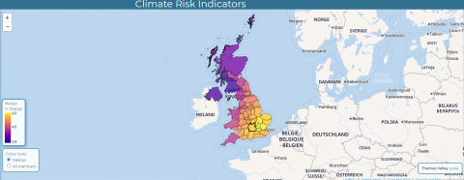
Programme News
The Climate Risk Indicators project has calculated a wide range of indicators of climate risk with the UKCP18 climate projections, now available through a dedicated website (https://uk-cri.org).
Aimed at people and organisations who want to see how climate risks are changing in their local area and across the UK.
Indicators include:
hot and cold temperature extremes (including heatwaves and hot and cold weather alerts)
risks to transport and agriculture
river flooding and low flows
wildfire danger
Climate Risk Indicators Project:
New Website
Notes:
The website includes details on the methods used and the indicators, and links to published papers: https://uk-cri.org

Slide 6
Wider news
Calls for evidence:
House of Lords Environment and Climate Change Committee
Inquiry into behaviour change in the context of climate change (mitigation and adaptation) and the environment (e.g. biodiversity, water, waste and the circular economy, and air pollution)
Evidence is invited by 13th December 2021
https://committees.parliament.uk/call-for-evidence/628/
Joint Committee on the National Security Strategy (JCNSS)
Considering the resilience of UK CNI to the effects of climate change, which is predicted to result in an increase in extreme weather events such as flooding, droughts, wildfires and heatwaves, as well as rising sea levels.
Evidence is invited by 7 January 2022
https://committees.parliament.uk/work/1659/critical-national-infrastructure-and-climate-adaptation/
Notes:
Call for Evidence
Critical National Infrastructure and Climate Adaptation
The Joint Committee on the National Security Strategy (JCNSS) welcomes written evidence for its new inquiry into critical national infrastructure (CNI) and climate adaptation. This inquiry is considering the resilience of UK CNI to the effects of climate change, which is predicted to result in an increase in extreme weather events such as flooding, droughts, wildfires and heatwaves, as well as rising sea levels. UK CNI incorporates 13 sectors: Chemicals, Civil Nuclear, Communications, Defence, Emergency Services, Energy, Finance, Food, Government, Health, Space, Transport and Water. The Committee is considering CNI resilience to climate change in the short, medium and long term (two years, five years and 20+ years, respectively).
Evidence is invited on the following topics by 7 January 2022:
Key vulnerabilities and levels of preparedness of UK CNI to extreme weather events and other effects of climate change, including:
The possible compound effects of such events;
The interdependencies between different aspects of UK CNI;
Supply chain vulnerabilities; and
Recent ‘near miss’ scenarios;
What might constitute an ‘acceptable’ level of resilience to climate change within UK CNI, both to near-term risks and longer-term uncertainties or ‘tipping points’, and the obstacles to achieving it;
The effectiveness of Government policy, legislation and implementation frameworks for managing national security risks arising from climate change, including those emerging within the private sector;
Allocation of roles and responsibilities at the national, devolved and local level, and the connections between them;
The role of the Government’s forthcoming National Resilience Strategy, particularly in addressing opportunities for (and obstacles to) improved resilience among CNI providers;
The extent and effectiveness of UK-wide monitoring and early warning systems; and
The opportunities presented by technological solutions (such as AI and digital twins) for anticipating and managing the implications of climate change for CNI.
Submissions may address any one of these issues, and do not need to cover the entire remit of the Committee’s inquiry.

Slide 7
Wider news
Launch of Historic Environment Scotland’s climate adaptation plan
18th November 2021
The organisation’s ground-breaking plan dedicated to preparing for the risks and impacts associated with climate change as part of their Climate Action Plan (2020-2025).
Notes:
18th November
Historic Environment Scotland has today, Thursday 18 November, launched its new climate adaptation plan. ‘Climate ready HES’ sets out a series of actions that HES will undertake in order to prepare for, and review the risks and impacts associated with climate change, as Scotland experiences more extremities in weather and continues to move towards net zero.
The plan is a flagship deliverable of HES’s ambitious Climate Action Plan (2020-2025) and operates alongside other key climate action commitments, such as HES’ ambitions to achieve net-zero emissions by 2045.
Accelerating climate change is already posing a threat to Scotland’s historic environment and cultural heritage sites. Changes to the climate are increasing the frequency and intensity of physical climate risks, illustrated by the flash-flooding across Edinburgh in July 2021, which was the result of unprecedented heavy rainfall and directly impacted Edinburgh Castle.
In developing the plan, HES established a cross-organisational group to carry out a strategic level climate risk assessment which identified key climate risks where the organisation believes further action is required. The approach taken to carry out this assessment was informed by tools and guidance developed by Adaptation Scotland and its partners.
This new adaptation plan details HES’s primary adaptation response to the climate risks of concern identified. This is a series of priority actions including committing appropriate resources to climate change adaptation, mainstreaming ‘adaptation’ action into HES plans and policies, and integrating climate risk assessments into all relevant decisions the organisation takes.
These priority actions are crucial to reduce the impact of physical climate risks where possible, like extreme weather events and spread of invasive species, and to address additional risks that the organisation will be exposed to as society responds to the climate crisis and transitions towards a low-carbon economy.
Climate Ready Historic Environment Scotland (HES) is our organisation’s first climate change adaptation plan. It sets out our response to a series of climate risks that we have identified that each have the potential to negatively impact our organisation. It is a plan directly for our organisation, though the steps we have taken in preparing it may be of interest to others.
There are two ‘Climate Ready HES’ documents:
The Adaptation Plan: This provides an overview of the project, the key climate risks identified and our adaptation response to these risks. This document is intended to provide an accessible overview of our plan, for both HES colleagues and external partners who may be interested in our approach.
The Project Methodology and Results (due for release mid-December): This provides detailed insight (and our reflections) on the methodology used to identify the key climate risks. It also provides the results of the climate risk assessment process, including evidence supporting the inclusion of each risk. This document is intended to provide support to other organisations who may be looking to start their ‘climate ready’ journey.

Slide 8
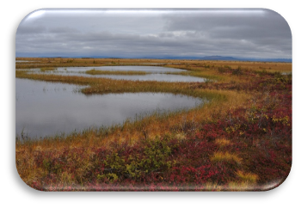
Understanding the microbial communities of resilient peatlands
Professor Martin Evans
University of Manchester

Slide 9
Response Tim Thom Yorkshire Peat Partnership

Slide 10
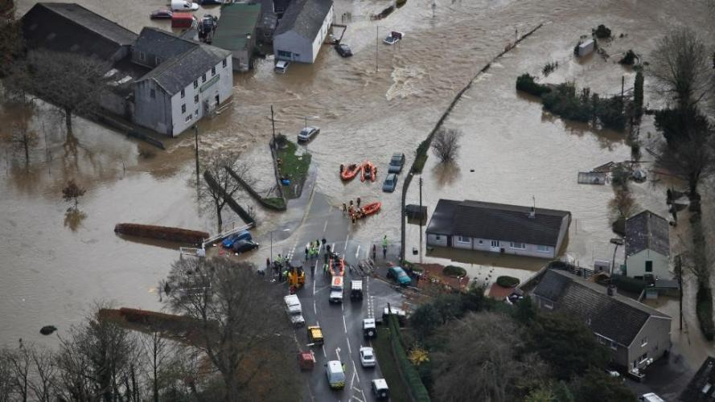
Next webinar:
Wednesday, 26th January, 2022 12.00-13.00
Speakers:
David Sexton (Met Office) and
Nick Leach (University of Oxford)
Title: ExSamples: Generating samples of extreme
winters to support climate adaptation
Register on our website:
https://www.ukclimateresilience.org/news-events/climate-resilience-webinar-series-2020-2021/

Slide 11
Contact details Website: www.ukclimateresilience.org Twitter: @UKCRP_SPF YouTube: UK Climate Resilience programme
The UK Climate Resilience programme is supported by the UKRI Strategic Priorities Fund.
The programme is co-delivered by the Met Office and NERC on behalf of UKRI partners AHRC, EPSRC, ESRC.

