Slide 1
SPF UK Climate Resilience Programme
Webinar Series 2021
Website: https://www.ukclimateresilience.org/

Slide 2
Timings
12:00 | UK Climate Resilience Programme news | Mark Harrison,​ Met Office
12.05 | Enhanced future FLows and Groundwater (eFLaG): a climate service to enhance the resilience of the water sector to drought events | Jamie Hannaford UK Centre for Hydrology and Ecology
12.25 | Response from stakeholder | Stuart Allen Environment Agency
12.35 | Q&A | Chaired by Mark Harrison
13.00 | End
Website: https://www.ukclimateresilience.org/
Notes:
Jamie Hannaford leads the Hydrological Status and Outlooks Group at the UK Centre for Ecology & Hydrology and is a visiting Associate Professor at the Irish Climate And Research Units (ICARUS) at Maynooth University in Ireland. His specialisation is in the analysis of hydrological extremes (floods and droughts) and he has led a number of major UK and international drought research projects.
Stuart Allen is a Principal Scientist in the Environment Agency Chief Scientists Group and leads on water issues for the Climate Change and Resource Efficiency team. Stuart has been with the Environment Agency for over 20 years, 17 of those in Research, and has been involved in many key developments including the original Future Flows and Groundwater Levels project.

Slide 3
How to engage
Presentations first then Q&A and discussion
Post questions in the Q&A box at any time
Upvote your favourites
Attendees will remain muted unless enabled to speak by the host​
Webinar (audio and slides) will be shared after the event
Technical problems – chat
The webinar is being recorded​
Twitter: @UKCRP_SPF #UKclimateResil
Website: https://www.ukclimateresilience.org/

Slide 4
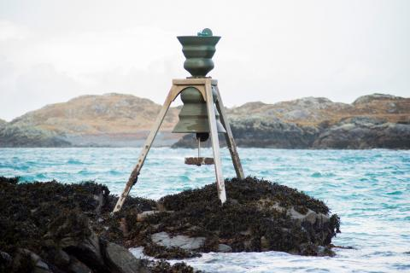
Project News
The UK Climate Resilience Programme has announced a second cohort of projects have been awarded through the Embedded Research fund with UKRI. Eight awards were made from a total fund of £440,000.
The projects span infrastructure, tourism, churches and their communities, place-based climate adaptation plans and strategies, stochastic weather generators, and the role of the arts and storytelling to inform resilience and communicate climate impacts and risk.
New Embedded Researcher Cohort Announced
Notes:
More info: https://www.ukclimateresilience.org/news-events/new-embedded-researcher-cohort-announced/

Slide 5
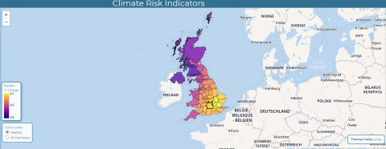
Project News
Climate Risk Indicators Project Launches New Website
The Climate Risk Indicators project has calculated a wide range of indicators of climate risk with the UKCP18 climate projections, now available through a dedicated website (https://uk-cri.org).
Aimed at people and organisations who want to see how climate risks are changing in their local area and across the UK.
Indicators include:
hot and cold temperature extremes (including heatwaves and hot and cold weather alerts)
risks to transport and agriculture
river flooding and low flows
wildfire danger
Notes:
The website includes details on the methods used and the indicators, and links to published papers: https://uk-cri.org

Slide 6
COP 26
Building resilience in a low carbon world
UKCR’s joint event with Future Climate For Africa discussed the use of scientific and technical advances in understanding climate risks and developing locally-appropriate responses.
https://www.youtube.com/watch?v=4_jLqV6Rzwo
Climate Risk and Adaptation: How We Understand and Respond to Climate Change Hazards
This event showcased the UK’s steps to collaboratively build adaptive capacity and reduce climate risk to communities.
https://www.youtube.com/watch?v=9_KDjGm7_6M
Harnessing Science for Adaption
In this Met Office Science Pavilion event, our co-Champion, Suraje Dessai spoke about the transdisciplinary research of the UK Climate Resilience Programme.
https://youtu.be/9tR78gCf9ZA
National Youth Theatre's 'On The Edge' performance
Young voices took centre stage and discussed their
‘eco-anxieties’ through a mixture of spoken word, poetry, music and short film.
https://www.youtube.com/watch?v=U5rqFiLAF9s

Slide 7
Enhanced future FLows and Groundwater (eFLaG): a climate service to enhance the resilience of the water sector to drought events
Jamie Hannaford (UK Centre for Ecology and Hydrology)

Slide 8
Questions, answers, discussion

Slide 9
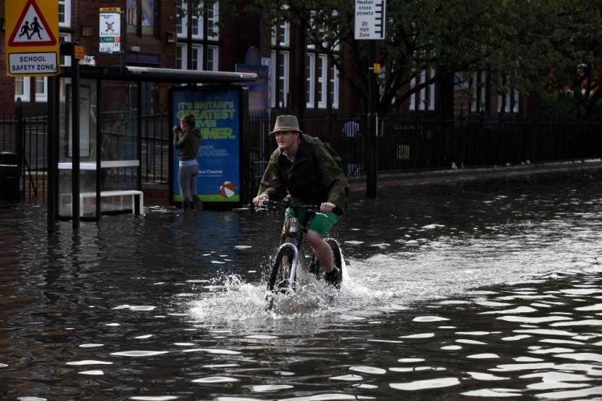
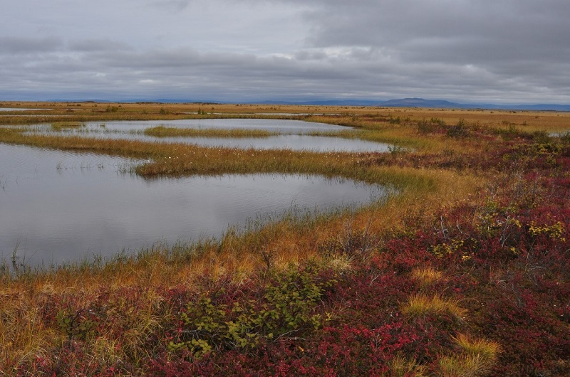
Next webinars:
Wednesday, 24th November , 2021 13.00-15.00
Speakers: Hayley Fowler, Murray Dale, Lizzie Kendon and others
Title: FUTURE-DRAINAGE workshop on new climate uplifts and implications for surface water flooding in the UK
Wednesday, 1st December, 2021 12.00-13.00
Speakers: Professor Martin Evans and Tim Thom
Title: Understanding the microbial communities of resilient peatlands
Register on our website:
https://www.ukclimateresilience.org/news-events/climate-resilience-webinar-series-2020-2021/

Slide 10
Contact details Website: www.ukclimateresilience.org Twitter: @UKCRP_SPF YouTube: UK Climate Resilience programme
The UK Climate Resilience programme is supported by the UKRI Strategic Priorities Fund.
The programme is co-delivered by the Met Office and NERC on behalf of UKRI partners AHRC, EPSRC, ESRC.

