Slide 1
SPF UK Climate Resilience Programme
Webinar Series 2022
Website: https://www.ukclimateresilience.org/

Slide 2
Timings
12:00 | UK Climate Resilience Programme news | Suraje Dessai UK Climate Resilience Champion
12.05 | IPCC WGII report – Impact, Adaptation and Vulnerability: insights and implications (Part 1) | Mike Morecroft, Natural England and CLA of Chapter 2, Terrestrial and Freshwater Ecosystems and their Services Daniela Schmidt, University of Bristol and CLA of Chapter 13, Europe
12.35 | Response | James Pearce-Higgins Director, Science, British Trust for Ornithology
12.40 | Q&A | Panel
13.00 | End
Website: https://www.ukclimateresilience.org/
Notes:
Mike Morecroft is Coordinating Lead Author on the Terrestrial and Freshwater Ecosystems chapter of the IPCC Working Group II report. He is an ecologist working for the government conservation body, Natural England, where he is the lead scientist on climate change adaptation and mitigation, carrying out research and providing advice to policy-makers and practitioners. He has published over 150 scientific papers, reports and book chapters. Mike led a research group at the Centre for Ecology and Hydrology before joining Natural England in 2009.
Daniela Schmidt is Professor in the school of Earth Sciences at the University of Bristol and coordinating lead author for the IPCC WGII chapter on Europe for the 6th IPCC assessment. Her research focuses on understanding the causes and effects of climate change on marine socio-ecological systems. Her lab exploits a breadth of novel techniques from material science and engineering to generate a holistic understanding of the threats of climate change on marine ecosystems. Working with colleagues in the humanities, social science and law, she lab assesses adaptation options and aims to widen the discourse of climate change risks. Prof Schmidt current project focusses on whether MPAs are effective tools to protect marine ecosystems against warming and sea level rise, considering organismal and ecological response to environmental changes, legal frameworks and adaptation feasibility.
James Pearce-Higgins is a member of the senior management team of the British Trust for Ornithology, responsible for providing strategic leadership of the science of the organisation. He provides strategic oversight of BTO science, which encompasses both monitoring and research. In addition, James specifically leads BTO’s climate change research. This involves documenting the impacts of climate change on UK biodiversity, undertaking projections of the likely future impact of climate change on species’ distributions and abundance, and informing the development of climate change adaptation. In recent years, James has led five multi-organisational climate change research consortia funded by Defra, Natural England and CCI, as well as many BTO projects.

Slide 3
How to engage
Presentations first then Q&A and discussion
Post questions in the Q&A box at any time
Up-vote your favourites
Attendees will remain muted unless enabled to speak by the host​
Webinar (audio and slides) will be shared after the event
Technical problems – chat
The webinar is being recorded​
Twitter: @UKCRP_SPF #UKclimateResil
Website: https://www.ukclimateresilience.org/

Slide 4
Wider news
Virtual Conference: Closing the Climate Adaptation Gap and Unlocking Opportunities for Transformative Change
24 – 25 March 2022
by Adapt Lock-in project (https://adaptlockin.eu/)
#AdaptLockin
Free to attend and open to all
Twitter: @UKCRP_SPF #UKclimateResil
Website: https://www.ukclimateresilience.org/
Notes:
To effectively adapt and keep pace with the rising impacts of climate change we cannot maintain business-as-usual. However, a range of barriers, path dependencies and self-reinforcing ‘lock-in’ dynamics are impeding efforts to adapt and are proving difficult to change. While ‘carbon lock-ins’ have increasingly been studied in climate mitigation, this conference turns the spotlight towards the lock-ins restricting climate adaptation and seeks to understand how these play out across different policy sectors and countries. Only by understanding these can we identify strategies for ‘unlocking’ opportunities for transformative change.
The conference will bridge the gap between research and practice as we collectively try to accelerate adaptation to climate change. This will be a valuable opportunity to share knowledge, experiences and best practices across countries and policy sectors, such as flood & coastal erosion risk management, biodiversity, forestry, water and health. Our speakers have been invited based on their established expertise in these areas.
Themes: adaptation gap through lens of lock-ins/adapting coastlines/human health under extremes/water resource management/adapting for and with nature/closing the adaptation gap

Slide 5
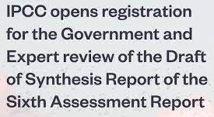
Wider news
Interested experts can register for participation in the review on the IPCC site at: https://apps.ipcc.ch/comments/ar6syr/fod/register.php
The Government and Expert Review of the Synthesis Report of the Sixth Assessment Report will take place from 10 January to 20 March 2022, 23:59 (GMT+1). Registration of experts closes on 13 March 2022, 23:59 (GMT+1), one week before the end of the review.

Slide 6
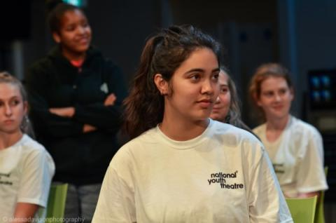
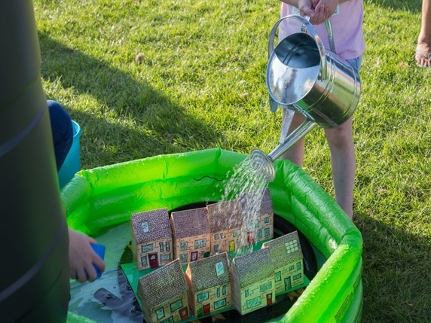
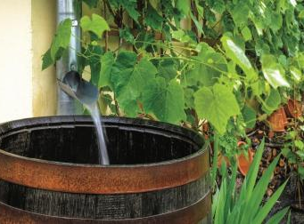
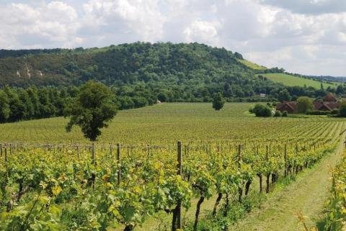
UKCR news
UKCR Festival and Conference
Provisional Dates
Festival
12-13th September 2022 in Hull
Conference
1st-2nd March 2023 in London
Twitter: @UKCRP_SPF #UKclimateResil
Website: https://www.ukclimateresilience.org/

Slide 7
IPCC WGII report – Impact, Adaptation and Vulnerability: insights and implications (Part 1)
Mike Morecroft (Natural England and CLA of Chapter 2, Terrestrial and Freshwater Ecosystems and their Services)
Daniela Schmidt (University of Bristol and CLA of Chapter 13, Europe)

Slide 8
Response James Pearce-Higgins, Director, Science, British Trust for Ornithology
Notes:
James Pearce-Higgins is a member of the senior management team of the British Trust for Ornithology, responsible for providing strategic leadership of the science of the organisation. He provides strategic oversight of BTO science, which encompasses both monitoring and research. In addition, James specifically leads BTO’s climate change research. This involves documenting the impacts of climate change on UK biodiversity, undertaking projections of the likely future impact of climate change on species’ distributions and abundance, and informing the development of climate change adaptation. In recent years, James has led five multi-organisational climate change research consortia funded by Defra, Natural England and CCI, as well as many BTO projects.

Slide 9
Next webinars:
Second webinar on the findings of the latest Working Group 2 of the IPCC:
Wednesday 9th March 12.00-13.00 Speakers: Lea Berrang-Ford, LA of Chapter 16: Key risks across sectors and regions; Diana Reckien, CLA of Chapter 17: Decision-making options for managing risk.
Wednesday 23rd March 12.00-13.00 Speakers: Louise Wilson and Nicola Golding (Met Office). Developing a National Framework for Climate Services for the UK
Register on our website:
https://www.ukclimateresilience.org/news-events/climate-resilience-webinar-series-2020-2021/

Slide 10
Contact details Website: www.ukclimateresilience.org Twitter: @UKCRP_SPF YouTube: UK Climate Resilience programme
The UK Climate Resilience programme is supported by the UKRI Strategic Priorities Fund.
The programme is co-delivered by the Met Office and NERC on behalf of UKRI partners AHRC, EPSRC, ESRC.

