Slide 1
SPF UK Climate Resilience Programme
Webinar Series 2022
Website: https://www.ukclimateresilience.org/

Slide 2
Timings
12:00 | UK Climate Resilience Programme news | Professor Jason Lowe OBE Head of Climate Services, Met Office
12.05 | IPCC WGII report – Impact, Adaptation and Vulnerability: insights and implications (Part 2) | Lea Berrang Ford, University of Leeds and LA of Chapter 16, Key Risks Across Sectors and Regions Diana Reckien, University of Twente and CLA of Chapter 17, Decision Making Options for Managing Risk
12.35 | Response | Richard Millar, Head of Adaptation and Climate Science, Climate Change Committee
12.40 | Q&A | Panel
13.00 | End
Website: https://www.ukclimateresilience.org/
Notes:
Lea Berrang Ford is a Professor and Research Chair in Climate and Health in the Priestley International Centre for Climate at the University of Leeds, and an expert in adaptation to climate change, tracking global adaptation progress, systematic evidence synthesis for climate solutions, and the health impacts of climate change. Prof Berrang Ford is a Lead Author for Chapter 16 AR6-WGII, focusing on synthesis of global adaptation responses. She is a co-founder of TRAC3: Tracking Adaptation to Climate Change Consortium, and leads international interdisciplinary research on Indigenous health and climate change in the Canadian north, the Peruvian Amazon, and southwestern Uganda. Prof Berrang Ford was recently recognised on Reuters ‘Hot List’ of top global climate scientists.
Diana Reckien is Associate Professor for Climate Change and Urban Inequality at the Faculty of Geo-Information Science and Earth Observation (ITC), Department of Urban and Regional Planning and Geo-Information Management (PGM) of the University of Twente in Enschede, the Netherlands. Dr Reckien is Coordinating Lead Author for ‘Chapter 17: Decision-making options for managing risk’ of the Working Group II Contribution to the IPCC Sixth Assessment Report (AR6). She has worked at Climate Analytics Berlin, Germany, Columbia University in the City of New York, USA, and the Potsdam Institute for Climate Impact Research, Germany. She was also a Social Development Specialist for the Asian Development Bank in parallel and during parts of these positions.
Richard Millar is currently the Head of Adaptation and Climate Science at the Climate Change Committee (CCC). The CCC is the independent advisor to UK Governments on both reducing greenhouse gas emissions and adapting to the impacts of climate change in the UK. Richard joined the CCC in 2018 and has worked across the CCC’s remit, including on the 3rd UK Climate Change Risk Assessment and CCC advice on setting UK emissions reduction targets under the Climate Change Act. Richard holds a doctorate in climate physics and prior to joining the CCC worked as a researcher looking at constraining global emissions reduction pathways consistent with the long-term temperature goal of the Paris Agreement.

Slide 3
How to engage
Presentations first then Q&A and discussion
Post questions in the Q&A box at any time
Up-vote your favourites
Attendees will remain muted unless enabled to speak by the host​
Webinar (audio and slides) will be shared after the event
Technical problems – chat
The webinar is being recorded​
Twitter: @UKCRP_SPF #UKclimateResil
Website: https://www.ukclimateresilience.org/

Slide 4
New Publication
New paper from UKCRP projects
A new paper has been published from the IMPRES and OpenCLIM projects
Projected risks associated with heat stress in the UK Climate Projections (UKCP18)
By Alan T Kennedy-Asser, Gwilym Owen, Gareth J Griffith, Oliver Andrews, Y T Eunice Lo, Dann M Mitchell, Katie Jenkins and Rachel F Warren
Environmental Research Letters, Volume 17, Number 3
https://iopscience.iop.org/article/10.1088/1748-9326/ac541a
Twitter: @UKCRP_SPF #UKclimateResil
Website: https://www.ukclimateresilience.org/

Slide 5
New Dataset
Hydrological projections for the UK, based on UK Climate Projections 2018 (UKCP18) data, from the Enhanced Future Flows and Groundwater (eFLaG) project
eFLaG project dataset is now available for download
By Hannaford, J.; Mackay, J.; Ascot, M.; Bell, V.; Chitson, T.; Cole, S.; Counsell, C.; Durant, M.; Facer-Childs, K.; Jackson, C.; Kay, A.; Lane, R.; Mansour, M.; Moore, R. J.; Parry, S.; Rudd, A.; Simpson, M.; Turner, S.; Wallbank, J.; Wells, S.; Wilcox, A.
NERC EDS Environmental Information Data Centre. (Dataset).
https://catalogue.ceh.ac.uk/documents/1bb90673-ad37-4679-90b9-0126109639a9
https://www.ceh.ac.uk/our-science/projects/eflag-enhanced-future-flows-and-groundwater
Twitter: @UKCRP_SPF #UKclimateResil
Website: https://www.ukclimateresilience.org/

Slide 6
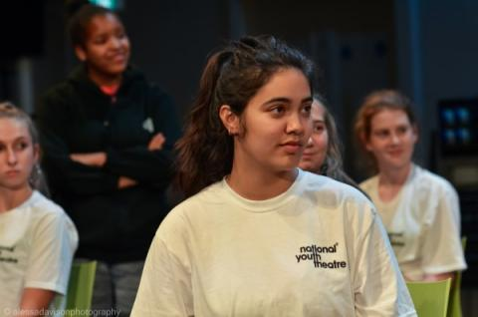
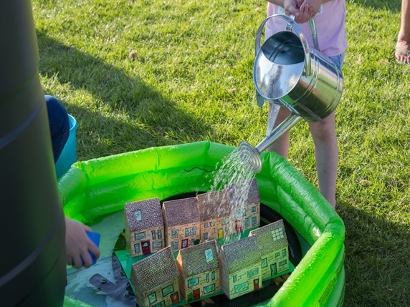
UKCR news
UKCR Festival and Conference
Provisional Dates
Festival
12-13th September 2022 in Hull
Conference
1st-2nd March 2023 in London
Twitter: @UKCRP_SPF #UKclimateResil
Website: https://www.ukclimateresilience.org/

Slide 7
IPCC WGII report – Impact, Adaptation and Vulnerability: insights and implications (Part 2)
Lea Berrang-Ford, LA of Chapter 16: Key risks across sectors and regions
Diana Reckien, CLA of Chapter 17: Decision-making options for managing risk

Slide 8
Response Richard Millar, Head of Adaptation and Climate Science, Climate Change Committee
Notes:
Richard Millar is currently the Head of Adaptation and Climate Science at the Climate Change Committee (CCC). The CCC is the independent advisor to UK Governments on both reducing greenhouse gas emissions and adapting to the impacts of climate change in the UK. Richard joined the CCC in 2018 and has worked across the CCC’s remit, including on the 3rd UK Climate Change Risk Assessment and CCC advice on setting UK emissions reduction targets under the Climate Change Act. Richard holds a doctorate in climate physics and prior to joining the CCC worked as a researcher looking at constraining global emissions reduction pathways consistent with the long-term temperature goal of the Paris Agreement.

Slide 9
Next webinars:
Wednesday 23rd March 12.00-13.00 Speakers: Louise Wilson and Nicola Golding (Met Office). Developing a National Framework for Climate Services for the UK
Wednesday 25th May 12.00-13.00
Speaker: Meghan Alexander (UEA, Tyndall Centre) and Tim Rayner (UEA, Tyndall Centre). Explaining the adaptation gap in the UK: The hidden story of policy lock-ins
Register on our website:
https://www.ukclimateresilience.org/news-events/climate-resilience-webinar-series-2020-2021/

Slide 10
Contact details Website: www.ukclimateresilience.org Twitter: @UKCRP_SPF YouTube: UK Climate Resilience programme
The UK Climate Resilience programme is supported by the UKRI Strategic Priorities Fund.
The programme is co-delivered by the Met Office and NERC on behalf of UKRI partners AHRC, EPSRC, ESRC.

